Slide 1
INST 414: Data Science Techniques
Lecture 8
From Linear Regression to Decision Trees

Slide 2
Recap of Ordinary Least Square and Logistic Regression

Slide 3
Predict Admission
In the next slide, we’ll see the relationship between a student’s test score and whether they got admitted into college (this is made up data)
We’ll also see a prediction model that comes from running Ordinary Least Squares on this data

Slide 4
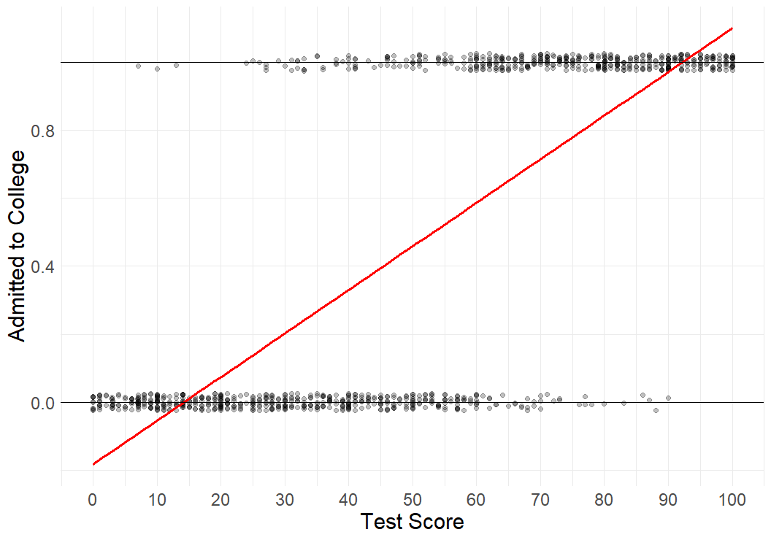
$$Admitted=−0.18+0.01 ∗ TestScore$$

Slide 5

Chart shows relationship between Test Score and being admitted to college.
We ran a regression (OLS) on this data.
We see that while the regression captures the relationship, it generates probabilities that are nonsensical (less than zero and greater than one)
$$Admitted=−0.18+0.01 ∗ TestScore$$

Slide 6
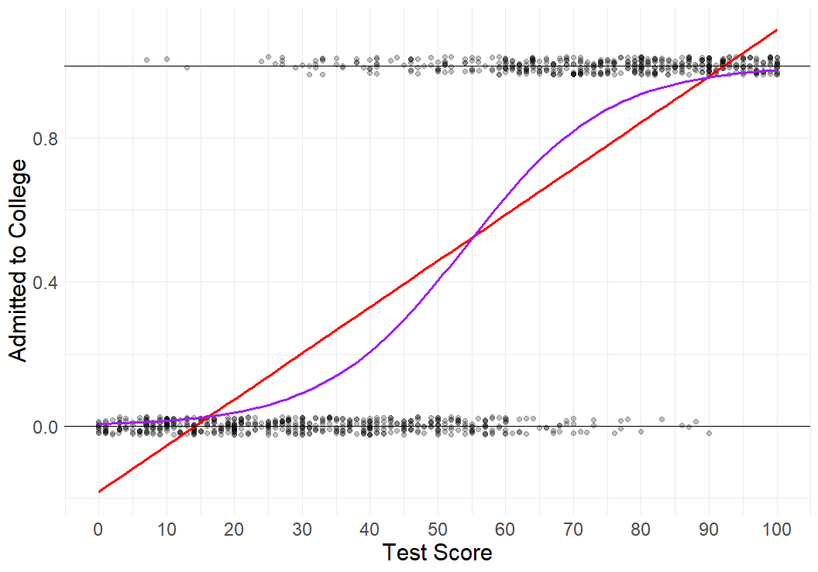
Logistic Regression

Slide 7
How can we visualize calibration using a chart like this?
Logistic Regression

Slide 8
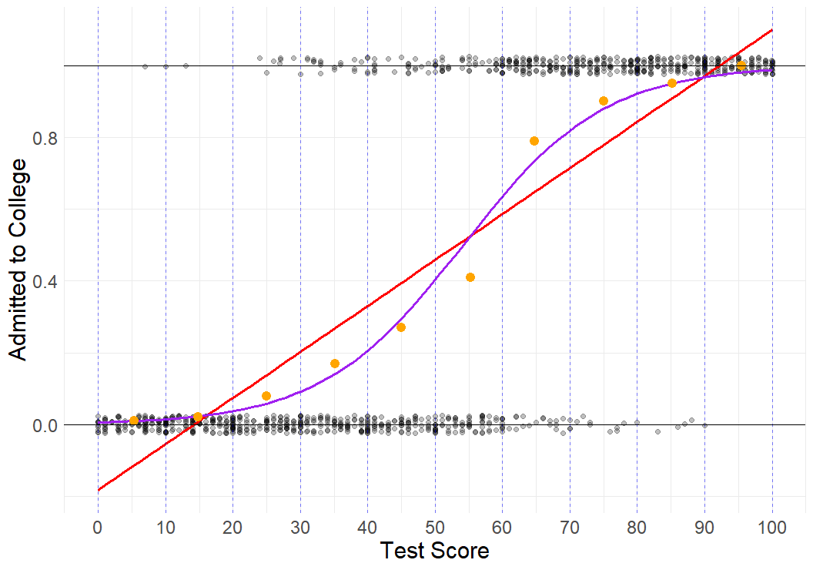

Slide 9
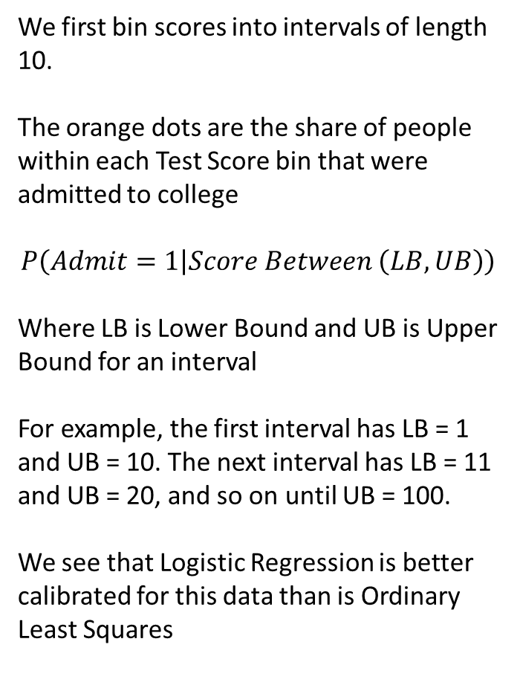
We first bin scores into intervals of length 10.
The orange dots are the share of people within each Test Score bin that were admitted to college
$$P\left(Admit=1 | Score Between \left(LB, UB\right)\right)$$
Where LB is Lower Bound and UB is Upper Bound for an interval
For example, the first interval has LB = 1 and UB = 10. The next interval has LB = 11 and UB = 20, and so on until UB = 100.
We see that Logistic Regression is better calibrated for this data than is Ordinary Least Squares

Slide 10
Limits of Linear/Logistic Regression

Slide 11
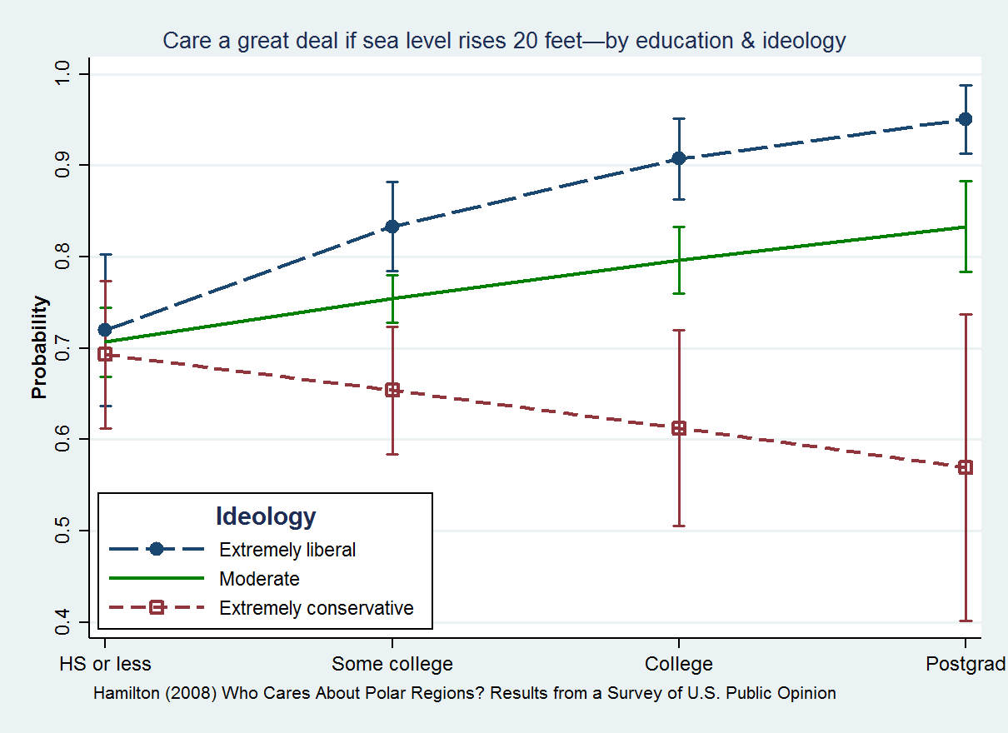
Statistical Interaction
Relationship between 2 variables depends on third
  Sea Level Concerns
  Education
Different patterns for different political ideologies

Slide 12
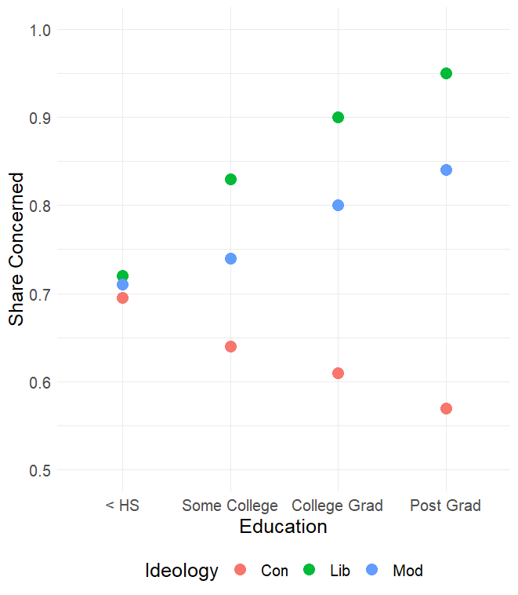
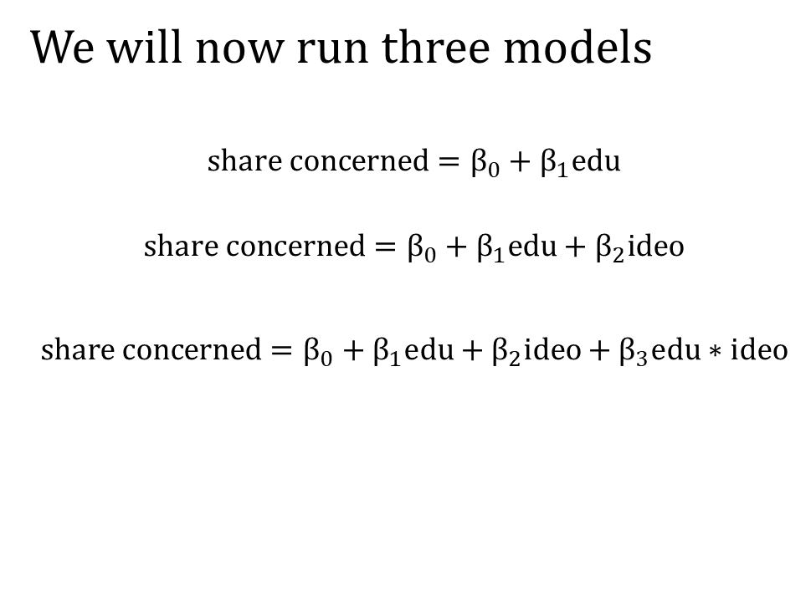
Interactions
We will now run three models
$$share concerned=β_{0}+β_{1}edu$$
$$share concerned=β_{0}+β_{1}edu+β_{2}ideo$$
$$share concerned=β_{0}+β_{1}edu+β_{2}ideo+β_{3}edu∗ideo$$

Slide 13
What does the dataset look like?
Share Concerned | Education | Ideology | Education Ideology
0.695 | < HS | Con | < HS & Con
0.64 | Some College | Con | Some College & Con
0.61 | College Grad | Con | College Grad & Con
0.57 | Post Grad | Con | Post Grad & Con
0.71 | < HS | Mod | < HS & Mod
0.74 | Some College | Mod | Some College & Mod
0.8 | College Grad | Mod | College Grad & Mod
0.84 | Post Grad | Mod | Post Grad & Mod
0.72 | < HS | Lib | < HS & Lib
0.83 | Some College | Lib | Some College & Lib
0.9 | College Grad | Lib | College Grad & Lib
0.95 | Post Grad | Lib | Post Grad & Lib

Slide 14
What does the dataset look like for Python?
Share Concerned | SC | CG | PG | Mod | Lib | SC*Mod | CG*Mod | PG*Mod | SC*Lib | CG*Lib | PG*Lib
0.695 | 0 | 0 | 0 | 0 | 0 | 0 | 0 | 0 | 0 | 0 | 0
0.64 | 1 | 0 | 0 | 0 | 0 | 0 | 0 | 0 | 0 | 0 | 0
0.61 | 0 | 1 | 0 | 0 | 0 | 0 | 0 | 0 | 0 | 0 | 0
0.57 | 0 | 0 | 1 | 0 | 0 | 0 | 0 | 0 | 0 | 0 | 0
0.71 | 0 | 0 | 0 | 1 | 0 | 0 | 0 | 0 | 0 | 0 | 0
0.74 | 1 | 0 | 0 | 1 | 0 | 1 | 0 | 0 | 0 | 0 | 0
0.8 | 0 | 1 | 0 | 1 | 0 | 0 | 1 | 0 | 0 | 0 | 0
0.84 | 0 | 0 | 1 | 1 | 0 | 0 | 0 | 1 | 0 | 0 | 0
0.72 | 0 | 0 | 0 | 0 | 1 | 0 | 0 | 0 | 0 | 0 | 0
0.83 | 1 | 0 | 0 | 0 | 1 | 0 | 0 | 0 | 1 | 0 | 0
0.9 | 0 | 1 | 0 | 0 | 1 | 0 | 0 | 0 | 0 | 1 | 0
0.95 | 0 | 0 | 1 | 0 | 1 | 0 | 0 | 0 | 0 | 0 | 1

Slide 15

Dataset for $share concerned=β_{0}+β_{1}edu$
Share Concerned | SC | CG | PG
0.695 | 0 | 0 | 0
0.64 | 1 | 0 | 0
0.61 | 0 | 1 | 0
0.57 | 0 | 0 | 1
0.71 | 0 | 0 | 0
0.74 | 1 | 0 | 0
0.8 | 0 | 1 | 0
0.84 | 0 | 0 | 1
0.72 | 0 | 0 | 0
0.83 | 1 | 0 | 0
0.9 | 0 | 1 | 0
0.95 | 0 | 0 | 1

Slide 16
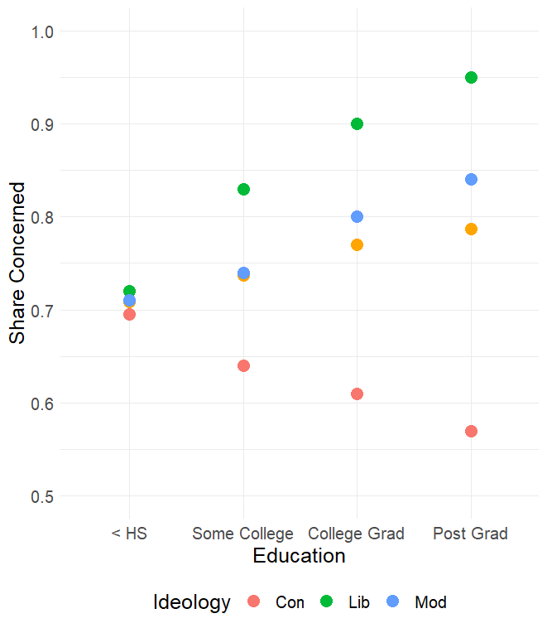
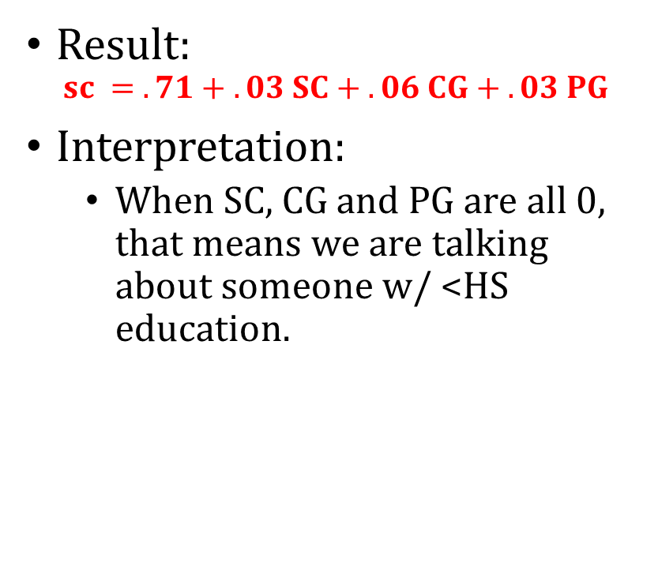
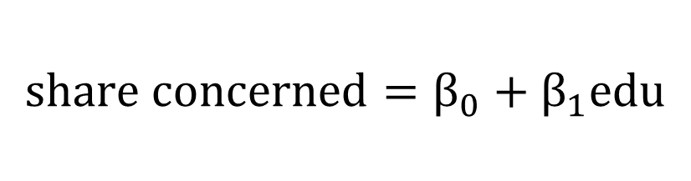
$$share concerned=β_{0}+β_{1}edu$$
Result:
$$sc = .71 + .03 SC + .06 CG + .03 PG$$
Interpretation:
  When SC, CG and PG are all 0, that means we are talking about someone w/ <HS education.

Slide 17
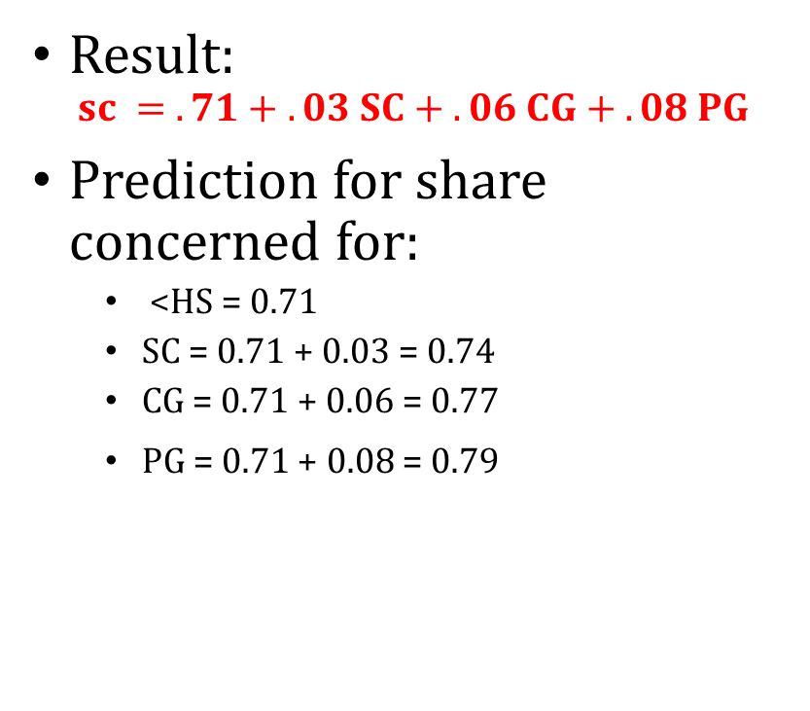
$$share concerned=β_{0}+β_{1}edu$$
Result:
$$sc = .71 + .03 SC + .06 CG + .08 PG$$
Prediction for share concerned for:
  <HS = 0.71
  SC = 0.71 + 0.03 = 0.74
  CG = 0.71 + 0.06 = 0.77
  PG = 0.71 + 0.08 = 0.79

Slide 18

Dataset for $share concerned=β_{0}+β_{1}edu+β_{2}ideo$
Share Concerned | SC | CG | PG | Mod | Lib
0.695 | 0 | 0 | 0 | 0 | 0
0.64 | 1 | 0 | 0 | 0 | 0
0.61 | 0 | 1 | 0 | 0 | 0
0.57 | 0 | 0 | 1 | 0 | 0
0.71 | 0 | 0 | 0 | 1 | 0
0.74 | 1 | 0 | 0 | 1 | 0
0.8 | 0 | 1 | 0 | 1 | 0
0.84 | 0 | 0 | 1 | 1 | 0
0.72 | 0 | 0 | 0 | 0 | 1
0.83 | 1 | 0 | 0 | 0 | 1
0.9 | 0 | 1 | 0 | 0 | 1
0.95 | 0 | 0 | 1 | 0 | 1

Slide 19
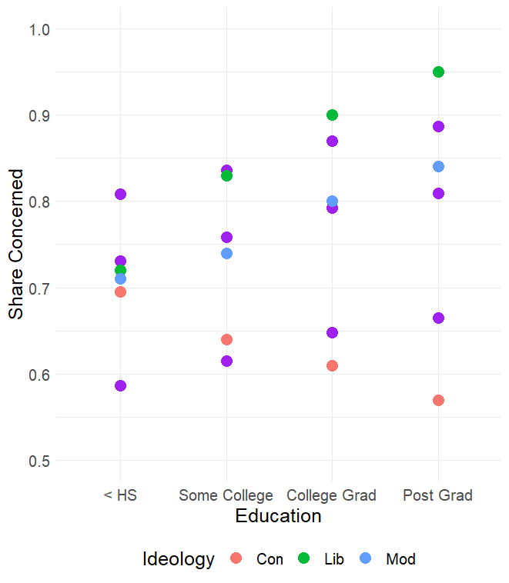

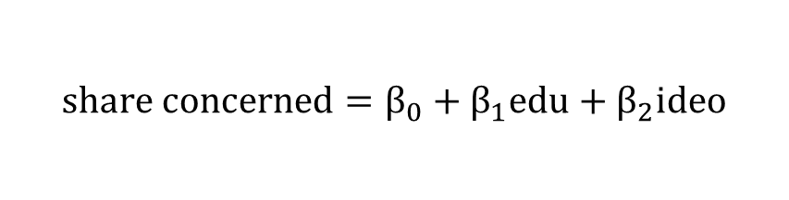
$$share concerned=β_{0}+β_{1}edu+β_{2}ideo$$
Result:
$$sc =0.59 + .03 SC + .06 CG + .08 PG+0.14 Mod+0.22 Lib$$

Slide 20
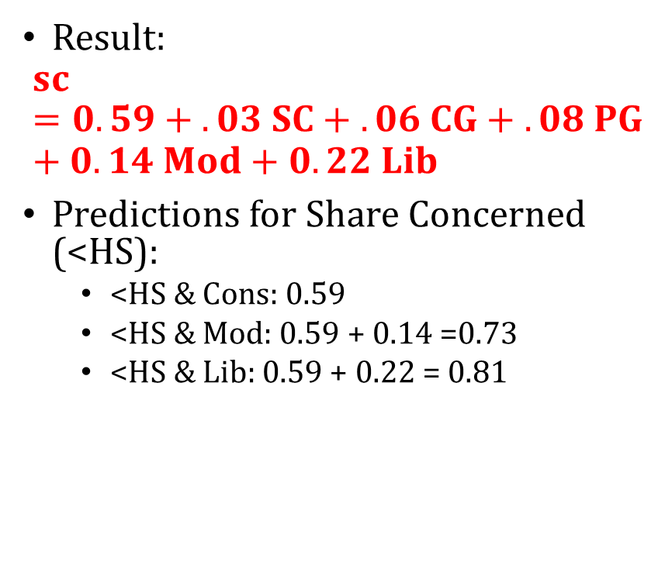
$$share concerned=β_{0}+β_{1}edu+β_{2}ideo$$
Result:
$$sc =0.59 + .03 SC + .06 CG + .08 PG+0.14 Mod+0.22 Lib$$
Predictions for Share Concerned (<HS):
  <HS & Cons: 0.59
  <HS & Mod: 0.59 + 0.14 =0.73
  <HS & Lib: 0.59 + 0.22 = 0.81

Slide 21

$$share concerned=β_{0}+β_{1}edu+β_{2}ideo$$
Result:
$$sc =0.59 + .03 SC + .06 CG + .08 PG+0.14 Mod+0.22 Lib$$
Predictions for Share Concerned (Post Grad):
  PG & Cons: 0.59 + .08 = 0.67
  PG & Mod: 0.59 + .08 + 0.14 =0.81
  PG & Lib: 0.59 + .08 + 0.22 = 0.89

Slide 22

Dataset for $share concerned=β_{0}+β_{1}edu+β_{2}ideo+β_{3}edu∗ideo$
Share Concerned | SC | CG | PG | Mod | Lib | SC*Mod | CG*Mod | PG*Mod | SC*Lib | CG*Lib | PG*Lib
0.695 | 0 | 0 | 0 | 0 | 0 | 0 | 0 | 0 | 0 | 0 | 0
0.64 | 1 | 0 | 0 | 0 | 0 | 0 | 0 | 0 | 0 | 0 | 0
0.61 | 0 | 1 | 0 | 0 | 0 | 0 | 0 | 0 | 0 | 0 | 0
0.57 | 0 | 0 | 1 | 0 | 0 | 0 | 0 | 0 | 0 | 0 | 0
0.71 | 0 | 0 | 0 | 1 | 0 | 0 | 0 | 0 | 0 | 0 | 0
0.74 | 1 | 0 | 0 | 1 | 0 | 1 | 0 | 0 | 0 | 0 | 0
0.8 | 0 | 1 | 0 | 1 | 0 | 0 | 1 | 0 | 0 | 0 | 0
0.84 | 0 | 0 | 1 | 1 | 0 | 0 | 0 | 1 | 0 | 0 | 0
0.72 | 0 | 0 | 0 | 0 | 1 | 0 | 0 | 0 | 0 | 0 | 0
0.83 | 1 | 0 | 0 | 0 | 1 | 0 | 0 | 0 | 1 | 0 | 0
0.9 | 0 | 1 | 0 | 0 | 1 | 0 | 0 | 0 | 0 | 1 | 0
0.95 | 0 | 0 | 1 | 0 | 1 | 0 | 0 | 0 | 0 | 0 | 1

Slide 23
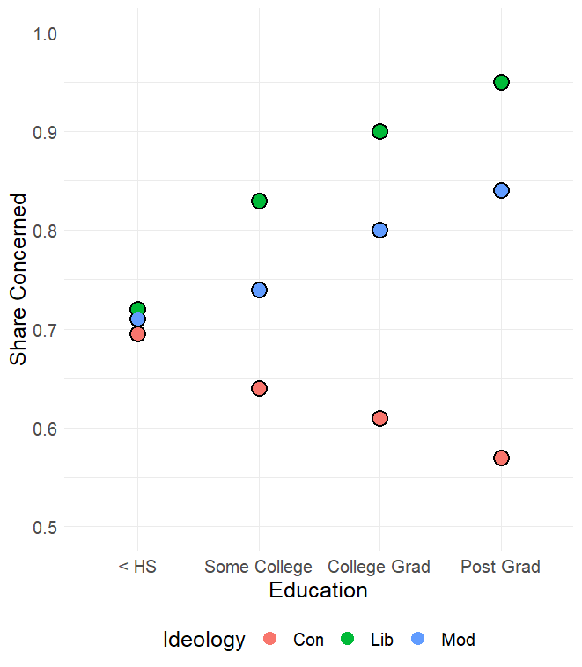
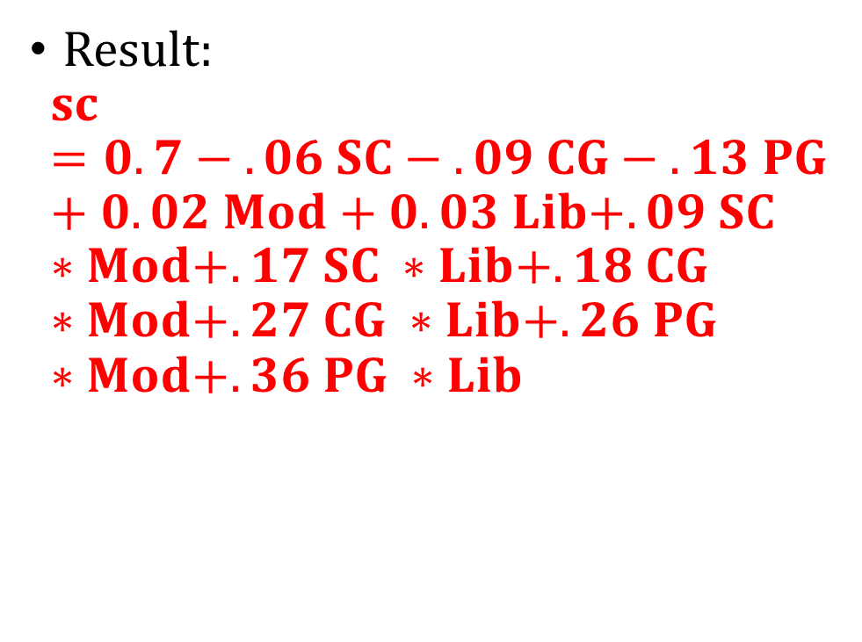
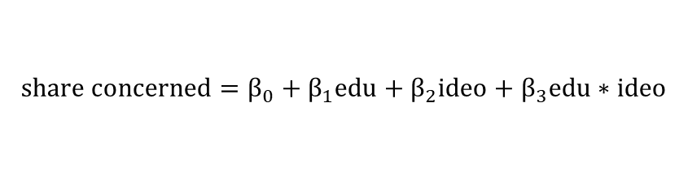
$$share concerned=β_{0}+β_{1}edu+β_{2}ideo+β_{3}edu∗ideo$$
Result:
$$sc =0.7 − .06 SC − .09 CG − .13 PG+0.02 Mod+0. 03 Lib+.09 SC ∗Mod+.17 SC ∗Lib+.18 CG ∗Mod+.27 CG ∗Lib+.26 PG ∗Mod+.36 PG ∗Lib$$

Slide 24
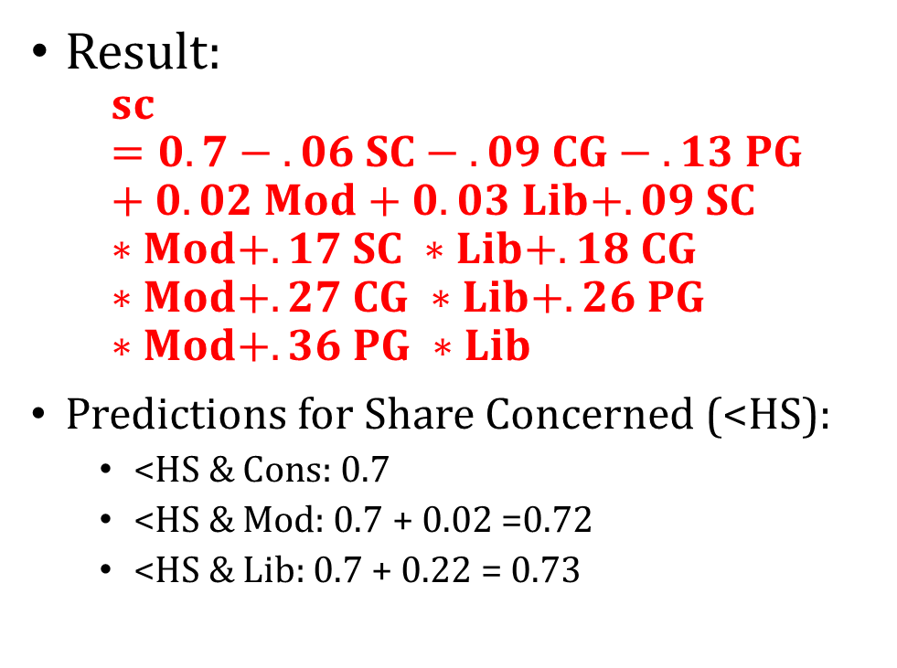
$$share concerned=β_{0}+β_{1}edu+β_{2}ideo+β_{3}edu∗ideo$$
Result:
$$sc =0.7 − .06 SC − .09 CG − .13 PG+0.02 Mod+0. 03 Lib+.09 SC ∗Mod+.17 SC ∗Lib+.18 CG ∗Mod+.27 CG ∗Lib+.26 PG ∗Mod+.36 PG ∗Lib$$
Predictions for Share Concerned (<HS):
  <HS & Cons: 0.7
  <HS & Mod: 0.7 + 0.02 =0.72
  <HS & Lib: 0.7 + 0.22 = 0.73

Slide 25
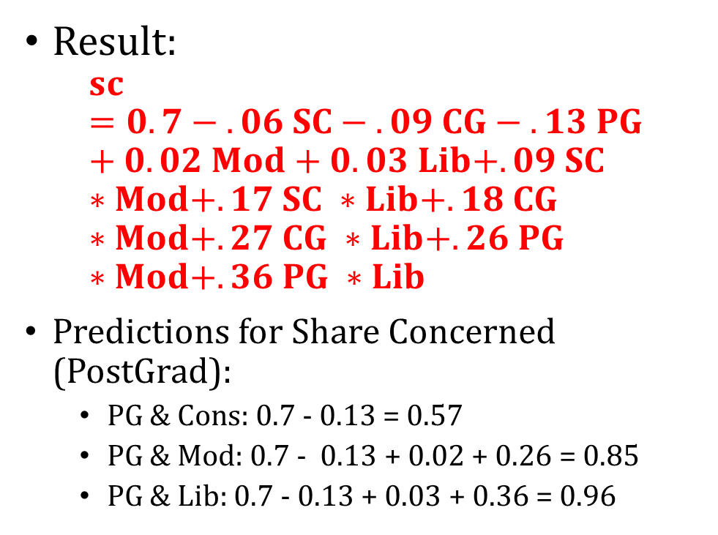
$$share concerned=β_{0}+β_{1}edu+β_{2}ideo+β_{3}edu∗ideo$$
Result:
$$sc =0.7 − .06 SC − .09 CG − .13 PG+0.02 Mod+0. 03 Lib+.09 SC ∗Mod+.17 SC ∗Lib+.18 CG ∗Mod+.27 CG ∗Lib+.26 PG ∗Mod+.36 PG ∗Lib$$
Predictions for Share Concerned (PostGrad):
  PG & Cons: 0.7 - 0.13 = 0.57
  PG & Mod: 0.7 - 0.13 + 0.02 + 0.26 = 0.85
  PG & Lib: 0.7 - 0.13 + 0.03 + 0.36 = 0.96

Slide 26
Statistical Interaction
Definition: When the outcome differs based on value of more than one predictor AT THE SAME TIME
For example, the true value of share concerned for liberals with post graduate degree is 0.95
  A model that includes by education and ideology, but without an interaction would predict 0.89
  A model that interacts education and ideology would predict the correct value of 0.95
Because the model can now distinguish these types of people from people who just have a post graduate degree, or are just Liberals

Slide 27
Interactions are hard for Linear Regression
We had to create 6 variables that captured the possible interactions between education and ideology
We usually don’t know what the relationship is beforehand
So we in theory would need to test for each possible interaction

Slide 28
Interactions are hard for Linear Regression
What if we had 2 binary variables, how many pair-wise interactions are there between the two?
  1, when both variables are equal to 1
What about 3 binary variables (A, B, and C)?
  3 pair-wise interactions (A * B, B * C, and A * C)
What about 4?
  General formula is N choose 2, so here it is 4 choose 2 = 6
What about 100?
  4,950
A data scientist would have to create all of these variables before running a model. Is there a better way?

Slide 29
Decision Trees

Slide 30
Basics
Want to estimate: $p_{i}=P(Y_{i}=1|X_{i})$
Naive Bayes:
  Count ‘em up
Linear Regression:
  Estimate $β$s by fitting a line to our data
Decisions Trees:
  At each point, find the one variable (and threshold) that bests separates 1s and 0s
  Splits feature space into perpendicular sections

Slide 31
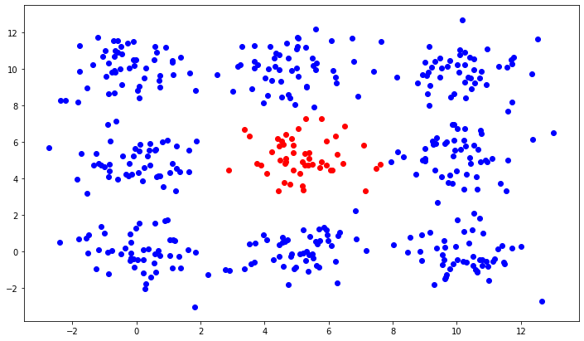
Prediction Problem
Red is Y=1, Blue is Y=0
Two predictors, $X_{1}, X_{2}$

Slide 32
Let’s Use a Linear Model
$y=β_{0}+β_{1}X_{1}+β_{2} X_{2}$
We get
  $y=.10+.0009X_{1}+.0009X_{2}$

Slide 33
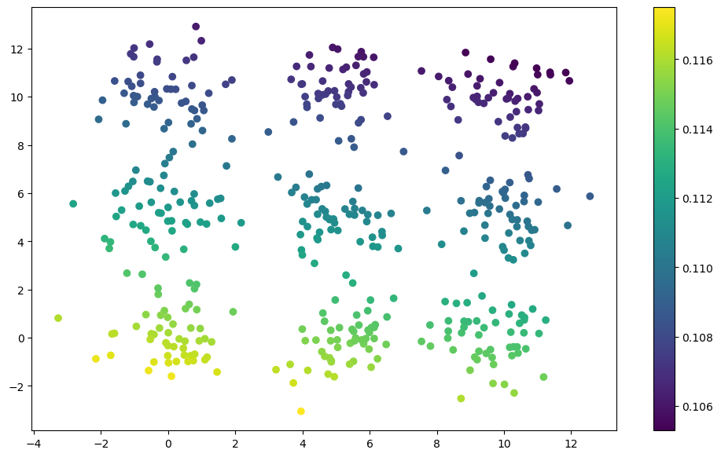
Predictions
Dots are colored by predicted probability. The range is narrow, from .105 to .117

Slide 34
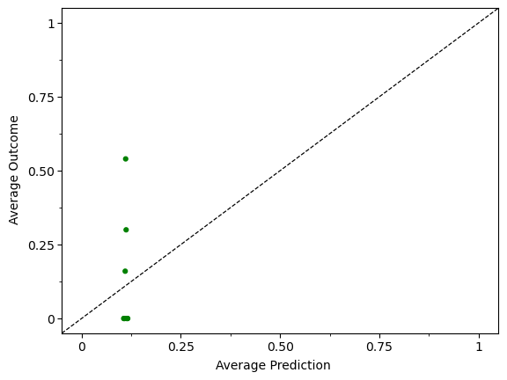
Calibration
Break predictions into 10 equally sized bins (45 data points in each)
Compute the average value of the outcome and average value of the prediction for each bin.
Each point in the plot is (average prediction, average outcome) for each bin
If model was calibrated, points would fall on 45-degree line

Slide 35
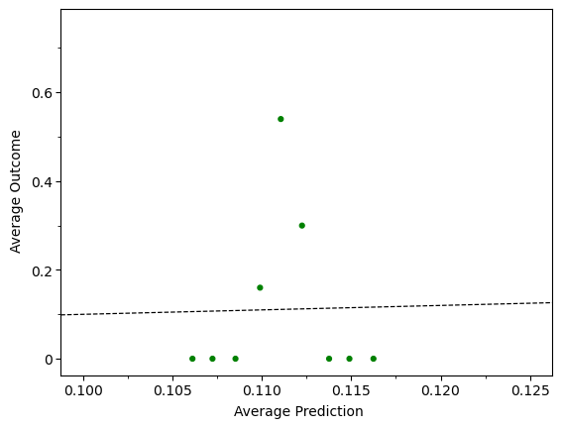
Calibration – Zooming In
Break predictions into 10 equally sized bins (45 data points in each)
Compute the average value of the outcome and average value of the prediction for each bin.
Each point in the plot is (average prediction, average outcome) for each bin
If model was calibrated, points would fall on 45-degree line

Slide 36
Let’s Introduce Interactions
$y=β_{0}+β_{1}X_{1}+β_{2} X_{2}+β_{3}X_{1}^{2}+β_{4}X_{2}^{2}+β_{5}X_{1}X_{2}$
We get
  $y=−.04+.09 X_{1}+.09 X_{2}−.01X_{1}^{2}−.01 X_{2}^{2}−.001β_{5}X_{1}X_{2}$

Slide 37
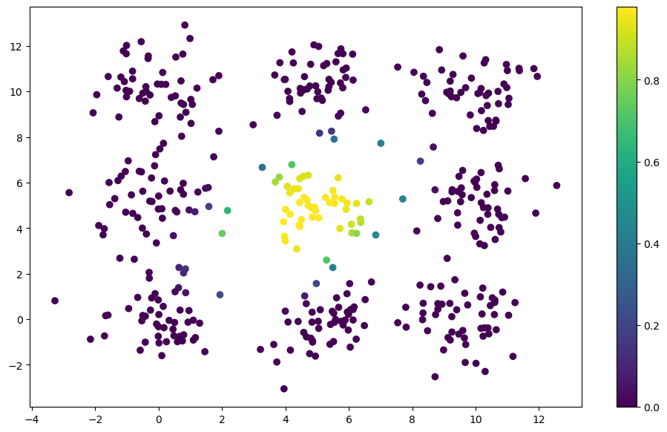
Predictions
Dots are colored by predicted probability.

Slide 38
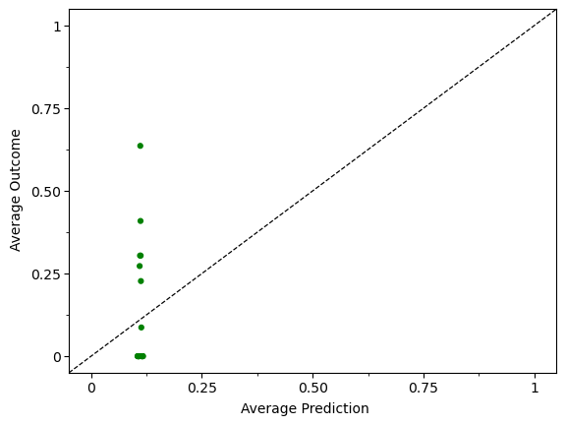
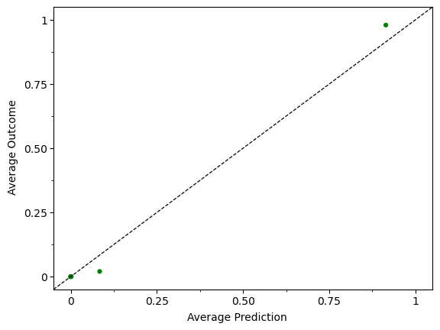
Calibration
Break predictions into 10 equally sized bins (45 data points in each)
Compute the average value of the outcome and average value of the prediction for each bin.
Each point in the plot is (average prediction, average outcome) for each bin
If model was calibrated, points would fall on 45-degree line

Slide 39
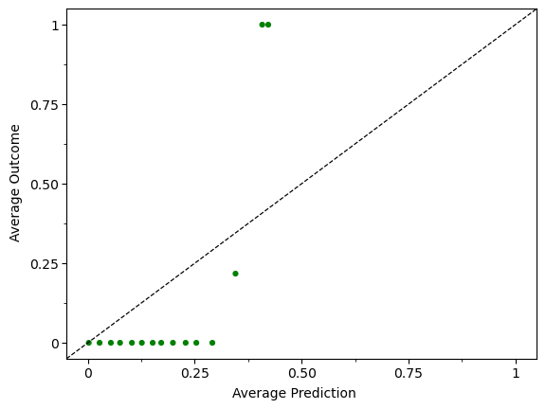
Calibration
Break predictions into 10 equally sized bins (45 data points in each)
Compute the average value of the outcome and average value of the prediction for each bin.
Each point in the plot is (average prediction, average outcome) for each bin
If model was calibrated, points would fall on 45-degree line

Slide 40

Now Let’s Use a Decision Tree
We’re going to feed in $X_{1},$ $X_{2},$ and $y$

Slide 41
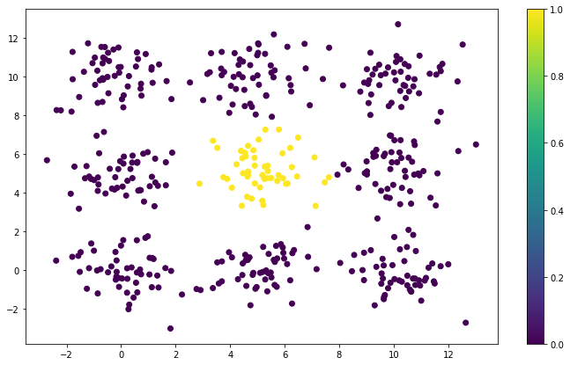
Predictions
Dots are colored by predicted probability. Decision tree gets close to perfect prediction

Slide 42
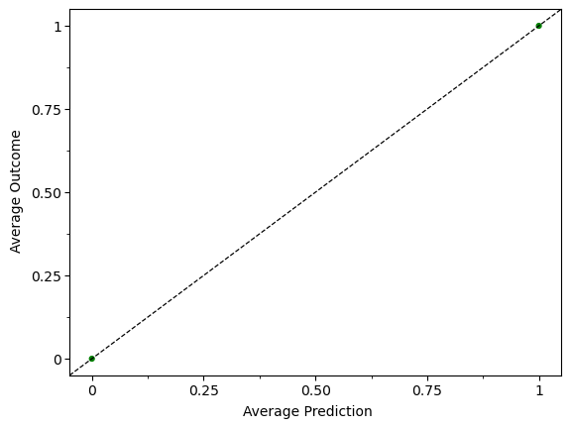
Calibration
Break predictions into 10 equally sized bins (45 data points in each)
Compute the average value of the outcome and average value of the prediction for each bin.
Each point in the plot is (average prediction, average outcome) for each bin
If model was calibrated, points would fall on 45-degree line

Slide 43
What Just Happened?
A decision tree is a method for “cutting up” the input space in a linear fashion.
Identifies regions of the input space where regions are places where the data points are more similar to each other

Slide 44

Decision Tree Terminology
Parent
(or Root) Node
Child Nodes

Slide 45
Decision Tree Terminology
Internal Node
Leaves

Slide 46
Decision Trees Algorithm
At each node:
  Cycle through each variable
    Cycle through each value the variable can take
      Compute a splitting criteria statistic
      Basic idea is to find the variable and threshold that:
        Classification: best separates the classes
        Regression: minimizes the variance
Go until you hit your stopping criteria (will get to this)

Slide 47
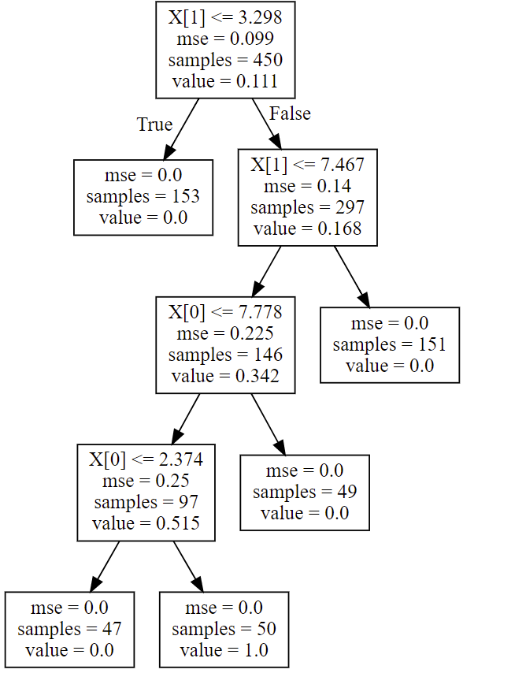

Slide 49
Dividing Up the Feature Space

Slide 50
Dividing Up the Feature Space

Slide 51
Dividing Up the Feature Space
Dividing Up the Feature Space

Slide 53
Dividing Up the Feature Space

Slide 54
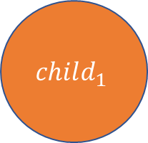
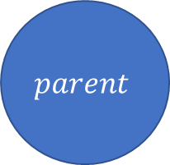
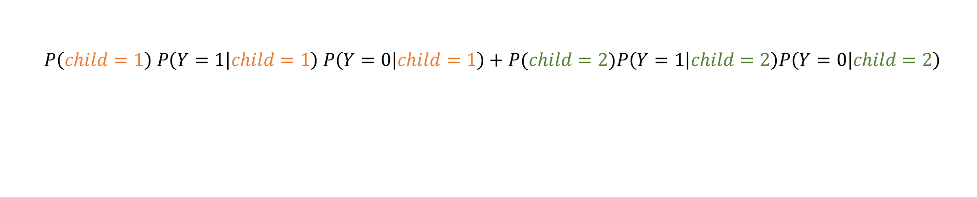
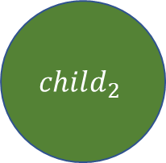
Splitting Criteria for Classification
$$parent$$
  Gini Impurity
  Measures how well a potential split (variable and threshold) separate the 0s from the 1s. Smaller values mean does better job separating.
  Equation we’ll use for this class:
$$child_{1}$$
$$child_{2}$$
  $$P\left(child=1\right) P\left(Y=1 | child=1\right) P\left(Y=0 | child=1\right)+P(child=2)P\left(Y=1 | child=2\right)P\left(Y=0 | child=2\right)$$

Slide 55
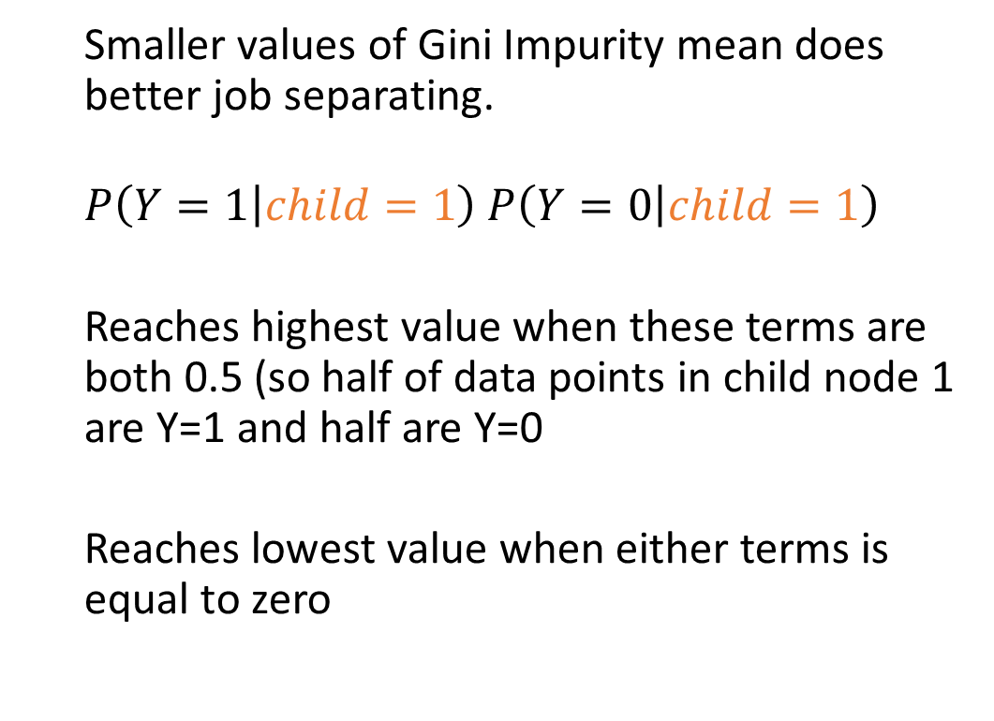
Splitting Criteria for Classification
$$parent$$
  Smaller values of Gini Impurity mean does better job separating.
  $$P\left(Y=1 | child=1\right) P\left(Y=0 | child=1\right)$$
  Reaches highest value when these terms are both 0.5 (so half of data points in child node 1 are Y=1 and half are Y=0
  Reaches lowest value when either terms is equal to zero
$$child_{1}$$
$$child_{2}$$

Slide 56

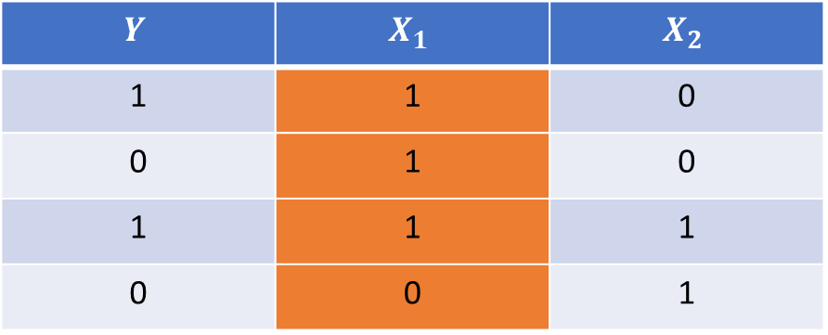
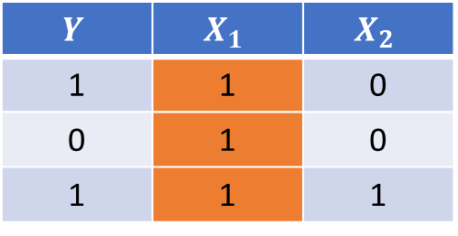
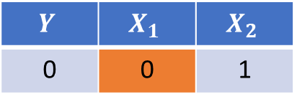
Example #1
$$Y$$ | $$X_{1}$$ | $$X_{2}$$
1 | 1 | 0
0 | 1 | 0
1 | 1 | 1
0 | 0 | 1
$$X_{1}≥1$$
False
True
$$Y$$ | $$X_{1}$$ | $$X_{2}$$
1 | 1 | 0
0 | 1 | 0
1 | 1 | 1
$$Y$$ | $$X_{1}$$ | $$X_{2}$$
0 | 0 | 1

Slide 57

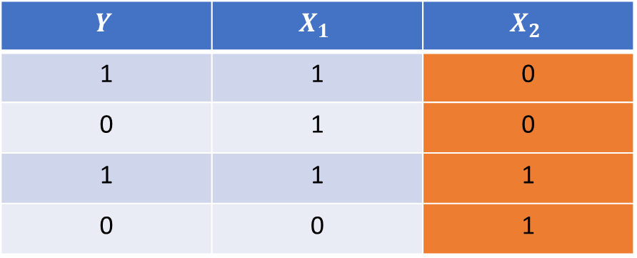
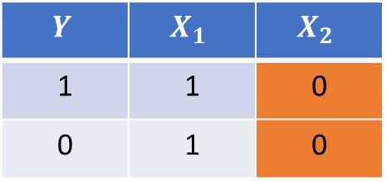
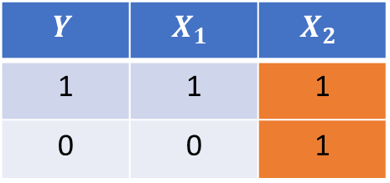
Example #1
$$Y$$ | $$X_{1}$$ | $$X_{2}$$
1 | 1 | 0
0 | 1 | 0
1 | 1 | 1
0 | 0 | 1
$$X_{2}≥1$$
False
True
$$Y$$ | $$X_{1}$$ | $$X_{2}$$
1 | 1 | 0
0 | 1 | 0
$$Y$$ | $$X_{1}$$ | $$X_{2}$$
1 | 1 | 1
0 | 0 | 1

Slide 58
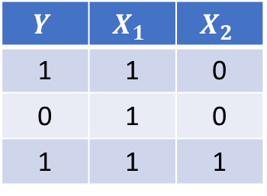
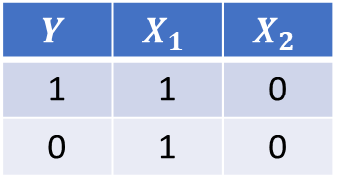
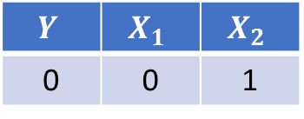
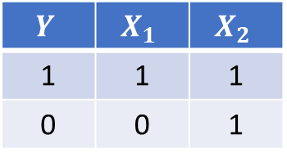
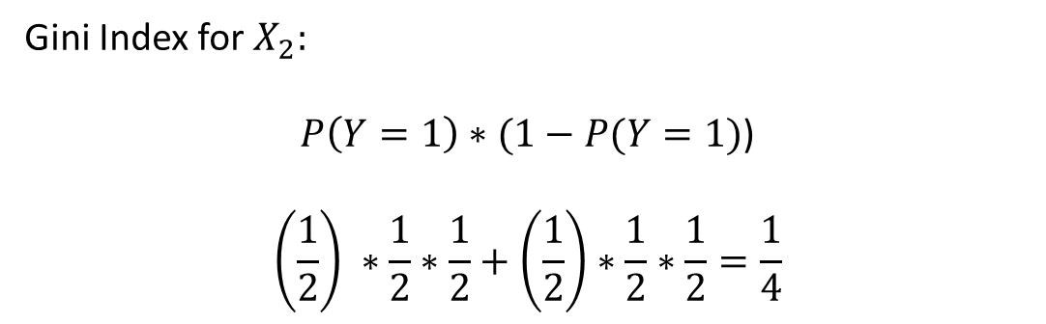
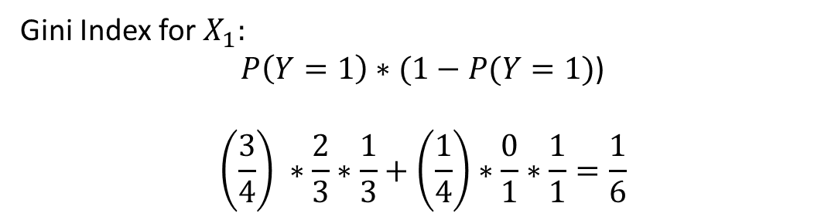
Example #2
$$Y$$ | $$X_{1}$$ | $$X_{2}$$
1 | 1 | 0
0 | 1 | 0
1 | 1 | 1
Gini Index for$X_{1}:$
$P\left(Y=1\right)∗(1−P(Y=1)$)
$$\left(\frac{3}{4}\right) ∗\frac{2}{3}∗\frac{1}{3}+\left(\frac{1}{4}\right)∗\frac{0}{1}∗\frac{1}{1}=\frac{1}{6}$$
$$Y$$ | $$X_{1}$$ | $$X_{2}$$
0 | 0 | 1
$$Y$$ | $$X_{1}$$ | $$X_{2}$$
1 | 1 | 0
0 | 1 | 0
Gini Index for$X_{2}:$
$P\left(Y=1\right)∗(1−P(Y=1)$)
$$\left(\frac{1}{2}\right) ∗\frac{1}{2}∗\frac{1}{2}+\left(\frac{1}{2}\right)∗\frac{1}{2}∗\frac{1}{2}=\frac{1}{4}$$
$$Y$$ | $$X_{1}$$ | $$X_{2}$$
1 | 1 | 1
0 | 0 | 1

Slide 59
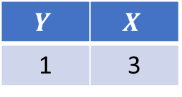






Example #2
$$Y$$ | $$X$$
1 | 3
0 | 2
1 | 0
0 | 0
Run through possible thresholds
  One split: [0], [2, 3]
  Second split: [0, 2], [3]
$$X≥1$$
$$X≥3$$
False
True
False
True
$$Y$$ | $$X$$
0 | 2
1 | 0
0 | 0
$$Y$$ | $$X$$
1 | 0
0 | 0
$$Y$$ | $$X$$
1 | 3
0 | 2
$$Y$$ | $$X$$
1 | 3

Slide 60






Example #2
Gini Index for$X≥1:$
$P\left(Y=1\right)∗(1−P(Y=1)$)
$$\left(\frac{1}{2}\right)∗\frac{1}{2}∗\frac{1}{2}+\left(\frac{1}{2}\right)∗\frac{1}{2}∗\frac{1}{2}=\frac{1}{4}$$
$$Y$$ | $$X$$
1 | 0
0 | 0
$$Y$$ | $$X$$
1 | 3
0 | 2
Gini Index for$X≥3:$
$P\left(Y=1\right)∗(1−P(Y=1)$)
$$\left(\frac{3}{4}\right) ∗\frac{1}{3}∗\frac{2}{3}+\left(\frac{1}{4}\right)∗\frac{1}{1}∗\frac{0}{0}=\frac{1}{6}$$
$$Y$$ | $$X$$
0 | 2
1 | 0
0 | 0
$$Y$$ | $$X$$
1 | 3

Slide 61
So what is the objective function here?
There is no explicit global objective being optimized
  Unlike linear or logistic regression
Greedy and local optimization
  No guarantee that reducing variance locally leads to lowest variance solution globally
  But it works well
  Actually finding global solution is impractical

Slide 62
Area Under the Curve

Slide 63




Evaluating Binary Prediction Problems
Scenario:
  Our outcome variable is a (0,1)
  Our prediction model output a score or a probability
Ways we can evaluate the predictive accuracy:
  Calibration
  Confusion Matrix
    Accuracy
    Precision
    True Positive Rate
    Etc.
$$y=0$$
$$y=1$$
True Negative (TN)
False Negative (FN)
$$\hat{y}=0$$
False Positive (FP)
True Positive (TP)
$$\hat{y}=1$$

Slide 64




Evaluating Binary Prediction Problems
$$y=0$$
$$y=1$$
True Negative (TN)
False Negative (FN)
Confusion Matrix
  Accuracy
  Precision
  True Positive Rate
  Etc.
Drawback: Confusion matrix approaches require us to choose a threshold (often not obvious what the right threshold is)
$$\hat{y}=0$$
False Positive (FP)
True Positive (TP)
$$\hat{y}=1$$
1
1
1
1
0
1
0
0
0
0.5
0

Slide 65

Area Under the Curve (AUC)
Full name:
  Area under the receiver operating characteristic curve (AUC-ROC)
A metric that captures how well a model ranks Y=1s versus Y=0s
Importantly: Doesn’t rely on a single threshold.

Slide 66

Why Not Use All the Thresholds?

Slide 67
Why Not Use All the Thresholds?
$TPR=\frac{TP}{TP+FN}=\frac{1}{1+9}=.1$ $FPR=\frac{FP}{FP+TN}=\frac{0}{0+10}=0$

Slide 68
Why Not Use All the Thresholds?
$TPR=\frac{TP}{TP+FN}=\frac{2}{2+8}=.2$ $FPR=\frac{FP}{FP+TN}=\frac{0}{0+10}=0$

Slide 69
Why Not Use All the Thresholds?
$TPR=\frac{TP}{TP+FN}=\frac{2}{2+8}=.2$ $FPR=\frac{FP}{FP+TN}=\frac{1}{1+9}=.1$

Slide 70
Why Not Use All the Thresholds?
$TPR=\frac{TP}{TP+FN}=\frac{5}{5+5}=.5$ $FPR=\frac{FP}{FP+TN}=\frac{1}{1+9}=.1$

Slide 71
Why Not Use All the Thresholds?
$TPR=\frac{TP}{TP+FN}=\frac{10}{10+0}=1$ $FPR=\frac{FP}{FP+TN}=\frac{9}{9+1}=.9$

Slide 72
Why Not Use All the Thresholds?
$TPR=\frac{TP}{TP+FN}=\frac{10}{10+0}=1$ $FPR=\frac{FP}{FP+TN}=\frac{10}{10+0}=1$

Slide 73
So What?
The area under this line is called the Area Under the Receiver Operating Characteristic Curve. (AUC)
Has a very nice probabilistic interpretation:
AUC is the probability that a randomly chosen member of Y=1 class is ranked higher than a randomly chosen member of Y=0
AUC = 1 is perfect classifier
AUC = 0.5 is a random classifier
AUC < 0.5 you did something wrong

Slide 74


Practice Computing AUC
First threshold is 0.17
  $TPR=\frac{50}{50}=1$
  $FPR=\frac{350}{400}=0.875$
0.1825
0.165
0.1825
0.3075
0.39
0.3075
0.2075
0.29
0.2075

Slide 75

Practice Computing AUC
Second threshold is 0.19
  $TPR=\frac{50}{50}=1$
  $FPR=\frac{250}{400}=0.625$
0.1825
0.165
0.1825
0.3075
0.39
0.3075
0.2075
0.29
0.2075

Slide 76

Practice Computing AUC
Third threshold is 0.21
  $TPR=\frac{50}{50}=1$
  $FPR=\frac{150}{400}=0.375$
0.1825
0.165
0.1825
0.3075
0.39
0.3075
0.2075
0.29
0.2075

Slide 77

Practice Computing AUC
Fourth threshold is 0.30
  $TPR=\frac{50}{50}=1$
  $FPR=\frac{100}{400}=0.25$
0.1825
0.165
0.1825
0.3075
0.39
0.3075
0.2075
0.29
0.2075

Slide 78

Practice Computing AUC
Fifth threshold is 0.35
  $TPR=\frac{50}{50}=.95$
  $FPR=\frac{0}{400}=0$
0.1825
0.165
0.1825
0.3075
0.39
0.3075
0.2075
0.29
0.2075

