Slide 1
INST 414: Data Science Techniques Lecture 7 Overfitting

Slide 2
Recap

Slide 3

The Story So Far
Data Science is largely about prediction
In this class, prediction means estimating $P(Y=1|X=x)$
Re-arrest, dropout, etc

Slide 4
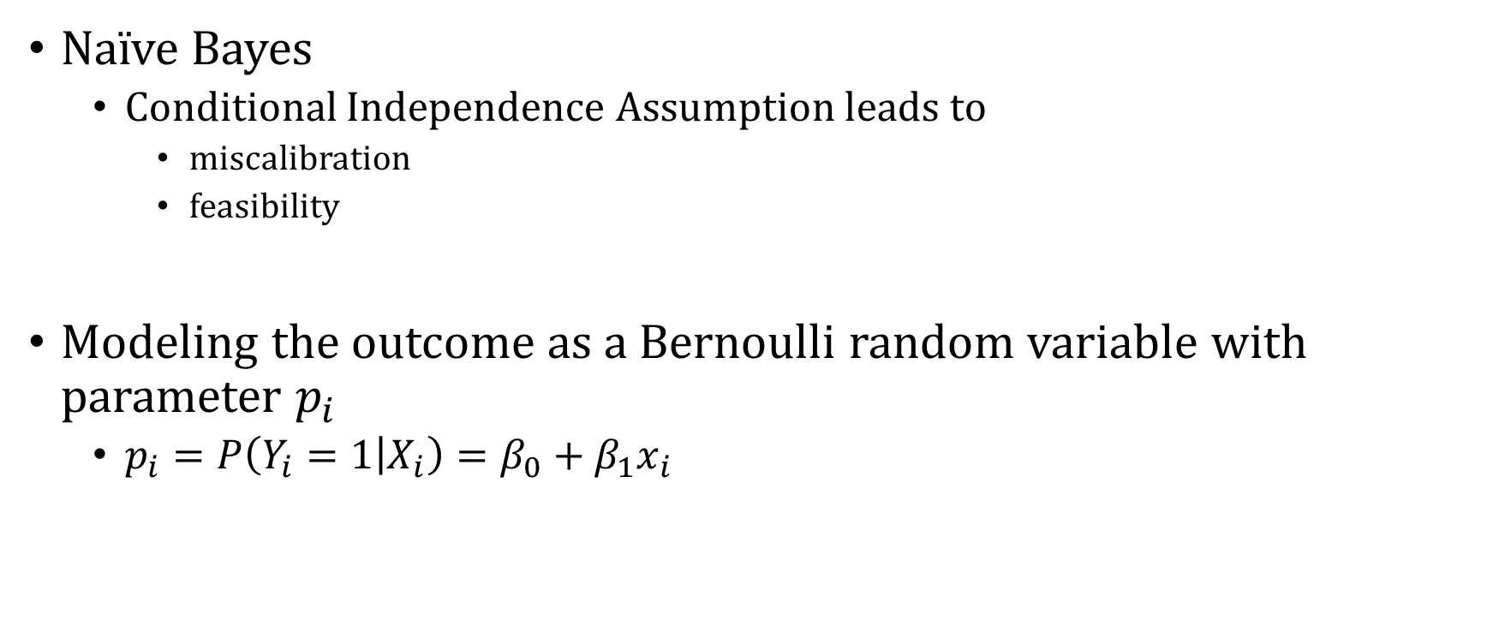
The Story So Far
Naïve Bayes
Conditional Independence Assumption leads to
miscalibration
feasibility
Modeling the outcome as a Bernoulli random variable with parameter $p_{i}$
$p_{i}=P\left(Y_{i}=1 | X_{i}\right)=β_{0}+β_{1}x_{i}$

Slide 5
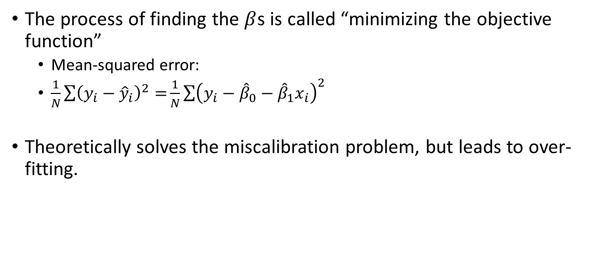
The Story So Far
The process of finding the $β$s is called “minimizing the objective function”
Mean-squared error:
$\frac{1}{N}\sum{{\left(y_{i}−{\hat{y}}_{i}\right)}^{2}=}\frac{1}{N}\sum{{\left(y_{i}−{\hat{β}}_{0}−{\hat{β}}_{1}x_{i}\right)}^{2}}$
Theoretically solves the miscalibration problem, but leads to over-fitting.

Slide 6
Overfitting

Slide 7
Can You Minimize the Objective “Too Much”?
I said that if you get the error down to zero, you are guaranteed calibration --- in sample
But we care about calibration out of sample
Could that go wrong?

Slide 8
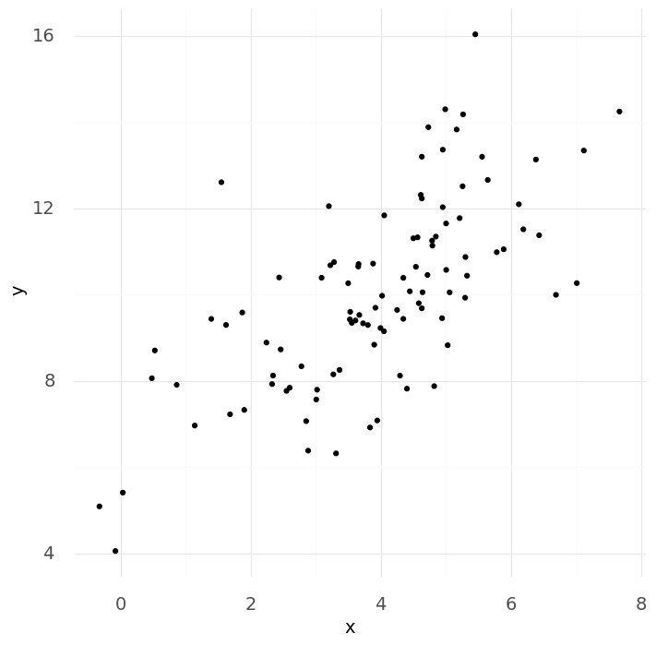

Slide 9
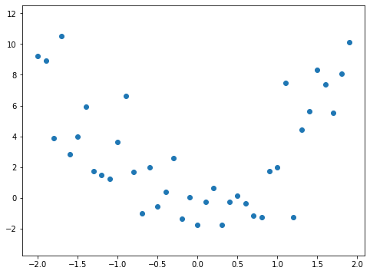
Let’s Fit a Line to This Data

Slide 10
Let’s Fit a Line to This Data
Training Data

Slide 11
Let’s Fit a Line to This Data
Training Data
Testing Data

Slide 12
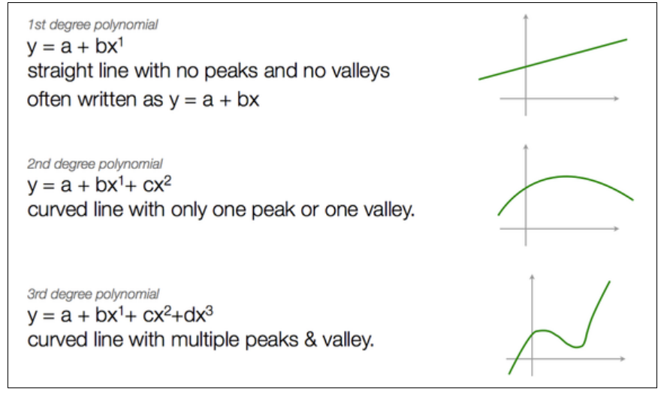
Source

Slide 13
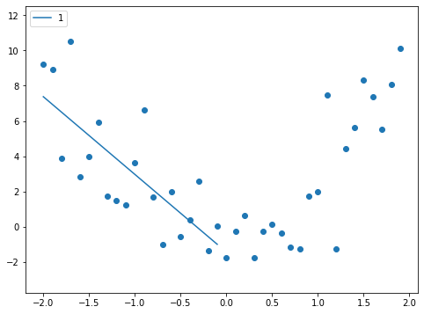
Add a 1st-Degree Polynomial (a straight line)
Training Data
$$\hat{f}\left(x\right)=β_{0}+β_{1} X_{1}=−1.4−4.4 X_{1}$$

Slide 14
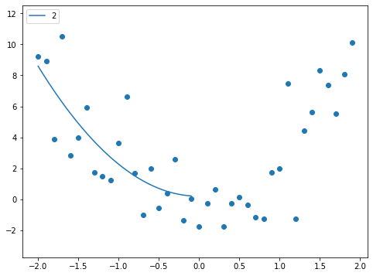
Add a 2nd-Degree Polynomial (a curved line)
Training Data
$$\hat{f}\left(x\right)=β_{0}+β_{1} X_{1}+β_{2}X_{1}^{2}=0.2+0.07 X_{1}+2.1 X_{1}^{2}$$

Slide 15

Add a 3rd-Degree Polynomial
Training Data
$$\hat{f}\left(x\right)=β_{0}+β_{1} X_{1}+β_{2} X_{1}^{2}+β_{3} X_{1}^{3}=−1.0−6.3 X_{1}−5.3 X_{1}^{2}−2.4X^{3}$$

Slide 16

Add a 4th-Degree Polynomial
Training Data
$$\hat{f}\left(x\right)=β_{0}+β_{1} X_{1}+β_{2} X_{1}^{2}+β_{3} X_{1}^{3}+β_{4} X_{1}^{4}=−0.43−1.5 X_{1}+4.5 X_{1}^{2}+4.8 X^{3}+1.7 X^{4}$$

Slide 17
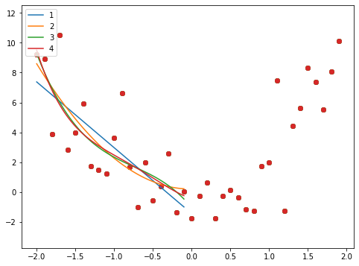
Let’s Put Everything onto the Same Chart
Training Data

Slide 18
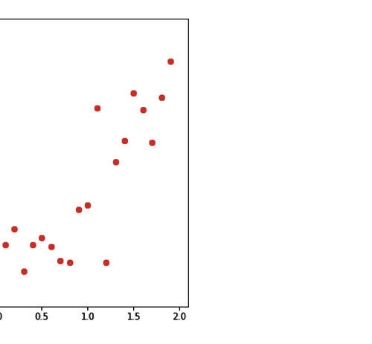
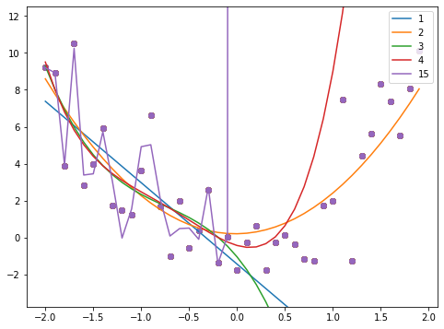
15th Degree Polynomial – Massive Overfitting
Training Data

Slide 19
Compute Error on Training Data
Training Data

Slide 20
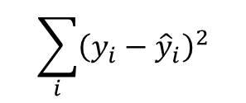
Error = Sum of Squared Errors
$$\sum_{i}{{\left(y_{i}−{\hat{y}}_{i}\right)}^{2}}$$
Training Data
Degree | Training Error
1 | 97.4
2 | 89.4
3 | 87
4 | 86.7

Slide 21
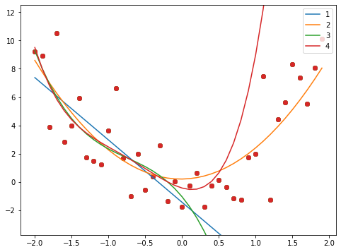
Now Let’s Predict With Each Model
Training Data
Testing Data

Slide 22
Compute Test Error and Compare
Training Data
Testing Data
Degree | Training Error | Test Error
1 | 97.4 | 2,148
2 | 89.4 | 89.6
3 | 87 | 14,827
4 | 86.7 | 10,142

Slide 23
Recap
We want to optimize an objective function
Find weights that minimize the loss
We use the data we have (training data)
We varied the order of the polynomial (less complex to more complex)
We saw that training error was not a good predictor of test error
We chose a 2nd order polynomial by looking at the test error
Can we automate this process?

Slide 24
Preventing Overfitting a.k.a Regularization

Slide 25
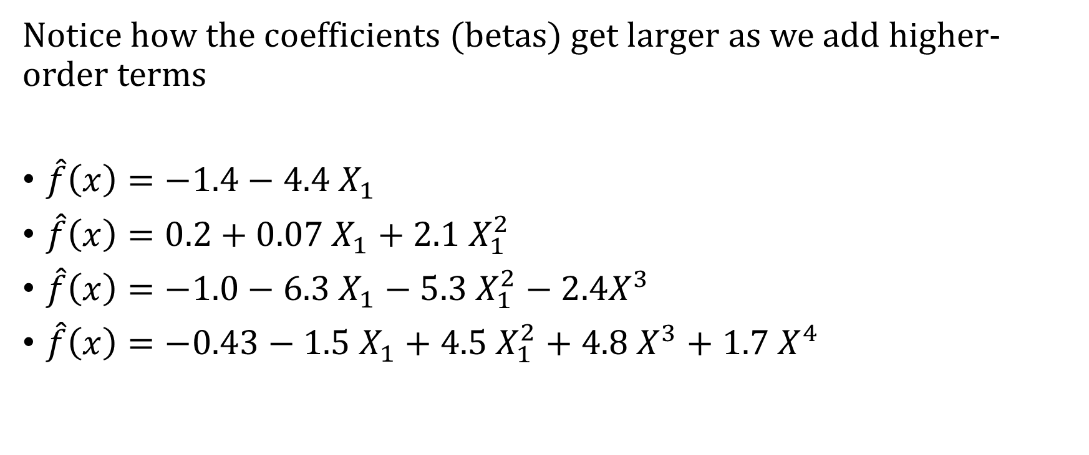
Can We Automate the Selection Process
Notice how the coefficients (betas) get larger as we add higher-order terms
$\hat{f}\left(x\right)=−1.4−4.4 X_{1}$
$\hat{f}\left(x\right)=0.2+0.07 X_{1}+2.1 X_{1}^{2}$
$\hat{f}\left(x\right)=−1.0−6.3 X_{1}−5.3 X_{1}^{2}−2.4X^{3}$
$\hat{f}\left(x\right)=−0.43−1.5 X_{1}+4.5 X_{1}^{2}+4.8 X^{3}+1.7 X^{4}$

Slide 26

Objective Functions with Regularization
Ordinary Least Squares (OLS):
$$\sum_{i}{{\left(Y_{i}−{\hat{p}}_{i}\right)}^{2}}$$
Ridge Regression:
$$\sum_{i}{{\left(Y_{i}−{\hat{p}}_{i}\right)}^{2}}+λ \sum_{j}{β_{j}^{2}}$$
Lasso Regression:
$$\sum_{i}{{\left(Y_{i}−{\hat{p}}_{i}\right)}^{2}}+λ \sum_{j}{|β_{j}|}$$

Slide 27
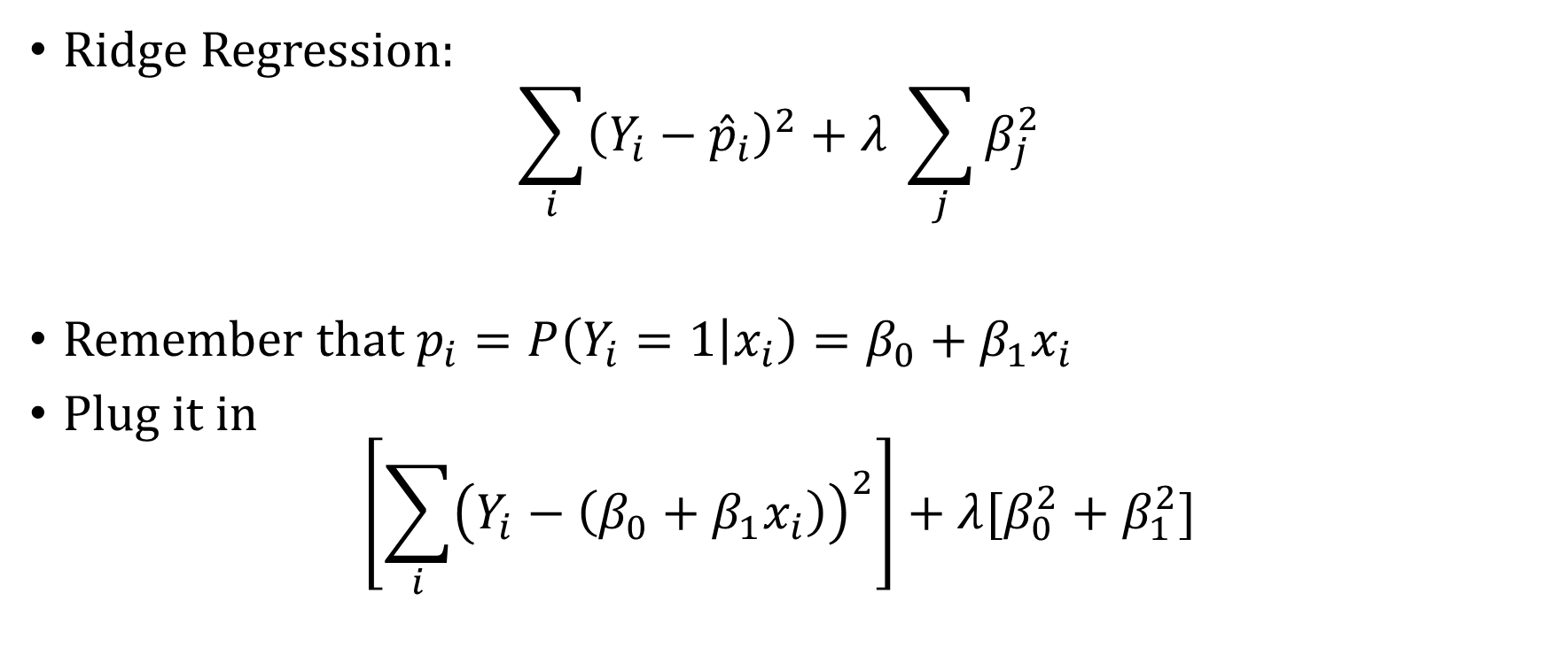
Ridge Regression Objective
Ridge Regression:
$$\sum_{i}{{\left(Y_{i}−{\hat{p}}_{i}\right)}^{2}}+λ \sum_{j}{β_{j}^{2}}$$
Remember that $p_{i}=P\left(Y_{i}=1 | x_{i}\right)=β_{0}+β_{1}x_{i}$
Plug it in
$$\left[\sum_{i}{{\left(Y_{i}−\left(β_{0}+β_{1}x_{i}\right)\right)}^{2}}\right]+λ[β_{0}^{2}+β_{1}^{2}]$$

Slide 28
Ridge vs Lasso Regularization
See here for visualization of difference between Ridge and Lasso:
https://www.youtube.com/watch?v=Xm2C_gTAl8c&vl=en

Slide 29
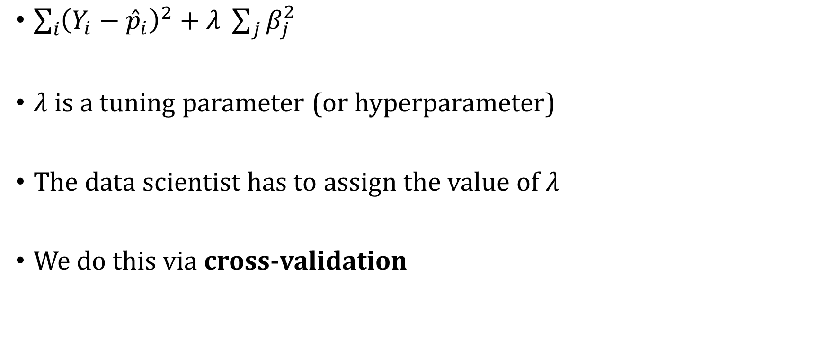
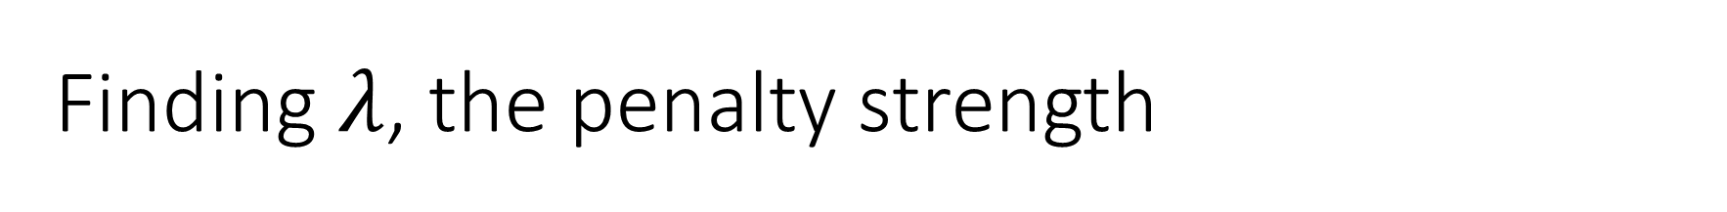
Finding $λ$, the penalty strength
$\sum_{i}{{\left(Y_{i}−{\hat{p}}_{i}\right)}^{2}}+λ \sum_{j}{β_{j}^{2}}$
$λ$ is a tuning parameter (or hyperparameter)
The data scientist has to assign the value of $λ$
We do this via cross-validation

Slide 30
Cross-validation
We want our model to perform well out-of-sample
We mimic this by splitting up our data first into two parts:
Training
Holdout (ultimate out-of-sample performance measure)
All Data
Train
Holdout

Slide 31

K-fold Cross-validation
Training data:
We split this up into $k$ folds
Train
Fold 1
Fold 2
Fold 3
Fold 4
Fold 5

Slide 32
K-fold Cross-validation
Training data:
We iteratively holdout one fold (validation set) and train on the rest.
Validation
Train
Train
Validation
Train
Train
Validation

Slide 33




K-Fold Cross-Validation
For each fold we train the model with many different values of $λ$
Validation
Train
$$λ∈\{.01, .1, 1, …,10, …\}$$
Train
Validation
Train
$$λ∈\{.01, .1, 1, …,10, …\}$$
Train
Validation
$$λ∈\{.01, .1, 1, …,10, …\}$$

Slide 34
Training Data
Holdout Data
Validation Point
Training Point
1st Fold

Slide 35
Training Data
Holdout Data
Validation Point
Training Point
2nd Fold

Slide 36


K-Fold Cross-Validation
For each $λ$ and for each fold, we predict for the validation set
We average performance across the validation sets for each $λ$
We choose the $λ$ with the best performance for our final model
Fold | $$λ=1$$ | $$λ=5$$ | $$λ=25$$ | $$λ=50$$
1 | 92.0 | 49.1 | 39.3 | 44.4
2 | 17.3 | 13.8 | 11.9 | 11.8
3 | 33.5 | 34.9 | 38.4 | 40.1
4 | 100.0 | 8.3 | 6.8 | 6.6
5 | 7.9 | 7.9 | 7.8 | 7.9
Average | 32.1 | 22.8 | 20.9 | 22.2

Slide 37

K-fold Cross-validation
Build Ridge Regression on Train data (all folds combined):
$$\sum_{i=1}^{n}{{{(y}_{i}−(β_{0}+β_{1}x_{i}))}^{^2}+}25\sum_{j=1}^{k}{β_{j}^{2}}$$
Predict and evaluate for the Holdout
Train
Holdout

Slide 38
Adding the Ridge Regression Model
Training Data
Holdout Data
Degree | Training Error | Holdout Error
1 | 97.4 | 2,148
2 | 89.4 | 89.6
3 | 87 | 14,827
4 | 86.7 | 10,142

Slide 39
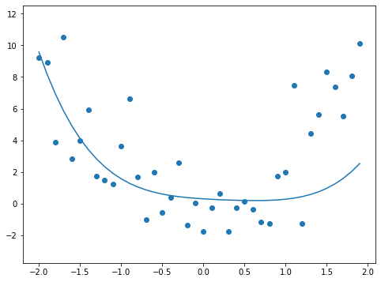
Predicting With Ridge
Training Data
Holdout Data
Degree | Training Error | Holdout Error
1 | 97.4 | 2,148
2 | 89.4 | 89.6
3 | 87 | 14,827
4 | 86.7 | 10,142
Ridge | 92.5 | 312.7

Slide 40
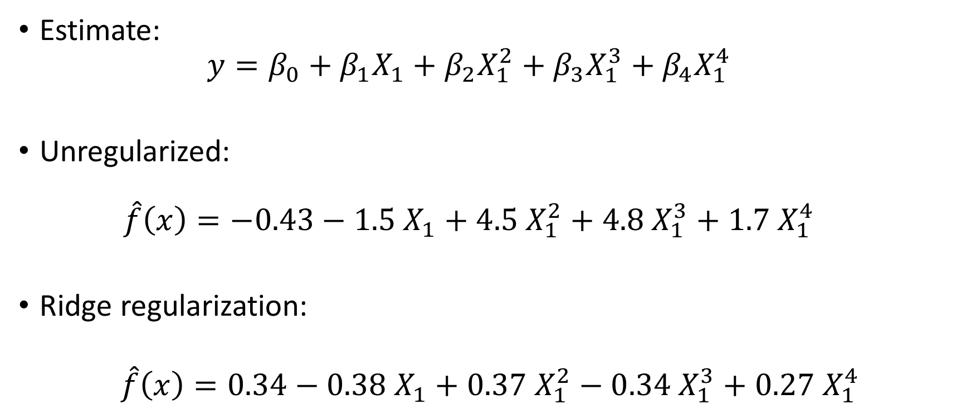
Difference Between
Estimate:
$$y=β_{0}+β_{1}X_{1}+β_{2}X_{1}^{2}+β_{3}X_{1}^{3}+β_{4}X_{1}^{4}$$
Unregularized:
$$\hat{f}\left(x\right)=−0.43−1.5 X_{1}+4.5 X_{1}^{2}+4.8 X_{1}^{3}+1.7 X_{1}^{4}$$
Ridge regularization:
$$\hat{f}\left(x\right)=0.34−0.38 X_{1}+0.37 X_{1}^{2}−0.34 X_{1}^{3}+0.27 X_{1}^{4}$$

Slide 41
Now Let’s Predict With Ridge
Training Data
Holdout Data
Degree | Training Error | Holdout Error
1 | 97.4 | 2,148
2 | 89.4 | 89.6
3 | 87 | 14,827
4 | 86.7 | 10,142
Ridge | 92.5 | 312.7

Slide 42
Bias-Variance Tradeoff

Slide 43
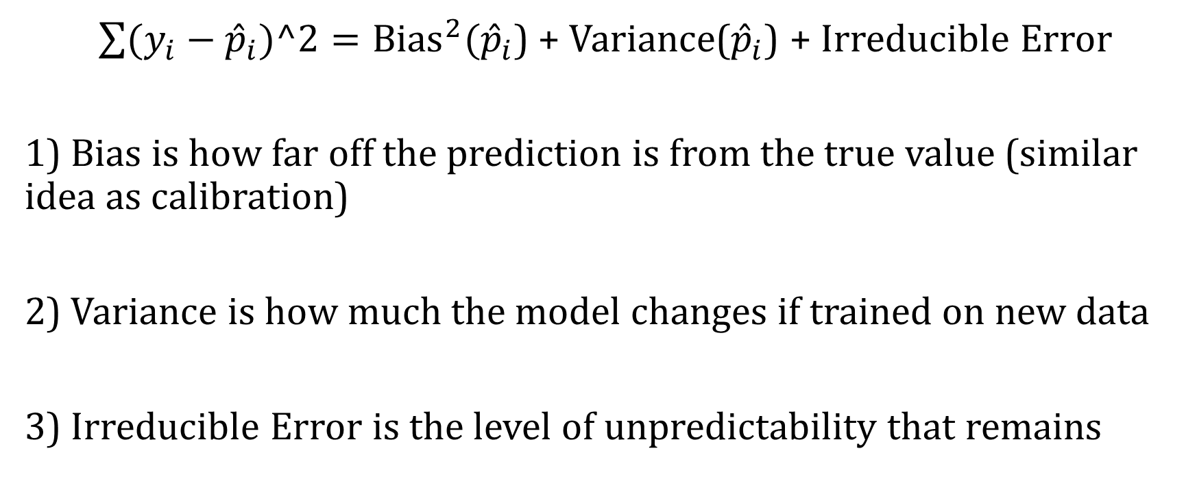
Three Sources of Error on Unseen Data
$\sum{(y_{i}−{\hat{p}}_{i})^2}={Bias}^{2}({\hat{p}}_{i}$) + Variance(${\hat{p}}_{i}$) + Irreducible Error
1) Bias is how far off the prediction is from the true value (similar idea as calibration)
2) Variance is how much the model changes if trained on new data
3) Irreducible Error is the level of unpredictability that remains

Slide 44
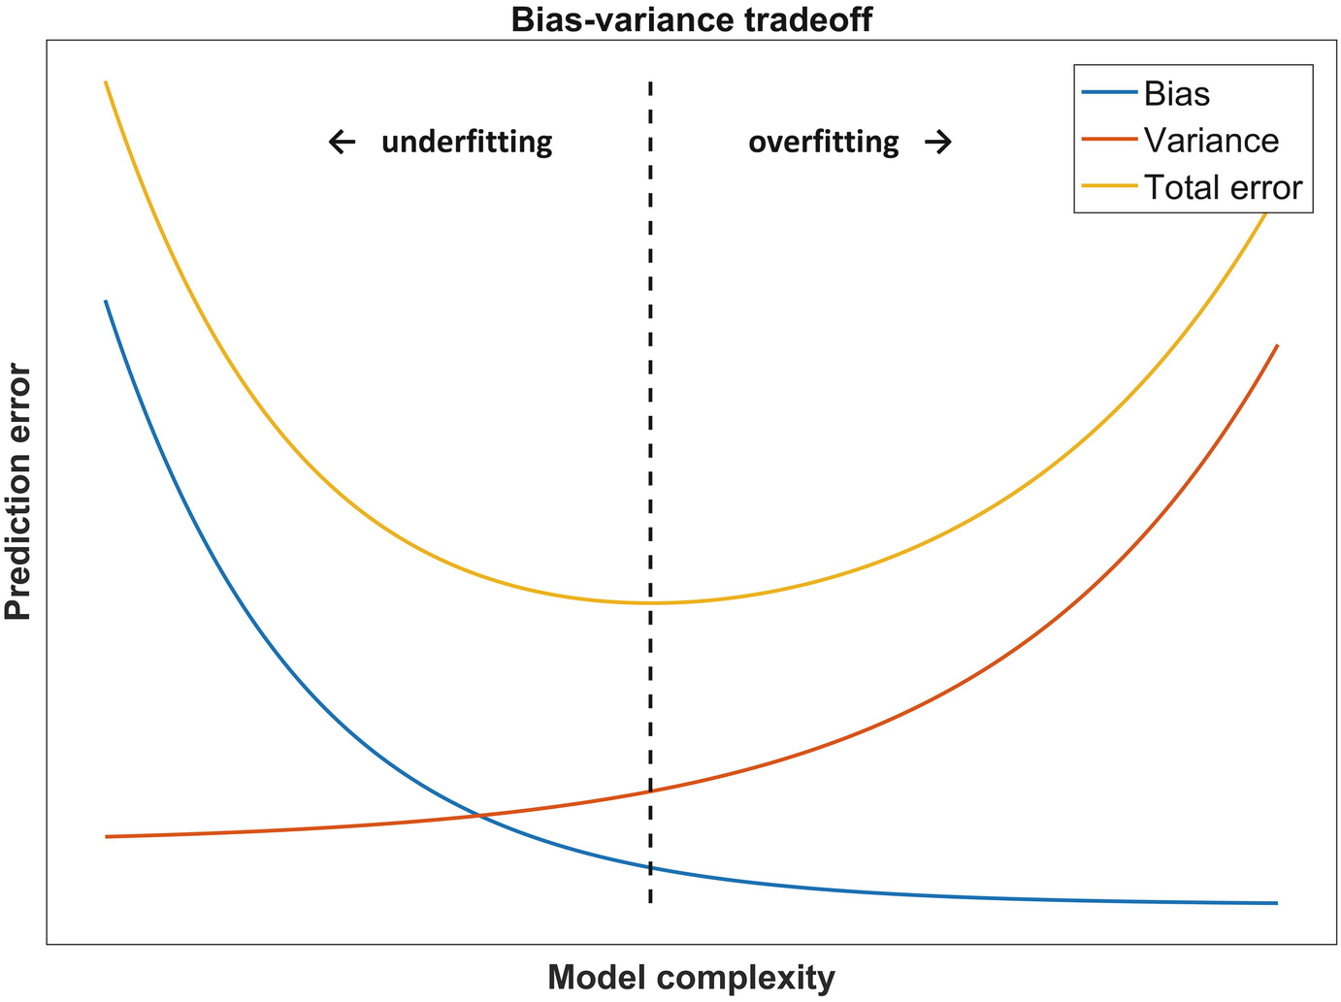

Slide 45
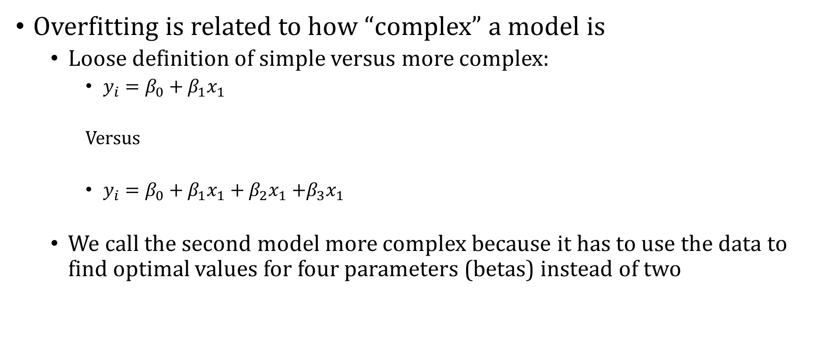
Model Complexity
Overfitting is related to how “complex” a model is
Loose definition of simple versus more complex:
$y_{i}=β_{0}+β_{1}x_{1}$
Versus
$y_{i}=β_{0}+β_{1}x_{1}+β_{2}x_{1}$ $+β_{3}x_{1}$
We call the second model more complex because it has to use the data to find optimal values for four parameters (betas) instead of two

Slide 46
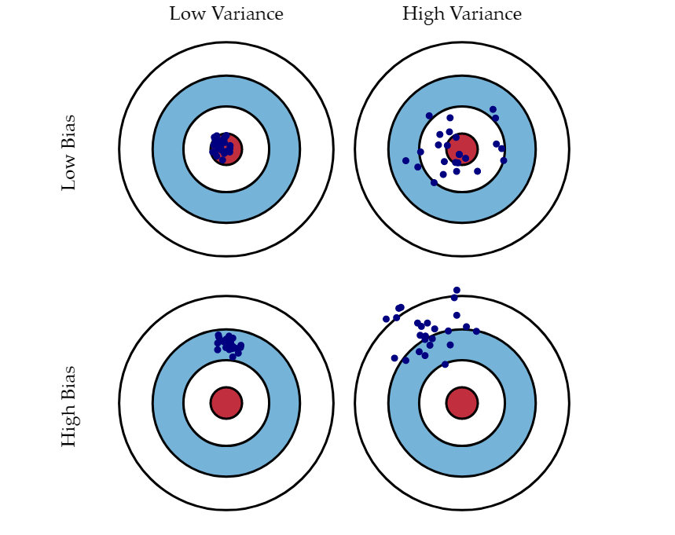
Bias-Variance Tradeoff
Source

Slide 47
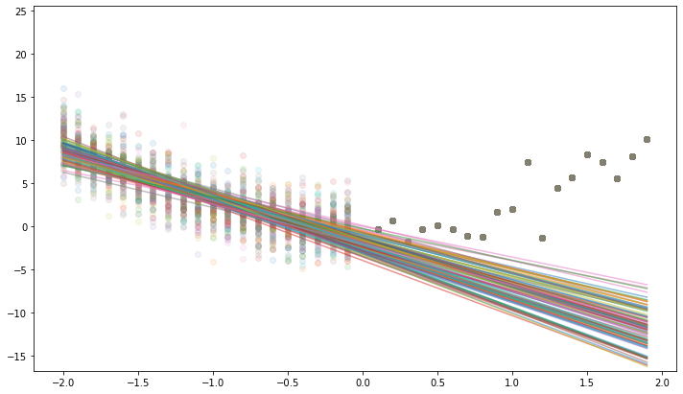
Bias + Variance: 1st Degree Polynomial
We generate data 1,000 times
We run OLS with one predictor on the training data
We predict with each model

Slide 48
Bias + Variance: 1st Degree Polynomial
We see that the predictions are pretty consistent
Low Variance
We see that predictions have a lot of error
High Bias

Slide 49
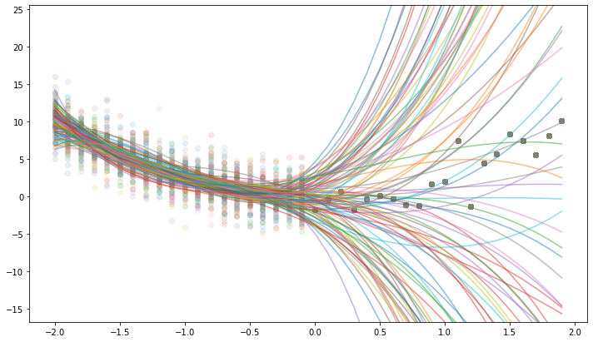
Bias + Variance: 3rd Degree Polynomial
We generate data 1,000 times
We run OLS with three predictors on the training data
We predict with each model

Slide 50
Bias + Variance: 3rd Degree Polynomial
We see that the predictions are all of the place
High Variance
We see that the average of the predictions have low error
Low Bias

Slide 51
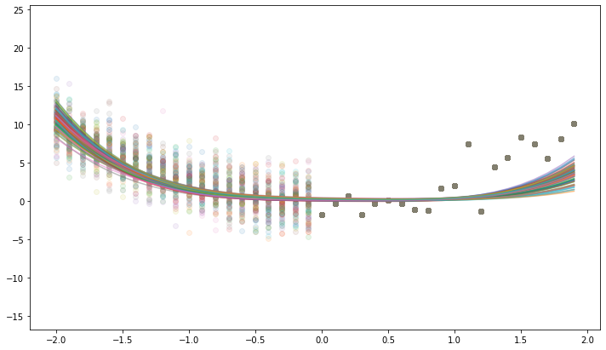
Bias + Variance: Ridge Regression
We generate data 1,000 times
We run Ridge Regression with four predictors on the training data
We predict with each model

Slide 52
Bias + Variance: Ridge Regression
We see that the predictions are pretty consistent
Low Variance
We see that the average of the predictions have low/medium error
Low/Medium Bias

Slide 53
Bias – Variance Tradeoff
Degree | Training Error | Test Error | Bias | Variance
1 | 97.4 | 2,148 | 135 | 2.5
2 | 89.4 | 89.6 | 4.1 | 49.9
3 | 87 | 14,827 | 67.2 | 1060
4 | 86.7 | 10,142 | 52.5 | 33130
Ridge | 92.5 | 312.7 | 19.4 | 0.23

