Slide 1
INST 414: Data Science Techniques
Lecture 6
Regression

Slide 2
Estimating P(Y|X) directly

Slide 3
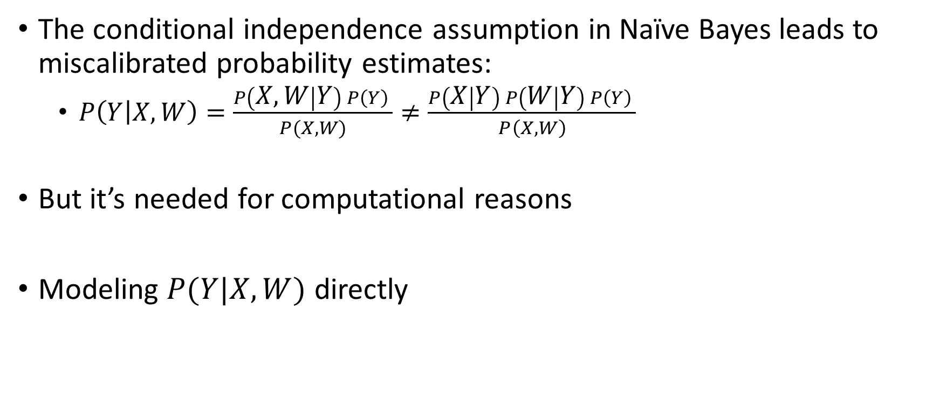
From Naïve Bayes to Regression
The conditional independence assumption in Naïve Bayes leads to miscalibrated probability estimates:
  $P\left(Y | X,W\right)=\frac{P\left(X, W | Y\right) P\left(Y\right) }{P(X,W)}≠\frac{P\left(X | Y\right) P\left(W | Y\right) P\left(Y\right) }{P\left(X,W\right)}$
But it’s needed for computational reasons
Modeling $P(Y|X, W)$ directly

Slide 4
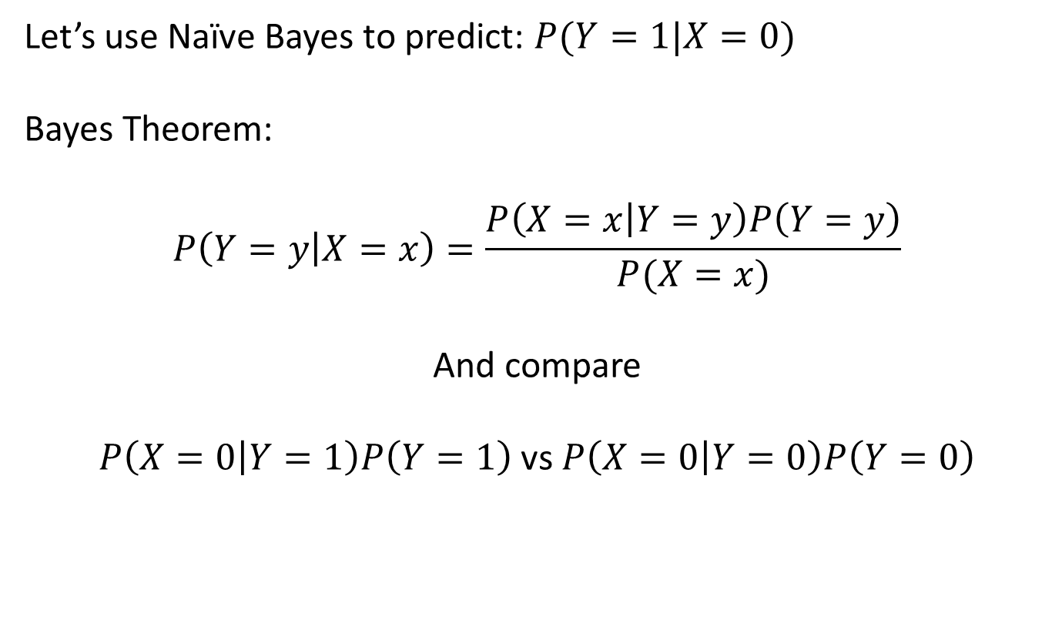
Recapping Naïve Bayes + Miscalibration
Y | X
1 | 1
1 | 0
0 | 0
1 | 1
0 | 0
? | 0
Let’s use Naïve Bayes to predict: $P(Y=1|X=0)$
Bayes Theorem:
$$P\left(Y=y | X=x\right)=\frac{P\left(X=x | Y=y\right)P\left(Y=y\right)}{P(X=x)}$$
And compare
$P\left(X=0 | Y=1\right)P\left(Y=1\right)$ vs $P\left(X=0 | Y=0\right)P\left(Y=0\right)$

Slide 5
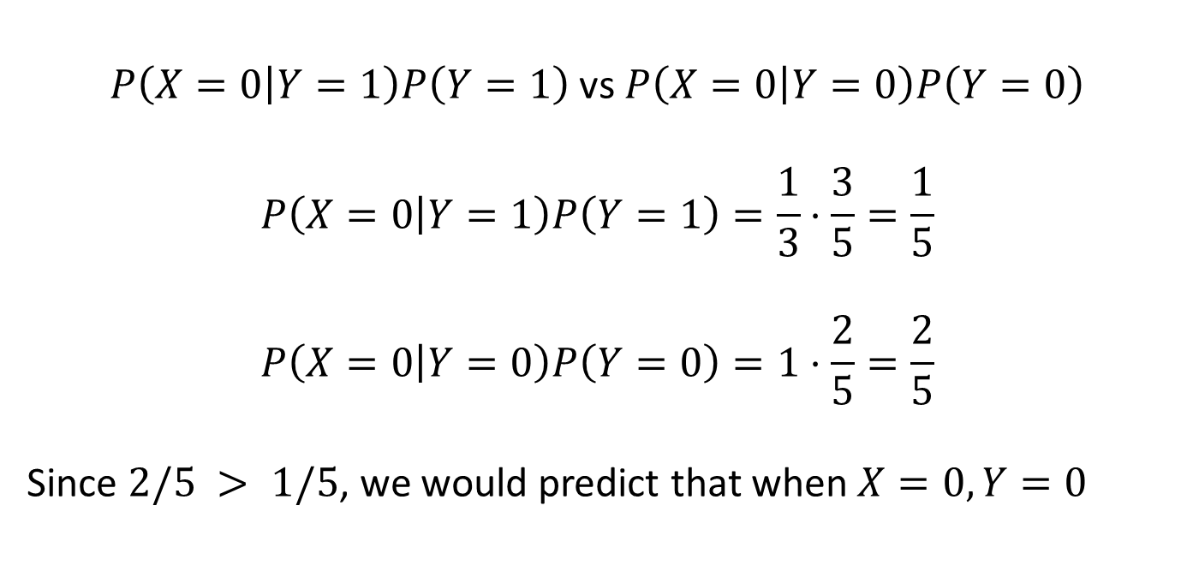
Recapping Naïve Bayes + Miscalibration
Y | X
1 | 1
1 | 0
0 | 0
1 | 1
0 | 0
? | 0
$P\left(X=0 | Y=1\right)P\left(Y=1\right)$ vs $P\left(X=0 | Y=0\right)P\left(Y=0\right)$
$$P\left(X=0 | Y=1\right)P\left(Y=1\right)=\frac{1}{3}⋅\frac{3}{5}=\frac{1}{5}$$
$$P\left(X=0 | Y=0\right)P\left(Y=0\right)=1⋅\frac{2}{5}=\frac{2}{5}$$
Since $2/5 > 1/5$, we would predict that when $X=0, Y=0$

Slide 6
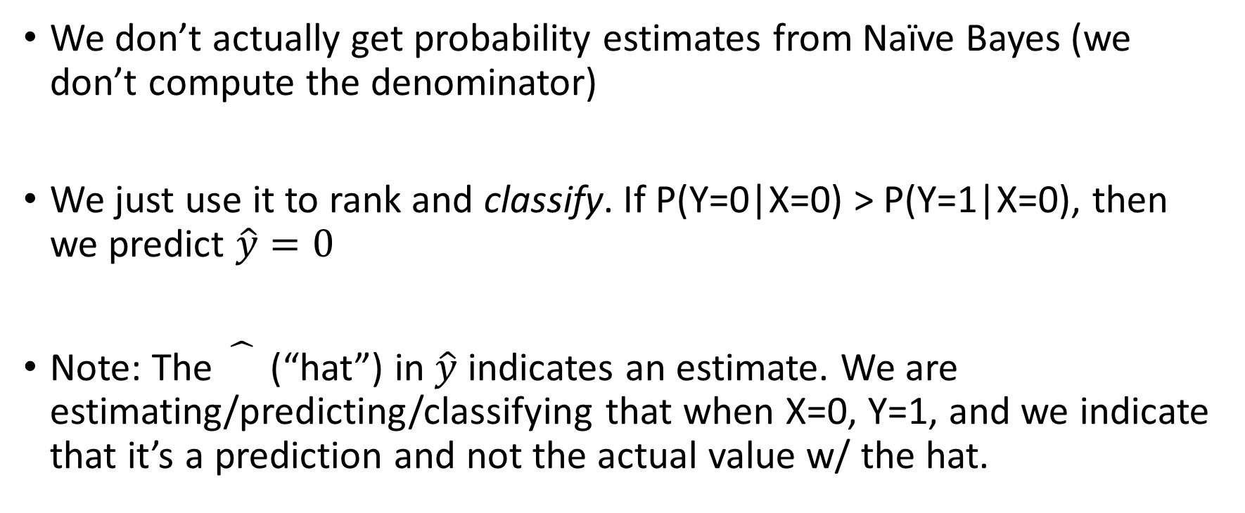
The Utility of Naïve Bayes
We don’t actually get probability estimates from Naïve Bayes (we don’t compute the denominator)
We just use it to rank and classify. If P(Y=0|X=0) > P(Y=1|X=0), then we predict $\hat{y}=0$
Note: The (“hat”) in $\hat{y}$ indicates an estimate. We are estimating/predicting/classifying that when X=0, Y=1, and we indicate that it’s a prediction and not the actual value w/ the hat.

Slide 7
Linear Regression

Slide 8
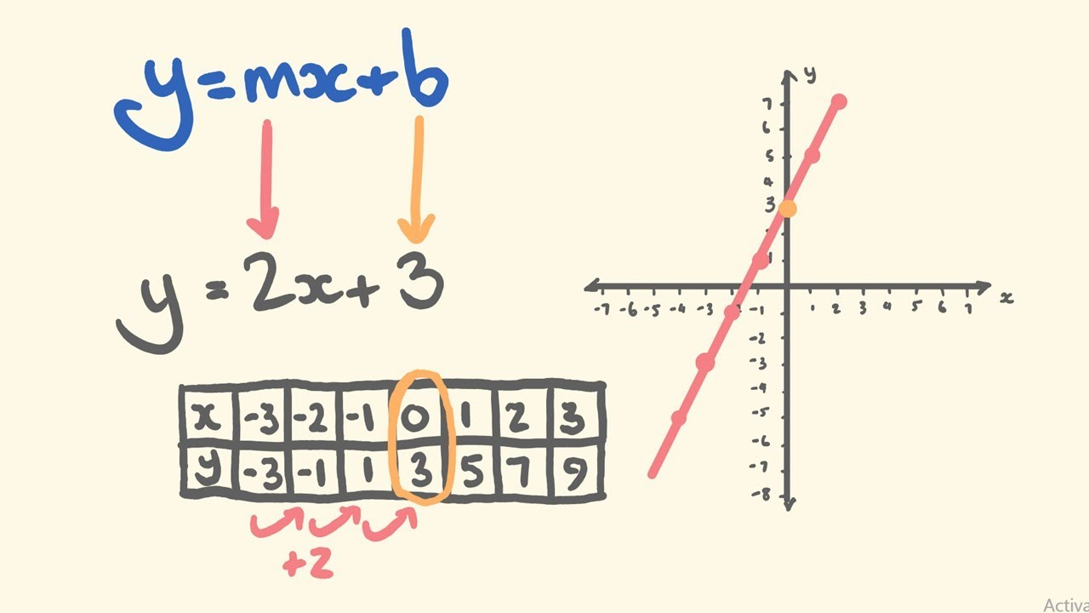

Equation for a Line
$y=mx+b$
  $m$ is the slope
  $b$ is the intercept

Slide 9

Equation for a Line
$y=mx+b$
  $m$ is the slope
  $b$ is the intercept
Alter in two ways
  $y=b+ mx$
  $y=β_{0}+β_{1}x$

Slide 10
What Can We Do With a Line?
We can model relationships between two (or more) variables
Keep in mind the maxim:
  “All models are wrong, but some are useful”
Linear regression is a great illustration

Slide 11
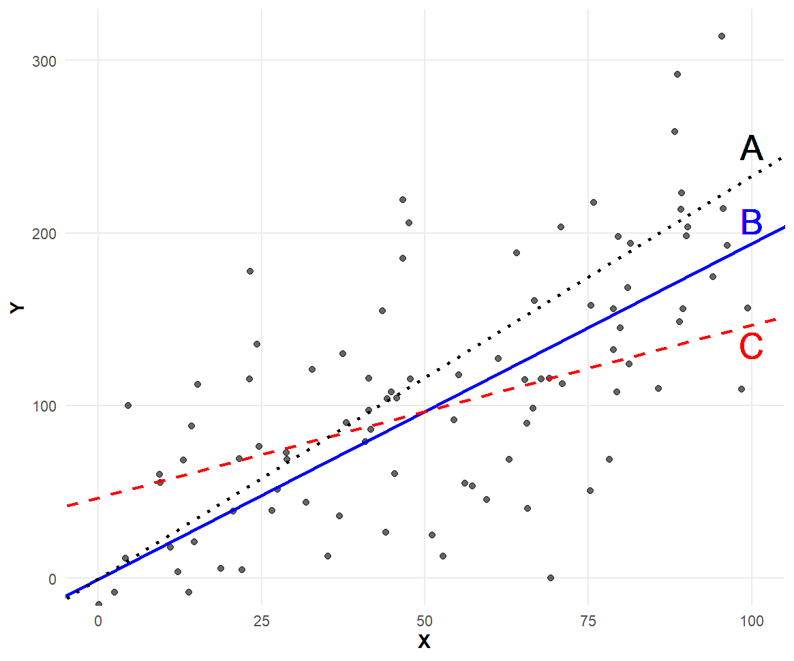

Linear Regression
Intercept
Slope
$Y_{i}=β_{0}+β_{1}x_{i }$
Goal:
  Fit the above
  equation to the data
What should criteria be?

Slide 12
What’s our objective?
Three hypothetical lines
Which one fits data best?
What do you like about it?

Slide 13
What’s our objective?
What do you like about it?
Two potential objectives
  The vertical distance
  between the line and the points
  is smallest
  The perpendicular distance
  is smallest

Slide 14
What’s our objective?
What do you like about it?
Two potential objectives
  The vertical distance
  between the line and the points
  is smallest
  The perpendicular distance
  is smallest

Slide 15
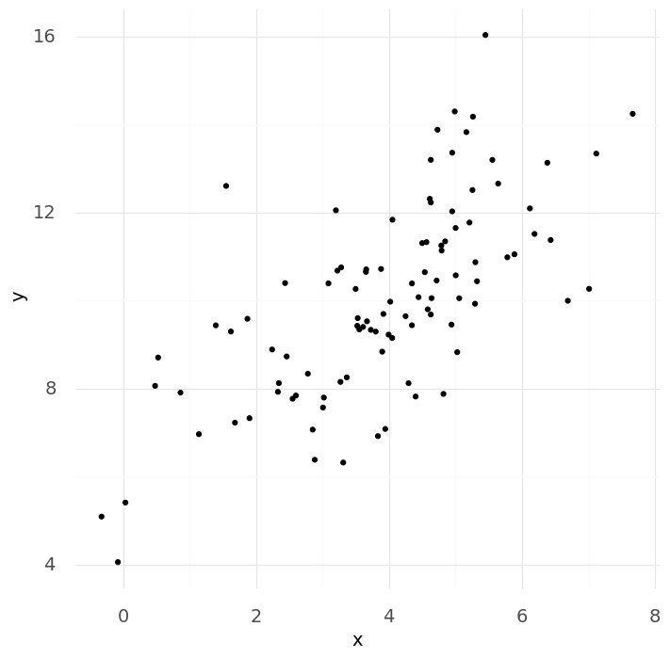
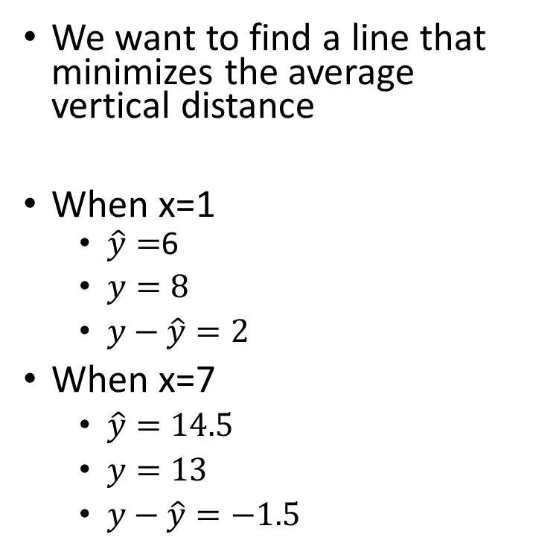
Objective: Target Vertical distance
We want to find a line that minimizes the average vertical distance
When x=1
  $\hat{y}=$6
  $y=8$
  $y−\hat{y}=2$
When x=7
  $\hat{y}=14.5$
  $y=13$
  $y−\hat{y}=−1.5$

Slide 16
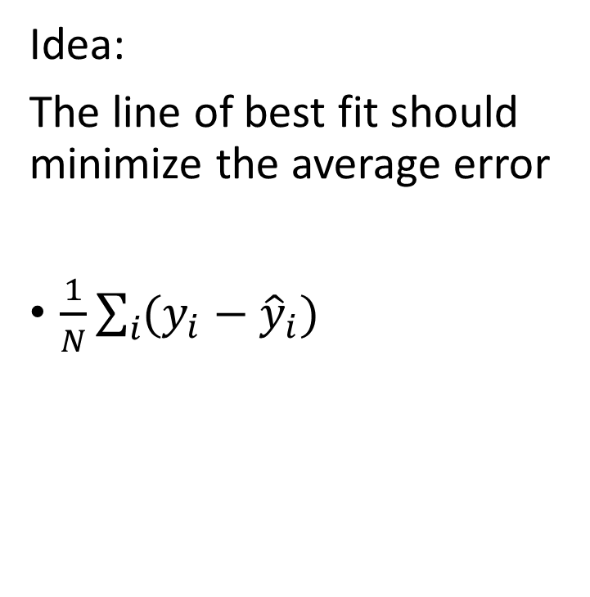
Objective: Target Vertical distance
Idea:
The line of best fit should minimize the average error
$\frac{1}{N}\sum_{i}{(y_{i}−{\hat{y}}_{i}) }$

Slide 17
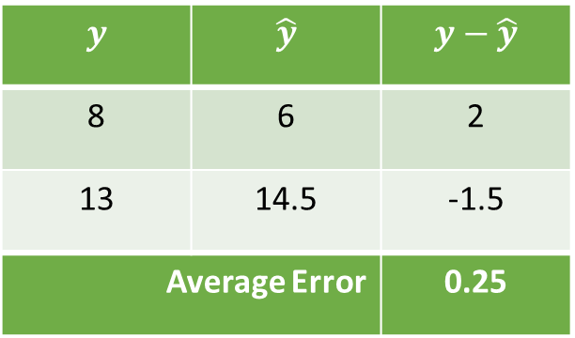
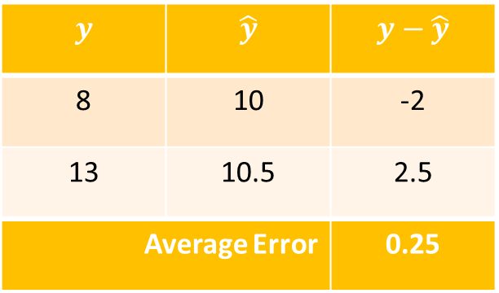
Objective: Target Vertical distance
$$y$$ | $$\hat{y}$$ | $$y−\hat{y}$$
8 | 6 | 2
13 | 14.5 | -1.5
Average Error |  | 0.25
$$y$$ | $$\hat{y}$$ | $$y−\hat{y}$$
8 | 10 | -2
13 | 10.5 | 2.5
Average Error |  | 0.25

Slide 18
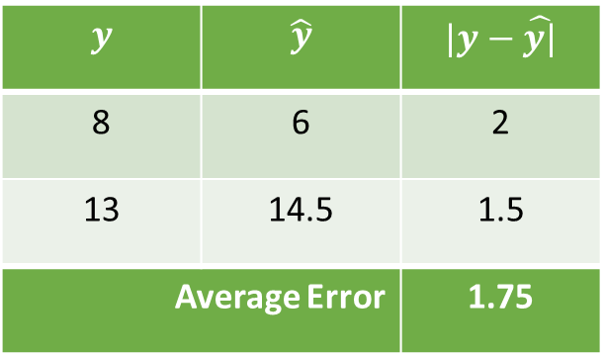
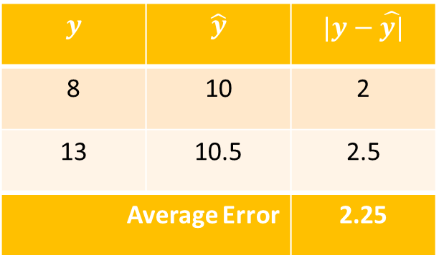
Objective: Target Vertical distance
$$y$$ | $$\hat{y}$$ | $$|y−\hat{y|}$$
8 | 6 | 2
13 | 14.5 | 1.5
Average Error |  | 1.75
$$y$$ | $$\hat{y}$$ | $$|y−\hat{y|}$$
8 | 10 | 2
13 | 10.5 | 2.5
Average Error |  | 2.25

Slide 19
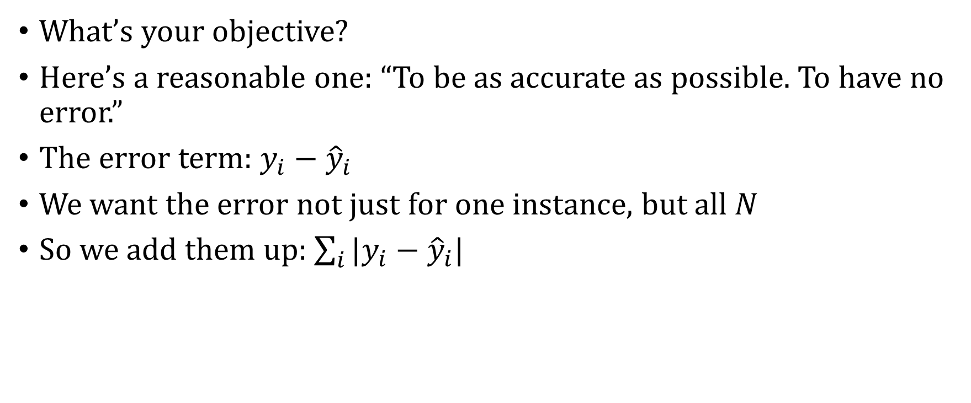
Recap: Objective Function
What’s your objective?
Here’s a reasonable one: “To be as accurate as possible. To have no error.”
The error term: $y_{i}−{\hat{y}}_{i}$
We want the error not just for one instance, but all $N$
So we add them up: $\sum_{i}{|y_{i}−{\hat{y}}_{i}|}$

Slide 20
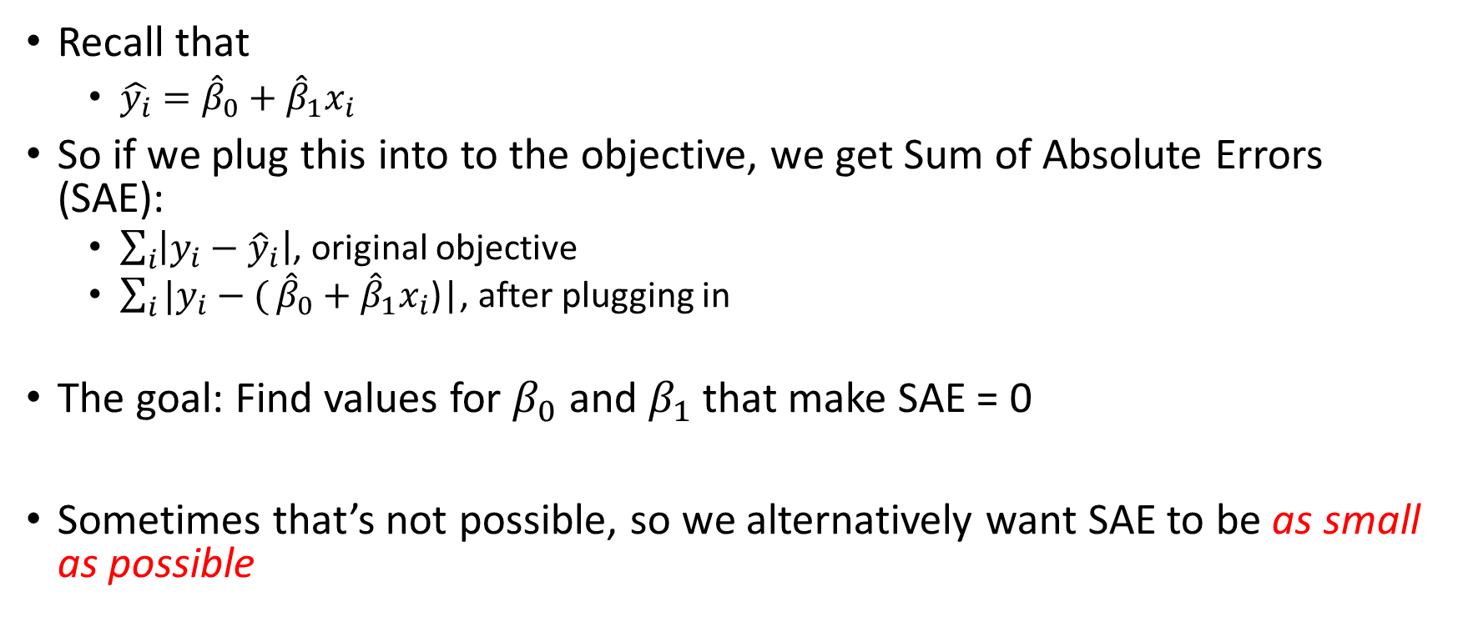

But How Do We Get the ${\hat{y}}_{i}$?
Recall that
  $\hat{y_{i}}={\hat{β}}_{0}+{\hat{β}}_{1}x_{i}$
So if we plug this into to the objective, we get Sum of Absolute Errors (SAE):
  $\sum_{i}{\left|y_{i}−{\hat{y}}_{i}\right|}$, original objective
  $\sum_{i}{|y_{i}−(}{\hat{β}}_{0}+{\hat{β}}_{1}x_{i}$)|, after plugging in
The goal: Find values for $β_{0}$ and $β_{1}$ that make SAE = 0
Sometimes that’s not possible, so we alternatively want SAE to be as small as possible

Slide 21
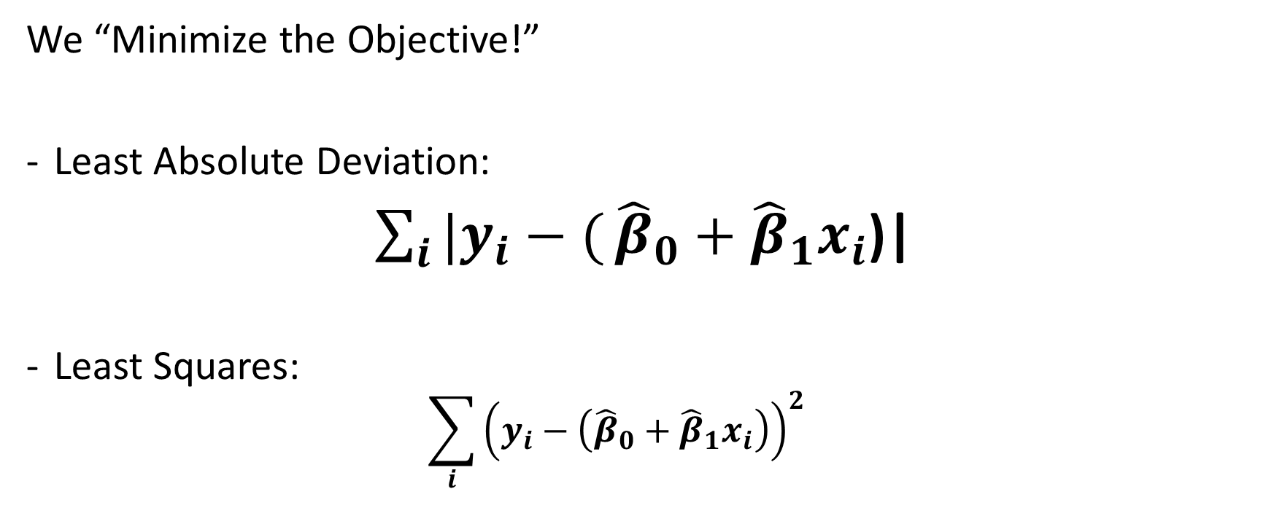

But How Do We Get ${\hat{β}}_{0}$and ${\hat{β}}_{1}$?
We “Minimize the Objective!”
Least Absolute Deviation:
$\sum_{i}{|y_{i}−(}{\hat{β}}_{0}+{\hat{β}}_{1}x_{i}$)|
Least Squares:
  $$\sum_{i}{{\left(y_{i}−\left({\hat{β}}_{0}+{\hat{β}}_{1}x_{i}\right)\right)}^{2}}$$

Slide 22
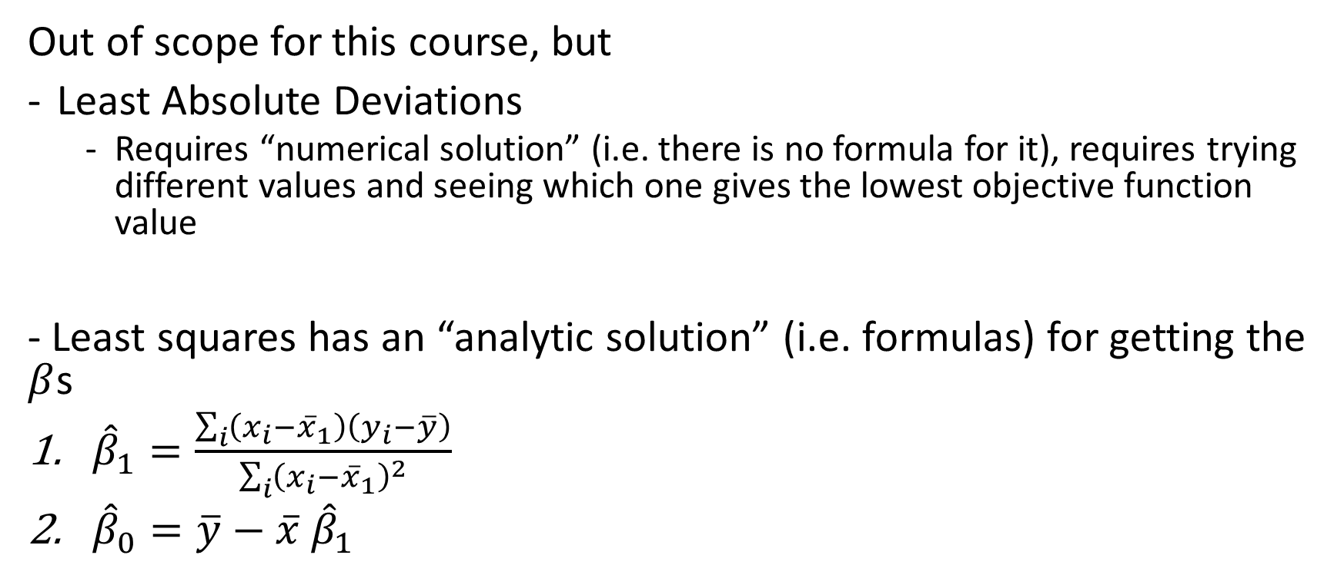
Minimizing the Objective
Out of scope for this course, but
Least Absolute Deviations
  Requires “numerical solution” (i.e. there is no formula for it), requires trying different values and seeing which one gives the lowest objective function value
- Least squares has an “analytic solution” (i.e. formulas) for getting the $β$s
${\hat{β}}_{1}=\frac{\sum_{i}{\left(x_{i}−{\overline{x}}_{1}\right)\left(y_{i}−\overline{y}\right)}}{\sum_{i}{{\left(x_{i}−{\overline{x}}_{1}\right)}^{2}}}$
${\hat{β}}_{0}=\overline{y}−\overline{x} {\hat{β}}_{1}$

Slide 23
Modeling P(Y|X) Directly

Slide 24




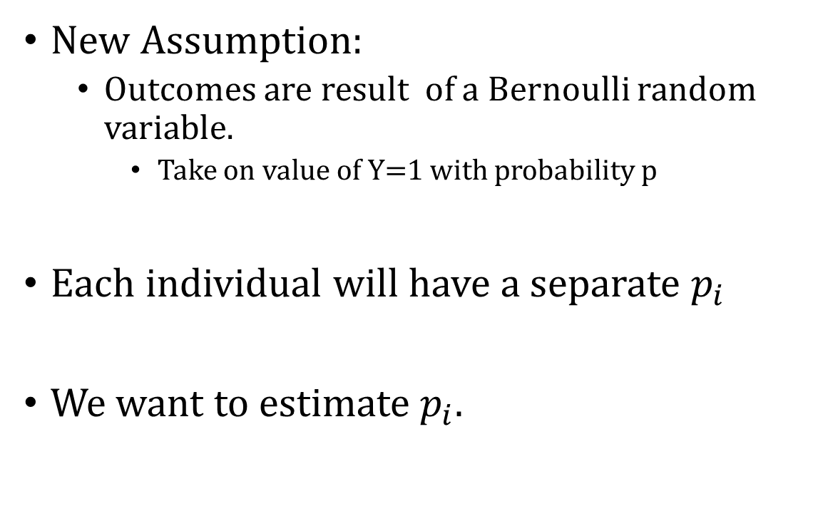


Modeling Conditional Probabilities Directly
New Assumption:
  Outcomes are result of a Bernoulli random variable.
    Take on value of Y=1 with probability p
Each individual will have a separate $p_{i}$
We want to estimate $p_{i}.$
$$p_{1}$$
$$p_{2}$$
$$p_{3}$$
$$p_{4}$$

Slide 25
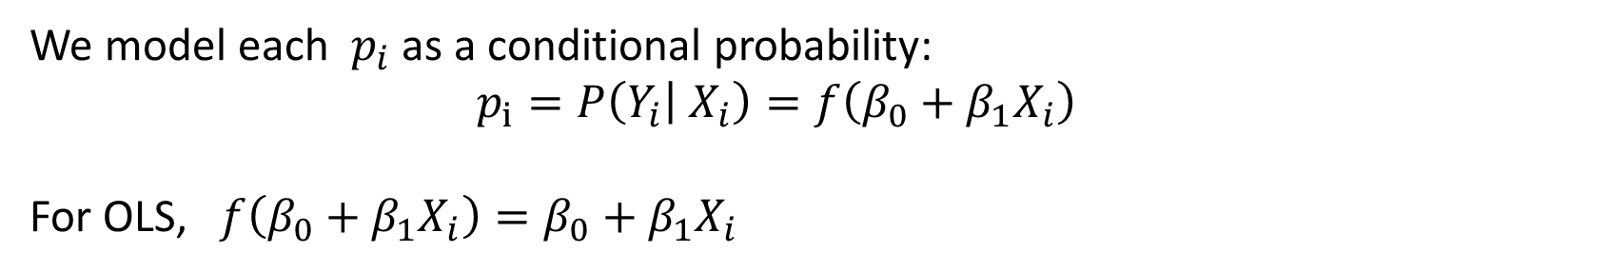
Individual Outcomes Are “Modeled” as the Outcome of a Coin Toss
We model each $p_{i}$ as a conditional probability:
  $$p_{i}=P\left(Y_{i} | X_{i}\right)=f\left(β_{0}+β_{1}X_{i}\right)$$
For OLS, $f\left(β_{0}+β_{1}X_{i}\right)=β_{0}+β_{1}X_{i}$

Slide 26
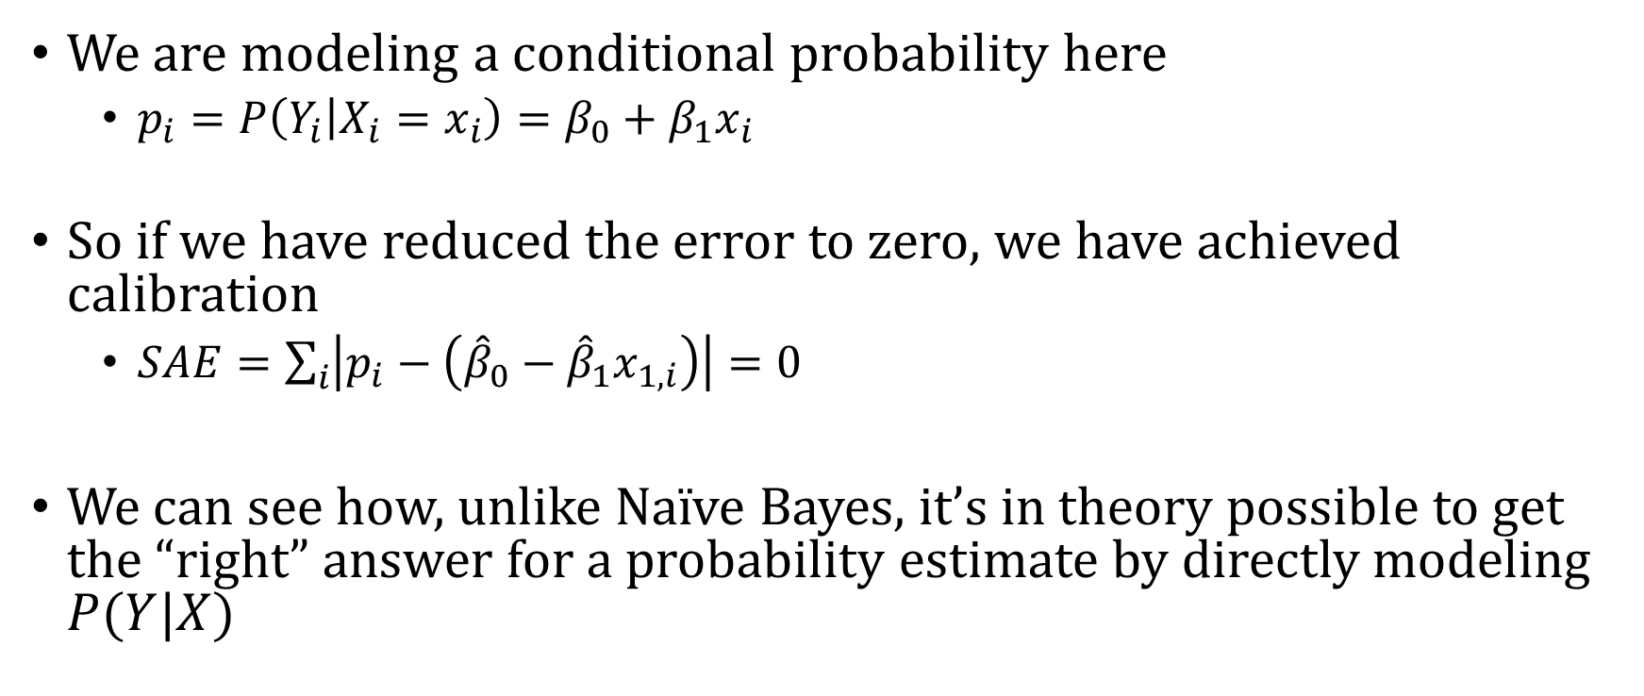
So What?
We are modeling a conditional probability here
  $p_{i}=P\left(Y_{i} | X_{i}=x_{i}\right)=β_{0}+β_{1}x_{i}$
So if we have reduced the error to zero, we have achieved calibration
  $SAE=\sum_{i}{\left|p_{i}−\left({\hat{β}}_{0}−{\hat{β}}_{1}x_{1,i}\right)\right|=0}$
We can see how, unlike Naïve Bayes, it’s in theory possible to get the “right” answer for a probability estimate by directly modeling $P(Y|X)$

Slide 27
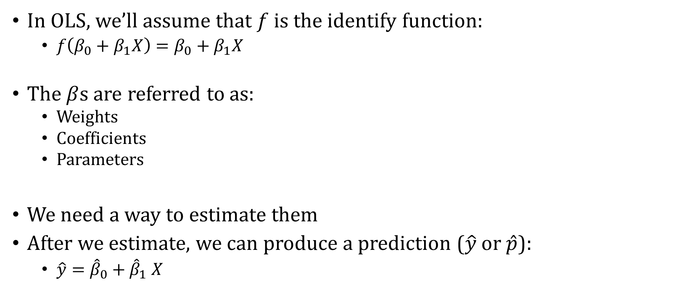
Ordinary Least Squares (OLS) Regression
In OLS, we’ll assume that $f$ is the identify function:
  $f\left(β_{0}+β_{1}X\right)=β_{0}+β_{1}X$
The $β$s are referred to as:
  Weights
  Coefficients
  Parameters
We need a way to estimate them
After we estimate, we can produce a prediction ($\hat{y}$ or $\hat{p}$):
  $\hat{y}={\hat{β}}_{0}+{\hat{β}}_{1} X$

Slide 28
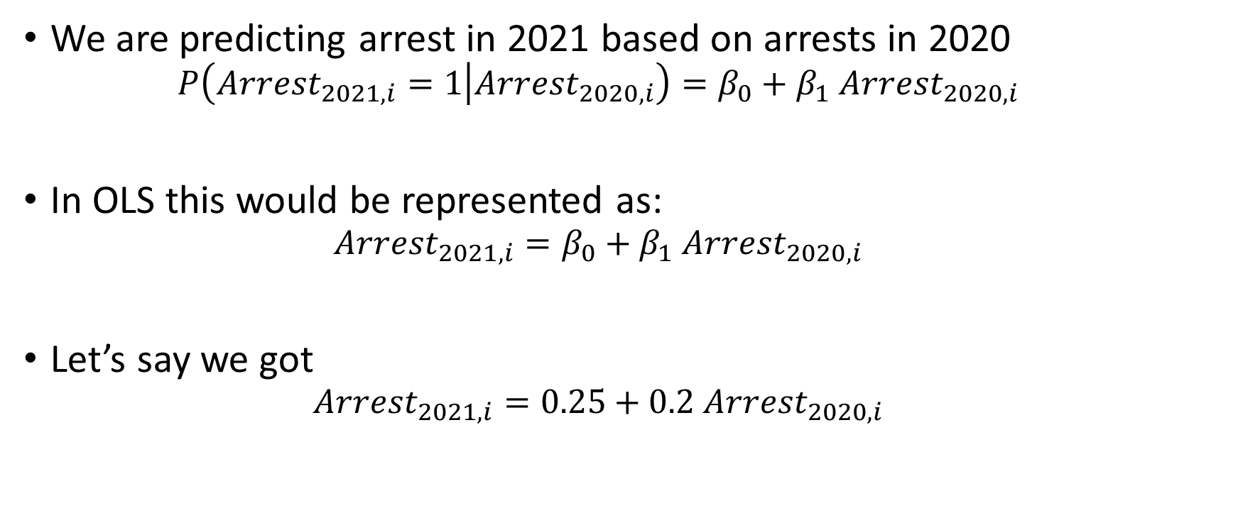
Interpretation
We are predicting arrest in 2021 based on arrests in 2020
  $$P\left(Arrest_{2021,i}=1 | Arrest_{2020,i}\right)=β_{0}+β_{1} Arrest_{2020,i}$$
In OLS this would be represented as:
  $$Arrest_{2021,i}=β_{0}+β_{1} Arrest_{2020,i}$$
Let’s say we got
  $$Arrest_{2021,i}=0.25+0.2 Arrest_{2020,i}$$

Slide 29
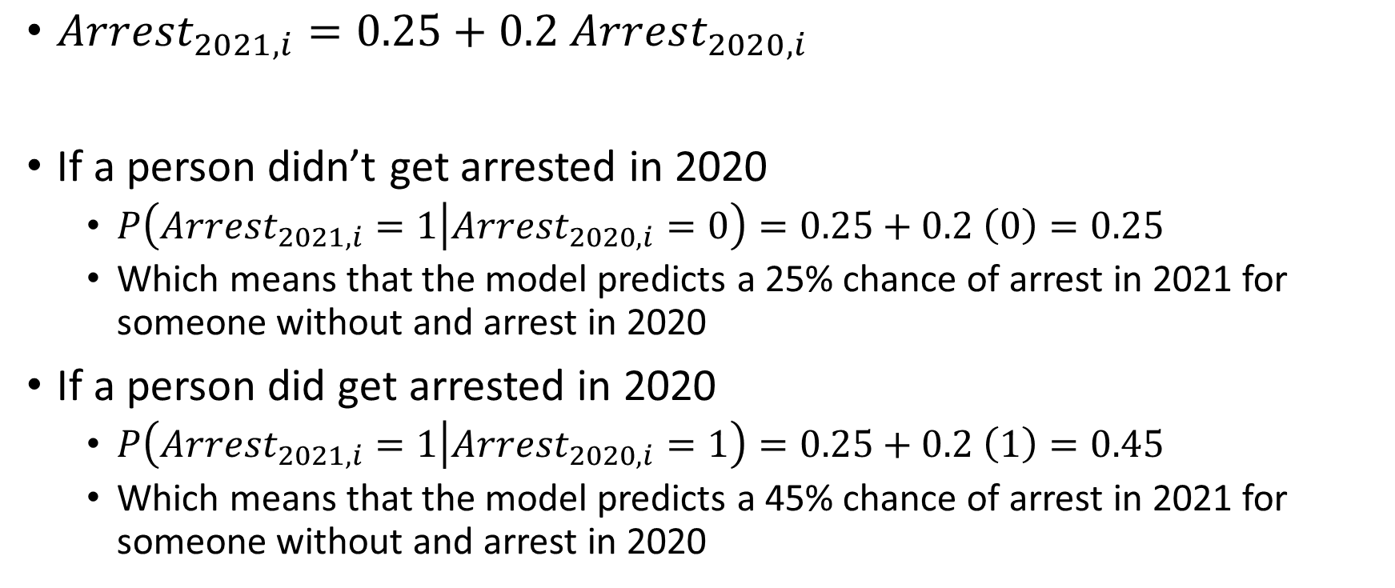
Interpretation
$Arrest_{2021,i}=0.25+0.2 Arrest_{2020,i}$
If a person didn’t get arrested in 2020
  $P\left(Arrest_{2021,i}=1 | Arrest_{2020,i}=0\right)=0.25+0.2 \left(0\right)=0.25$
  Which means that the model predicts a 25% chance of arrest in 2021 for someone without and arrest in 2020
If a person did get arrested in 2020
  $P\left(Arrest_{2021,i}=1 | Arrest_{2020,i}=1\right)=0.25+0.2 \left(1\right)=0.45$
  Which means that the model predicts a 45% chance of arrest in 2021 for someone without and arrest in 2020

Slide 30
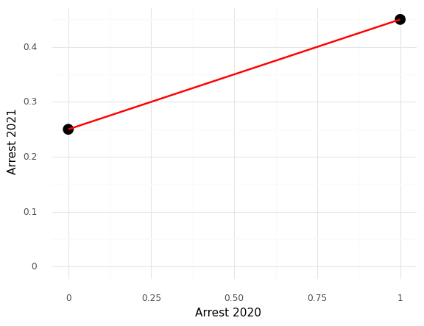
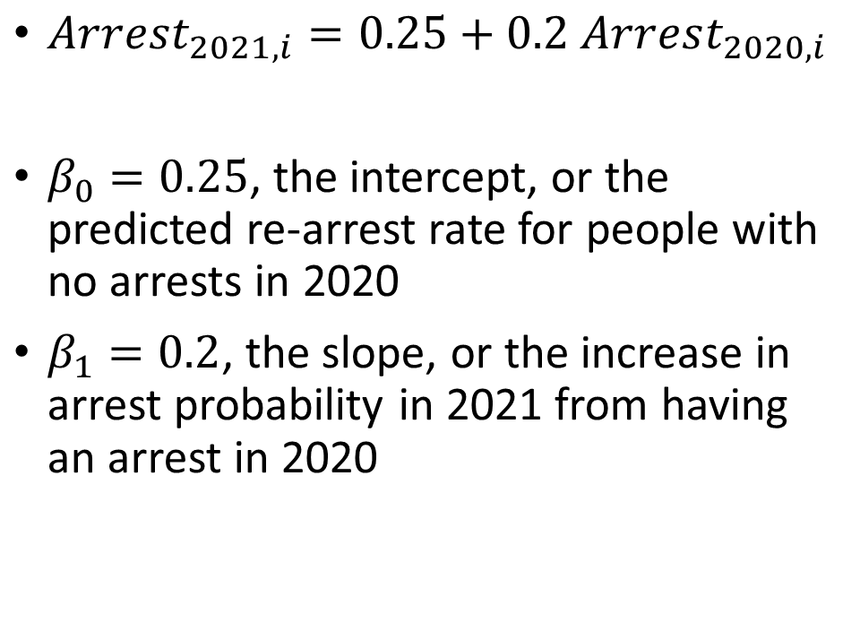
Interpretation
$Arrest_{2021,i}=0.25+0.2 Arrest_{2020,i}$
$β_{0}=0.25$, the intercept, or the predicted re-arrest rate for people with no arrests in 2020
$β_{1}=0.2$, the slope, or the increase in arrest probability in 2021 from having an arrest in 2020

Slide 31
Recap

Slide 32
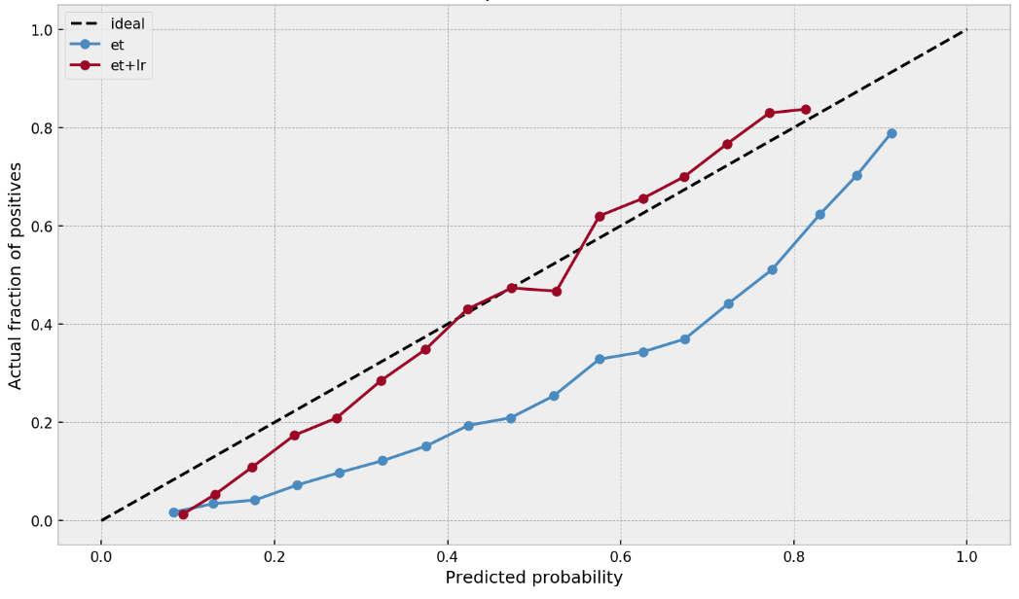
We want calibrated probabilities
This is called a calibration plot or a “reliability curve”
Steps:
  Split predicted probabilities into N-bins of equal size (each bin has same number of data points)
  For each bin, compute average of predicted probabilities and average of actual outcomes
X-axis: Average of predicted probabilities
Y-axis: Average of actual outcomes
If calibrated, the resulting line connecting the points should fall close to the “45-degree” line

Slide 33
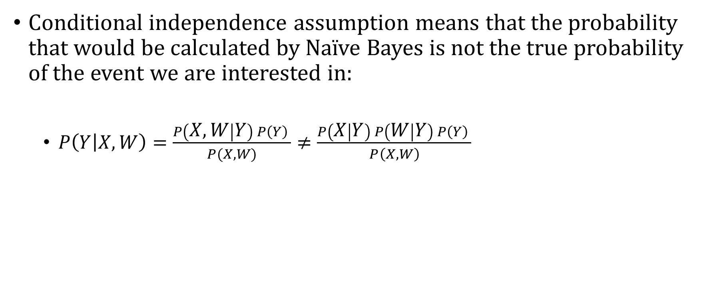
Naïve Bayes Doesn’t Achieve Calibration
Conditional independence assumption means that the probability that would be calculated by Naïve Bayes is not the true probability of the event we are interested in:
  $P\left(Y | X,W\right)=\frac{P\left(X, W | Y\right) P\left(Y\right) }{P(X,W)}≠\frac{P\left(X | Y\right) P\left(W | Y\right) P\left(Y\right) }{P\left(X,W\right)}$

Slide 34
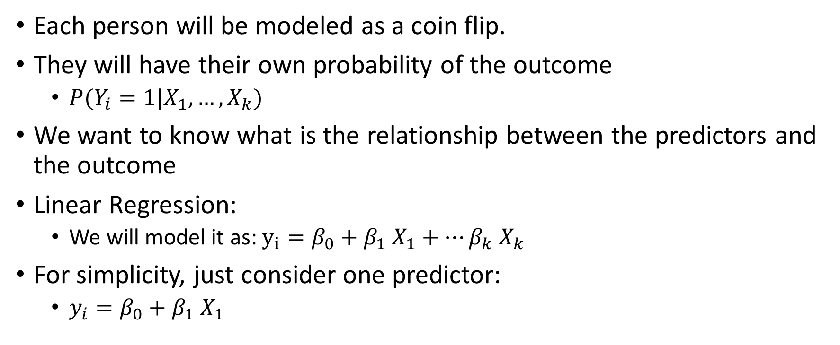
Another approach
Each person will be modeled as a coin flip.
They will have their own probability of the outcome
  $P(Y_{i}=1|X_{1},…,X_{k})$
We want to know what is the relationship between the predictors and the outcome
Linear Regression:
  We will model it as: $y_{i}=β_{0}+β_{1} X_{1}+…β_{k} X_{k}$
For simplicity, just consider one predictor:
  $y_{i}=β_{0}+β_{1} X_{1}$

Slide 35
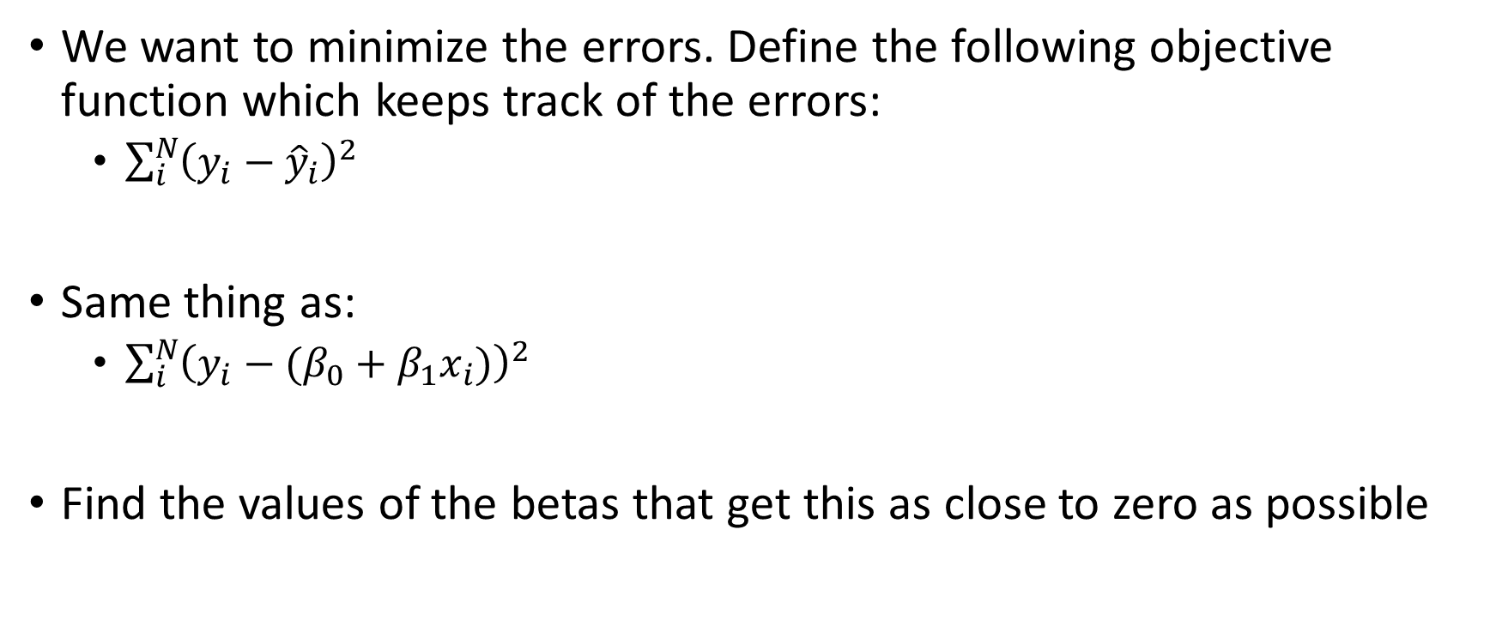

How Do We Find $β_{0}$ and $β_{1}$?
We want to minimize the errors. Define the following objective function which keeps track of the errors:
  $\sum_{i}^{N}{{\left(y_{i}−{\hat{y}}_{i}\right)}^{2}}$
Same thing as:
  $\sum_{i}^{N}{{\left(y_{i}−(β_{0}+β_{1}x_{i})\right)}^{2}}$
Find the values of the betas that get this as close to zero as possible

Slide 36
Interpretation
$Arrest_{2021,i}=0.25+0.2 Arrest_{2020,i}$
$β_{0}=0.25$, the intercept, or the predicted re-arrest rate for people with no arrests in 2020
$β_{1}=0.2$, the slope, or the increase in arrest probability in 2021 from having an arrest in 2020

Slide 37
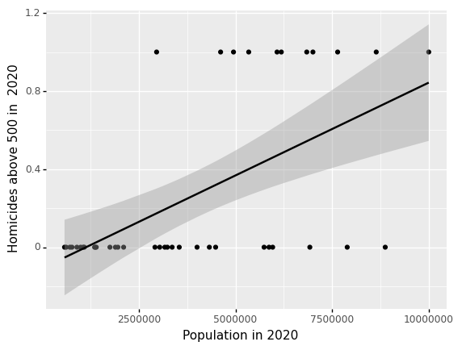
Shortcoming of Linear Probability Model
Plot shows relationship b/w state-level population in 2020 versus if there were more than 500 homicides.
What is the P(Y|Population<1million)?
Less than zero

Slide 38
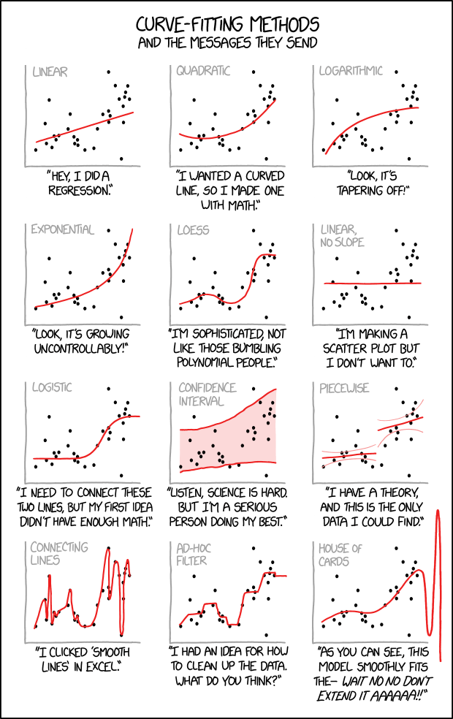
Logistic Regression

Slide 39
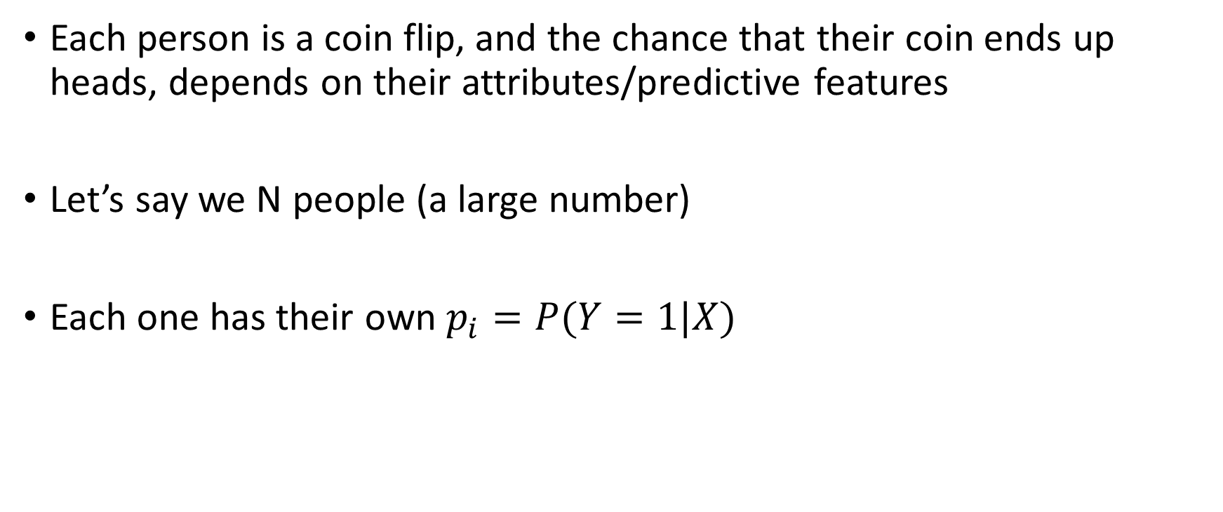
Same starting assumption as linear regression
Each person is a coin flip, and the chance that their coin ends up heads, depends on their attributes/predictive features
Let’s say we N people (a large number)
Each one has their own $p_{i}=P(Y=1|X)$

Slide 40
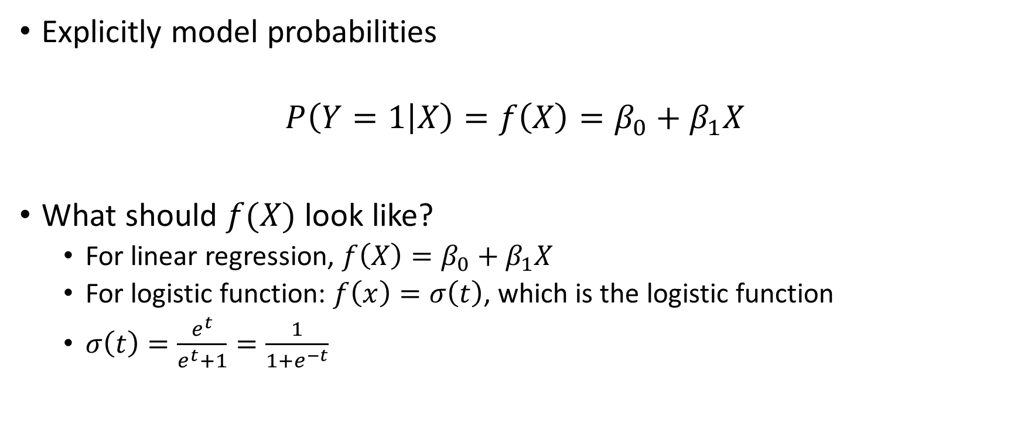
Linear Regression
Explicitly model probabilities
$$P\left(Y=1 | X\right)=f\left(X\right)=β_{0}+β_{1}X$$
What should $f(X)$ look like?
  For linear regression, $f\left(X\right)=β_{0}+β_{1}X$
  For logistic function: $f\left(x\right)=σ\left(t\right)$, which is the logistic function
  $σ\left(t\right)=\frac{e^{t}}{e^{t}+1}=\frac{1}{1+e^{−t}}$

Slide 41
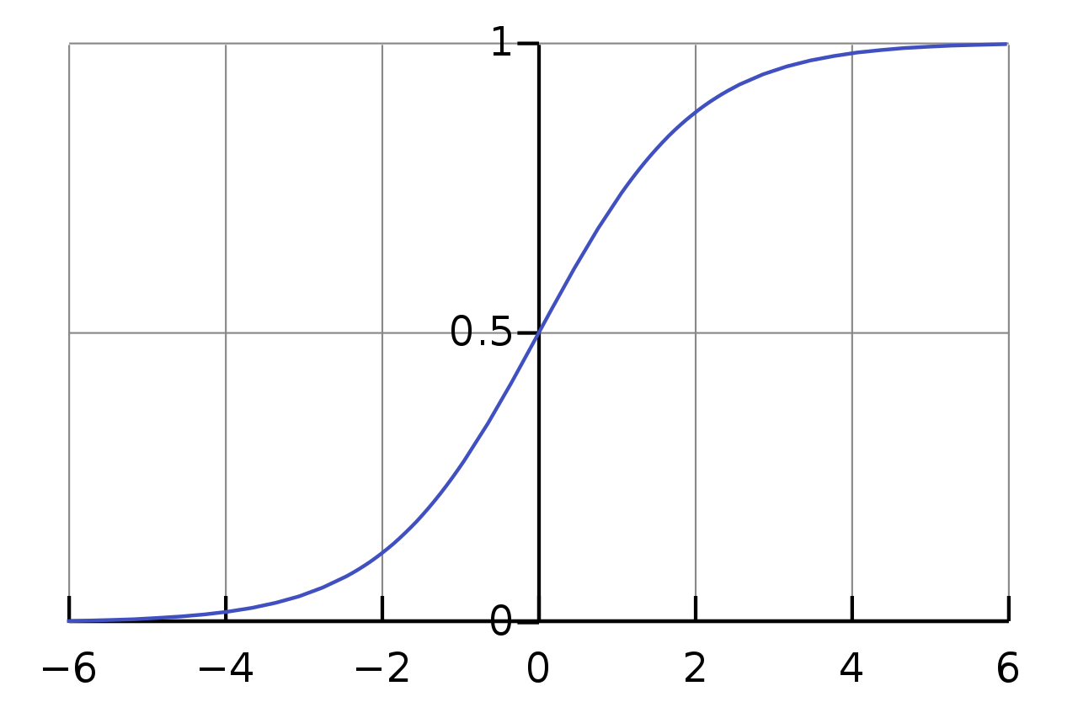
Logistic function
Compare to linear relationship
At intermediate values, when we move in the X-direction, the predicted probability has bigger changes
At extreme values on the X-axis, when we move in the X-direction, the predicted probability has smaller changes

Slide 42
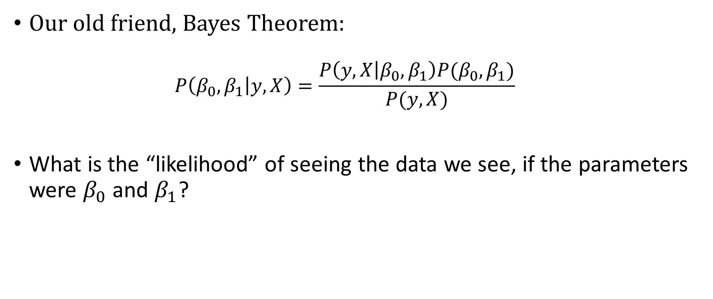
Likelihood function
Our old friend, Bayes Theorem:
  $$P\left(β_{0},β_{1} | y, X\right)=\frac{P\left(y,X | β_{0},β_{1}\right)P(β_{0},β_{1})}{P(y, X)}$$
What is the “likelihood” of seeing the data we see, if the parameters were $β_{0}$ and $β_{1}$?

Slide 43
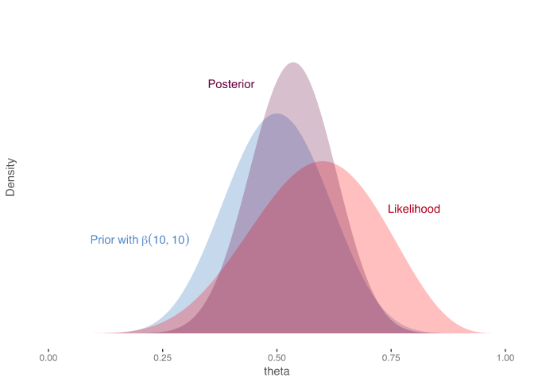

Likelihood Visualized
Posterior (After)
Prior (Before)
Likelihood
$$P\left(β_{0},β_{1} | y, X\right)=\frac{P\left(y,X | β_{0},β_{1}\right)P(β_{0},β_{1})}{P(y, X)}$$

Slide 44
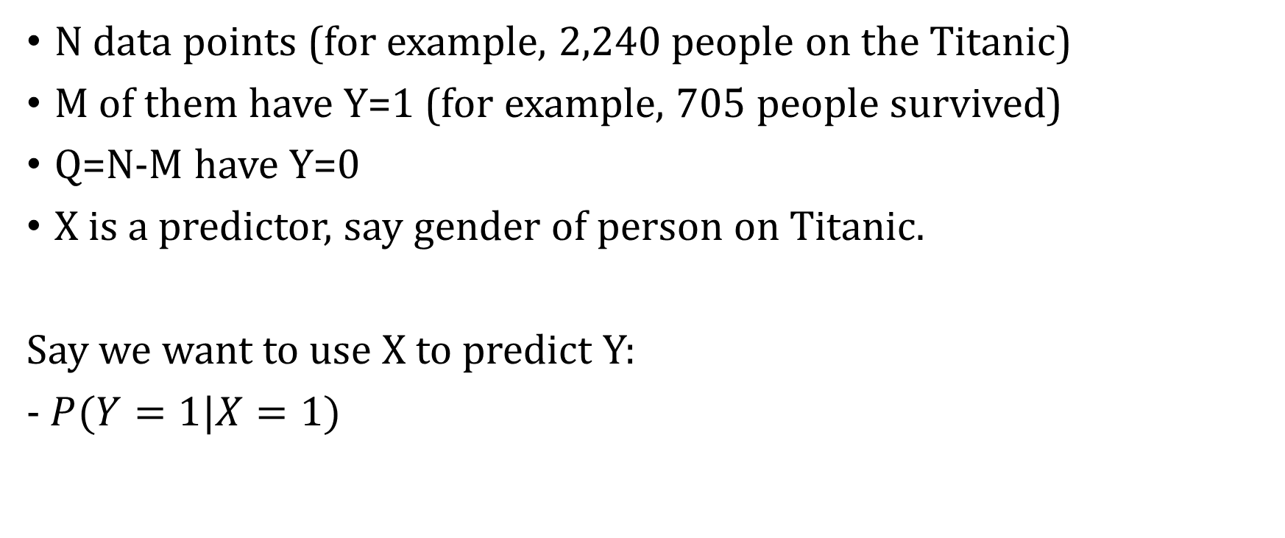
Likelihood for a binary outcome
N data points (for example, 2,240 people on the Titanic)
M of them have Y=1 (for example, 705 people survived)
Q=N-M have Y=0
X is a predictor, say gender of person on Titanic.
Say we want to use X to predict Y:
- $P(Y=1|X=1)$

Slide 45
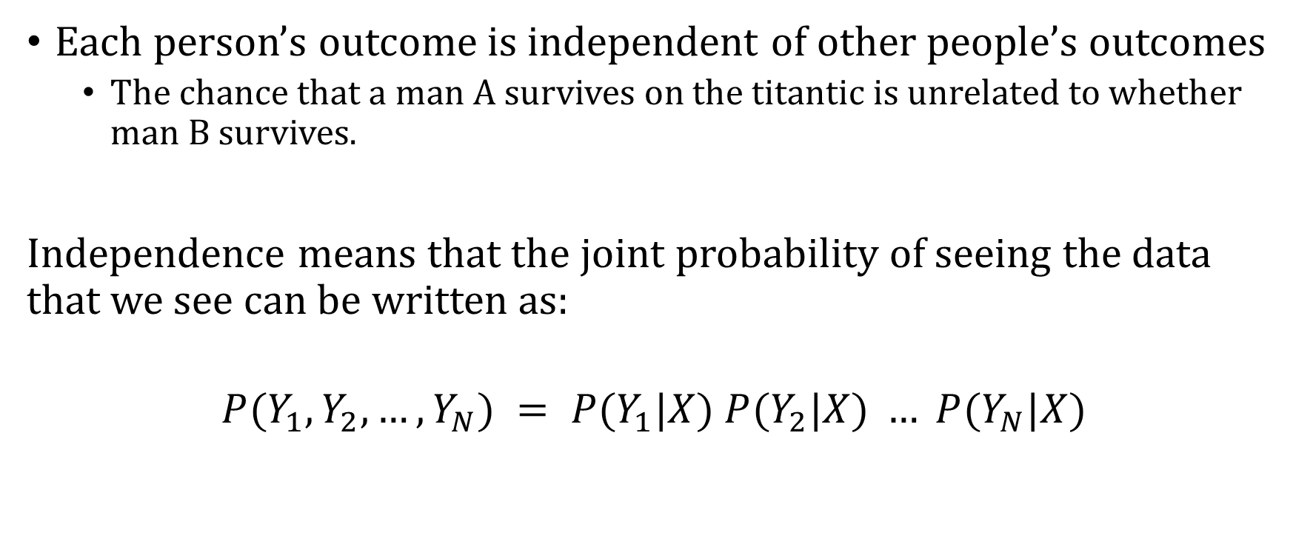
Assume Independence Between Data Samples
Each person’s outcome is independent of other people’s outcomes
  The chance that a man A survives on the titantic is unrelated to whether man B survives.
Independence means that the joint probability of seeing the data that we see can be written as:
$$P(Y_{1}, Y_{2}, …, Y_{N}) = P(Y_{1}|X) P(Y_{2}|X) … P(Y_{N}|X)$$

Slide 46
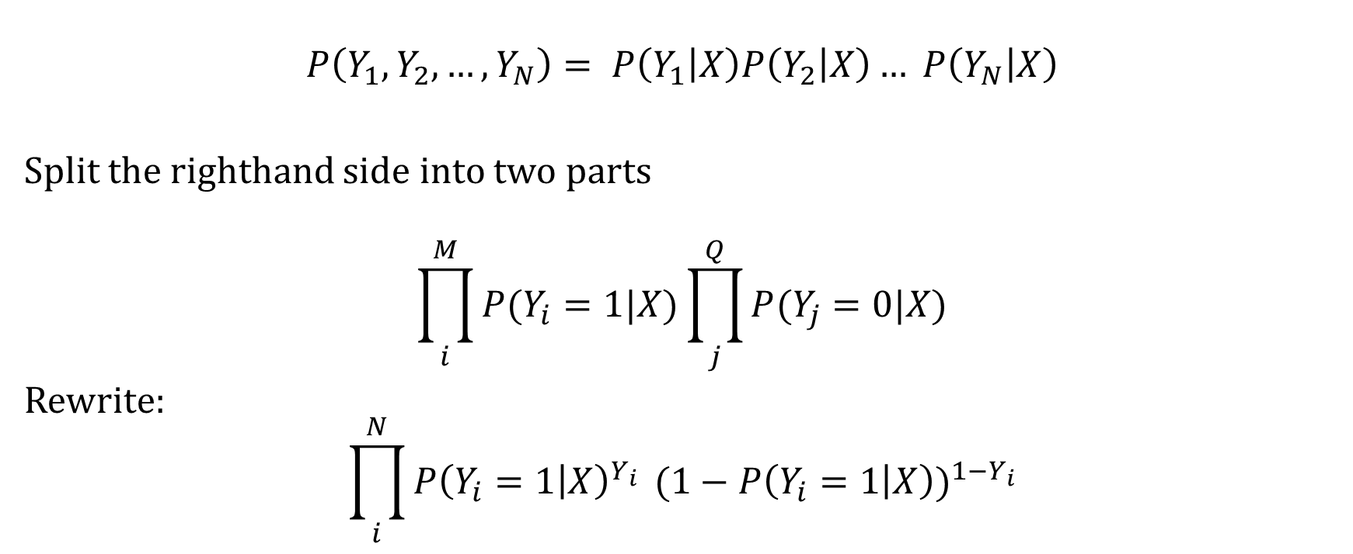
Assume Independence Between Data Samples
$$P\left(Y_{1}, Y_{2}, …, Y_{N}\right)= P\left(Y_{1} | X\right)P\left(Y_{2} | X\right)… P\left(Y_{N} | X\right)$$
Split the righthand side into two parts
$$\prod_{i}^{M}{P(Y_{i}=1|X)}\prod_{j}^{Q}{P(Y_{j}=0|X)}$$
Rewrite:
$${\prod_{i}^{N}{P{\left(Y_{i}=1 | X\right)}^{Y_{i}}}}^{ }(1−P{\left(Y_{i}=1 | X\right))}^{1−Y_{i}}$$

Slide 47
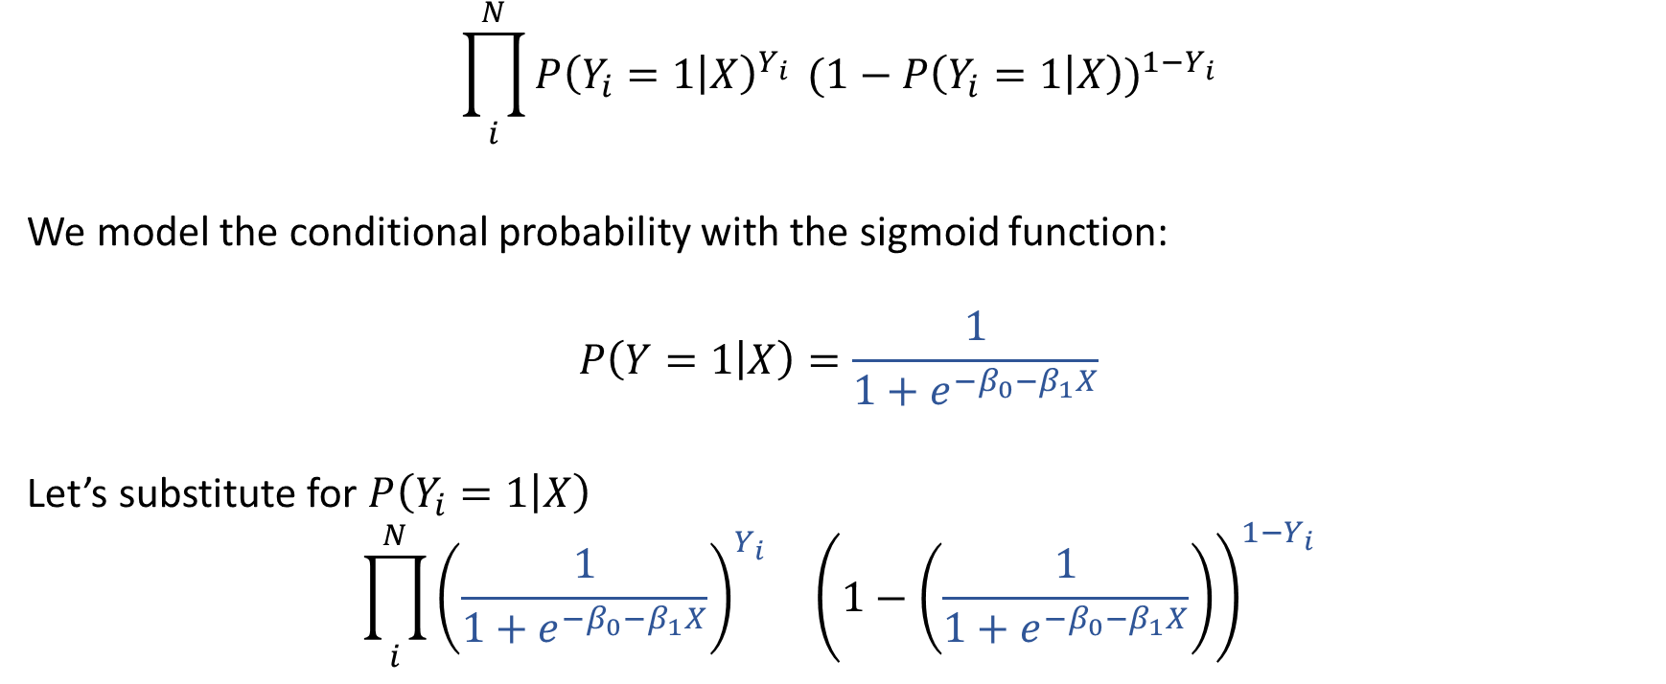
Going Back to the Likelihood function
$${\prod_{i}^{N}{P{\left(Y_{i}=1 | X\right)}^{Y_{i}}}}^{ }(1−P{\left(Y_{i}=1 | X\right))}^{1−Y_{i}}$$
We model the conditional probability with the sigmoid function:
$$P\left(Y=1 | X\right)=\frac{1}{1+e^{−β_{0}−β_{1}X}}$$
Let’s substitute for $P\left(Y_{i}=1 | X\right)$
$${\prod_{i}^{N}{{\left(\frac{1}{1+e^{−β_{0}−β_{1}X}}\right)}^{Y_{i}} }}^{}{\left(1−\left(\frac{1}{1+e^{−β_{0}−β_{1}X}}\right)\right)}^{1−Y_{i}}$$

Slide 48
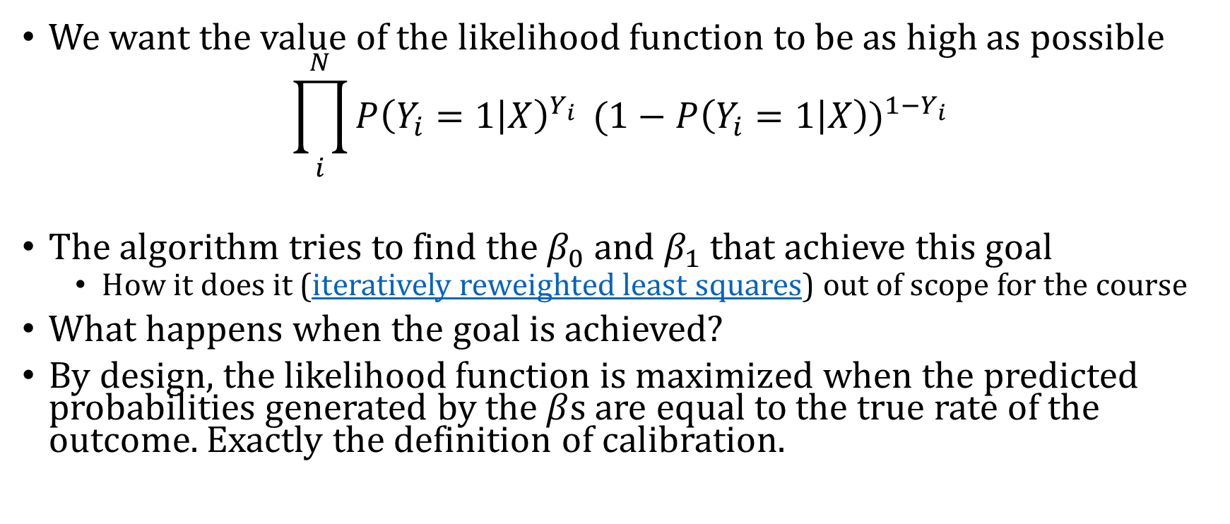
How Logistic Regression Can Achieve Calibration
We want the value of the likelihood function to be as high as possible
$${\prod_{i}^{N}{P{\left(Y_{i}=1 | X\right)}^{Y_{i}}}}^{ }(1−P{\left(Y_{i}=1 | X\right))}^{1−Y_{i}}$$
The algorithm tries to find the $β_{0}$ and $β_{1}$ that achieve this goal
  How it does it (iteratively reweighted least squares) out of scope for the course
What happens when the goal is achieved?
By design, the likelihood function is maximized when the predicted probabilities generated by the $β$s are equal to the true rate of the outcome. Exactly the definition of calibration.

