Slide 1
INST 414: Data Science Techniques Performance Metrics

Slide 2
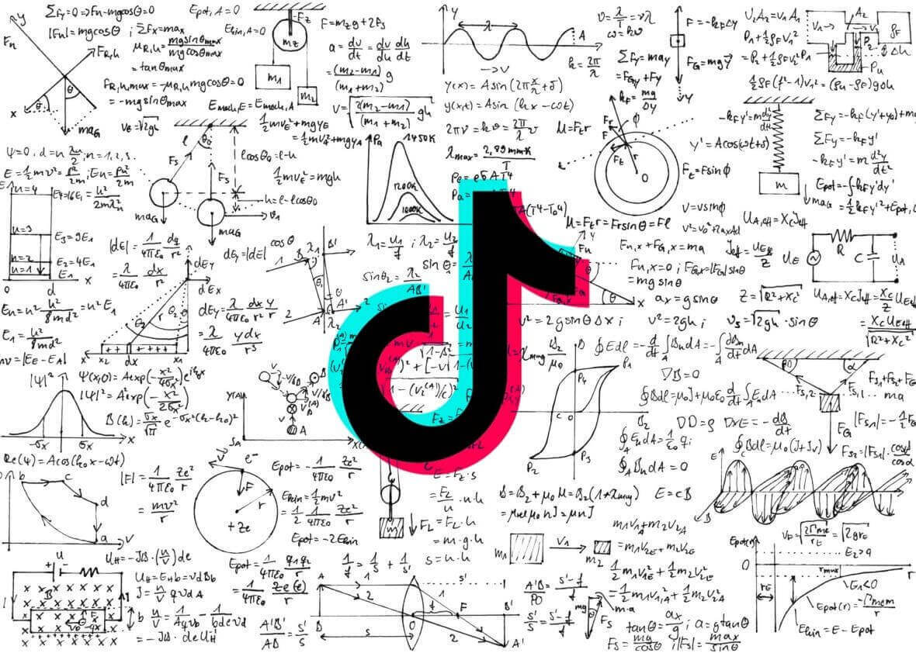
Is TikTok’s algorithm accurate?
A video that TikTok shows you is one that it predicts you will like/interact with
A video that TikTok doesn’t show you is one that it predicts you won’t like
A video that you like/interact with is one that you actually like

Slide 3
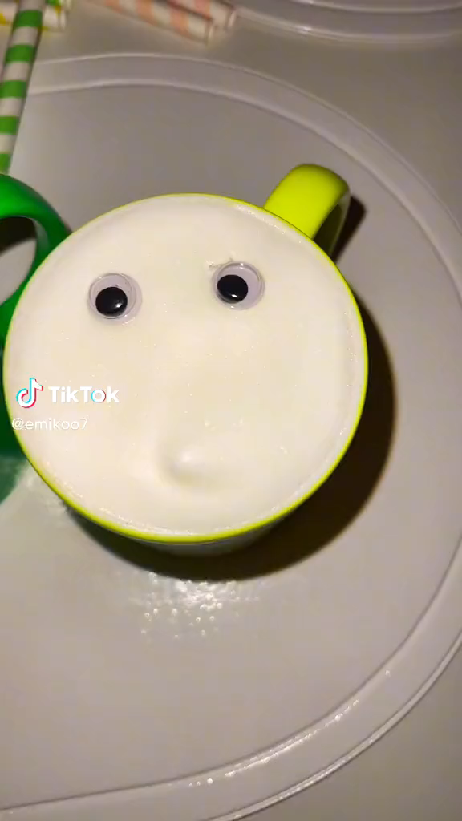

Slide 4
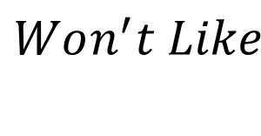



Is TikTok’s algorithm accurate?
$$Didn^{′}t Like$$
$$Did Like$$
Correctly Predicted You Wouldn’t Like
Incorrectly Predicted You Wouldn’t Like
$$Won^{′}t Like$$
Incorrectly Predicted You Would Like
Correctly Predicted You Would Like
$$Will Like$$

Slide 5
Which measure of accuracy is most informative?
Percent of predictions that are correct
Percent of videos that you would like that are actually shown to you
Percent of videos that are shown to you that you would actually like
Percent of videos that you wouldn’t like that are not shown to you
Percent of videos that are not shown to you that you wouldn’t like

Slide 6
Generating Performance Metrics
General setup: Algorithm that assigns scores
Score
Outcome
1
1
1
1
0
1
1
0
0
1
0
0
1
0
0
0
0
0.5
0

Slide 7
General setup: Algorithm that assigns scores
Scores above a certain threshold are classified as predicted likes/engagements
Score
Outcome
1
1
1
1
0
1
1
0
0
1
0
0
1
0
0
0
0
Threshold
0.5
0

Slide 8
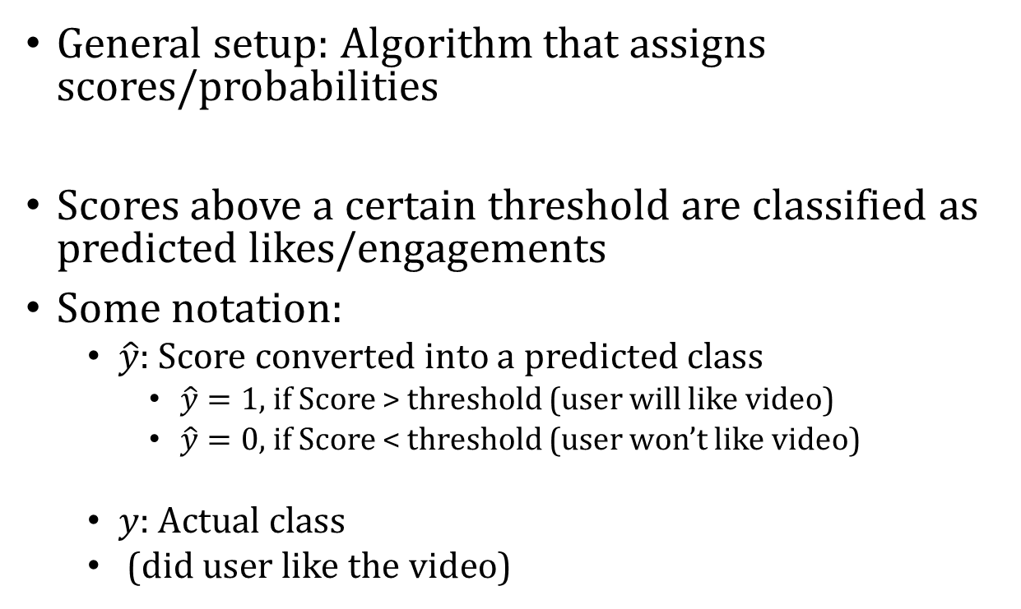
General setup: Algorithm that assigns scores/probabilities
Scores above a certain threshold are classified as predicted likes/engagements
Some notation:
$\hat{y}$: Score converted into a predicted class
$\hat{y}=1$, if Score > threshold (user will like video)
$\hat{y}=0$, if Score < threshold (user won’t like video)
$y$: Actual class
(did user like the video)
Score
Outcome
1
1
1
1
0
1
1
0
0
1
0
0
1
0
0
0
0
0.5
0

Slide 9
$$\hat{y}$$
$$y$$
Score
Outcome
1
1
1
0
1
1
0
0
1
0
0
1
0
0
0
0

Slide 10
$$\hat{y}$$
$$y$$
Score
Outcome
1
1
1
0
1
1
0
0
1
0
0
1
0
0
0
0
$\hat{y}$=1
$\hat{y}$=0

Slide 11
Confusion Matrix
$$y=0$$
$$y=1$$
True Negative (TN)
False Negative (FN)
$$\hat{y}=0$$
False Positive (FP)
True Positive (TP)
$$\hat{y}=1$$

Slide 12
Performance Metrics in Terms of Probability
Accuracy
$\frac{TP+TN}{TP+TN+FP+FN}=P(y=\hat{y})$
Precision or Positive Predictive Value:
$$\frac{TP}{FP+TP}=P\left(y=1 \right| \hat{y}=1)$$
True Positive Rate or Recall or Sensitivity:
$$\frac{TP}{FN+TP}=P\left(\hat{y}=1 \right| y=1)$$
True Negative Rate or Specificity:
$\frac{TN}{FP+TN}=P\left(\hat{y}=0 \right| y=0)$
$$y=0$$
$$y=1$$
True Negative (TN)
False Negative (FN)
$$\hat{y}=0$$
False Positive (FP)
True Positive (TP)
$$\hat{y}=1$$

Slide 13
Which measure of accuracy is most informative?
Percent of predictions that are correct
Percent of videos that you would like that are actually shown to you
Percent of videos that are shown to you that you would actually like

Slide 14
Which measure of accuracy is most informative?
Percent of predictions that are correct
Accuracy
Percent of videos that you would like that are actually shown to you
True Positive Rate / Recall / Sensitivity
Percent of videos that are shown to you that you would actually like
Precision / Positive Predictive Value

Slide 15

Limitations of Accuracy
$Accuracy=\frac{\# of correct likes+\# of correct dislikes}{\# likes +\# of dislikes}$
Scenario 1:
$Accuracy=\frac{ 0 +90}{10 + 90}=90\%$
Scenario 2:
$Accuracy=\frac{ 10 + 80}{10 + 90}=90\%$

Slide 16
Comparing Metrics (Same Threshold)
$$\hat{y}$$
$$y$$
$$\hat{y}$$
$$y$$
Risk Score
Outcome
Risk Score
Outcome
1
1
1
1
0
0
0
1
1
0
0
1
0
0
1
0
1
1
1
0
1
1
0
0
1
0
0
1
0
1
0
0
$\hat{y}$=1
$\hat{y}$=1
$\hat{y}$=0
$\hat{y}$=0

Slide 17
Algorithm 1
Accuracy = $\frac{700+100}{700+100+50+250}=80\%$
TPR = $\frac{100}{100+50}=75\%$
Precision = $\frac{100}{100+150}=40\%$
$$y=0$$
$$y=1$$
700
(TN)
50
(FN)
$$\hat{y}=0$$
150
(FP)
100
(TP)
$$\hat{y}=1$$

Slide 18
Algorithm 2 (Ranking Changes)
Accuracy = $\frac{750+150}{750+150+0+150}=90\%$
TPR = $\frac{150}{150+0}=100\%$
Precision = $\frac{150}{150+100}=60\%$
$$y=0$$
$$y=1$$
750
(TN)
0
(FN)
$$\hat{y}=0$$
100
(FP)
150
(TP)
$$\hat{y}=1$$

Slide 19
Comparing Metrics (Different Thresholds)
$$\hat{y}$$
$$y$$
$$\hat{y}$$
$$y$$
Risk Score
Outcome
Risk Score
Outcome
1
1
1
0
1
1
0
0
1
0
0
1
0
1
0
0
1
1
1
0
1
1
0
0
1
0
0
1
0
1
0
0
$\hat{y}$=1
$\hat{y}$=1
$\hat{y}$=0
$\hat{y}$=0

Slide 20
Algorithm 1
Accuracy = $\frac{850+100}{850+100+50+0}=95\%$
TPR = $\frac{100}{100+50}=75\%$
Precision = $\frac{100}{100+0}=100\%$
$$y=0$$
$$y=1$$
850
(TN)
50
(FN)
$$\hat{y}=0$$
0
(FP)
100
(TP)
$$\hat{y}=1$$

Slide 21
Algorithm 1 (Different Threshold)
Accuracy = $\frac{750+150}{750+150+0+150}=90\%$
TPR = $\frac{150}{150+0}=100\%$
Precision = $\frac{150}{150+100}=60\%$
$$y=0$$
$$y=1$$
750
(TN)
0
(FN)
$$\hat{y}=0$$
100
(FP)
150
(TP)
$$\hat{y}=1$$

Slide 22
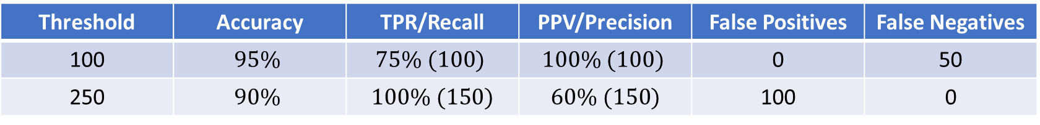
Performance
Same Threshold (Flagging 250 people)
Algorithm | Accuracy | TPR/Recall | PPV/Precision | False Positives | False Negatives
1 | $$80\%$$ | $$75\% (100)$$ | $$40\% (100)$$ | 150 | 50
2 | $$90\%$$ | $100\% (150)$ | $$60\% (150)$$ | 100 | 0
Different Thresholds (Alg 1: 100 people, Alg 1: 250 )
Threshold | Accuracy | TPR/Recall | PPV/Precision | False Positives | False Negatives
100 | $$95\%$$ | $$75\% (100)$$ | $$100\% (100)$$ | 0 | 50
250 | $$90\%$$ | $100\% (150)$ | $60\% (150)$ | 100 | 0

Slide 23
Takeaways
There are potentially different costs to different types of errors
Do you want to detain all defendants who are re-arrested?
Cost is that you will probably detain defendants who would not have been re-arrested (False Positives)
Do you want to release all defendants who would not be re-arrested?
Cost is that you will probably release defendants who would have been re-arrested (False Negatives)
No one performance metric is appropriate for all contexts

