Slide 1
INST 414: Data Science Techniques Bayes Theorem

Slide 2
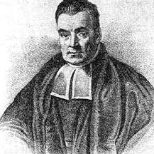


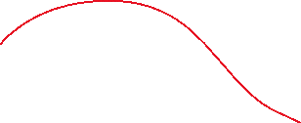

Bayes Theorem
Conditional Probability: $P\left(A | B\right)=\frac{P\left(A, B\right)}{P(B)}$
Chain rule:
$$P\left(A,B\right)=P\left(B | A\right)P(A)$$
Plug in for $P(A|B)$
$$P\left(A | B\right)=\frac{P\left(B | A\right) P\left(A\right)}{P(B)}$$

Slide 3

Pre-test, Post-test Probability
Let $C$ be whether someone has Covid
The prevalence of Covid in a population is 1%
$P\left(C=1\right)=1\%$ (base rate, outcome rate, y-bar)
Notes:
https://www.bmj.com/content/369/bmj.m1808

Slide 4
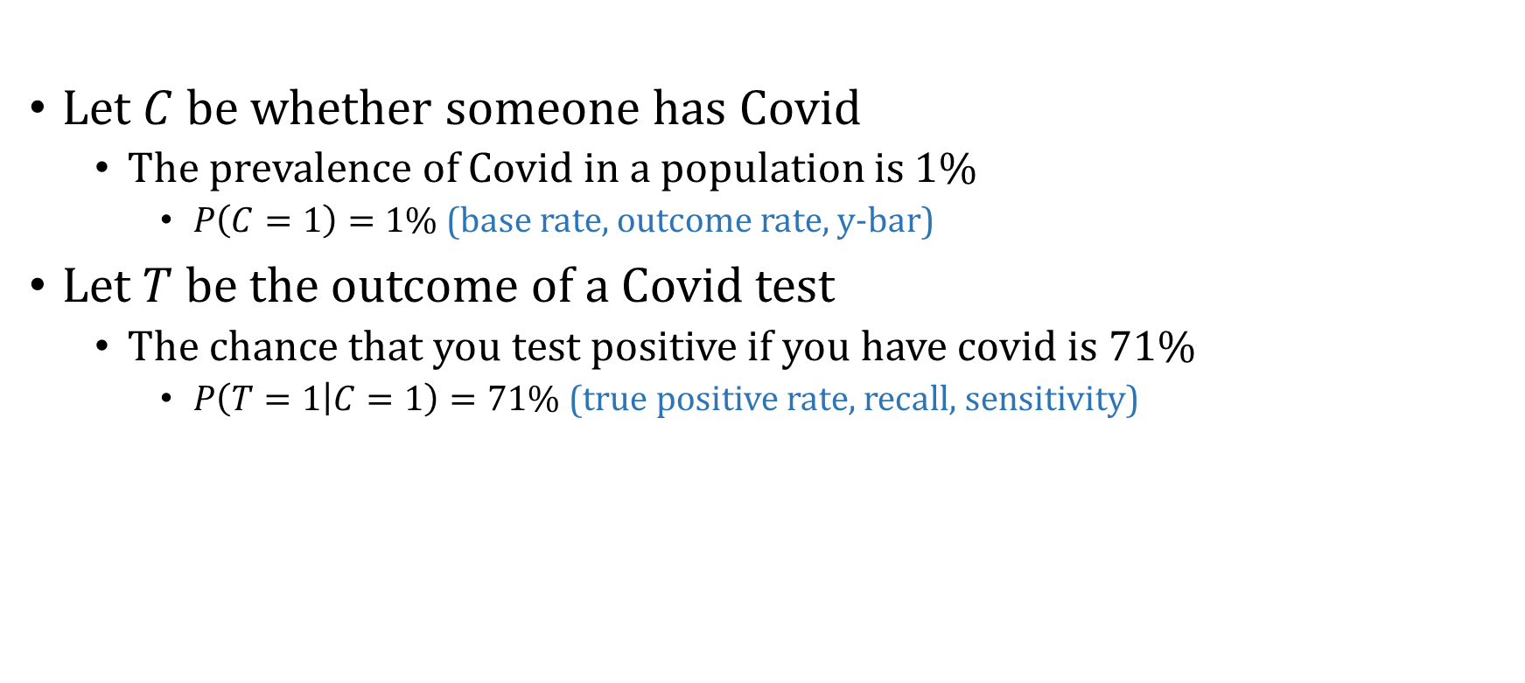
Pre-test, Post-test Probability
Let $C$ be whether someone has Covid
The prevalence of Covid in a population is 1%
$P\left(C=1\right)=1\%$ (base rate, outcome rate, y-bar)
Let $T$ be the outcome of a Covid test
The chance that you test positive if you have covid is 71%
$P\left(T=1 | C=1\right)=71\%$ (true positive rate, recall, sensitivity)
Notes:
https://www.bmj.com/content/369/bmj.m1808

Slide 5
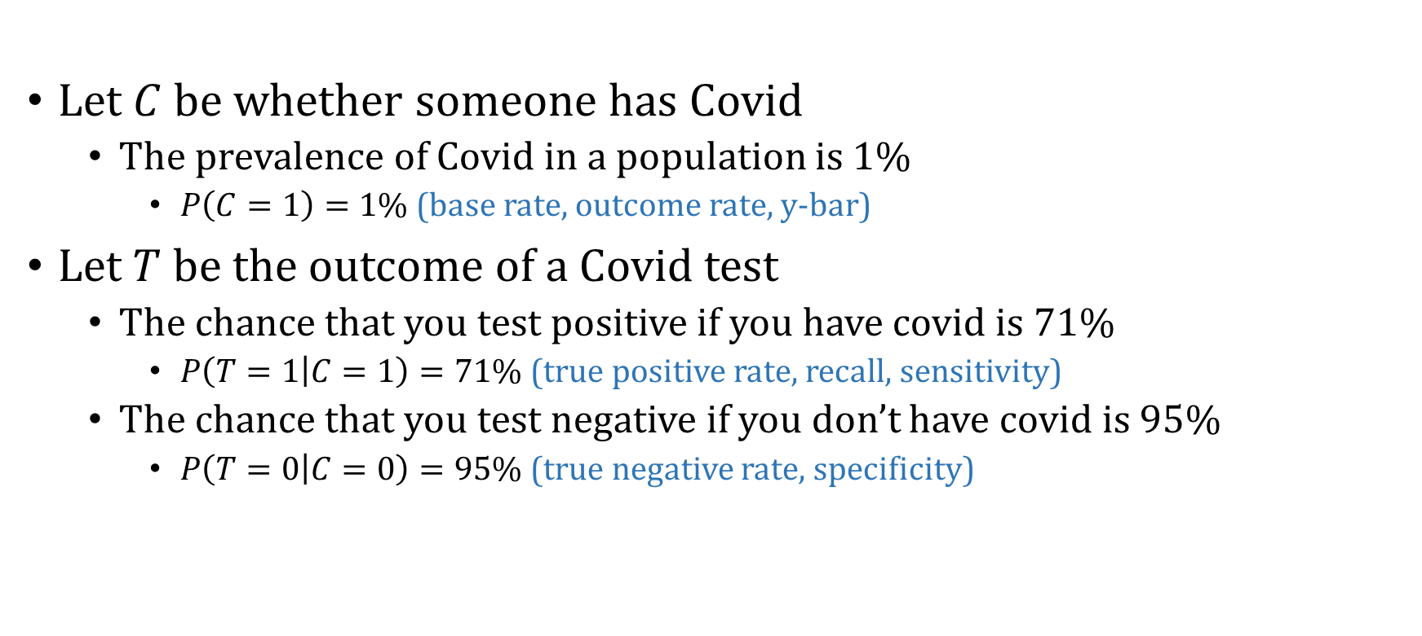
Pre-test, Post-test Probability
Let $C$ be whether someone has Covid
The prevalence of Covid in a population is 1%
$P\left(C=1\right)=1\%$ (base rate, outcome rate, y-bar)
Let $T$ be the outcome of a Covid test
The chance that you test positive if you have covid is 71%
$P\left(T=1 | C=1\right)=71\%$ (true positive rate, recall, sensitivity)
The chance that you test negative if you don’t have covid is 95%
$P\left(T=0 | C=0\right)=95\%$ (true negative rate, specificity)
Notes:
https://www.bmj.com/content/369/bmj.m1808

Slide 6
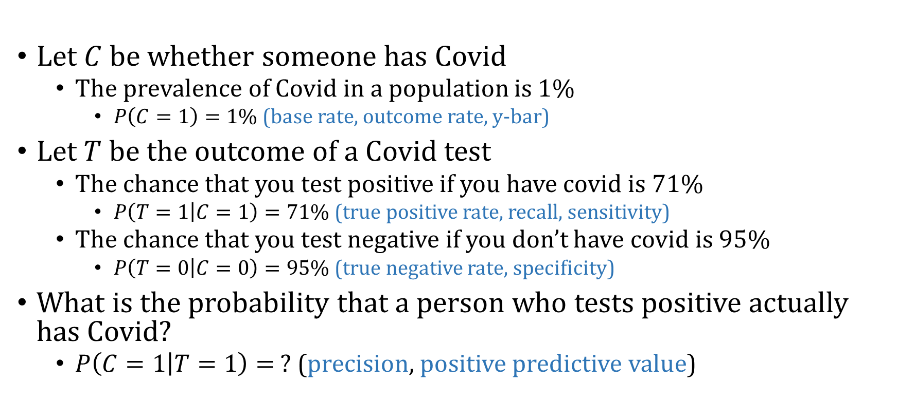
Pre-test, Post-test Probability
Let $C$ be whether someone has Covid
The prevalence of Covid in a population is 1%
$P\left(C=1\right)=1\%$ (base rate, outcome rate, y-bar)
Let $T$ be the outcome of a Covid test
The chance that you test positive if you have covid is 71%
$P\left(T=1 | C=1\right)=71\%$ (true positive rate, recall, sensitivity)
The chance that you test negative if you don’t have covid is 95%
$P\left(T=0 | C=0\right)=95\%$ (true negative rate, specificity)
What is the probability that a person who tests positive actually has Covid?
$P\left(C=1 | T=1\right)= ?$ (precision, positive predictive value)
Notes:
https://www.bmj.com/content/369/bmj.m1808

Slide 7
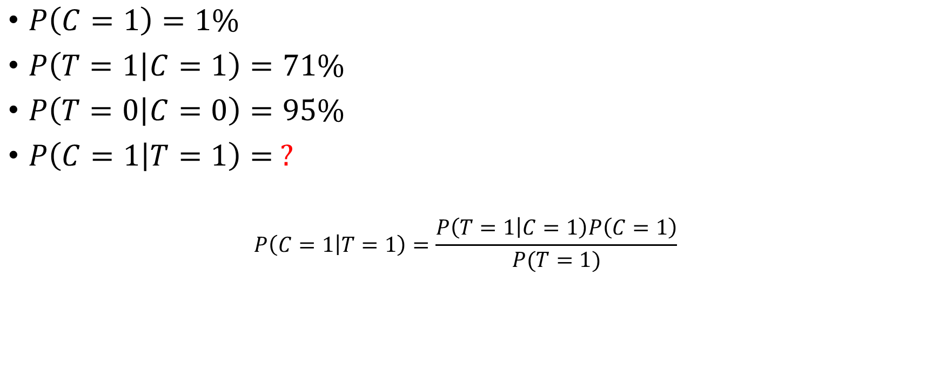
Pre-test, Post-test Probability
$P\left(C=1\right)=1\%$
$P\left(T=1 | C=1\right)=71\%$
$P\left(T=0 | C=0\right)=95\%$
$P\left(C=1 | T=1\right)= ?$
$$P\left(C=1 | T=1\right)=\frac{P\left(T=1 | C=1\right)P\left(C=1\right)}{P(T=1)}$$

Slide 8

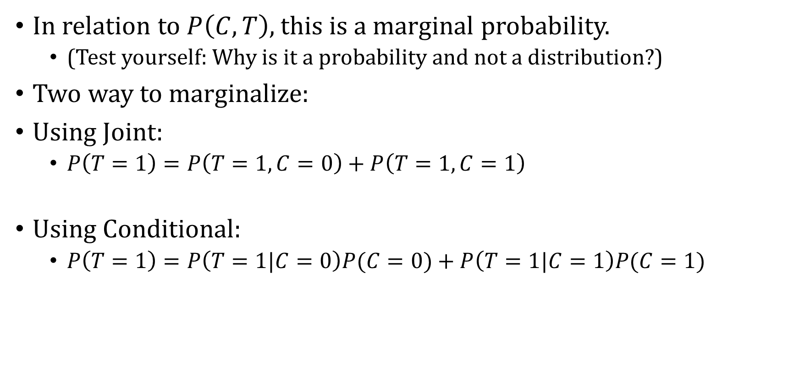
How to compute $P\left(T=1\right)?$
In relation to $P\left(C, T\right),$ this is a marginal probability.
(Test yourself: Why is it a probability and not a distribution?)
Two way to marginalize:
Using Joint:
$P\left(T=1\right)=P\left(T=1, C=0\right)+P\left(T=1,C=1\right)$
Using Conditional:
$P\left(T=1\right)=P\left(T=1|C=0\right)P(C=0)+P\left(T=1|C=1\right)P(C=1)$

Slide 9
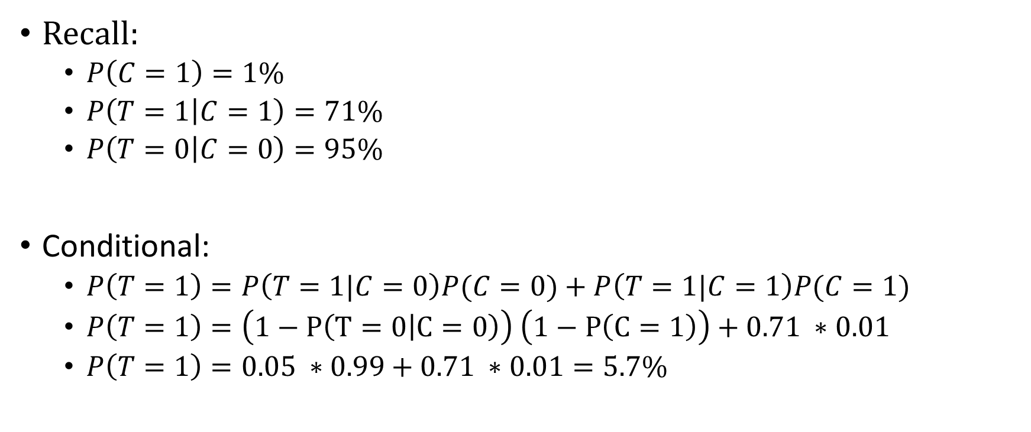
How to compute $P\left(T=1\right)?$
Recall:
$P\left(C=1\right)=1\%$
$P\left(T=1 | C=1\right)=71\%$
$P\left(T=0 | C=0\right)=95\%$
Conditional:
$P\left(T=1\right)=P\left(T=1|C=0\right)P(C=0)+P\left(T=1|C=1\right)P(C=1)$
$P\left(T=1\right)=\left(1−P\left(T=0 | C=0\right)\right) \left(1−P\left(C=1\right)\right)+0.71 ∗0.01$
$P\left(T=1\right)=0.05 ∗0.99+0.71 ∗0.01=5.7\%$

Slide 10

Pre-test, Post-test Probability
$P\left(C=1\right)=1\%$
$P\left(T=1 | C=1\right)=71\%$
$P\left(T=0 | C=0\right)=95\%$
$P\left(C=1 | T=1\right)= ?$
$$P\left(C=1 | T=1\right)=\frac{P\left(T=1 | C=1\right)P\left(C=1\right)}{P\left(T=1|C=0\right)P(C=0)+P\left(T=1|C=1\right)P(C=1)}=$$
$$\frac{\begin{aligned} \\ 0.71 ∗0.01\end{aligned}}{0.057}=12.5\%$$

Slide 11
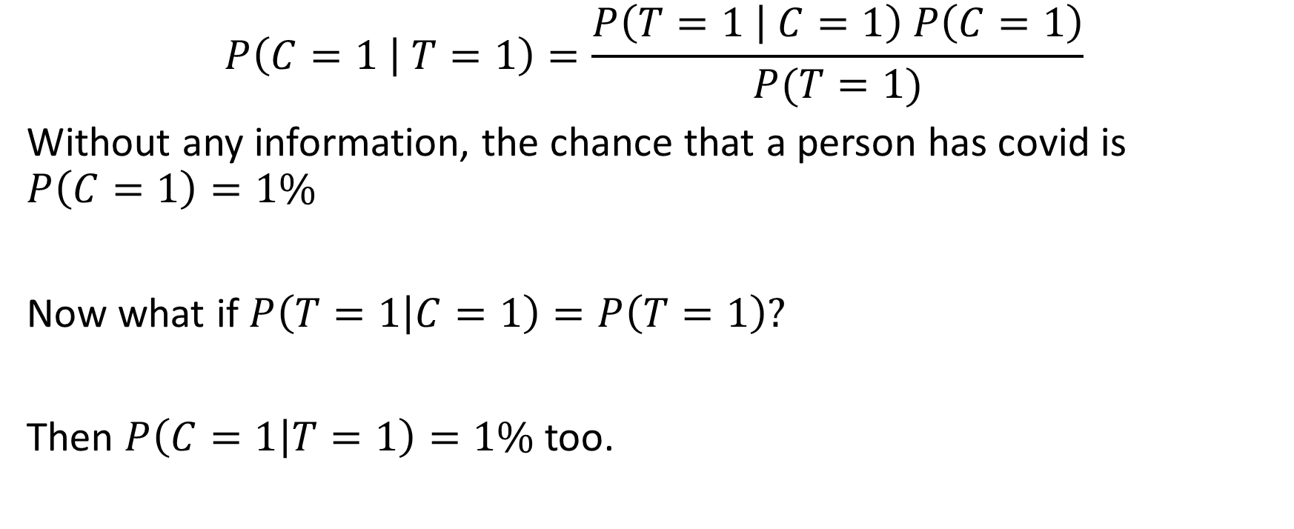
Bayes Theorem – Updating Beliefs
$$P\left(C=1 | T=1\right)=\frac{P\left(T=1 | C=1\right) P\left(C=1\right)}{P(T=1)}$$
Without any information, the chance that a person has covid is $P\left(C=1\right)=1\%$
Now what if $P\left(T=1 | C=1\right)=P\left(T=1\right)?$
Then $P\left(C=1 | T=1\right)=1\%$ too.

Slide 12
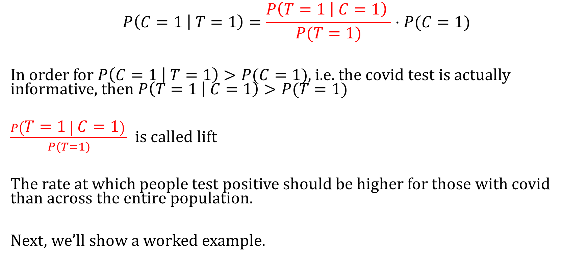
Bayes Theorem – Updating Beliefs
$$P\left(C=1 | T=1\right)=\frac{P\left(T=1 | C=1\right) }{P(T=1)}⋅P(C=1)$$
In order for $P\left(C=1 | T=1\right)>P(C=1)$, i.e. the covid test is actually informative, then $P\left(T=1 | C=1\right)>P(T=1)$
$\frac{P\left(T=1 | C=1\right) }{P(T=1)}$ is called lift
The rate at which people test positive should be higher for those with covid than across the entire population.
Next, we’ll show a worked example.

Slide 13
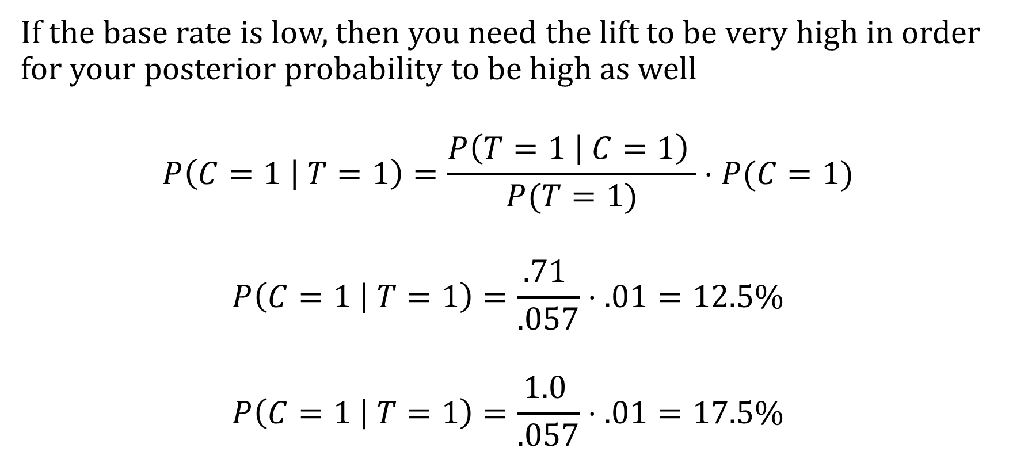
The Problem With Low Prevalence
If the base rate is low, then you need the lift to be very high in order for your posterior probability to be high as well
$$P\left(C=1 | T=1\right)=\frac{P\left(T=1 | C=1\right) }{P(T=1)}⋅P(C=1)$$
$$P\left(C=1 | T=1\right)=\frac{.71 }{.057}⋅.01=12.5\%$$
$$P\left(C=1 | T=1\right)=\frac{1.0 }{.057}⋅.01=17.5\%$$

Slide 14
Probability Practice

Slide 15
Relationships to Know (Probability Cheat Sheet)
Conditional Probability Formula:
$P\left(A | B\right)=\frac{P\left(A, B\right)}{P\left(B\right)}$
$P\left(B | A\right)=\frac{P\left(A,B\right)}{P\left(A\right)}$
Chain Rule:
$P\left(A, B\right)=P\left(A | B\right)P\left(B\right)=P\left(B | A\right)P\left(A\right)$
Bayes Theorem
$P\left(A | B\right)=\frac{P\left(B | A\right)P(A)}{P(B)}$
$P\left(B | A\right)=\frac{P\left(A | B\right)P(B)}{P(A)}$
Marginalizing:
$P\left(B\right)=P\left(B,A=0\right)+P(B,A=1)$
$P\left(B\right)=P\left(B|A=0\right)P\left(A=0\right)+P\left(B | A=1\right)P(A=1)$
Bayes Theorem:
$P\left(B | A\right)=\frac{P\left(A | B\right)P(B)}{P\left(A,B=0\right)+P(A,B=1)}$
$P\left(B | A\right)=\frac{P\left(A | B\right)P(B)}{P\left(A|B=0\right)P(B=0)+P\left(A | B=1\right)P(B=1)}$

Slide 16
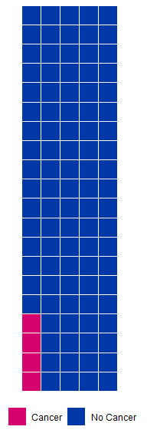
Pre-test, post-test
We want to know the chance of having cancer given you tested positive.
The prevalence of a particular type of cancer is 4% in a population

Slide 17
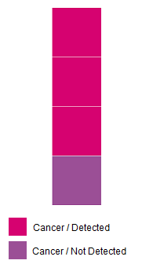
Pre-test, post-test
We want to what is the chance of having cancer given you tested positive.
The prevalence of a particular type of cancer is 4% in a population
There is a blood test with a detection rate of 75% if a patient has cancer

Slide 18
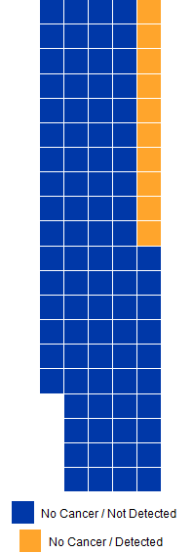
Pre-test, post-test
We want to what is the chance of having cancer given you tested positive.
The prevalence of a particular type of cancer is 4% in a population
There is a blood test with a detection rate of 75% if a patient has cancer
If a patient doesn’t have cancer, the test successfully returns a negative result 75% of the time

Slide 19
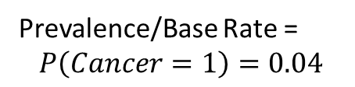
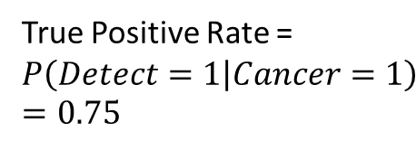
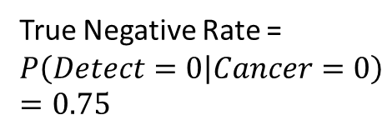
Pre-test, post-test
True Negative Rate =
$$P\left(Detect=0 | Cancer=0\right)=0.75$$
True Positive Rate =
$$P\left(Detect=1 | Cancer=1\right)=0.75$$
Prevalence/Base Rate =
$$P\left(Cancer=1\right)=0.04$$

Slide 20
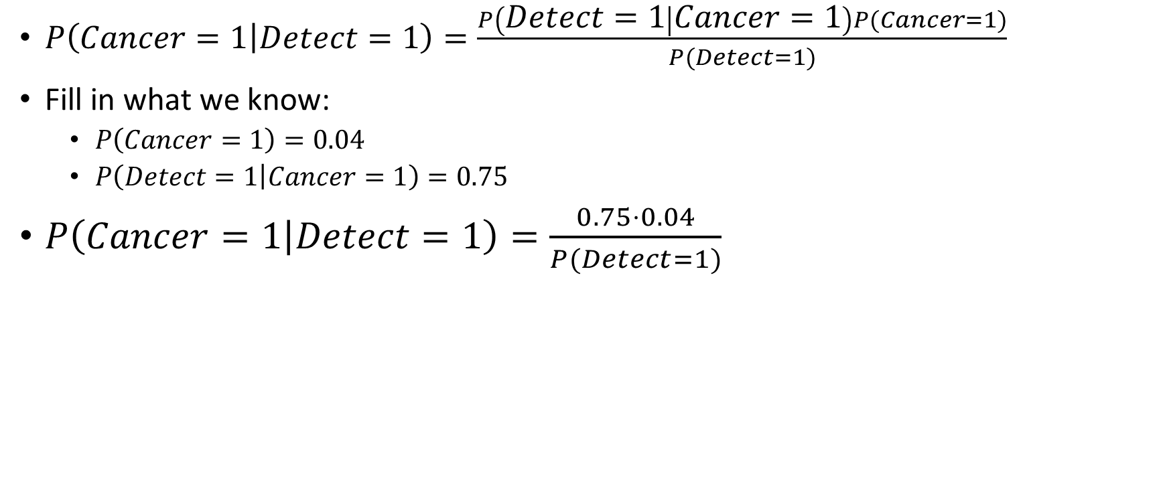
Bayes Theorem
$P\left(Cancer=1 | Detect=1\right)=\frac{P\left(Detect=1 | Cancer=1\right)P(Cancer=1)}{P(Detect=1)}$
Fill in what we know:
$P\left(Cancer=1\right)=0.04$
$P\left(Detect=1 | Cancer=1\right)=0.75$
$P\left(Cancer=1 | Detect=1\right)=\frac{0.75⋅0.04}{P(Detect=1)}$

Slide 21
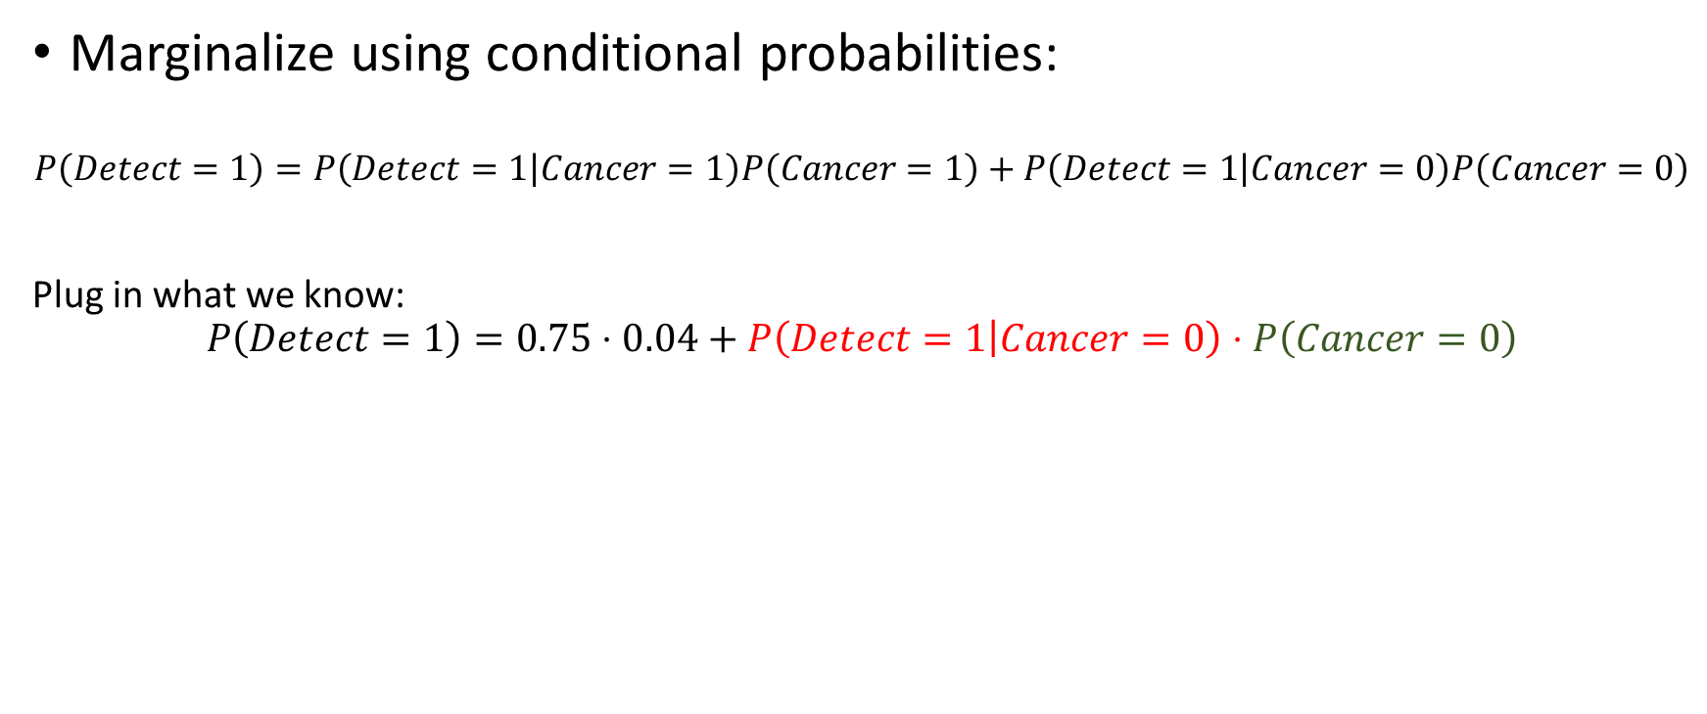

$$P(Detect=1)$$
Marginalize using conditional probabilities:
$$P\left(Detect=1\right)=P\left(Detect=1 | Cancer=1\right)P\left(Cancer=1\right)+P\left(Detect=1 | Cancer=0\right)P\left(Cancer=0\right)$$
Plug in what we know:
$$P\left(Detect=1\right)=0.75⋅0.04+P\left(Detect=1 | Cancer=0\right)⋅P\left(Cancer=0\right)$$

Slide 22


$$P(Cancer=0)$$
Since $P\left(Cancer=1\right)=0.04$
$P\left(Cancer=0\right)=1−P\left(Cancer=1\right)=0.96$

Slide 23


$$P(Detect=1|Cancer=0)$$
Since $P\left(Detect=0|Cancer=0\right)=0.75$
$P\left(Detect=1|Cancer=0\right)=1−P\left(Detect=1|Cancer=0\right)=0.25$

Slide 24
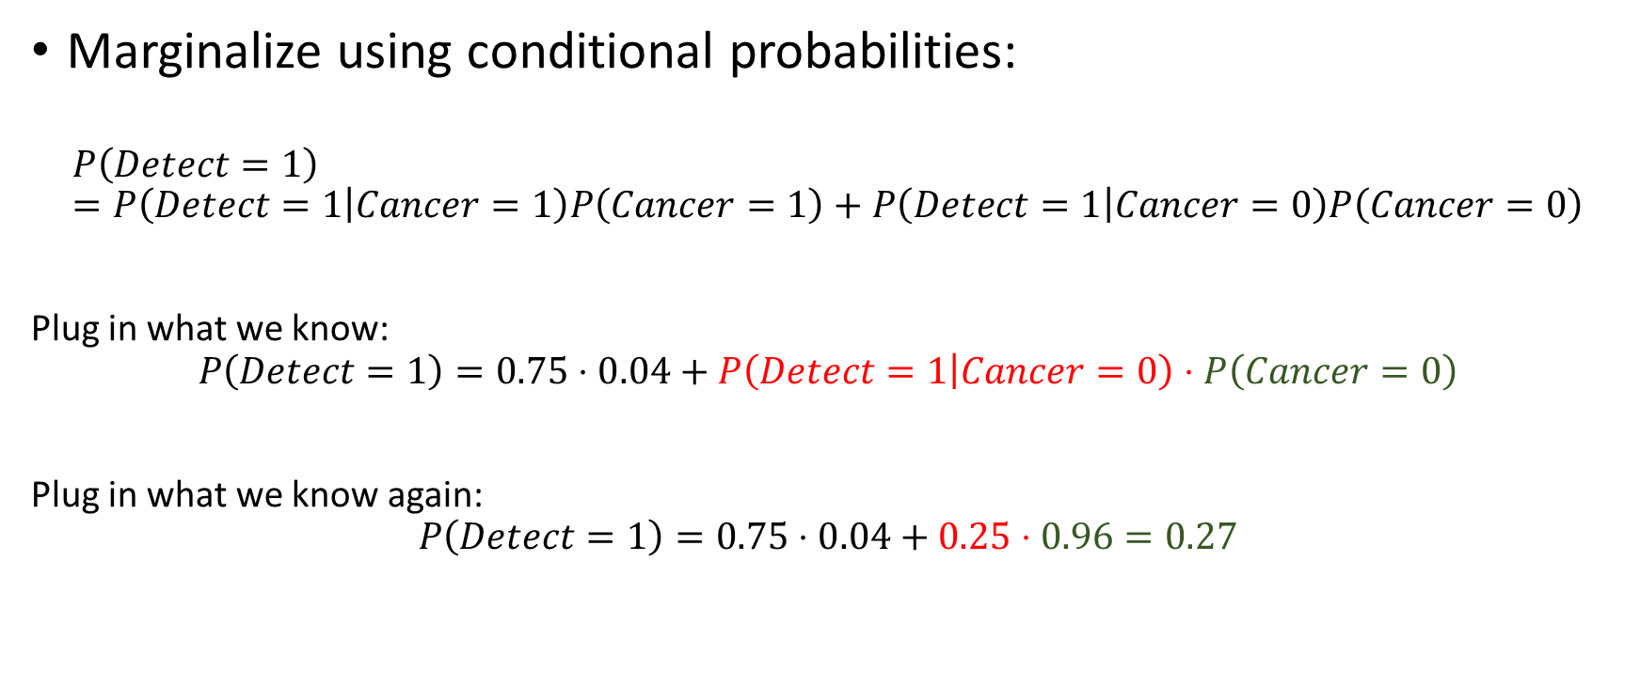
$$P(Detect=1)$$
Marginalize using conditional probabilities:
$$P\left(Detect=1\right)=P\left(Detect=1 | Cancer=1\right)P\left(Cancer=1\right)+P\left(Detect=1 | Cancer=0\right)P\left(Cancer=0\right)$$
Plug in what we know:
$$P\left(Detect=1\right)=0.75⋅0.04+P\left(Detect=1 | Cancer=0\right)⋅P\left(Cancer=0\right)$$
Plug in what we know again:
$$P\left(Detect=1\right)=0.75⋅0.04+0.25⋅0.96=0.27$$

Slide 25
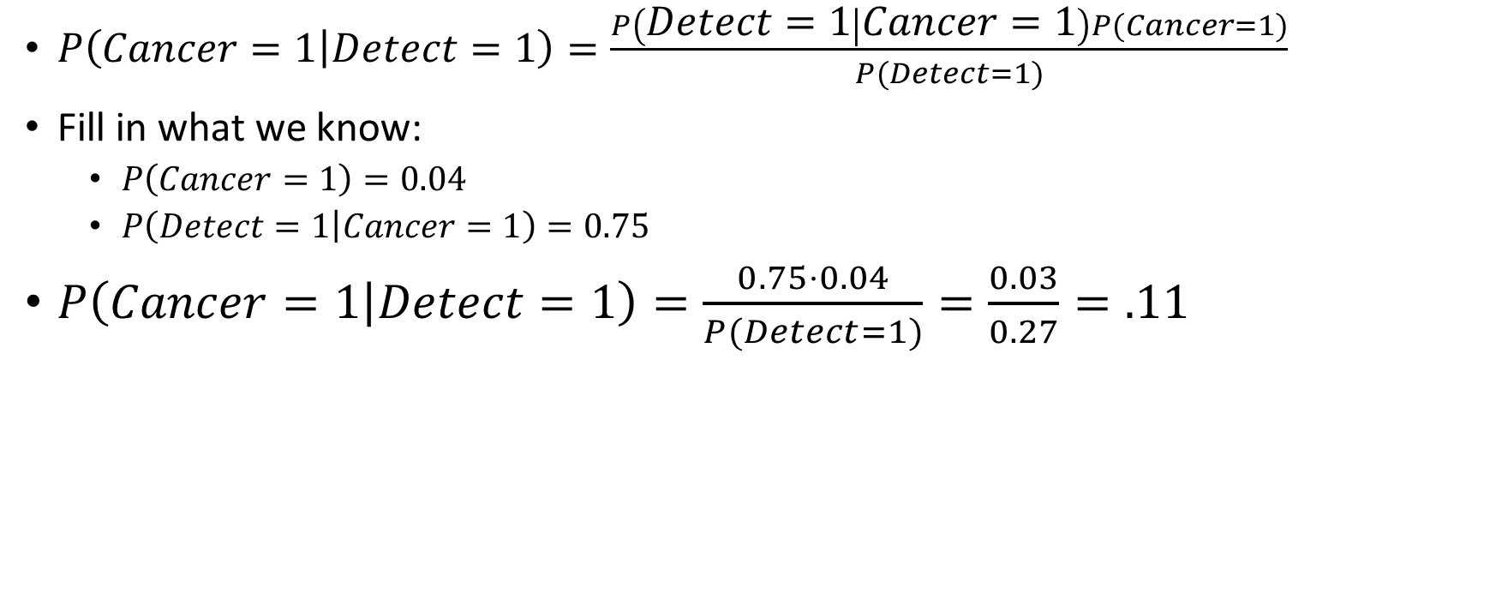
Bayes Theorem
$P\left(Cancer=1 | Detect=1\right)=\frac{P\left(Detect=1 | Cancer=1\right)P(Cancer=1)}{P(Detect=1)}$
Fill in what we know:
$P\left(Cancer=1\right)=0.04$
$P\left(Detect=1 | Cancer=1\right)=0.75$
$P\left(Cancer=1 | Detect=1\right)=\frac{0.75⋅0.04}{P(Detect=1)}=\frac{0.03}{0.27}=.11$

Slide 26
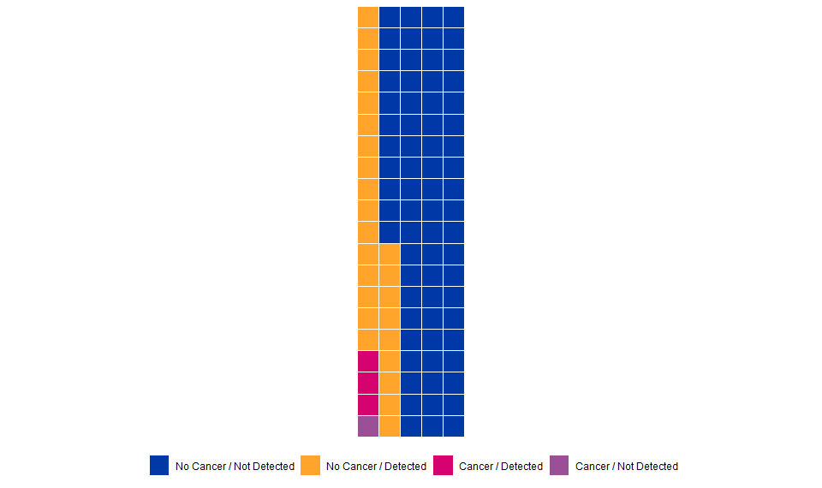

Result
$P\left(Cancer=1 | Detect=1\right)=.11$

