Slide 1
INST 414: Data Science Techniques Lecture 4 Statistical Independence, Performance Metrics

Slide 2
This Lecture
Statistical Independence
Bayes Theorem
Performance Metrics

Slide 3
Independence

Slide 4
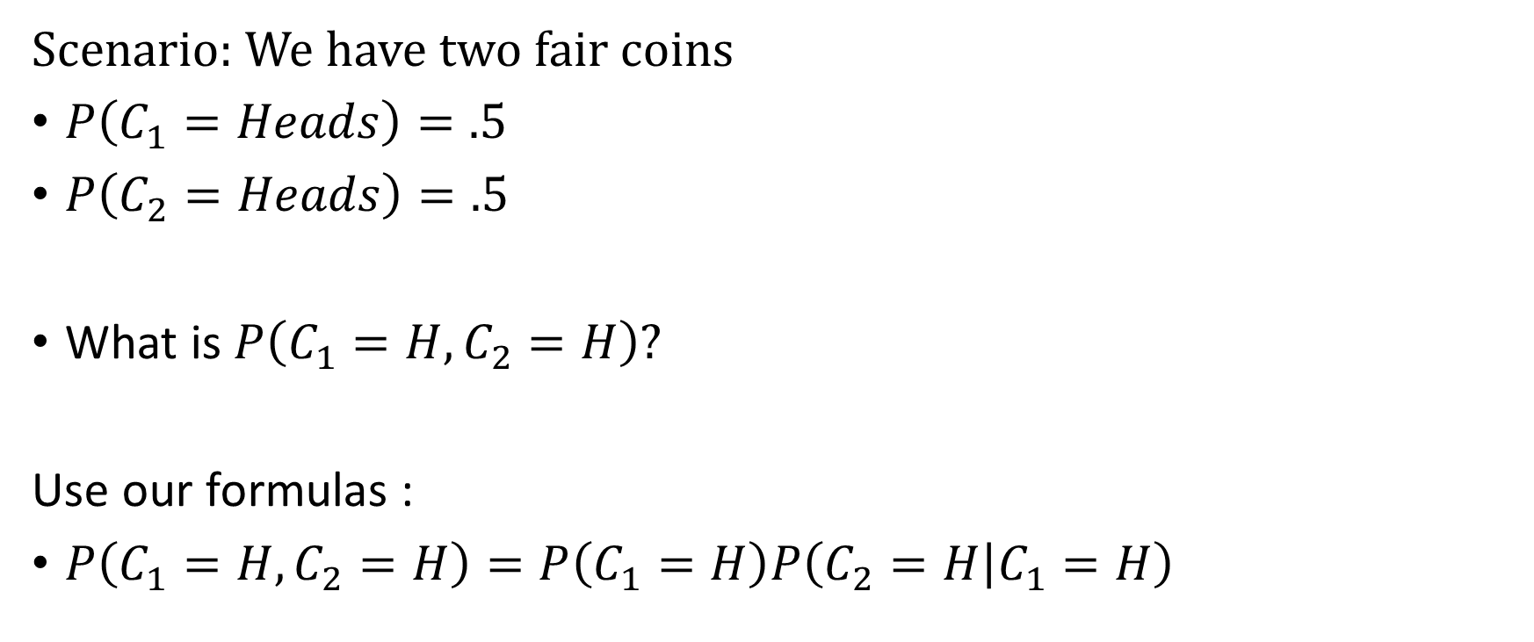
Two Fair Coins
Scenario: We have two fair coins
$P\left(C_{1}=Heads\right)=.5$
$P\left(C_{2}=Heads\right)=.5$
What is $P\left(C_{1}=H,C_{2}=H\right)?$
Use our formulas :
$P\left(C_{1}=H,C_{2}=H\right)=P\left(C_{1}=H\right)P\left(C_{2}=H | C_{1}=H\right)$

Slide 5








Two Fair Coins
$P\left(C_{1}=H,C_{2}=H\right)=P\left(C_{1}=H\right)P\left(C_{2}=H | C_{1}=H\right)$
$$C_{2}=H$$
$$C_{1}=H$$
$$C_{2}=T$$
$$C_{1}$$
$$C_{2}=H$$
$$C_{1}=T$$
$$C_{2}=T$$

Slide 6


Two Fair Coins
$P\left(C_{1}=H,C_{2}=H\right)=P\left(C_{1}=H\right)P\left(C_{2}=H | C_{1}=H\right)$
?
$$C_{2}=H$$
$$C_{1}=H$$
Does the value of Coin 1 influence the value of Coin 2?
0.5
$$C_{2}=T$$
$$C_{1}$$
$$C_{2}=H$$
0.5
$$C_{1}=T$$
$$C_{2}=T$$

Slide 7
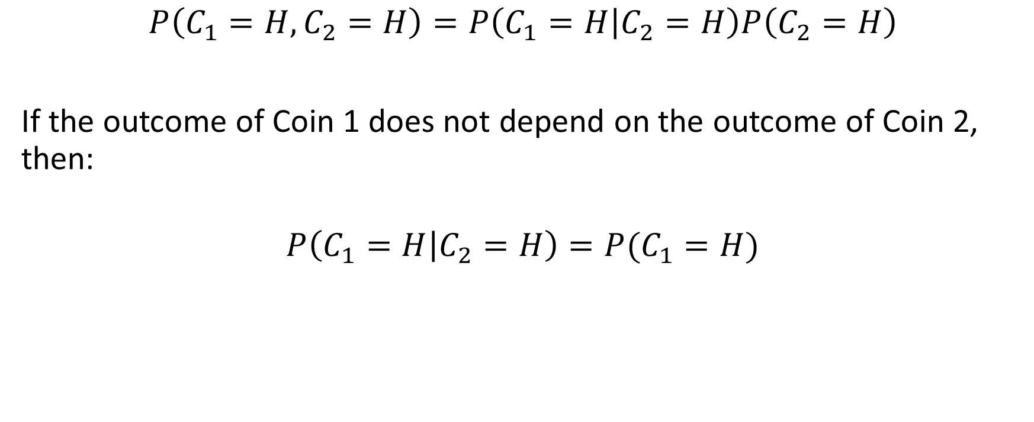
Two Fair Coins
$$P\left(C_{1}=H,C_{2}=H\right)=P\left(C_{1}=H | C_{2}=H\right)P\left(C_{2}=H\right)$$
If the outcome of Coin 1 does not depend on the outcome of Coin 2, then:
$$P\left(C_{1}=H | C_{2}=H\right)=P(C_{1}=H)$$

Slide 8
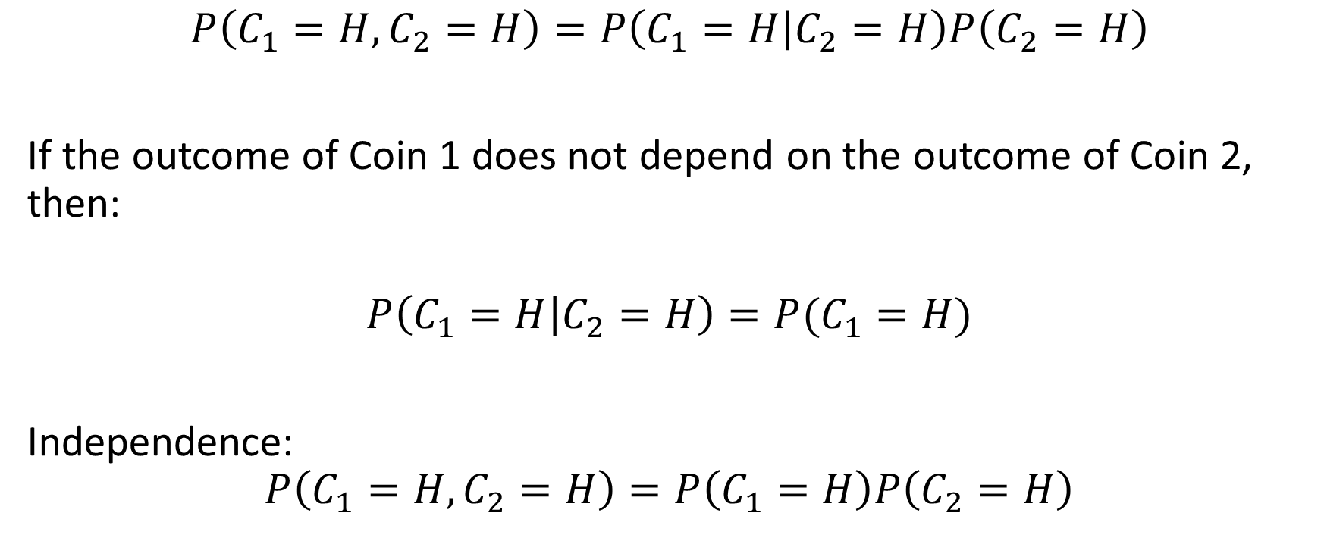
Two Fair Coins
$$P\left(C_{1}=H,C_{2}=H\right)=P\left(C_{1}=H | C_{2}=H\right)P\left(C_{2}=H\right)$$
If the outcome of Coin 1 does not depend on the outcome of Coin 2, then:
$$P\left(C_{1}=H | C_{2}=H\right)=P(C_{1}=H)$$
Independence:
$$P\left(C_{1}=H,C_{2}=H\right)=P\left(C_{1}=H\right)P\left(C_{2}=H\right)$$

Slide 9
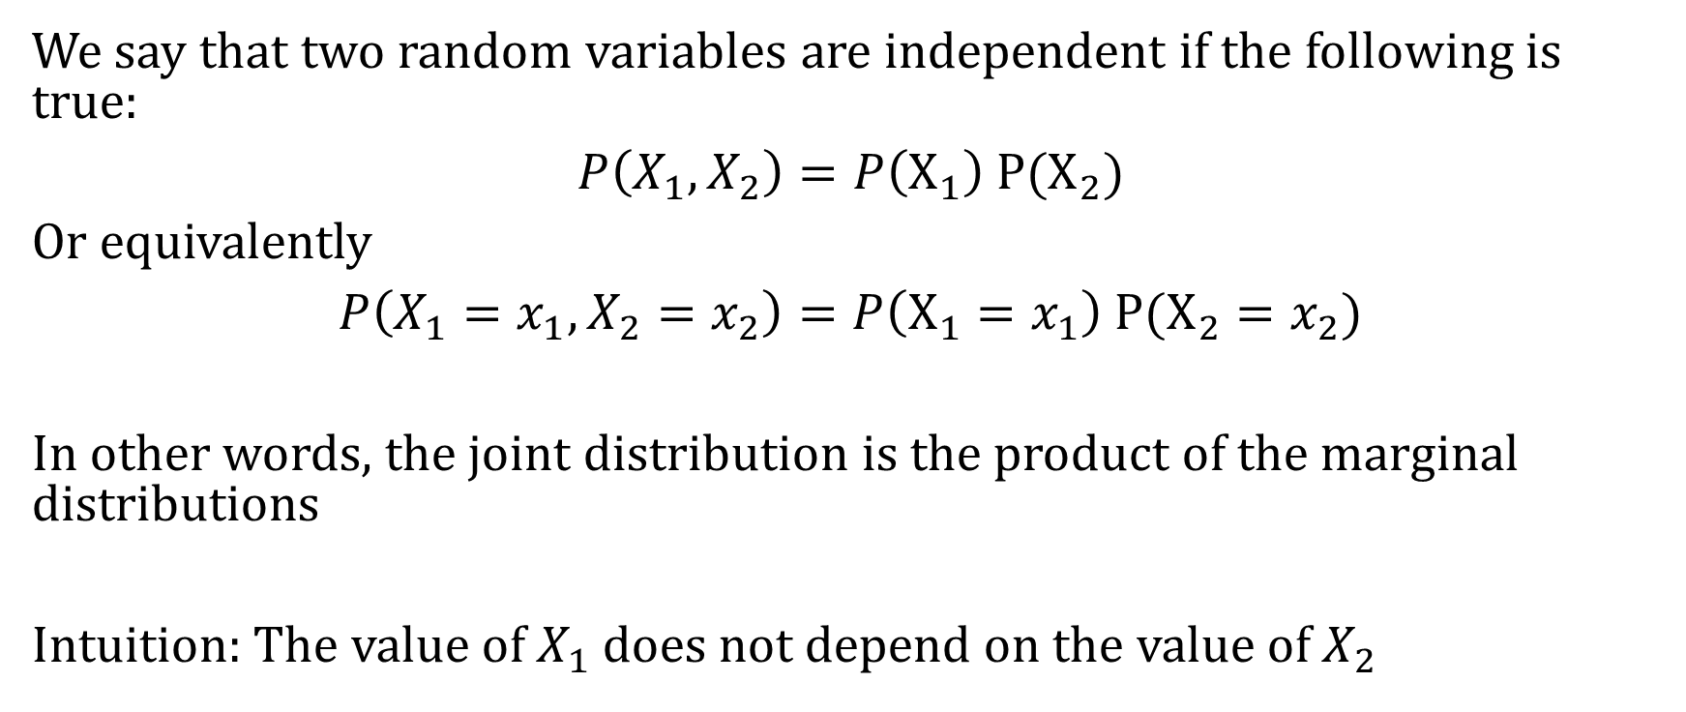
Independence
We say that two random variables are independent if the following is true:
$P\left(X_{1},X_{2}\right)=P\left(X_{1}\right) P(X_{2})$
Or equivalently
$P\left(X_{1}=x_{1},X_{2}=x_{2}\right)=P\left(X_{1}=x_{1}\right) P(X_{2}=x_{2})$
In other words, the joint distribution is the product of the marginal distributions
Intuition: The value of $X_{1}$ does not depend on the value of $X_{2}$

Slide 10
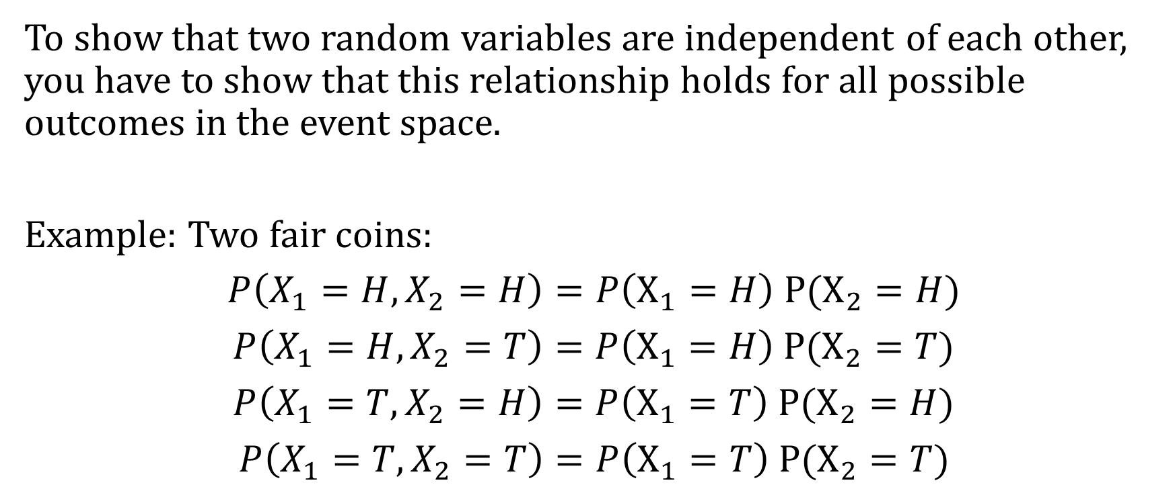
Independence
To show that two random variables are independent of each other, you have to show that this relationship holds for all possible outcomes in the event space.
Example: Two fair coins:
$P\left(X_{1}=H,X_{2}=H\right)=P\left(X_{1}=H\right) P(X_{2}=H)$
$P\left(X_{1}=H,X_{2}=T\right)=P\left(X_{1}=H\right) P(X_{2}=T)$
$P\left(X_{1}=T,X_{2}=H\right)=P\left(X_{1}=T\right) P(X_{2}=H)$
$P\left(X_{1}=T,X_{2}=T\right)=P\left(X_{1}=T\right) P(X_{2}=T)$

Slide 11
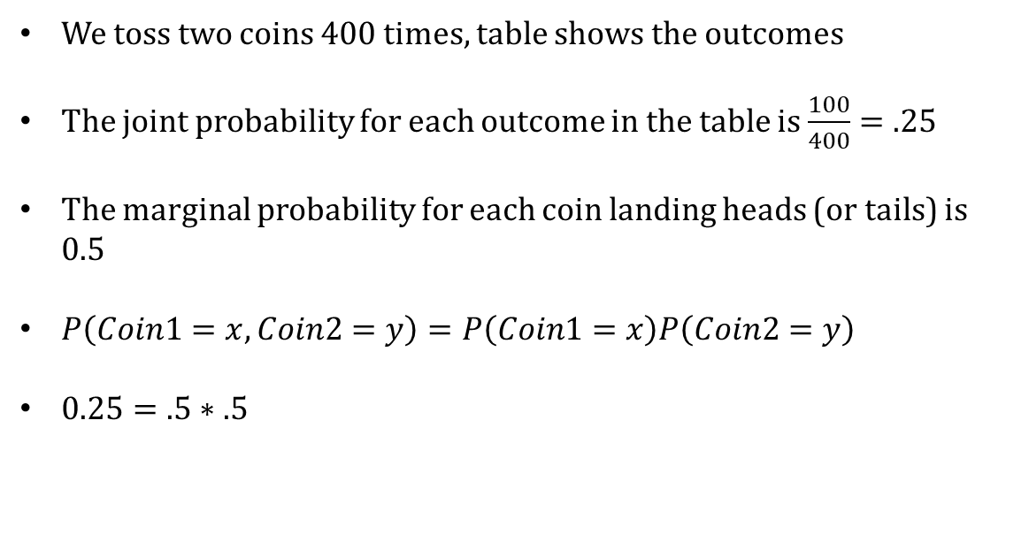
Let’s Verify
We toss two coins 400 times, table shows the outcomes
The joint probability for each outcome in the table is $\frac{100}{400}=.25$
The marginal probability for each coin landing heads (or tails) is $0.5$
$P\left(Coin1=x,Coin2=y\right)=P\left(Coin1=x\right)P\left(Coin2=y\right)$
$0.25=.5∗.5$
Coin 1 | Coin 2 | Count
Heads | Heads | 100
Heads | Tails | 100
Tails | Heads | 100
Tails | Tails | 100

Slide 12

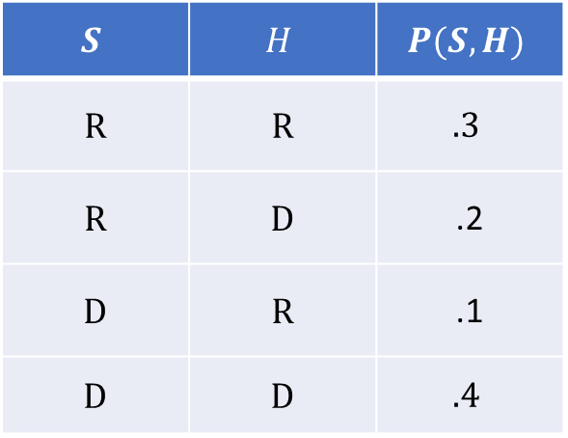
Independence
Returning to election example
$S$ – outcome for Senate (D or R)
$H$ – outcome for House (D or R)
Does $P\left(S, H\right)=P\left(S) P(H\right)?$
$$S$$ | $$H$$ | $$P(S,H)$$
R | R | $$.3$$
R | D | .2
D | R | .1
D | D | $$.4$$

Slide 13

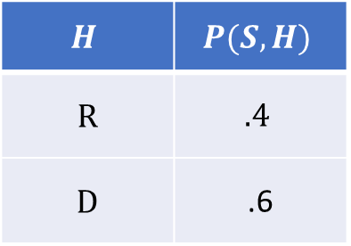
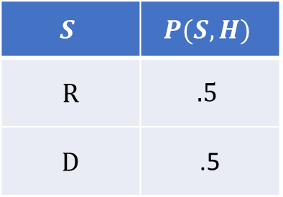
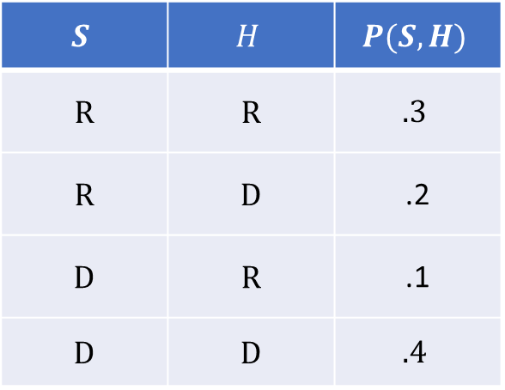
Independence
$$S$$ | $$H$$ | $$P(S,H)$$
R | R | $$.3$$
R | D | .2
D | R | .1
D | D | $$.4$$
Does $P\left(S, H\right)=P\left(S) P(H\right)?$
$$S$$ | $$P(S,H)$$
R | $$.5$$
D | .5
$$H$$ | $$P(S,H)$$
R | $$.4$$
D | .6

Slide 14

Independence
$$S$$ | $$H$$ | $$P(S,H)$$
R | R | $$.3$$
R | D | .2
D | R | .1
D | D | $$.4$$
Does $P\left(S, H\right)=P\left(S) P(H\right)?$
$P\left(S=D,H=D\right)=0.$4
$P\left(S=D\right)P\left(H=D\right)=0.5 ∗0.6=0.3$
$$S$$ | $$P(S,H)$$
R | $$.5$$
D | .5
$$H$$ | $$P(S,H)$$
R | $$.4$$
D | .6

Slide 15

Independence
$$S$$ | $$H$$ | $$P(S,H)$$
R | R | $$.3$$
R | D | .2
D | R | .1
D | D | $$.4$$
Does $P\left(S, H\right)=P\left(S) P(H\right)?$
$P\left(S=D,H=D\right)=0.4$
$P\left(S=D\right)P\left(H=D\right)=0.5 ∗0.6=0.3$
Not independent
$$S$$ | $$P(S,H)$$
R | $$.5$$
D | .5
$$H$$ | $$P(S,H)$$
R | $$.4$$
D | .6

Slide 16
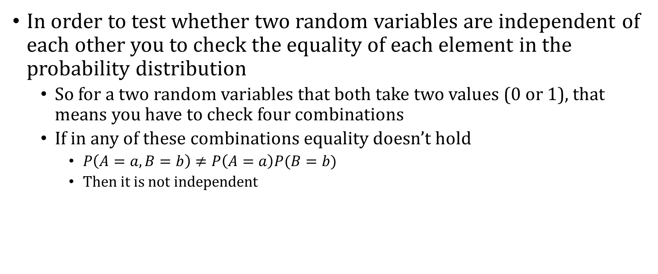
Recap
In order to test whether two random variables are independent of each other you to check the equality of each element in the probability distribution
So for a two random variables that both take two values (0 or 1), that means you have to check four combinations
If in any of these combinations equality doesn’t hold
$P\left(A=a,B=b\right)≠P\left(A=a\right)P(B=b)$
Then it is not independent

Slide 17
Bayes Theorem

Slide 18

Bayes Theorem
$P\left(A | B\right)P(B)=P\left(B | A\right)P(A)$
Bayes Theorem States:
$$P\left(A | B\right)=\frac{P\left(B | A\right) P\left(A\right)}{P(B)}$$

Slide 19

Pre-test, Post-test Probability
Let $C$ be whether someone has Covid
The prevalence of Covid in a population is 1%
$P\left(C=1\right)=1\%$ (base rate, outcome rate, y-bar)
Notes:
https://www.bmj.com/content/369/bmj.m1808

Slide 20
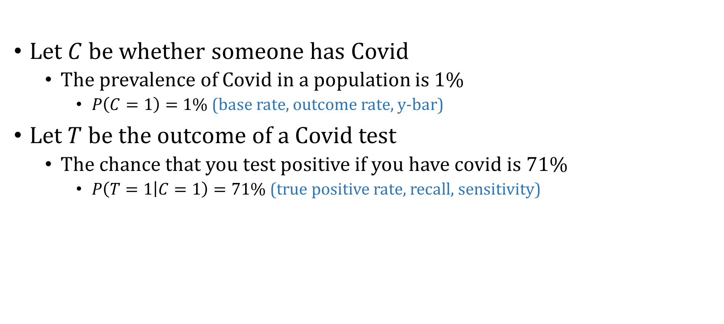
Pre-test, Post-test Probability
Let $C$ be whether someone has Covid
The prevalence of Covid in a population is 1%
$P\left(C=1\right)=1\%$ (base rate, outcome rate, y-bar)
Let $T$ be the outcome of a Covid test
The chance that you test positive if you have covid is 71%
$P\left(T=1 | C=1\right)=71\%$ (true positive rate, recall, sensitivity)
Notes:
https://www.bmj.com/content/369/bmj.m1808

Slide 21
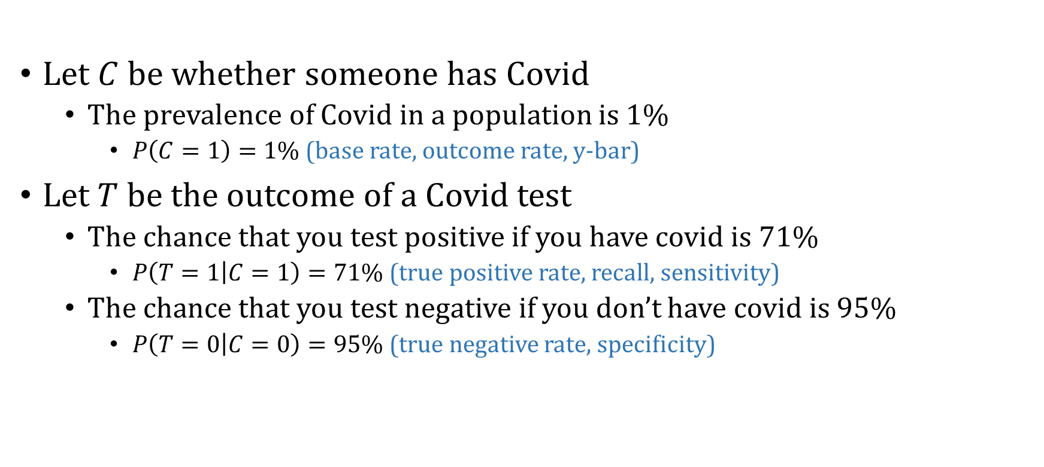
Pre-test, Post-test Probability
Let $C$ be whether someone has Covid
The prevalence of Covid in a population is 1%
$P\left(C=1\right)=1\%$ (base rate, outcome rate, y-bar)
Let $T$ be the outcome of a Covid test
The chance that you test positive if you have covid is 71%
$P\left(T=1 | C=1\right)=71\%$ (true positive rate, recall, sensitivity)
The chance that you test negative if you don’t have covid is 95%
$P\left(T=0 | C=0\right)=95\%$ (true negative rate, specificity)
Notes:
https://www.bmj.com/content/369/bmj.m1808

Slide 22
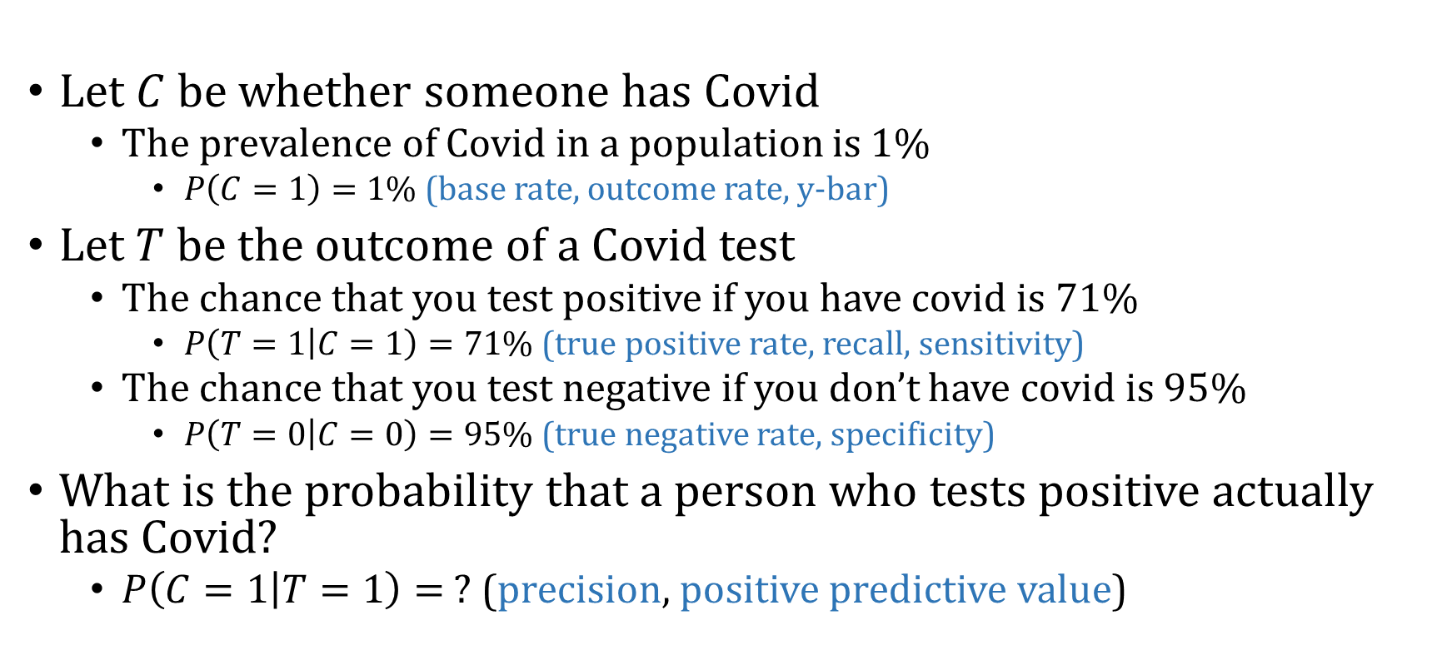
Pre-test, Post-test Probability
Let $C$ be whether someone has Covid
The prevalence of Covid in a population is 1%
$P\left(C=1\right)=1\%$ (base rate, outcome rate, y-bar)
Let $T$ be the outcome of a Covid test
The chance that you test positive if you have covid is 71%
$P\left(T=1 | C=1\right)=71\%$ (true positive rate, recall, sensitivity)
The chance that you test negative if you don’t have covid is 95%
$P\left(T=0 | C=0\right)=95\%$ (true negative rate, specificity)
What is the probability that a person who tests positive actually has Covid?
$P\left(C=1 | T=1\right)= ?$ (precision, positive predictive value)
Notes:
https://www.bmj.com/content/369/bmj.m1808

Slide 23
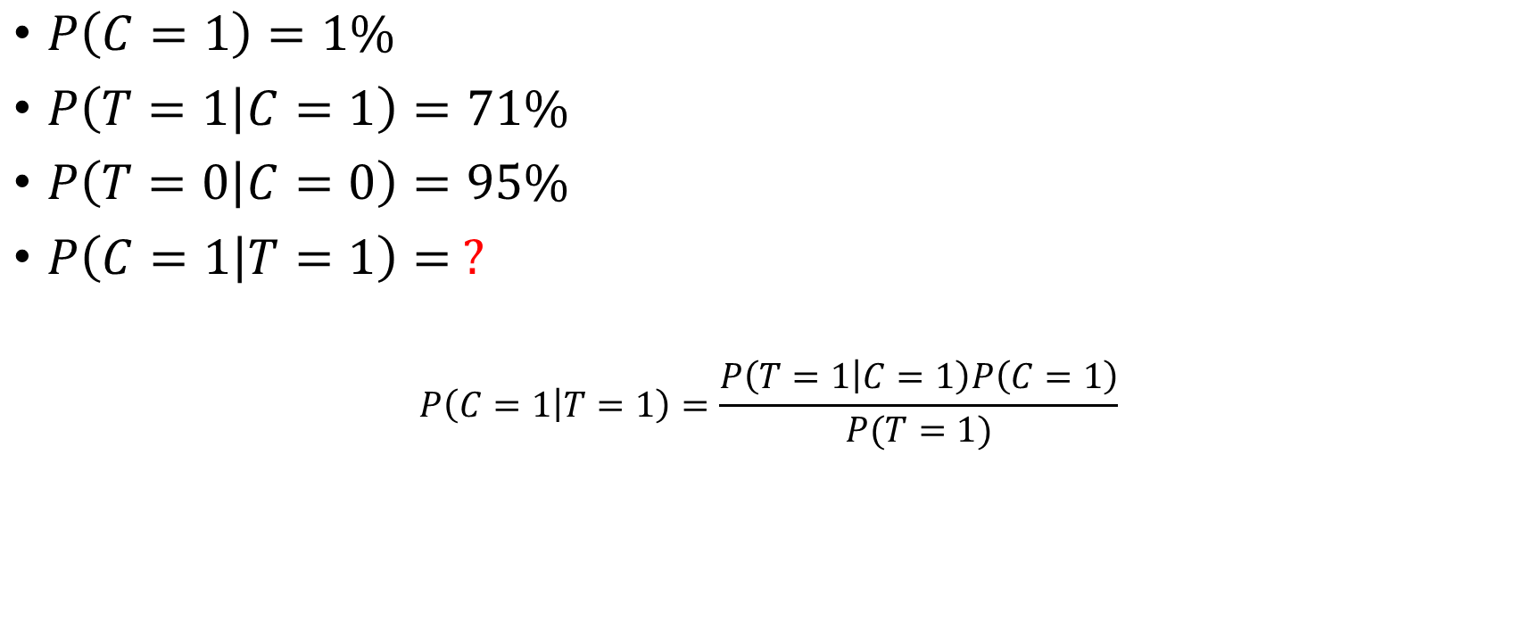
Pre-test, Post-test Probability
$P\left(C=1\right)=1\%$
$P\left(T=1 | C=1\right)=71\%$
$P\left(T=0 | C=0\right)=95\%$
$P\left(C=1 | T=1\right)= ?$
$$P\left(C=1 | T=1\right)=\frac{P\left(T=1 | C=1\right)P\left(C=1\right)}{P(T=1)}$$

Slide 24
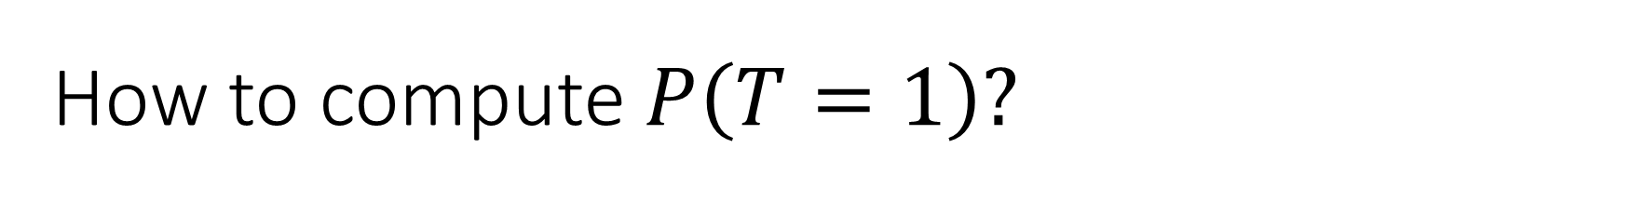
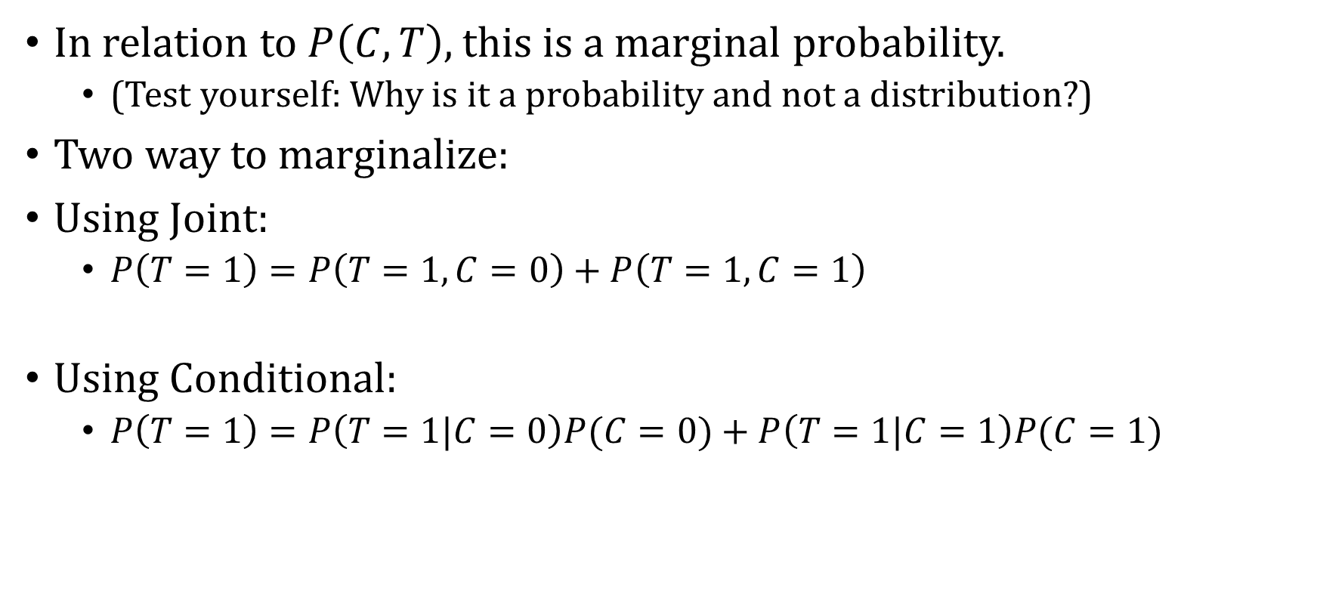
How to compute $P\left(T=1\right)?$
In relation to $P\left(C, T\right),$ this is a marginal probability.
(Test yourself: Why is it a probability and not a distribution?)
Two way to marginalize:
Using Joint:
$P\left(T=1\right)=P\left(T=1, C=0\right)+P\left(T=1,C=1\right)$
Using Conditional:
$P\left(T=1\right)=P\left(T=1|C=0\right)P(C=0)+P\left(T=1|C=1\right)P(C=1)$

Slide 25
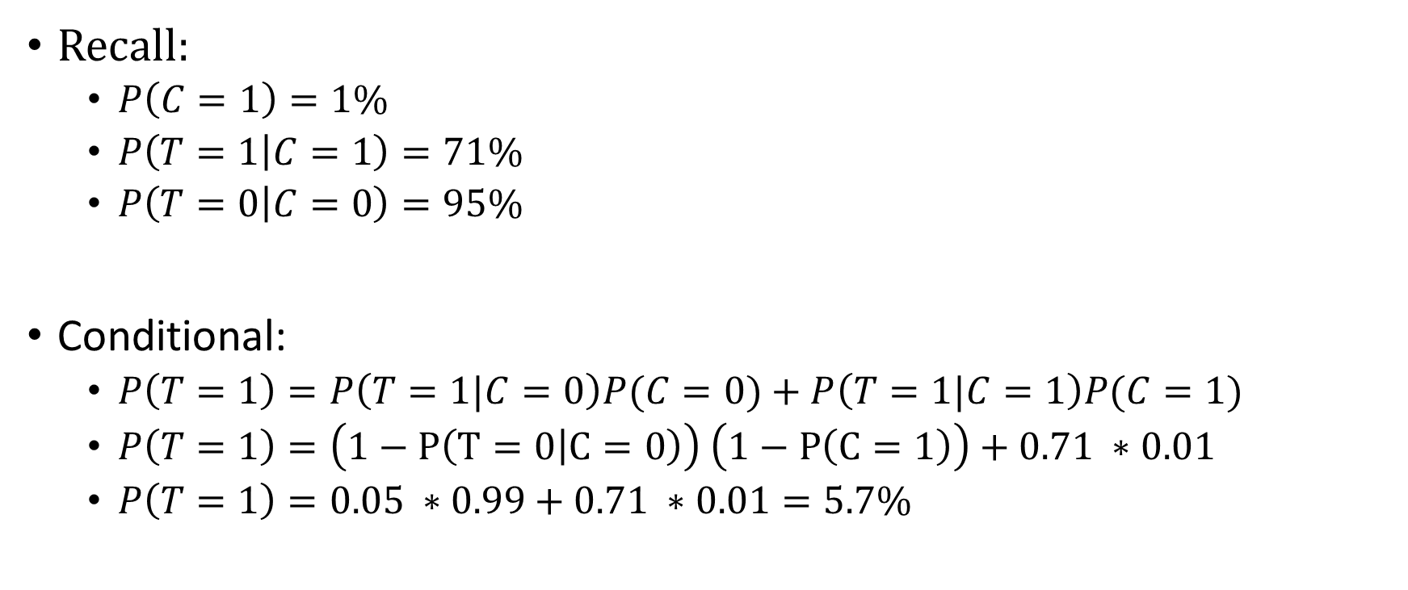
How to compute $P\left(T=1\right)?$
Recall:
$P\left(C=1\right)=1\%$
$P\left(T=1 | C=1\right)=71\%$
$P\left(T=0 | C=0\right)=95\%$
Conditional:
$P\left(T=1\right)=P\left(T=1|C=0\right)P(C=0)+P\left(T=1|C=1\right)P(C=1)$
$P\left(T=1\right)=\left(1−P\left(T=0 | C=0\right)\right) \left(1−P\left(C=1\right)\right)+0.71 ∗0.01$
$P\left(T=1\right)=0.05 ∗0.99+0.71 ∗0.01=5.7\%$

Slide 26

Pre-test, Post-test Probability
$P\left(C=1\right)=1\%$
$P\left(T=1 | C=1\right)=71\%$
$P\left(T=0 | C=0\right)=95\%$
$P\left(C=1 | T=1\right)= ?$
$$P\left(C=1 | T=1\right)=\frac{P\left(T=1 | C=1\right)P\left(C=1\right)}{P\left(T=1|C=0\right)P(C=0)+P\left(T=1|C=1\right)P(C=1)}=$$
$$\frac{\begin{aligned} \\ 0.71 ∗0.01\end{aligned}}{0.057}=12.5\%$$

Slide 27
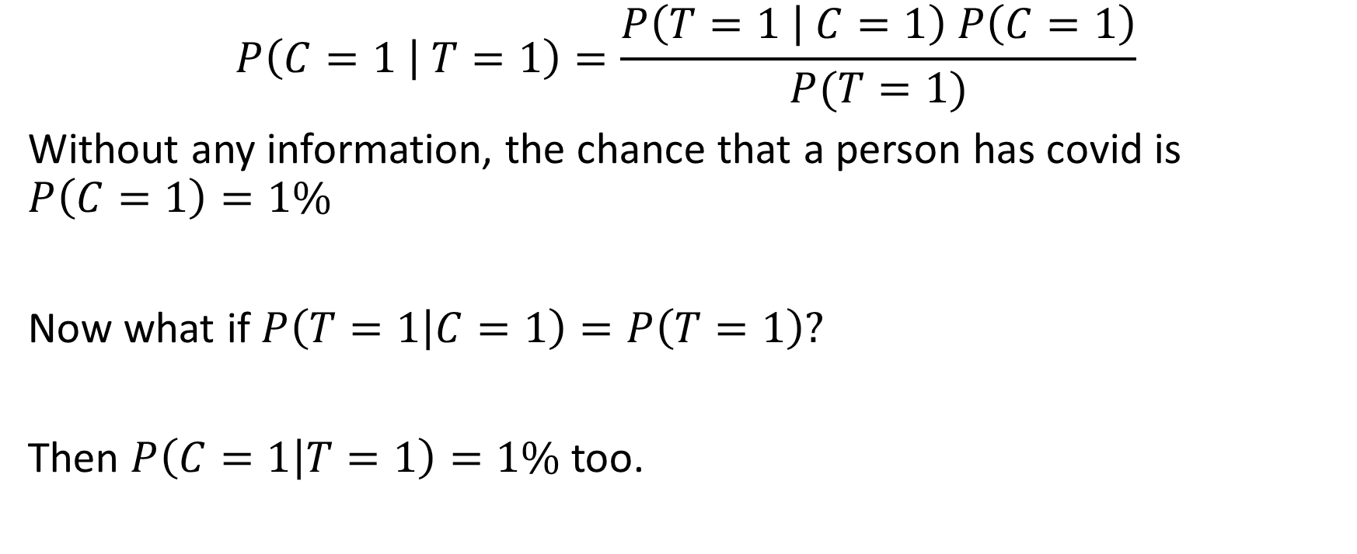
Bayes Theorem – Updating Beliefs
$$P\left(C=1 | T=1\right)=\frac{P\left(T=1 | C=1\right) P\left(C=1\right)}{P(T=1)}$$
Without any information, the chance that a person has covid is $P\left(C=1\right)=1\%$
Now what if $P\left(T=1 | C=1\right)=P\left(T=1\right)?$
Then $P\left(C=1 | T=1\right)=1\%$ too.

Slide 28
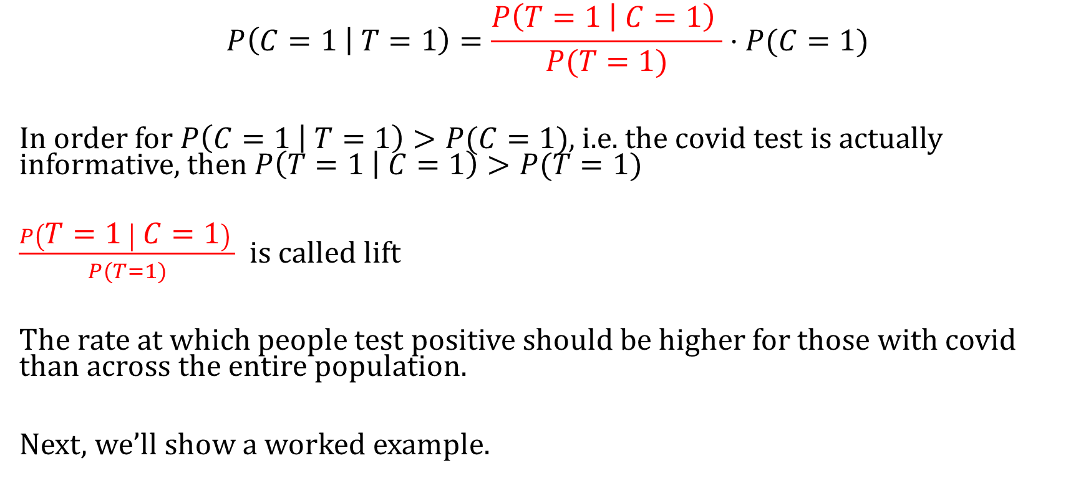
Bayes Theorem – Updating Beliefs
$$P\left(C=1 | T=1\right)=\frac{P\left(T=1 | C=1\right) }{P(T=1)}⋅P(C=1)$$
In order for $P\left(C=1 | T=1\right)>P(C=1)$, i.e. the covid test is actually informative, then $P\left(T=1 | C=1\right)>P(T=1)$
$\frac{P\left(T=1 | C=1\right) }{P(T=1)}$ is called lift
The rate at which people test positive should be higher for those with covid than across the entire population.
Next, we’ll show a worked example.

Slide 29
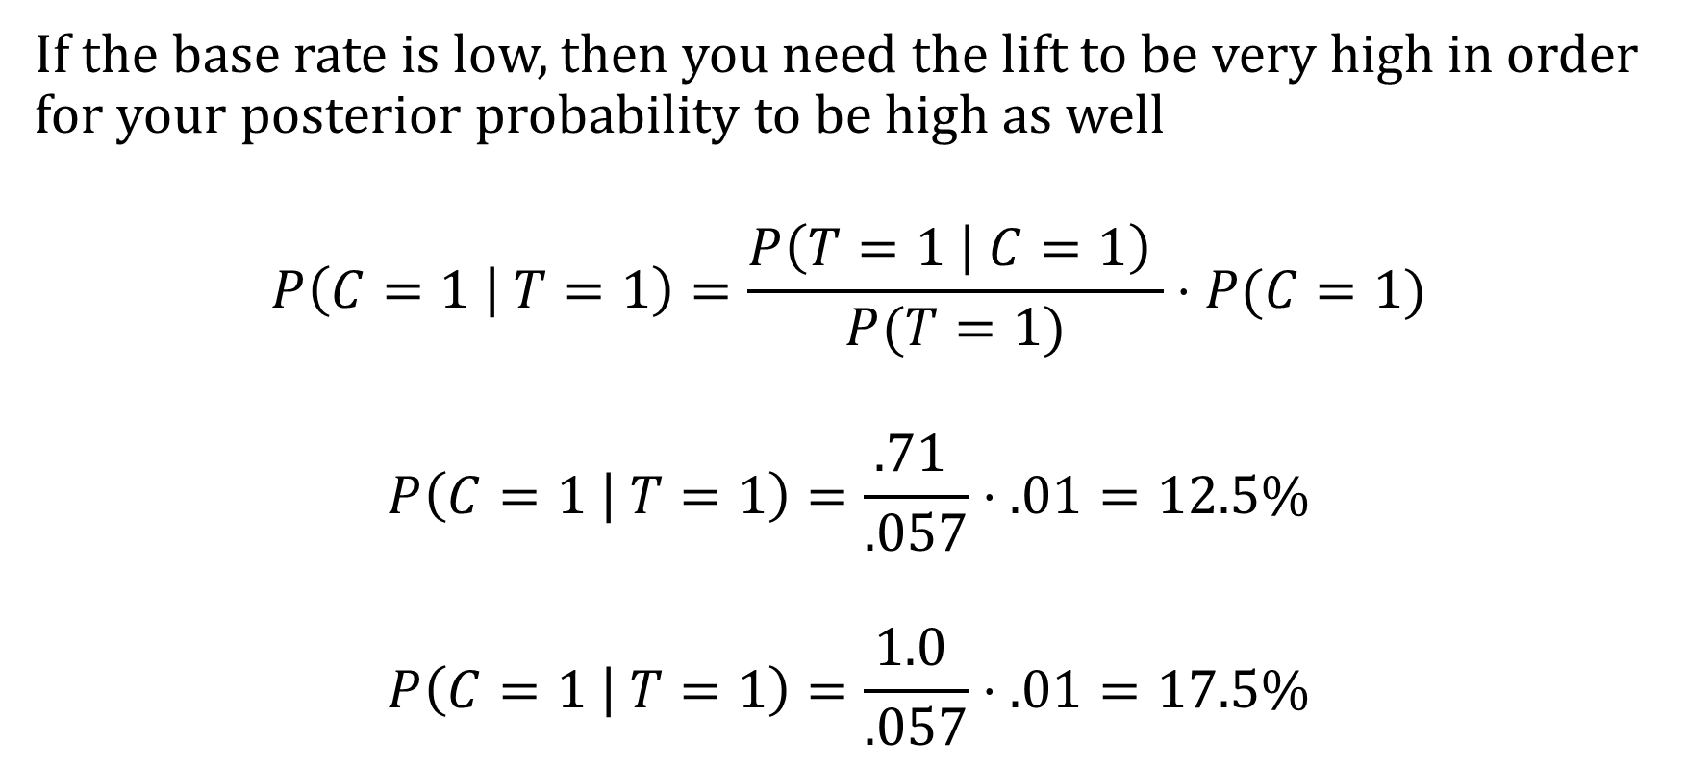
The Problem With Low Prevalence
If the base rate is low, then you need the lift to be very high in order for your posterior probability to be high as well
$$P\left(C=1 | T=1\right)=\frac{P\left(T=1 | C=1\right) }{P(T=1)}⋅P(C=1)$$
$$P\left(C=1 | T=1\right)=\frac{.71 }{.057}⋅.01=12.5\%$$
$$P\left(C=1 | T=1\right)=\frac{1.0 }{.057}⋅.01=17.5\%$$

Slide 30
Probability Practice

Slide 31
Relationships to Know (Probability Cheat Sheet)
Conditional Probability Formula:
$P\left(A | B\right)=\frac{P\left(A, B\right)}{P\left(B\right)}$
$P\left(B | A\right)=\frac{P\left(A,B\right)}{P\left(A\right)}$
Chain Rule:
$P\left(A, B\right)=P\left(A | B\right)P\left(B\right)=P\left(B | A\right)P\left(A\right)$
Bayes Theorem
$P\left(A | B\right)=\frac{P\left(B | A\right)P(A)}{P(B)}$
$P\left(B | A\right)=\frac{P\left(A | B\right)P(B)}{P(A)}$
Marginalizing:
$P\left(B\right)=P\left(B,A=0\right)+P(B,A=1)$
$P\left(B\right)=P\left(B|A=0\right)P\left(A=0\right)+P\left(B | A=1\right)P(A=1)$
Bayes Theorem:
$P\left(B | A\right)=\frac{P\left(A | B\right)P(B)}{P\left(A,B=0\right)+P(A,B=1)}$
$P\left(B | A\right)=\frac{P\left(A | B\right)P(B)}{P\left(A|B=0\right)P(B=0)+P\left(A | B=1\right)P(B=1)}$

Slide 32
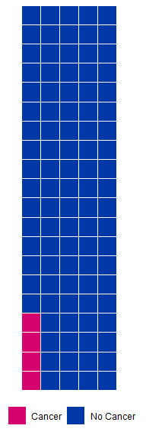
Pre-test, post-test
We want to know the chance of having cancer given you tested positive.
The prevalence of a particular type of cancer is 4% in a population

Slide 33
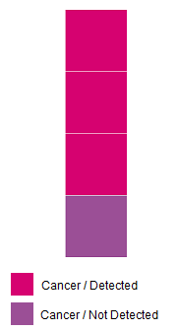
Pre-test, post-test
We want to what is the chance of having cancer given you tested positive.
The prevalence of a particular type of cancer is 4% in a population
There is a blood test with a detection rate of 75% if a patient has cancer

Slide 34
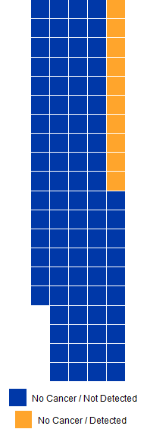
Pre-test, post-test
We want to what is the chance of having cancer given you tested positive.
The prevalence of a particular type of cancer is 4% in a population
There is a blood test with a detection rate of 75% if a patient has cancer
If a patient doesn’t have cancer, the test successfully returns a negative result 75% of the time

Slide 35
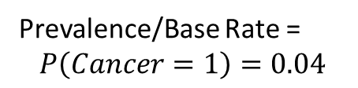
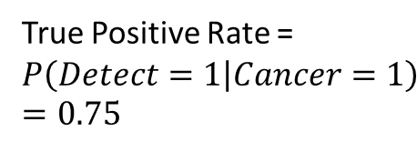
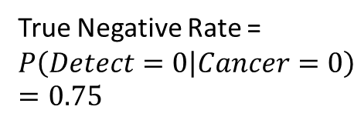
Pre-test, post-test
True Negative Rate =
$$P\left(Detect=0 | Cancer=0\right)=0.75$$
True Positive Rate =
$$P\left(Detect=1 | Cancer=1\right)=0.75$$
Prevalence/Base Rate =
$$P\left(Cancer=1\right)=0.04$$

Slide 36
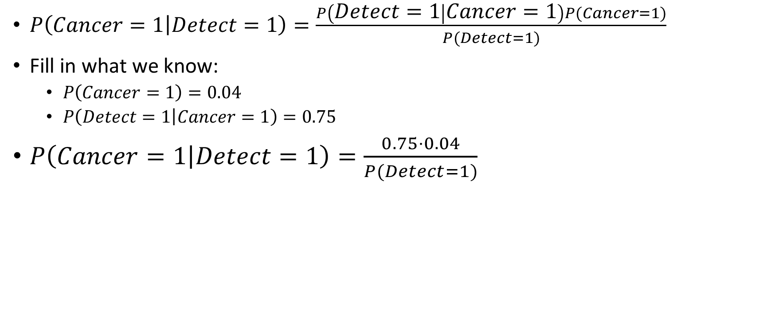
Bayes Theorem
$P\left(Cancer=1 | Detect=1\right)=\frac{P\left(Detect=1 | Cancer=1\right)P(Cancer=1)}{P(Detect=1)}$
Fill in what we know:
$P\left(Cancer=1\right)=0.04$
$P\left(Detect=1 | Cancer=1\right)=0.75$
$P\left(Cancer=1 | Detect=1\right)=\frac{0.75⋅0.04}{P(Detect=1)}$

Slide 37
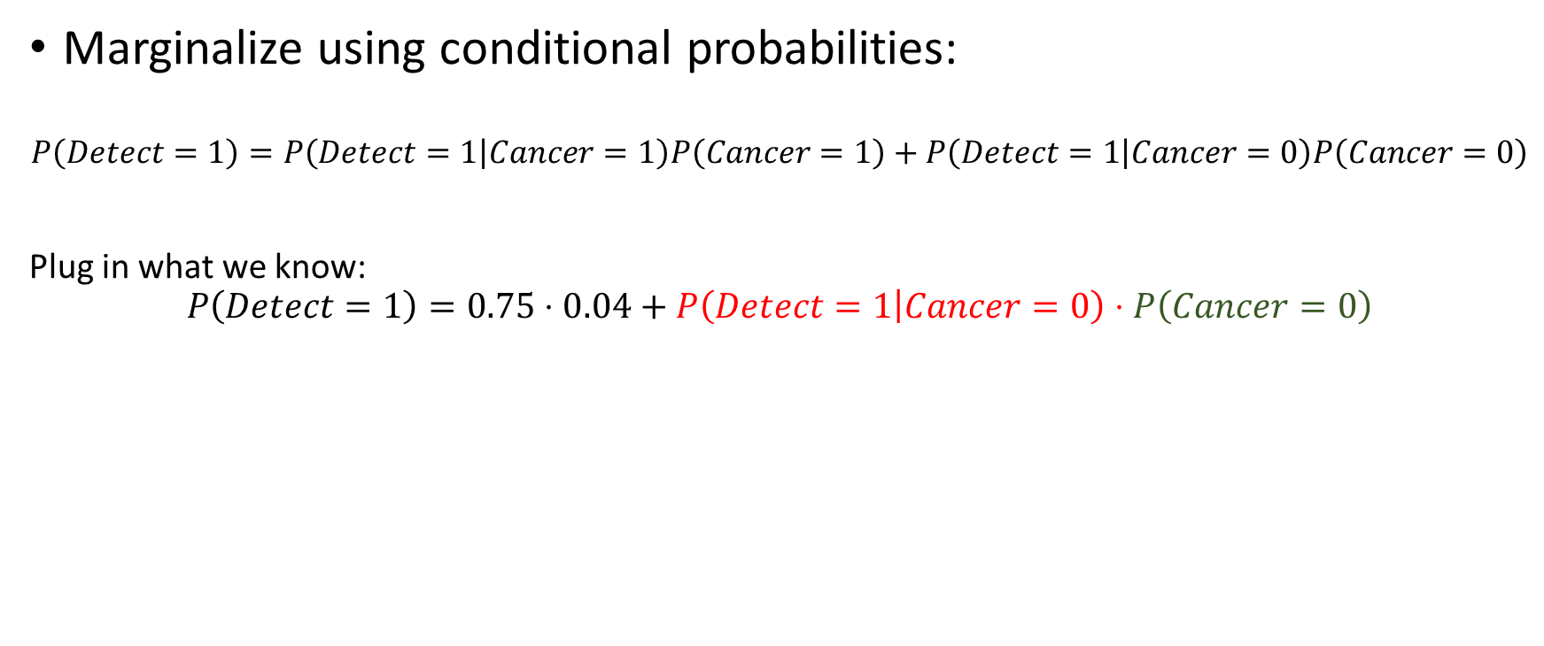

$$P(Detect=1)$$
Marginalize using conditional probabilities:
$$P\left(Detect=1\right)=P\left(Detect=1 | Cancer=1\right)P\left(Cancer=1\right)+P\left(Detect=1 | Cancer=0\right)P\left(Cancer=0\right)$$
Plug in what we know:
$$P\left(Detect=1\right)=0.75⋅0.04+P\left(Detect=1 | Cancer=0\right)⋅P\left(Cancer=0\right)$$

Slide 38


$$P(Cancer=0)$$
Since $P\left(Cancer=1\right)=0.04$
$P\left(Cancer=0\right)=1−P\left(Cancer=1\right)=0.96$

Slide 39


$$P(Detect=1|Cancer=0)$$
Since $P\left(Detect=0|Cancer=0\right)=0.75$
$P\left(Detect=1|Cancer=0\right)=1−P\left(Detect=1|Cancer=0\right)=0.25$

Slide 40
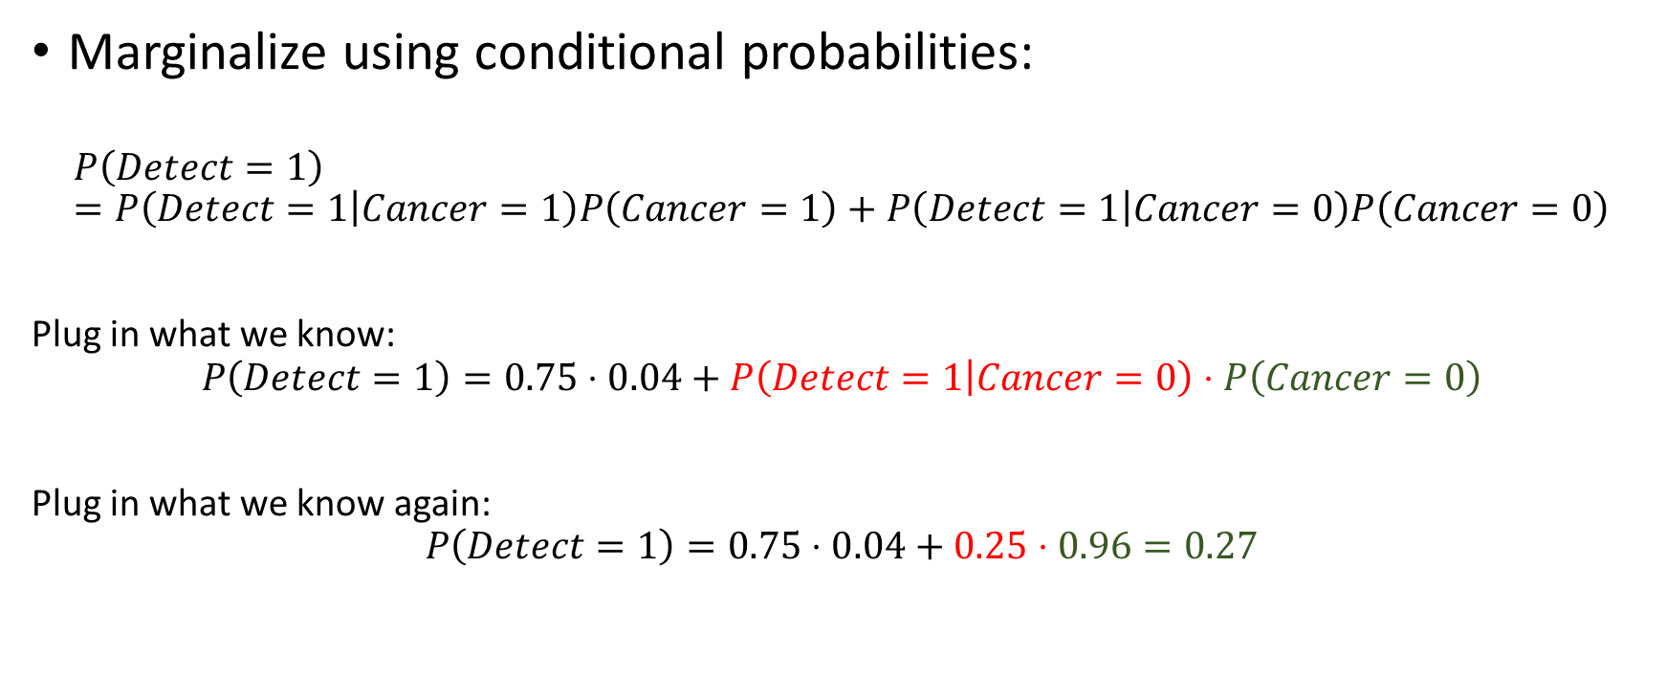
$$P(Detect=1)$$
Marginalize using conditional probabilities:
$$P\left(Detect=1\right)=P\left(Detect=1 | Cancer=1\right)P\left(Cancer=1\right)+P\left(Detect=1 | Cancer=0\right)P\left(Cancer=0\right)$$
Plug in what we know:
$$P\left(Detect=1\right)=0.75⋅0.04+P\left(Detect=1 | Cancer=0\right)⋅P\left(Cancer=0\right)$$
Plug in what we know again:
$$P\left(Detect=1\right)=0.75⋅0.04+0.25⋅0.96=0.27$$

Slide 41
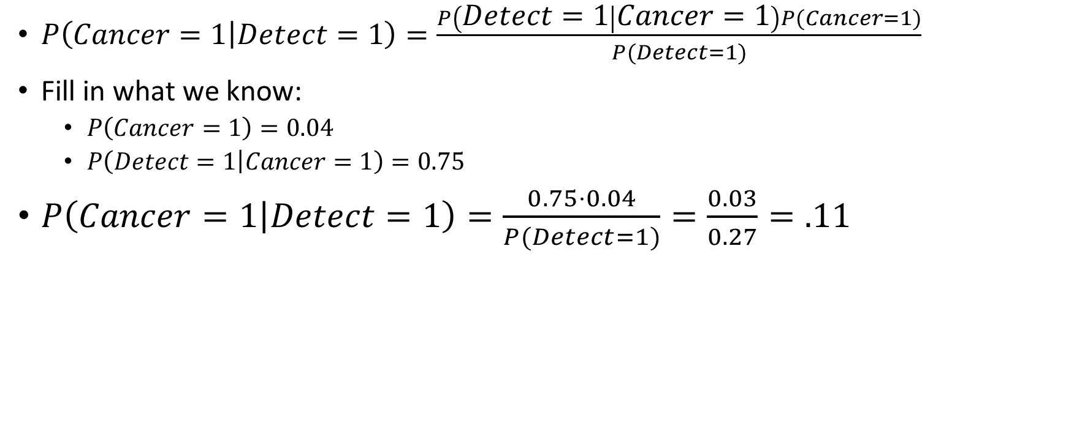
Bayes Theorem
$P\left(Cancer=1 | Detect=1\right)=\frac{P\left(Detect=1 | Cancer=1\right)P(Cancer=1)}{P(Detect=1)}$
Fill in what we know:
$P\left(Cancer=1\right)=0.04$
$P\left(Detect=1 | Cancer=1\right)=0.75$
$P\left(Cancer=1 | Detect=1\right)=\frac{0.75⋅0.04}{P(Detect=1)}=\frac{0.03}{0.27}=.11$

Slide 42
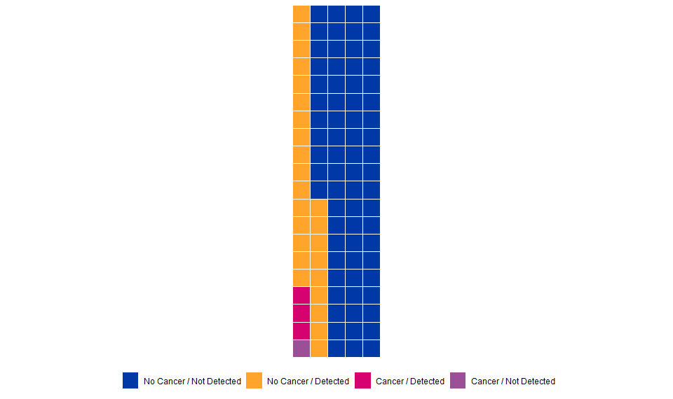

Result
$P\left(Cancer=1 | Detect=1\right)=.11$

Slide 43
Performance Metrics

Slide 44

Is TikTok’s algorithm accurate?
A video that TikTok shows you is one that it predicts you will like/interact with
A video that TikTok doesn’t show you is one that it predicts you won’t like
A video that you like/interact with is one that you actually like

Slide 45
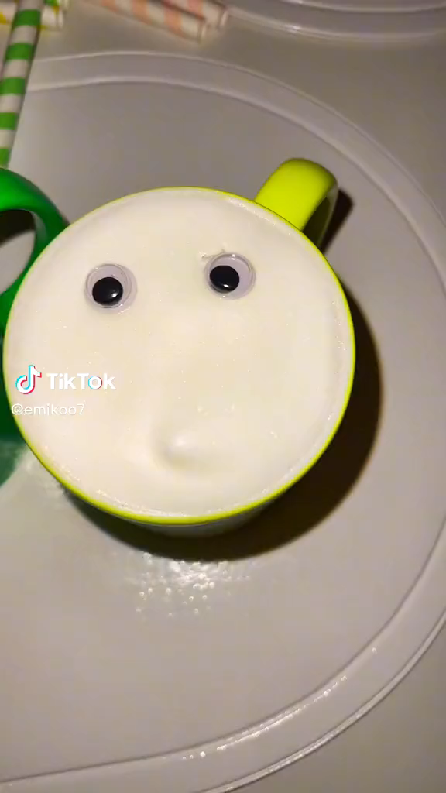

Slide 46
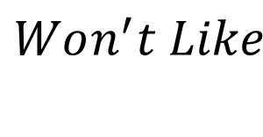



Is TikTok’s algorithm accurate?
$$Didn^{′}t Like$$
$$Did Like$$
Correctly Predicted You Wouldn’t Like
Incorrectly Predicted You Wouldn’t Like
$$Won^{′}t Like$$
Incorrectly Predicted You Would Like
Correctly Predicted You Would Like
$$Will Like$$

Slide 47
Which measure of accuracy is most informative?
Percent of predictions that are correct
Percent of videos that you would like that are actually shown to you
Percent of videos that are shown to you that you would actually like
Percent of videos that you wouldn’t like that are not shown to you
Percent of videos that are not shown to you that you wouldn’t like

Slide 48
Generating Performance Metrics
General setup: Algorithm that assigns scores
Score
Outcome
1
1
1
1
0
1
1
0
0
1
0
0
1
0
0
0
0
0.5
0

Slide 49
General setup: Algorithm that assigns scores
Scores above a certain threshold are classified as predicted likes/engagements
Score
Outcome
1
1
1
1
0
1
1
0
0
1
0
0
1
0
0
0
0
Threshold
0.5
0

Slide 50
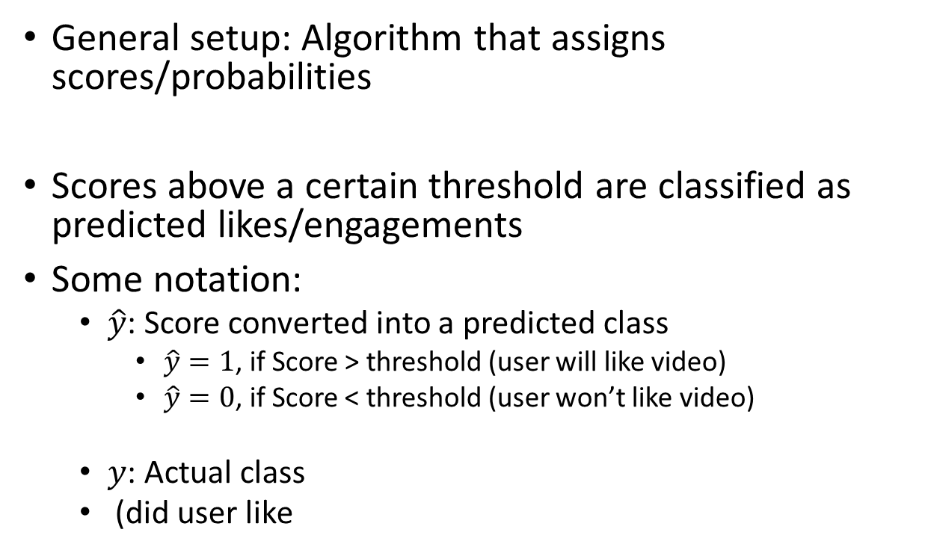
General setup: Algorithm that assigns scores/probabilities
Scores above a certain threshold are classified as predicted likes/engagements
Some notation:
$\hat{y}$: Score converted into a predicted class
$\hat{y}=1$, if Score > threshold (user will like video)
$\hat{y}=0$, if Score < threshold (user won’t like video)
$y$: Actual class
(did user like
Score
Outcome
1
1
1
1
0
1
1
0
0
1
0
0
1
0
0
0
0
0.5
0

Slide 51
$$\hat{y}$$
$$y$$
Score
Outcome
1
1
1
0
1
1
0
0
1
0
0
1
0
0
0
0

Slide 52
$$\hat{y}$$
$$y$$
Score
Outcome
1
1
1
0
1
1
0
0
1
0
0
1
0
0
0
0
$\hat{y}$=1
$\hat{y}$=0

Slide 53
Confusion Matrix
$$y=0$$
$$y=1$$
True Negative (TN)
False Negative (FN)
$$\hat{y}=0$$
False Positive (FP)
True Positive (TP)
$$\hat{y}=1$$

Slide 54
Performance Metrics in Terms of Probability
Accuracy
$\frac{TP+TN}{TP+TN+FP+FN}=P(y=\hat{y})$
Precision or Positive Predictive Value:
$$\frac{TP}{FP+TP}=P\left(y=1 \right| \hat{y}=1)$$
True Positive Rate or Recall or Sensitivity:
$$\frac{TP}{FN+TP}=P\left(\hat{y}=1 \right| y=1)$$
True Negative Rate or Specificity:
$\frac{TN}{FP+TN}=P\left(\hat{y}=0 \right| y=0)$
$$y=0$$
$$y=1$$
True Negative (TN)
False Negative (FN)
$$\hat{y}=0$$
False Positive (FP)
True Positive (TP)
$$\hat{y}=1$$

Slide 55
Which measure of accuracy is most informative?
Percent of predictions that are correct
Percent of videos that you would like that are actually shown to you
Percent of videos that are shown to you that you would actually like

Slide 56
Which measure of accuracy is most informative?
Percent of predictions that are correct
Accuracy
Percent of videos that you would like that are actually shown to you
True Positive Rate / Recall / Sensitivity
Percent of videos that are shown to you that you would actually like
Precision / Positive Predictive Value

Slide 57

Limitations of Accuracy
$Accuracy=\frac{\# of correct likes+\# of correct dislikes}{\# likes +\# of dislikes}$
Scenario 1:
$Accuracy=\frac{ 0 +90}{10 + 90}=90\%$
Scenario 2:
$Accuracy=\frac{ 10 + 80}{10 + 90}=90\%$

Slide 58
Three Error Metrics
False Discovery Rate (1-PPV):
$$\frac{FP}{TP+FP}=P(y=0|\hat{y}=1 )$$
False Positive Rate (1-TNR):
$$\frac{FP}{TN+FP}=P(\hat{y}=1|y=0)$$
False Negative Rate (1-TPR):
$$\frac{FN}{TP+FN}=P(\hat{y}=0|y=1)$$
$$y=0$$
$$y=1$$
True Negative (TN)
False Negative (FN)
$$\hat{y}=0$$
False Positive (FP)
True Positive (TP)
$$\hat{y}=1$$

Slide 59
Comparing Metrics (Same Threshold)
$$\hat{y}$$
$$y$$
$$\hat{y}$$
$$y$$
Risk Score
Outcome
Risk Score
Outcome
1
1
1
1
0
0
0
1
1
0
0
1
0
0
1
0
1
1
1
0
1
1
0
0
1
0
0
1
0
1
0
0
$\hat{y}$=1
$\hat{y}$=1
$\hat{y}$=0
$\hat{y}$=0

Slide 60
Algorithm 1
Accuracy = $\frac{700+100}{700+100+50+250}=80\%$
TPR = $\frac{100}{100+50}=75\%$
Precision = $\frac{100}{100+150}=40\%$
$$y=0$$
$$y=1$$
700
(TN)
50
(FN)
$$\hat{y}=0$$
150
(FP)
100
(TP)
$$\hat{y}=1$$

Slide 61
Algorithm 2 (Ranking Changes)
Accuracy = $\frac{750+150}{750+150+0+150}=90\%$
TPR = $\frac{150}{150+0}=100\%$
Precision = $\frac{150}{150+100}=60\%$
$$y=0$$
$$y=1$$
750
(TN)
0
(FN)
$$\hat{y}=0$$
100
(FP)
150
(TP)
$$\hat{y}=1$$

Slide 62
Comparing Metrics (Different Thresholds)
$$\hat{y}$$
$$y$$
$$\hat{y}$$
$$y$$
Risk Score
Outcome
Risk Score
Outcome
1
1
1
0
1
1
0
0
1
0
0
1
0
1
0
0
1
1
1
0
1
1
0
0
1
0
0
1
0
1
0
0
$\hat{y}$=1
$\hat{y}$=1
$\hat{y}$=0
$\hat{y}$=0

Slide 63
Algorithm 1
Accuracy = $\frac{850+100}{850+100+50+0}=95\%$
TPR = $\frac{100}{100+50}=75\%$
Precision = $\frac{100}{100+0}=100\%$
$$y=0$$
$$y=1$$
850
(TN)
50
(FN)
$$\hat{y}=0$$
0
(FP)
100
(TP)
$$\hat{y}=1$$

Slide 64
Algorithm 1 (Different Threshold)
Accuracy = $\frac{750+150}{750+150+0+150}=90\%$
TPR = $\frac{150}{150+0}=100\%$
Precision = $\frac{150}{150+100}=60\%$
$$y=0$$
$$y=1$$
750
(TN)
0
(FN)
$$\hat{y}=0$$
100
(FP)
150
(TP)
$$\hat{y}=1$$

Slide 65
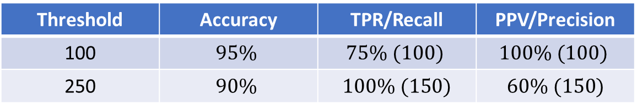
Performance
Same Threshold (Flagging 250 people)
Algorithm | Accuracy | TPR/Recall | PPV/Precision
1 | $$80\%$$ | $$75\% (100)$$ | $$40\% (100)$$
2 | $$90\%$$ | $100\% (150)$ | $$60\% (150)$$
Different Thresholds (Alg 1: 100 people, Alg 1: 250 )
Threshold | Accuracy | TPR/Recall | PPV/Precision
100 | $$95\%$$ | $$75\% (100)$$ | $$100\% (100)$$
250 | $$90\%$$ | $100\% (150)$ | $60\% (150)$

Slide 66
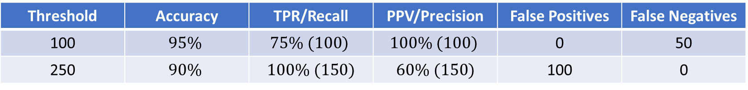
Performance
Same Threshold (Flagging 250 people)
Algorithm | Accuracy | TPR/Recall | PPV/Precision | False Positives | False Negatives
1 | $$80\%$$ | $$75\% (100)$$ | $$40\% (100)$$ | 150 | 50
2 | $$90\%$$ | $100\% (150)$ | $$60\% (150)$$ | 100 | 0
Different Thresholds (Alg 1: 100 people, Alg 1: 250 )
Threshold | Accuracy | TPR/Recall | PPV/Precision | False Positives | False Negatives
100 | $$95\%$$ | $$75\% (100)$$ | $$100\% (100)$$ | 0 | 50
250 | $$90\%$$ | $100\% (150)$ | $60\% (150)$ | 100 | 0

Slide 67
Takeaways
There are potentially different costs to different types of errors
Do you want to detain all defendants who are re-arrested?
Cost is that you will probably detain defendants who would not have been re-arrested (False Positives)
Do you want to release all defendants who would not be re-arrested?
Cost is that you will probably release defendants who would have been re-arrested (False Negatives)
No one performance metric is appropriate for all contexts
What are the costs of false negatives and false positives for the TikTok alg?

