Slide 1
INST 414: Data Science Techniques Lecture 3c Practice Problems

Slide 2
Recapping

Slide 3
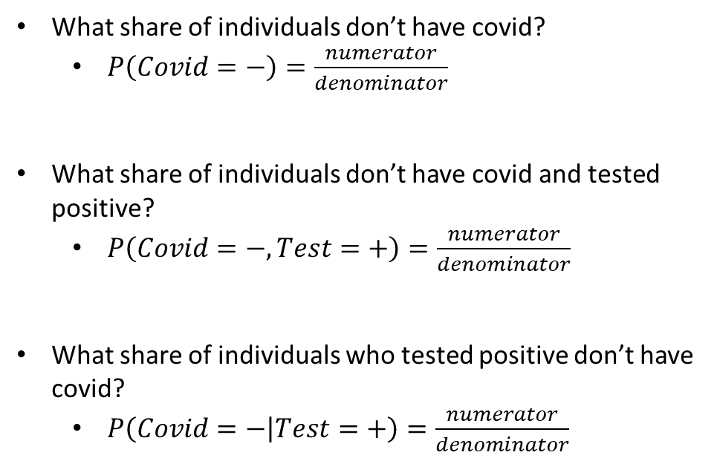
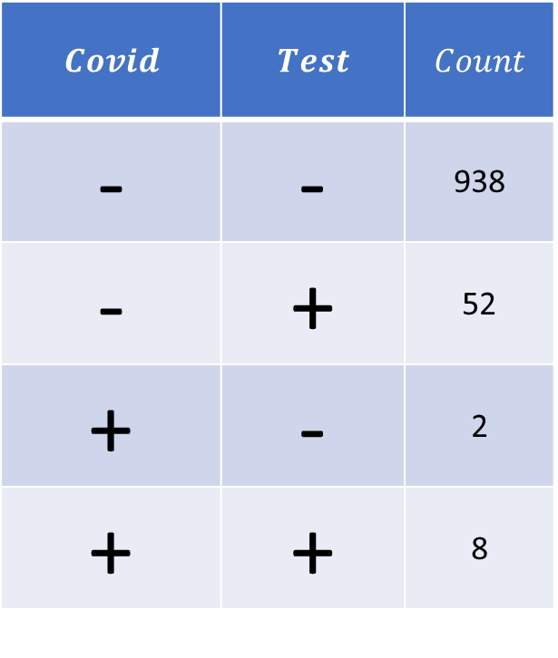
Difference between Marginal, Joint, and Conditional Probabilities
$$Covid$$ | $$Test$$ | $$Count$$
- | - | 938
- | + | 52
+ | - | 2
+ | + | 8
What share of individuals don’t have covid?
$P\left(Covid=−\right)=\frac{numerator}{denominator}$
What share of individuals don’t have covid and tested positive?
$P\left(Covid=−, Test=+\right)=\frac{numerator}{denominator}$
What share of individuals who tested positive don’t have covid?
$P\left(Covid=− | Test=+\right)=\frac{numerator}{denominator}$

Slide 4
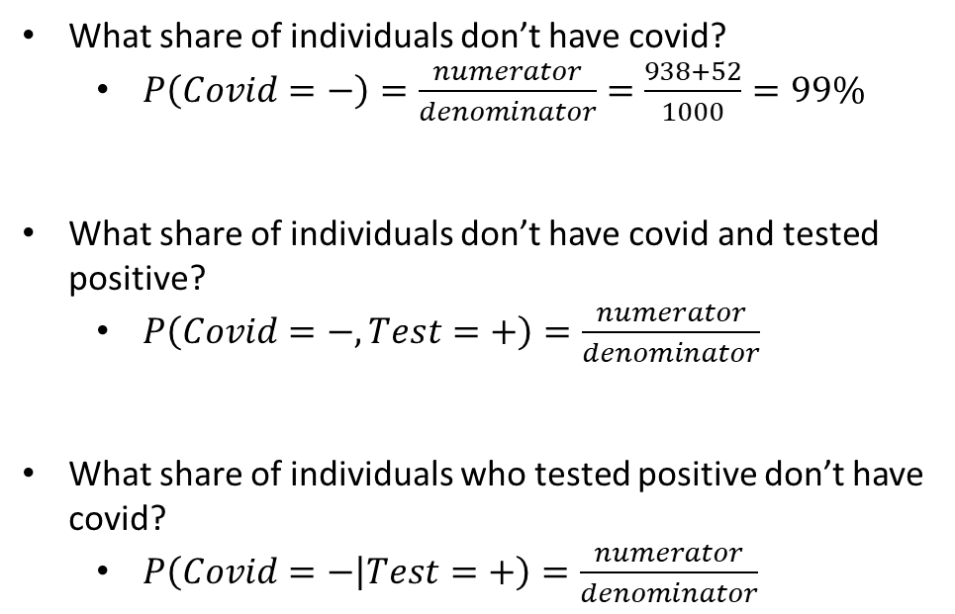
Difference between Marginal, Joint, and Conditional Probabilities
$$Covid$$ | $$Test$$ | $$Count$$
- | - | 938
- | + | 52
+ | - | 2
+ | + | 8
What share of individuals don’t have covid?
$P\left(Covid=−\right)=\frac{numerator}{denominator}=\frac{938+52}{1000}=99\%$
What share of individuals don’t have covid and tested positive?
$P\left(Covid=−, Test=+\right)=\frac{numerator}{denominator}$
What share of individuals who tested positive don’t have covid?
$P\left(Covid=− | Test=+\right)=\frac{numerator}{denominator}$

Slide 5
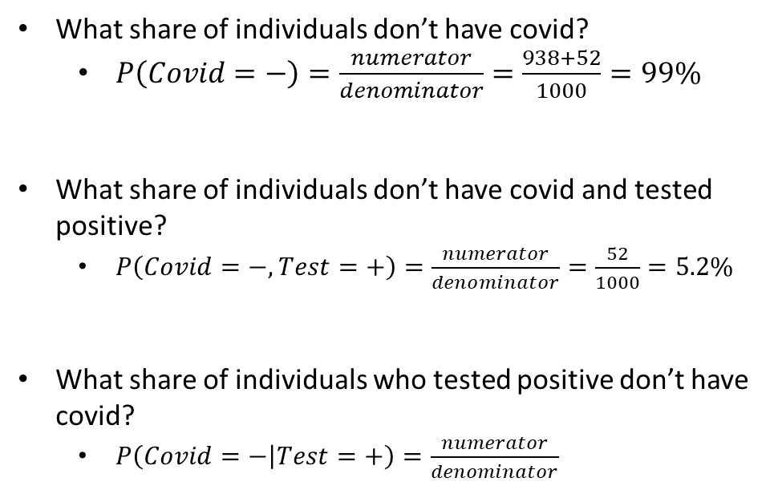
Difference between Marginal, Joint, and Conditional Probabilities
$$Covid$$ | $$Test$$ | $$Count$$
- | - | 938
- | + | 52
+ | - | 2
+ | + | 8
What share of individuals don’t have covid?
$P\left(Covid=−\right)=\frac{numerator}{denominator}=\frac{938+52}{1000}=99\%$
What share of individuals don’t have covid and tested positive?
$P\left(Covid=−, Test=+\right)=\frac{numerator}{denominator}=\frac{52}{1000}=5.2\%$
What share of individuals who tested positive don’t have covid?
$P\left(Covid=− | Test=+\right)=\frac{numerator}{denominator}$

Slide 6
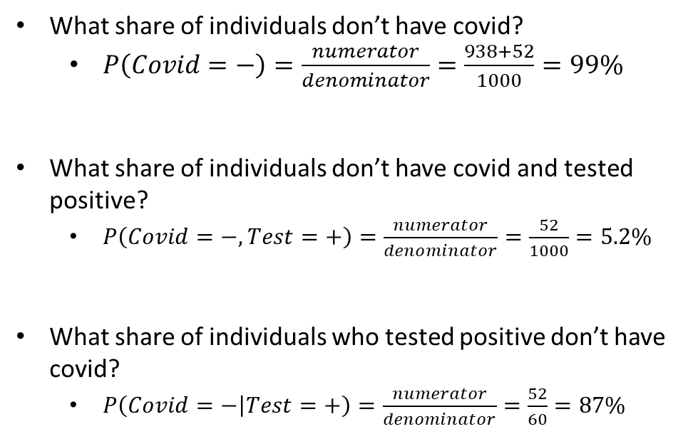
Difference between Marginal, Joint, and Conditional Probabilities
$$Covid$$ | $$Test$$ | $$Count$$
- | - | 938
- | + | 52
+ | - | 2
+ | + | 8
What share of individuals don’t have covid?
$P\left(Covid=−\right)=\frac{numerator}{denominator}=\frac{938+52}{1000}=99\%$
What share of individuals don’t have covid and tested positive?
$P\left(Covid=−, Test=+\right)=\frac{numerator}{denominator}=\frac{52}{1000}=5.2\%$
What share of individuals who tested positive don’t have covid?
$P\left(Covid=− | Test=+\right)=\frac{numerator}{denominator}=\frac{52}{60}=87\%$

Slide 7
Probability Practice

Slide 8
Dice roll
Let’s say we roll two dice one right after another. What is the probability that the sum of the two dice will be greater than 8 if the first roll was 5?

Slide 9

Dice roll – Direct Calculation
Let’s say we roll two dice one right after another. What is the probability that the sum of the two dice will be greater than 8 if the first roll was 5?
Let $X_{1}$ represent outcome of first roll
Let $X_{2}$ represent outcome of second roll

Slide 10
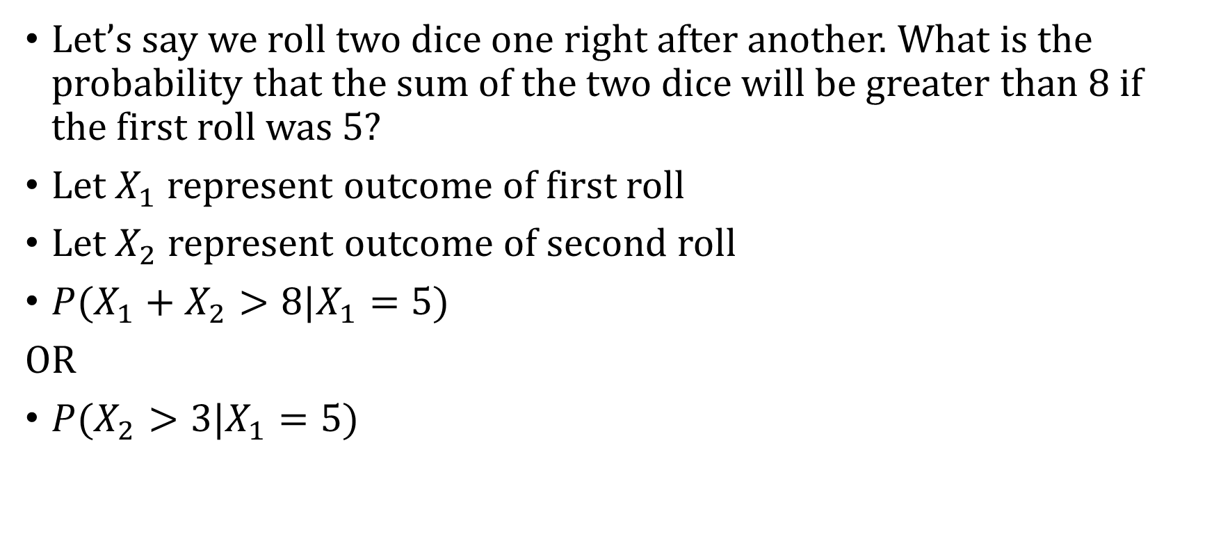
Dice roll – Direct Calculation
Let’s say we roll two dice one right after another. What is the probability that the sum of the two dice will be greater than 8 if the first roll was 5?
Let $X_{1}$ represent outcome of first roll
Let $X_{2}$ represent outcome of second roll
$P(X_{1}+X_{2}>8|X_{1}=5)$
OR
$P(X_{2}>3|X_{1}=5)$

Slide 11


Joint Distribution
$$X_{2}$$
 | 1 | 2 | 3 | 4 | 5 | 6
1 | 1/36 | 1/36 | 1/36 | 1/36 | 1/36 | 1/36
2 | 1/36 | 1/36 | 1/36 | 1/36 | 1/36 | 1/36
3 | 1/36 | 1/36 | 1/36 | 1/36 | 1/36 | 1/36
4 | 1/36 | 1/36 | 1/36 | 1/36 | 1/36 | 1/36
5 | 1/36 | 1/36 | 1/36 | 1/36 | 1/36 | 1/36
6 | 1/36 | 1/36 | 1/36 | 1/36 | 1/36 | 1/36
$$X_{1}$$

Slide 12
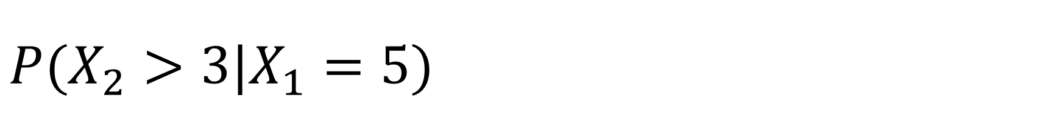
$P(X_{2}>3|X_{1}=5)$
$$X_{2}$$
 | 1 | 2 | 3 | 4 | 5 | 6
1 | 1/36 | 1/36 | 1/36 | 1/36 | 1/36 | 1/36
2 | 1/36 | 1/36 | 1/36 | 1/36 | 1/36 | 1/36
3 | 1/36 | 1/36 | 1/36 | 1/36 | 1/36 | 1/36
4 | 1/36 | 1/36 | 1/36 | 1/36 | 1/36 | 1/36
5 | 1/36 | 1/36 | 1/36 | 1/36 | 1/36 | 1/36
6 | 1/36 | 1/36 | 1/36 | 1/36 | 1/36 | 1/36
$$X_{1}$$

Slide 13

$P(X_{2}>3|X_{1}=5)$
$$X_{2}$$
 | 1 | 2 | 3 | 4 | 5 | 6
1 | 1/36 | 1/36 | 1/36 | 1/36 | 1/36 | 1/36
2 | 1/36 | 1/36 | 1/36 | 1/36 | 1/36 | 1/36
3 | 1/36 | 1/36 | 1/36 | 1/36 | 1/36 | 1/36
4 | 1/36 | 1/36 | 1/36 | 1/36 | 1/36 | 1/36
5 | 1/36 | 1/36 | 1/36 | 1/36 | 1/36 | 1/36
6 | 1/36 | 1/36 | 1/36 | 1/36 | 1/36 | 1/36
$$X_{1}$$
What share of the time is $X_{2}>3?$
$$\frac{\frac{3}{36}}{\frac{6}{36}}=\frac{1}{2}$$

Slide 14
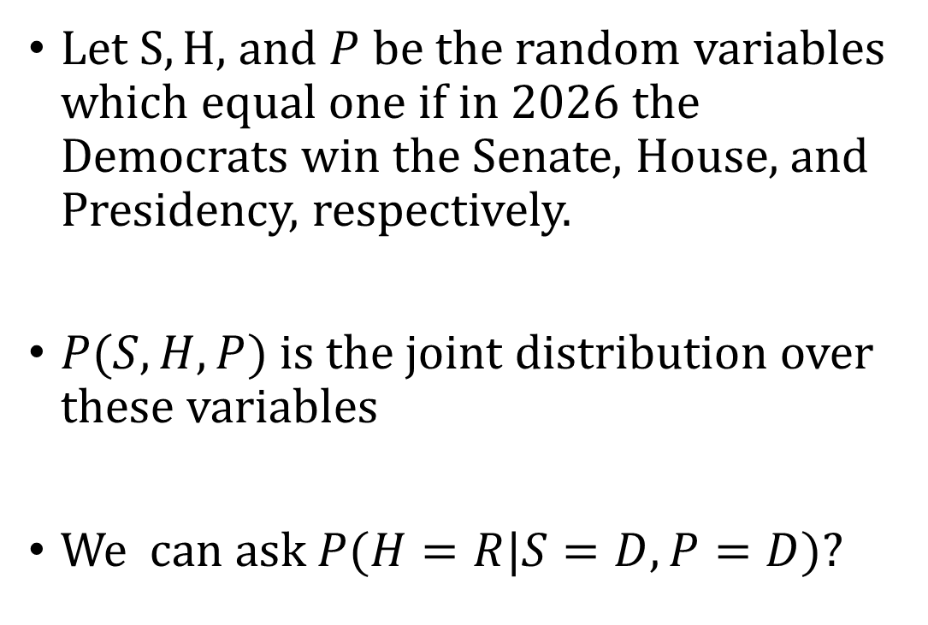
More than two random variables
House | President | Senate | Prob
D | D | D | .4
D | D | R | .05
D | R | D | .1
D | R | R | .05
R | D | D | .05
R | D | R | .1
R | R | D | .05
R | R | R | .2
Let $S, H,$ and $P$ be the random variables which equal one if in 2026 the Democrats win the Senate, House, and Presidency, respectively.
$P(S, H, P)$ is the joint distribution over these variables
We can ask $P(H=R|S=D, P=D)$?

Slide 15

More than two random variables
House | President | Senate | Prob
D | D | D | .4
D | D | R | .05
D | R | D | .1
D | R | R | .05
R | D | D | .05
R | D | R | .1
R | R | D | .05
R | R | R | .2
We can ask $P(H=R|S=D, P=D)$?
$P\left(H=R | S=D, P=D\right)=\frac{P\left(H=R, S=D, P=D\right)}{P(S=D, P=D)}$

Slide 16

More than two random variables
House | President | Senate | Prob
D | D | D | .4
D | D | R | .05
D | R | D | .1
D | R | R | .05
R | D | D | .05
R | D | R | .1
R | R | D | .05
R | R | R | .2
$P\left(H=R | S=D, P=D\right)=\frac{P\left(H=R, S=D, P=D\right)}{P(S=D, P=D)}$
$P\left(H=R, S=D, P=D\right)=.05$
$P\left(S=D,P=D\right)?$

Slide 17
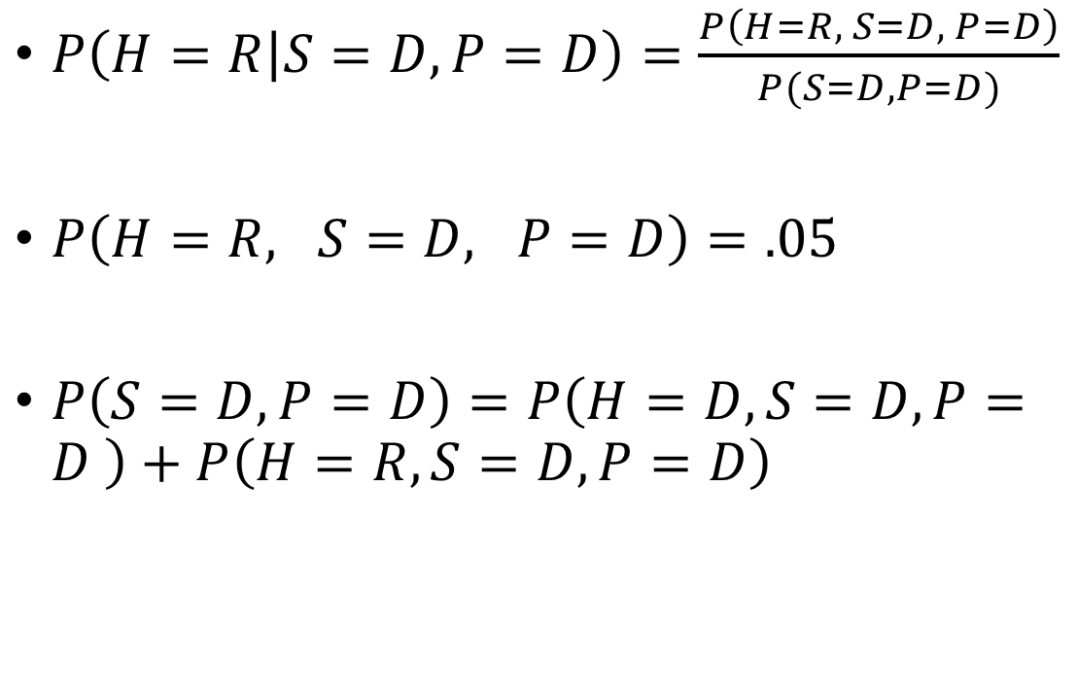
More than two random variables
House | President | Senate | Prob
D | D | D | .4
D | D | R | .05
D | R | D | .1
D | R | R | .05
R | D | D | .05
R | D | R | .1
R | R | D | .05
R | R | R | .2
$P\left(H=R | S=D, P=D\right)=\frac{P\left(H=R, S=D, P=D\right)}{P(S=D, P=D)}$
$P\left(H=R, S=D, P=D\right)=.05$
$P\left(S=D,P=D\right)=P\left(H=D, S=D,P=D \right)+P\left(H=R,S=D,P=D\right)$

Slide 18
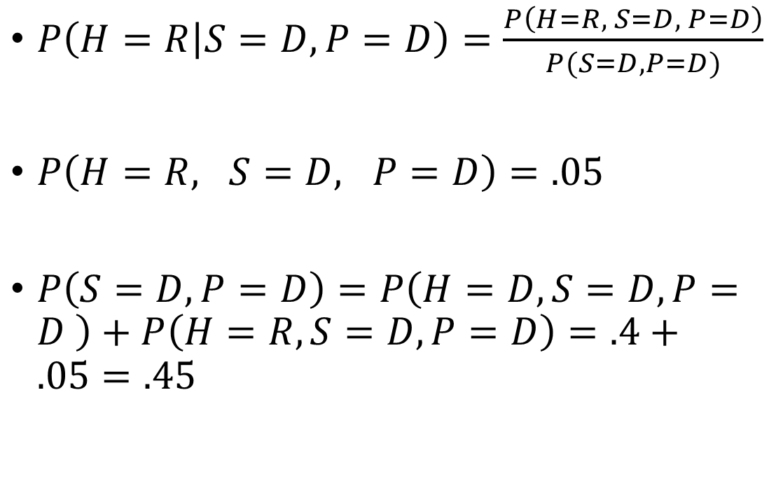
More than two random variables
House | President | Senate | Prob
D | D | D | .4
D | D | R | .05
D | R | D | .1
D | R | R | .05
R | D | D | .05
R | D | R | .1
R | R | D | .05
R | R | R | .2
$P\left(H=R | S=D, P=D\right)=\frac{P\left(H=R, S=D, P=D\right)}{P(S=D, P=D)}$
$P\left(H=R, S=D, P=D\right)=.05$
$P\left(S=D,P=D\right)=P\left(H=D, S=D,P=D \right)+P\left(H=R,S=D,P=D\right)=.4+.05=.45$

Slide 19
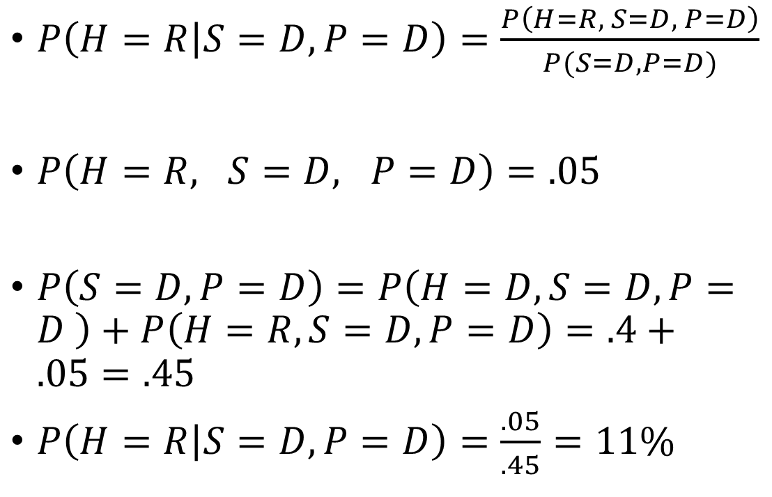
More than two random variables
House | President | Senate | Prob
D | D | D | .4
D | D | R | .05
D | R | D | .1
D | R | R | .05
R | D | D | .05
R | D | R | .1
R | R | D | .05
R | R | R | .2
$P\left(H=R | S=D, P=D\right)=\frac{P\left(H=R, S=D, P=D\right)}{P(S=D, P=D)}$
$P\left(H=R, S=D, P=D\right)=.05$
$P\left(S=D,P=D\right)=P\left(H=D, S=D,P=D \right)+P\left(H=R,S=D,P=D\right)=.4+.05=.45$
$P\left(H=R | S=D, P=D\right)=\frac{.05}{.45}=11\%$

Slide 20
Relationship Between Our Three Distributions

Slide 21
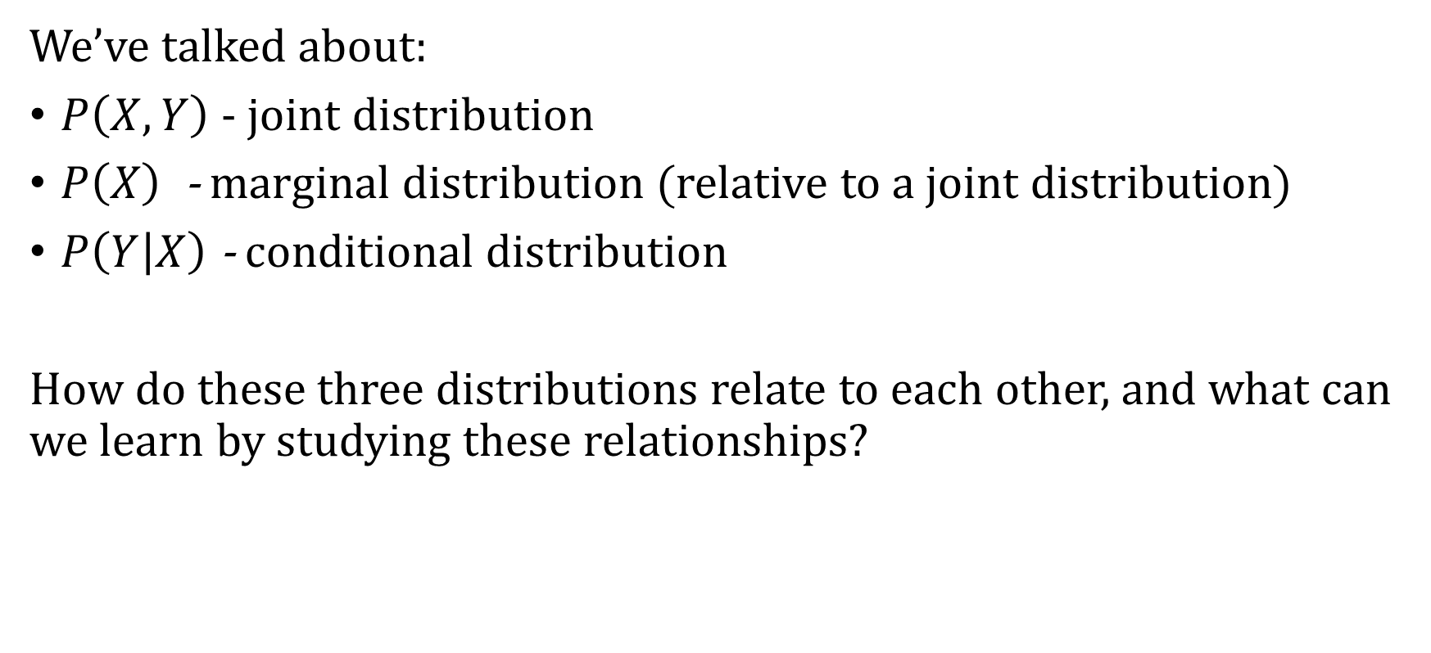
Relationship between Marginal, Joint, and Conditional
We’ve talked about:
$P\left(X, Y\right)$ - joint distribution
$P\left(X\right)$- marginal distribution (relative to a joint distribution)
$P\left(Y | X\right)$ - conditional distribution
How do these three distributions relate to each other, and what can we learn by studying these relationships?

Slide 22

Relationship between Marginal, Joint, and Conditional
Conditional Probability Formula:
$$P\left(B | A\right)=\frac{P\left(A, B\right)}{P(A)}$$

Slide 23

Relationship between Marginal, Joint, and Conditional
Conditional Probability Formula:
$$P\left(A\right) P\left(B | A\right)=\frac{P\left(A, B\right)}{P(A)}P\left(A\right)$$

Slide 24
Relationship between Marginal, Joint, and Conditional
Conditional Probability Formula:
$$P\left(A\right) P\left(B | A\right)=\frac{P\left(A, B\right)}{P(A)}P\left(A\right)$$

Slide 25

Relationship between Marginal, Joint, and Conditional
Conditional Probability Formula:
$$P\left(A\right) P\left(B | A\right)=\frac{P\left(A, B\right)}{P(A)}P\left(A\right)$$
That gives us the chain rule:
$$P\left(A, B\right)=P\left(B | A\right) P(A)$$

Slide 26
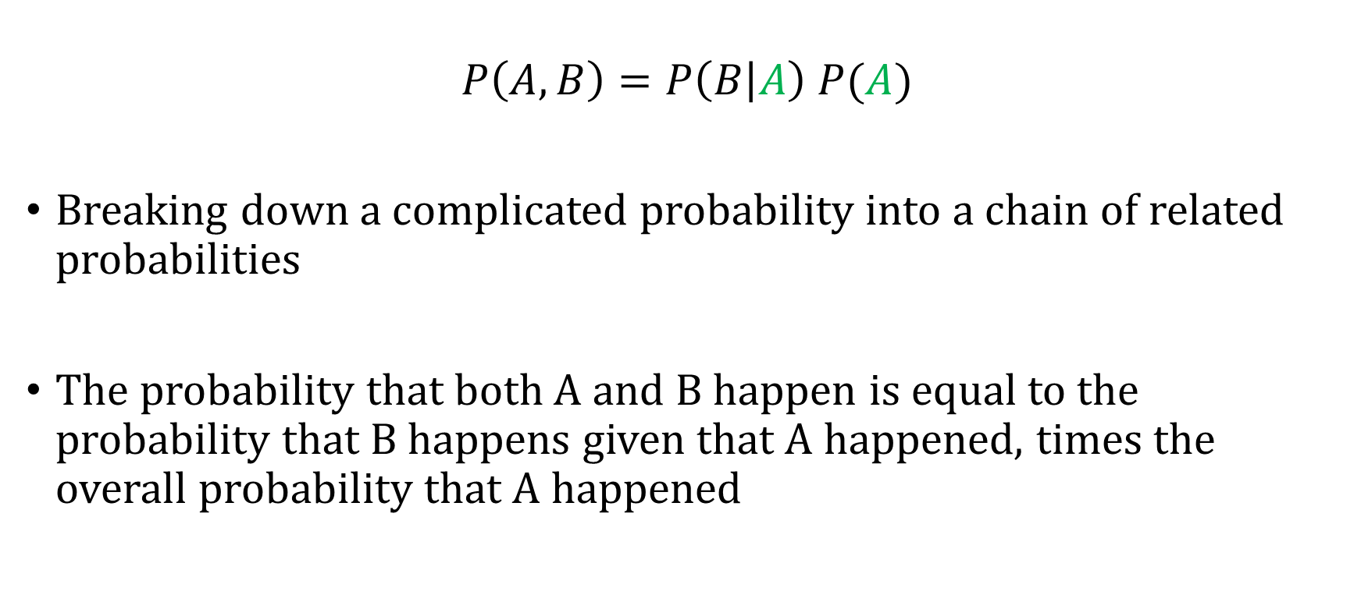
The Chain Rule
$$P\left(A, B\right)=P\left(B | A\right) P(A)$$
Breaking down a complicated probability into a chain of related probabilities
The probability that both A and B happen is equal to the probability that B happens given that A happened, times the overall probability that A happened

Slide 27

An Algebraic Fact
Let
$P\left(X\right) P\left(Y | X\right)=P\left(X, Y\right)$
$P\left(Y\right)P\left(X | Y\right)= ?$

Slide 28
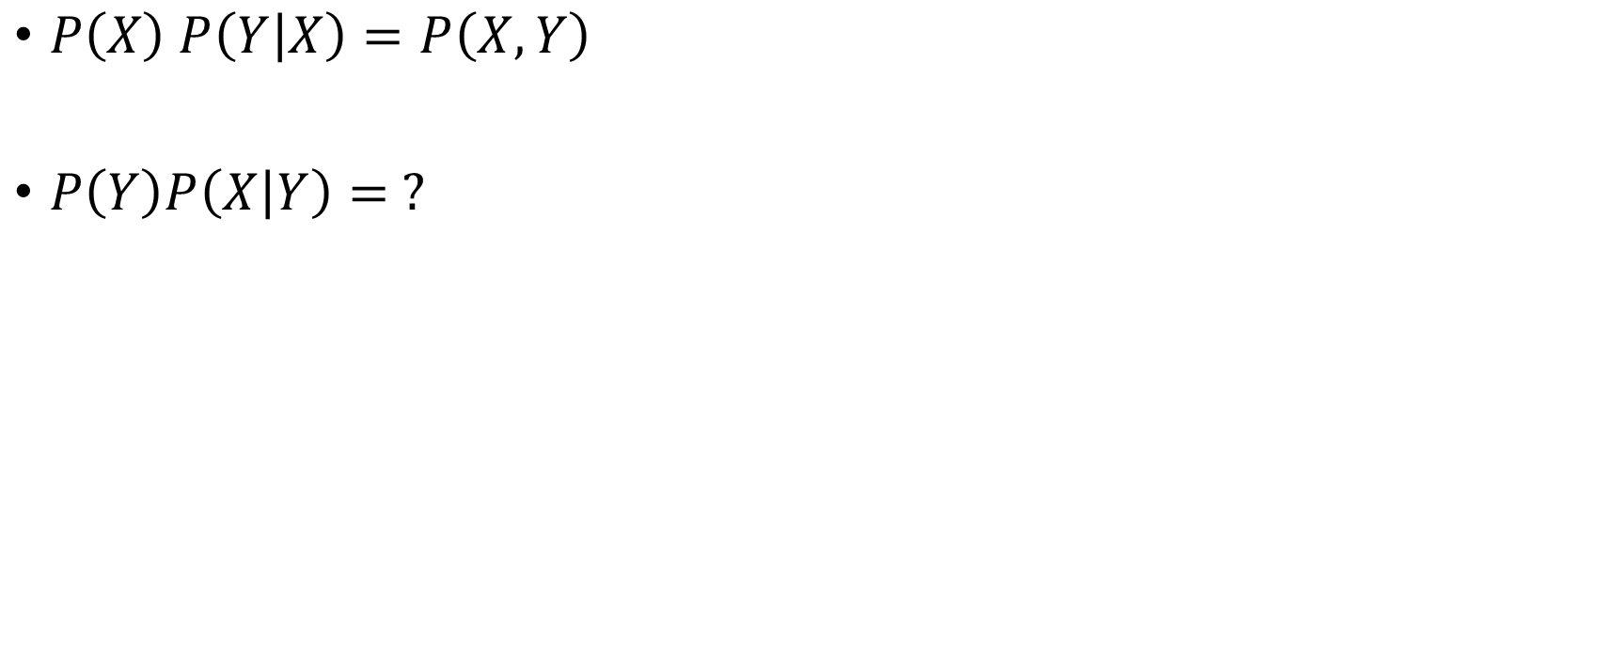
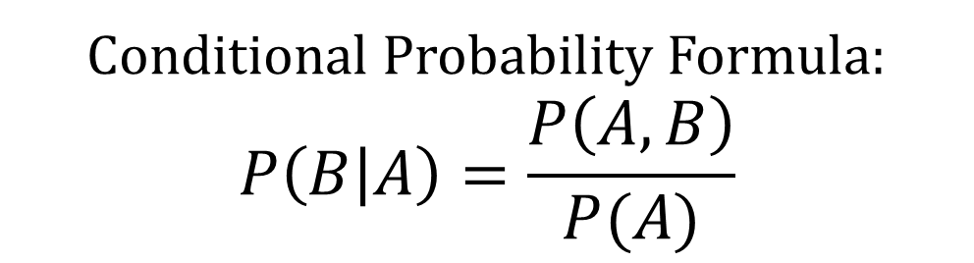
Relationship between Marginal, Joint, and Conditional
$P\left(X\right) P\left(Y | X\right)=P\left(X, Y\right)$
$P\left(Y\right)P\left(X | Y\right)= ?$
Conditional Probability Formula:
$$P\left(B | A\right)=\frac{P\left(A, B\right)}{P(A)}$$

Slide 29

Relationship between Marginal, Joint, and Conditional
$P\left(X\right) P\left(Y | X\right)=P\left(X, Y\right)$
$P\left(Y\right)P\left(X | Y\right)= ?$
Plug in:
$P\left(X | Y\right)=\frac{P(X, Y)}{P(Y)}$
Rearrange:
$P\left(Y\right)P\left(X | Y\right)=P(X,Y)$
Conditional Probability Formula:
$$P\left(B | A\right)=\frac{P\left(A, B\right)}{P(A)}$$

Slide 30
Marginalizing with Conditional Probabilities

Slide 31
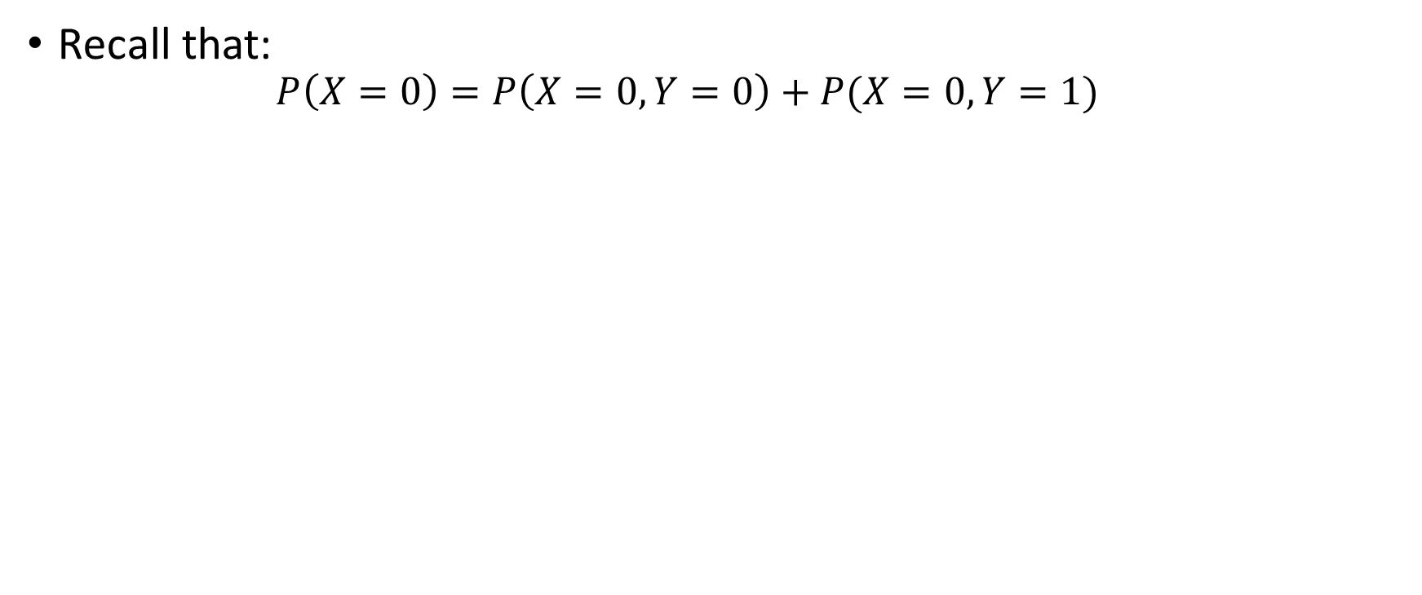
We Learned How to Marginalize with Joint Probabilities
Recall that:
$$P\left(X=0\right)=P\left(X=0,Y=0\right)+P(X=0,Y=1)$$

Slide 32
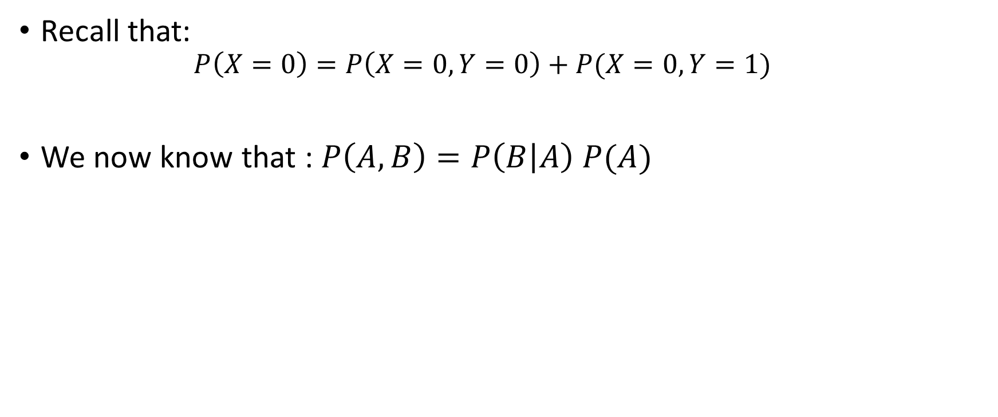
Marginalizing with Conditional Probabilities
Recall that:
$$P\left(X=0\right)=P\left(X=0,Y=0\right)+P(X=0,Y=1)$$
We now know that : $P\left(A,B\right)=P\left(B | A\right) P(A)$

Slide 33

Marginalizing with Conditional Probabilities
Recall that:
$$P\left(X=0\right)=P\left(X=0,Y=0\right)+P(X=0,Y=1)$$
We now know that : $P\left(A,B\right)=P\left(B | A\right) P(A)$
So use the fact that: $P\left(X,Y\right)=P\left(X | Y\right)P(Y)$

Slide 34
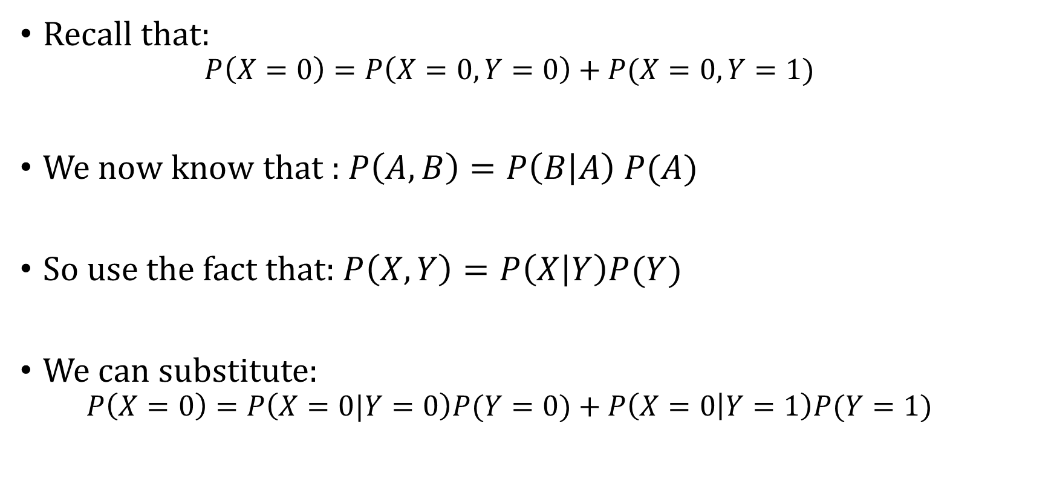
Marginalizing with Conditional Probabilities
Recall that:
$$P\left(X=0\right)=P\left(X=0,Y=0\right)+P(X=0,Y=1)$$
We now know that : $P\left(A,B\right)=P\left(B | A\right) P(A)$
So use the fact that: $P\left(X,Y\right)=P\left(X | Y\right)P(Y)$
We can substitute:
$$P\left(X=0\right)=P\left(X=0|Y=0\right)P(Y=0)+P\left(X=0 | Y=1\right)P(Y=1)$$

Slide 35
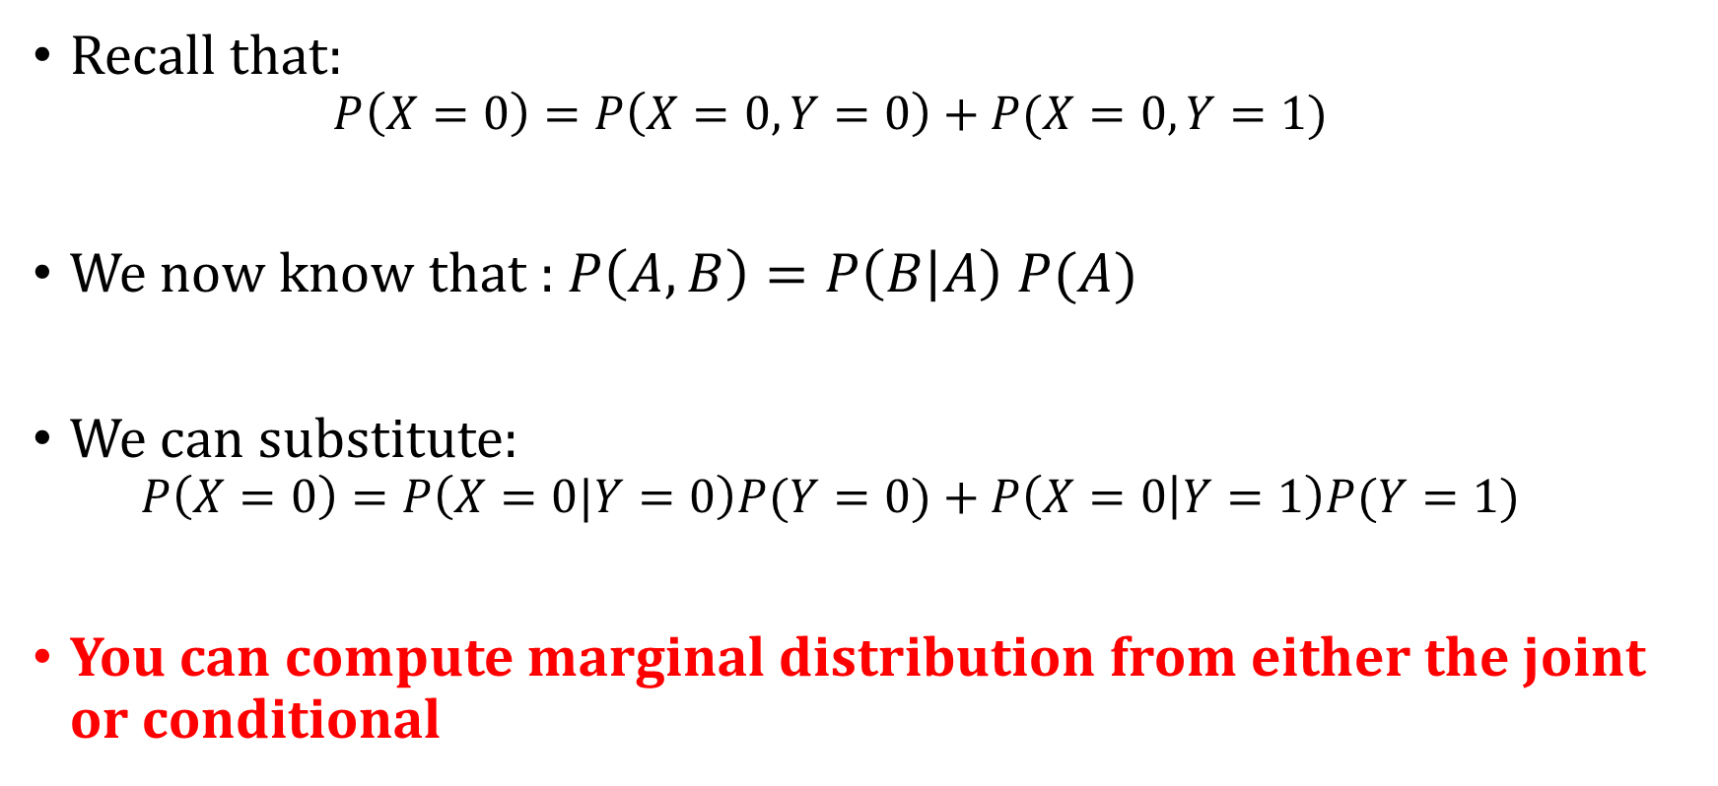
Marginalizing with Conditional Probabilities
Recall that:
$$P\left(X=0\right)=P\left(X=0,Y=0\right)+P(X=0,Y=1)$$
We now know that : $P\left(A,B\right)=P\left(B | A\right) P(A)$
We can substitute:
$$P\left(X=0\right)=P\left(X=0|Y=0\right)P(Y=0)+P\left(X=0 | Y=1\right)P(Y=1)$$
You can compute marginal distribution from either the joint or conditional

Slide 36
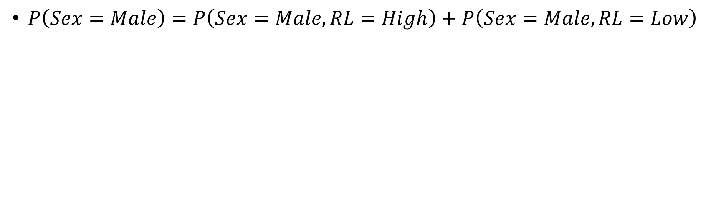
Example
Risk Level | Sex | Count
Low Risk | Male | 80
Low Risk | Female | 24
High Risk | Male | 76
High Risk | Female | 20
$P\left(Sex=Male\right)=P\left(Sex=Male, RL=High\right)+P\left(Sex=Male, RL=Low\right)$

Slide 37
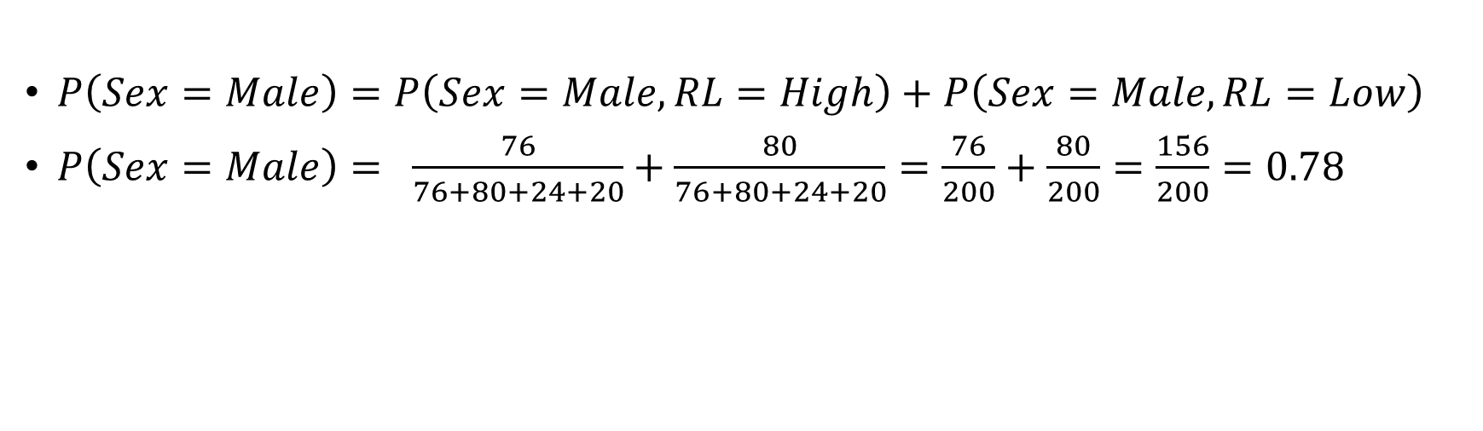
Example
Risk Level | Sex | Count
Low Risk | Male | 80
Low Risk | Female | 24
High Risk | Male | 76
High Risk | Female | 20
$P\left(Sex=Male\right)=P\left(Sex=Male, RL=High\right)+P\left(Sex=Male, RL=Low\right)$
$P\left(Sex=Male\right)= \frac{76}{76+80+24+20}+\frac{80}{76+80+24+20}=\frac{76}{200}+\frac{80}{200}=\frac{156}{200}=0.78$

Slide 38
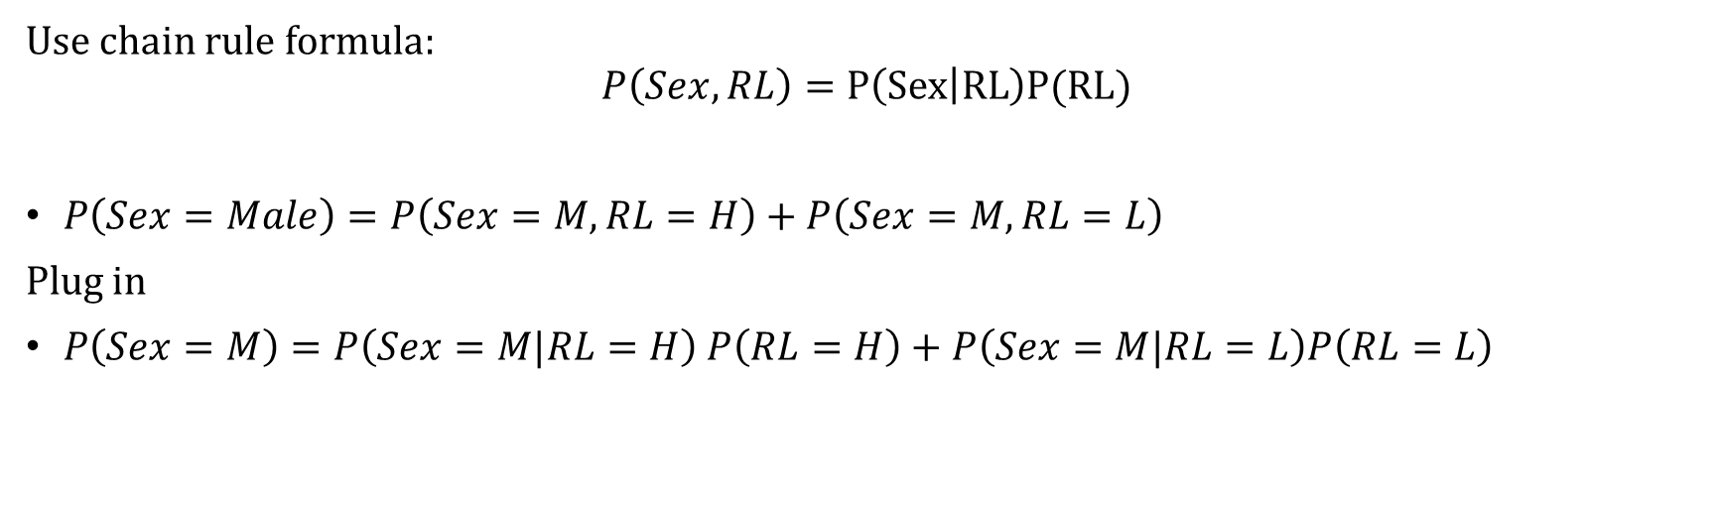
Example
Risk Level | Sex | Count
Low Risk | Male | 80
Low Risk | Female | 24
High Risk | Male | 76
High Risk | Female | 20
Use chain rule formula:
$$P\left(Sex, RL\right)=P\left(Sex | RL\right)P(RL)$$
$P\left(Sex=Male\right)=P\left(Sex=M, RL=H\right)+P\left(Sex=M, RL=L\right)$
Plug in
$P\left(Sex=M\right)=P\left(Sex=M|RL=H\right) P\left(RL=H\right)+P\left(Sex=M|RL=L\right)P\left(RL=L\right)$

Slide 39
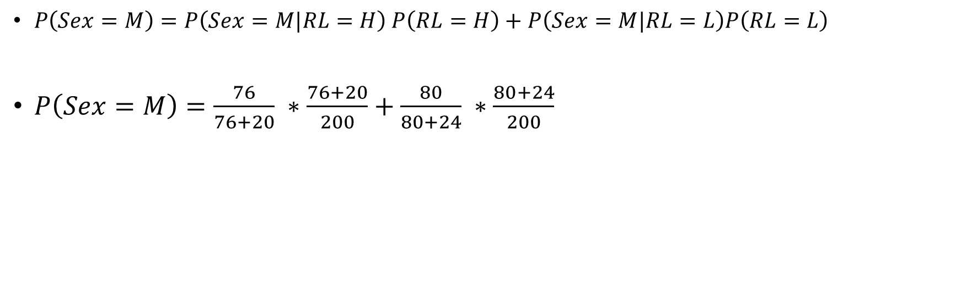
Example
Risk Level | Sex | Count
Low Risk | Male | 80
Low Risk | Female | 24
High Risk | Male | 76
High Risk | Female | 20
$P\left(Sex=M\right)=P\left(Sex=M|RL=H\right) P\left(RL=H\right)+P\left(Sex=M|RL=L\right)P\left(RL=L\right)$
$P\left(Sex=M\right)=\frac{76}{76+20} ∗\frac{76+20}{200}+\frac{80}{80+24} ∗\frac{80+24}{200}$

