Slide 1
INST 414: Data Science Techniques Lecture 3b Conditional Probability

Slide 2
Cond. Prob. Is Why Data Science Is Useful
Many prediction problems are binary:
Will this borrower default on their loan?
Will this student dropout of high school?
Will this defendant be re-arrested?
Does this MRI show cancer?
Will this user click on this ad?
Will this team win the Super Bowl?
Make traction by “conditioning” on what you observe

Slide 3
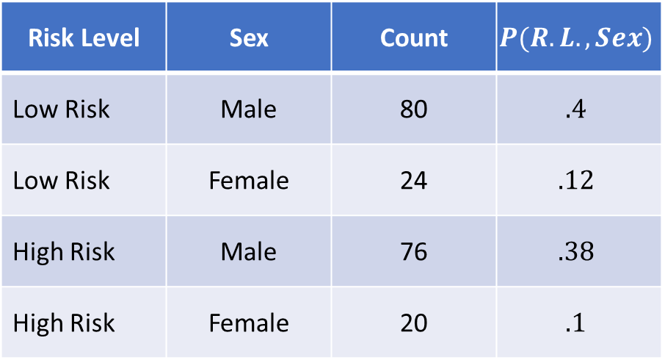
Joint Distribution
Risk Level | Sex | Count | $$P(R.L.,Sex)$$
Low Risk | Male | 80 | $$.4$$
Low Risk | Female | 24 | $$.12$$
High Risk | Male | 76 | $$.38$$
High Risk | Female | 20 | $$.1$$
We can ask:
What is the P(RL=H, Sex=M)?
Also write as P(RL=H and Sex=M)
What is the P(Sex=F)?
What is the P(RL=H or Sex=Male)?

Slide 4
Conditional Probability
Risk Level | Sex | Count | $$P(R.L.,Sex)$$
Low Risk | Male | 80 | $$.4$$
Low Risk | Female | 24 | $$.12$$
High Risk | Male | 76 | $$.38$$
High Risk | Female | 20 | $$.1$$
This week:
What is the probability that a Male is
high risk?

Slide 5
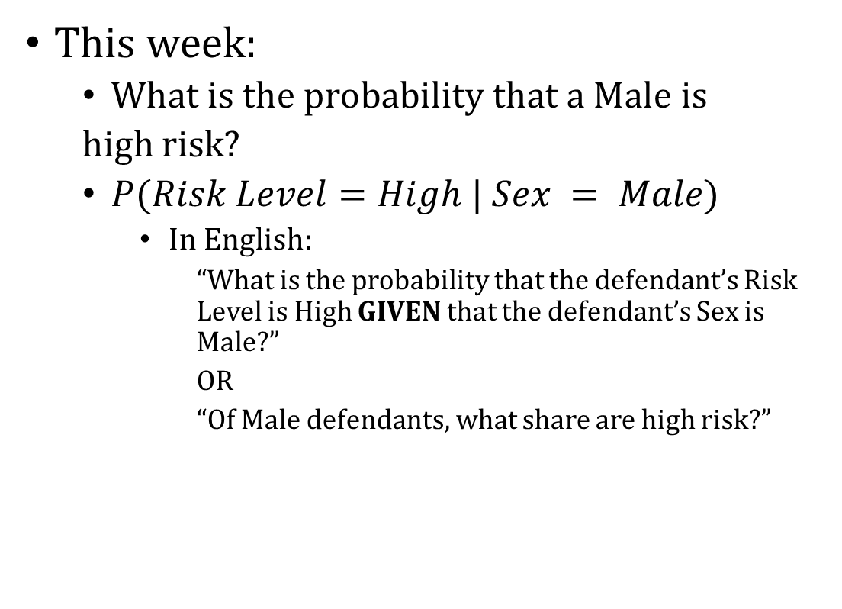
Conditional Probability
Risk Level | Sex | Count | $$P(R.L.,Sex)$$
Low Risk | Male | 80 | $$.4$$
Low Risk | Female | 24 | $$.12$$
High Risk | Male | 76 | $$.38$$
High Risk | Female | 20 | $$.1$$
This week:
What is the probability that a Male is
high risk?
$P(Risk Level=High | Sex = Male)$
In English:
“What is the probability that the defendant’s Risk Level is High GIVEN that the defendant’s Sex is Male?”
OR
“Of Male defendants, what share are high risk?”

Slide 6
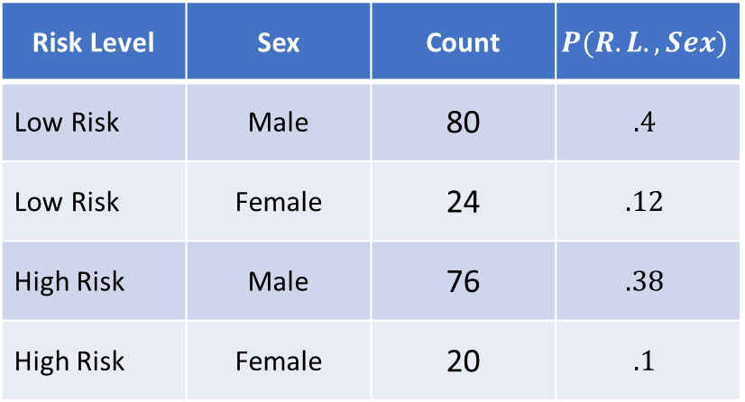

Conditional Probability
$$P(Risk Level=High | Sex = Male)=\frac{Numerator}{Denominator}$$
“Of Male defendants”
Which rows don’t satisfy this condition?
Risk Level | Sex | Count | $$P(R.L.,Sex)$$
Low Risk | Male | 80 | $$.4$$
Low Risk | Female | 24 | $$.12$$
High Risk | Male | 76 | $$.38$$
High Risk | Female | 20 | $$.1$$

Slide 7
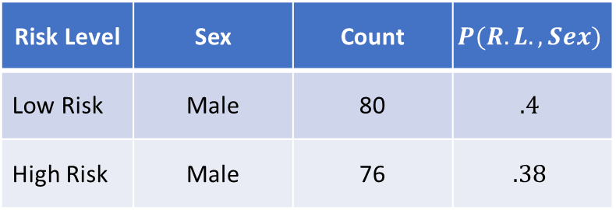
Conditional Probability
$$P(Risk Level=High | Sex = Male)=\frac{Numerator}{Denominator}$$
“Of Male defendants”
Which rows don’t satisfy this condition?
Risk Level | Sex | Count | $$P(R.L.,Sex)$$
Low Risk | Male | 80 | $$.4$$
High Risk | Male | 76 | $$.38$$

Slide 8
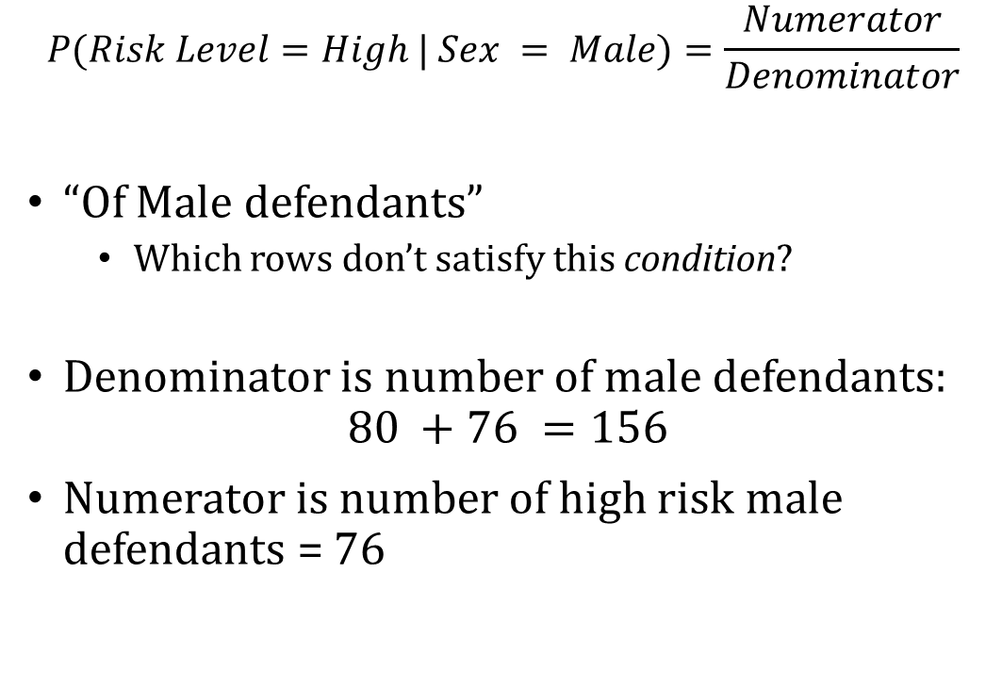
Conditional Probability
$$P(Risk Level=High | Sex = Male)=\frac{Numerator}{Denominator}$$
“Of Male defendants”
Which rows don’t satisfy this condition?
Denominator is number of male defendants:
$$80 +76 =156$$
Numerator is number of high risk male defendants = 76
Risk Level | Sex | Count | $$P(R.L.,Sex)$$
Low Risk | Male | 80 | $$.4$$
High Risk | Male | 76 | $$.38$$

Slide 9
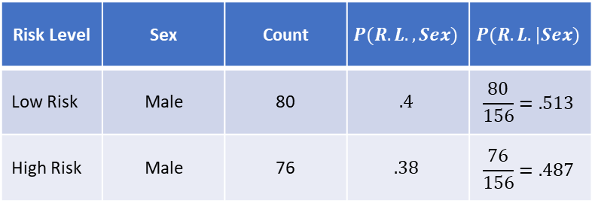
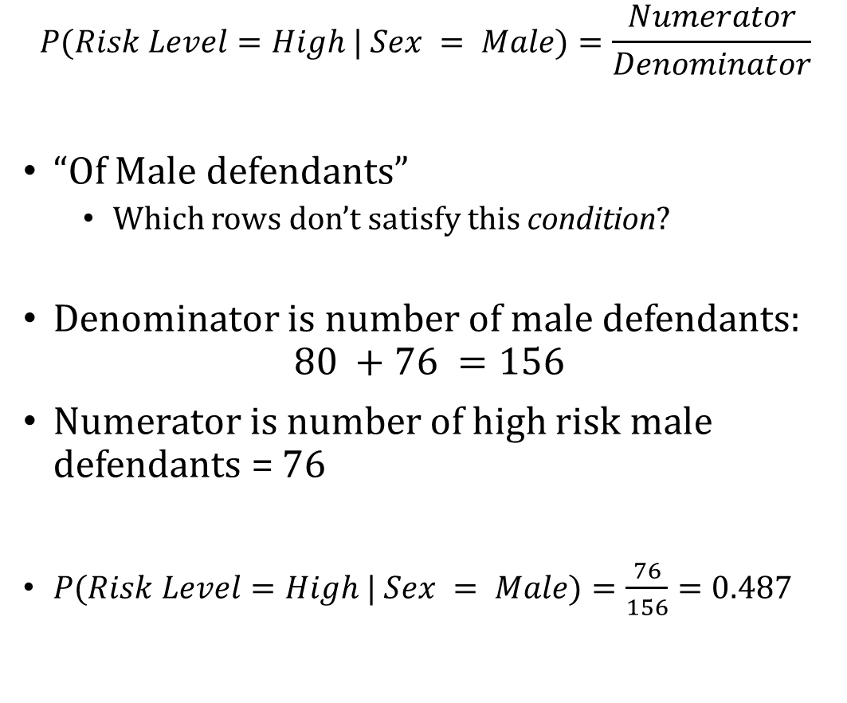
Conditional Probability
$$P(Risk Level=High | Sex = Male)=\frac{Numerator}{Denominator}$$
“Of Male defendants”
Which rows don’t satisfy this condition?
Denominator is number of male defendants:
$$80 +76 =156$$
Numerator is number of high risk male defendants = 76
$P(Risk Level=High | Sex = Male)=\frac{76}{156}=0.487$
Risk Level | Sex | Count | $$P(R.L.,Sex)$$ | $$P(R.L.|Sex)$$
Low Risk | Male | 80 | $$.4$$ | $$\frac{80}{156}=.513$$
High Risk | Male | 76 | $$.38$$ | $$\frac{76}{156}=.487$$

Slide 10
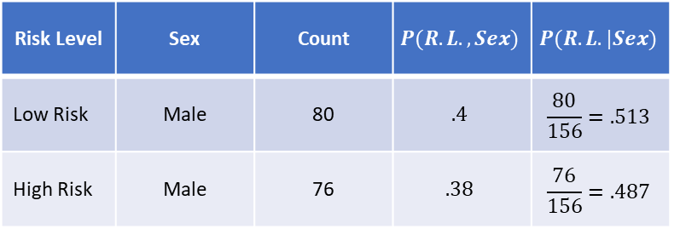

Conditional Probability
$$P(Risk Level=High | Sex = Male)=\frac{P(Risk Level=High, Sex=Male)}{P(Sex=Male)}=0.487$$
Risk Level | Sex | Count | $$P(R.L.,Sex)$$ | $$P(R.L.|Sex)$$
Low Risk | Male | 80 | $$.4$$ | $$\frac{80}{156}=.513$$
High Risk | Male | 76 | $$.38$$ | $$\frac{76}{156}=.487$$

Slide 11
Relationship between Conditional / Joint / Marginal Distributions

Slide 12
Visualizing Probabilities
This diagram represents the joint distribution of A and B
A=0 B=0
A=1
B=0
A=1
B=1
A=0
B=1

Slide 13

What Does Marginalizing Look Like?
Marginalization formula:
$P\left(A=1\right)=P\left(A=1,B=0\right)+P(A=1,B=1)$
A=0 B=0
A=1
B=0
A=1
B=1
A=0
B=1

Slide 14

What Does Marginalizing Look Like?
Marginalization formula:
$P\left(A=0\right)=P\left(A=0,B=0\right)+P\left(A=0,B=1\right)=1−P(A=1)$
A=0 B=0
A=1
B=0
A=1
B=1
A=0
B=1

Slide 15

What Does Conditioning Look Like?
$$P\left(A=0|B=1\right)= ?$$
A=0 B=0
A=1
B=0
A=1
B=1
A=0
B=1

Slide 16
What Does Conditioning Look Like?
$$P\left(A=0|B=1\right)= ?$$
A=0 B=0
A=1
B=0
A=1
B=1
A=0
B=1

Slide 17

What Does Conditioning Look Like?
$$P\left(A=0|B=1\right)=\frac{P\left(A=0, B=1\right)}{P\left(A=0, B=1\right)+P(A=1,B=1)}$$
A=0 B=0
A=1
B=0
A=1
B=1
A=0
B=1

Slide 18

What Does Conditioning Look Like?
$$P\left(A=0|B=1\right)=\frac{P\left(A=0, B=1\right)}{P\left(B=1\right)}$$
A=0 B=0
A=1
B=0
A=1
B=1
A=0
B=1

Slide 19
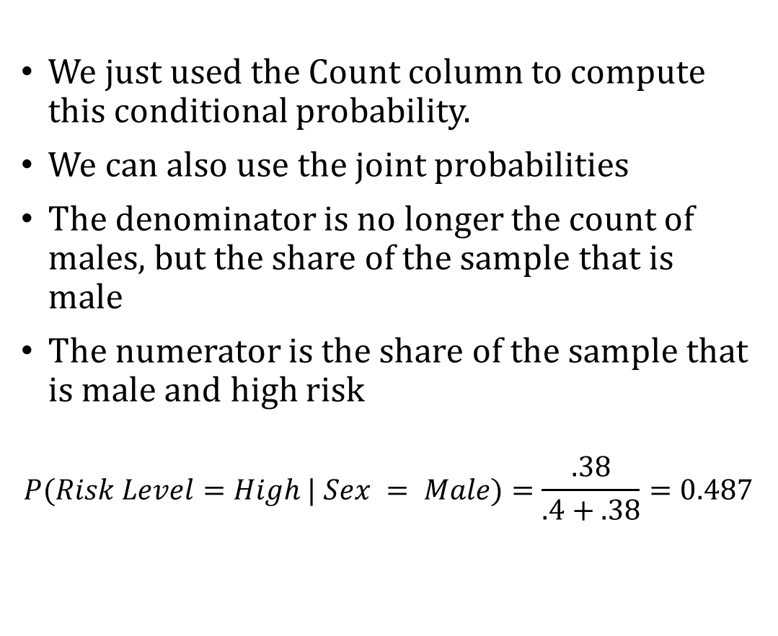
Conditional Probability
We just used the Count column to compute this conditional probability.
We can also use the joint probabilities
The denominator is no longer the count of males, but the share of the sample that is male
The numerator is the share of the sample that is male and high risk
$$P(Risk Level=High | Sex = Male)=\frac{.38}{.4+.38}=0.487$$
Risk Level | Sex | Count | $$P(R.L.,Sex)$$ | $$P(R.L.|Sex)$$
Low Risk | Male | 80 | $$.4$$ | $$\frac{80}{156}=.513$$
High Risk | Male | 76 | $$.38$$ | $$\frac{76}{156}=.487$$

