Slide 1
INST 414: Data Science Techniques
Lecture 3a
Recap

Slide 2

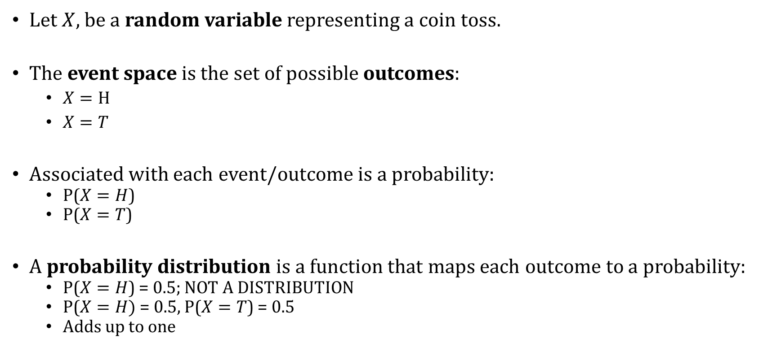
Probability
Let $X,$ be a random variable representing a coin toss.
The event space is the set of possible outcomes:
  $X=H$
  $X=T$
Associated with each event/outcome is a probability:
  P($X=H$)
  P($X=T$)
A probability distribution is a function that maps each outcome to a probability:
  P($X=H$) = 0.5; NOT A DISTRIBUTION
  P($X=H)$ = 0.5, P($X=T$) = 0.5
  Adds up to one

Slide 3
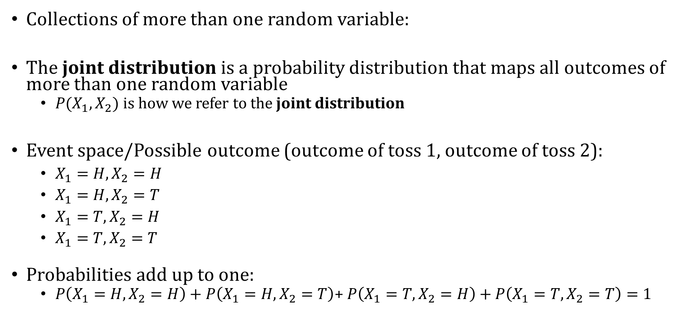
Joint and Marginal Distributions
Collections of more than one random variable:
The joint distribution is a probability distribution that maps all outcomes of more than one random variable
  $P(X_{1},X_{2})$ is how we refer to the joint distribution
Event space/Possible outcome (outcome of toss 1, outcome of toss 2):
  $X_{1}=H, X_{2}=H$
  $X_{1}=H, X_{2}=T$
  $X_{1}=T, X_{2}=H$
  $X_{1}=T, X_{2}=T$
Probabilities add up to one:
  $P\left(X_{1}=H,X_{2}=H\right)+P\left(X_{1}=H,X_{2}=T\right)$+ $P\left(X_{1}=T,X_{2}=H\right)+P\left(X_{1}=T,X_{2}=T\right)=1$

Slide 4

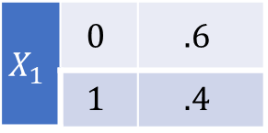
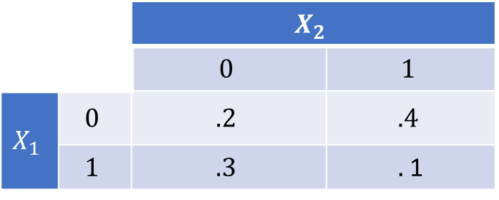
“Marginalizing” – Going from a Joint Distribution to a Marginal Distribution
 |  | $$X_{2}$$
 |  | $$0$$ | $$1$$
$$X_{1}$$ | $$0$$ | $$.2$$ | $$.4$$
 | $$1$$ | $$.3$$ | $.$1
Table describes $P\left(X_{1}=x,X_{2}=y\right)$
What is $P\left(X_{1}\right)?$
To get it, marginalize, or “sum over” $X_{2}$
$P\left(X_{1}=0\right)=P\left(X_{1}=0, X_{2}=0\right)+P\left(X_{1}=0, X_{2}=1\right)=.6$
$P\left(X_{1}=1\right)=P\left(X_{1}=1, X_{2}=0\right)+P\left(X_{1}=1, X_{2}=1\right)=.4$
$$X_{1}$$ | $$0$$ | $$.6$$
 | $$1$$ | $$.4$$

Slide 5
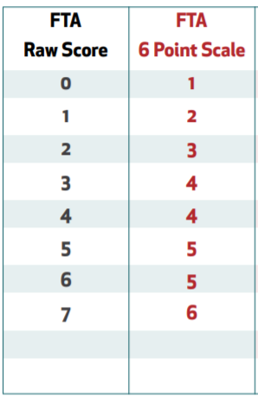
Risk Categorization from an Algorithm
Table shows the possible risk scores for future risk of failing to appear. Scores above 4 are considered high risk
Table shows the number of people in each risk level and sex category.
Risk Level | Sex | Count
Low Risk | Male | 80
Low Risk | Female | 24
High Risk | Male | 76
High Risk | Female | 20
Low Risk
High
Risk

Slide 6


$$P(Risk Level, Sex)$$
What is the joint distribution: $P\left(Risk Level, Sex\right)?$
Risk Level | Sex | Count
Low Risk | Male | 80
Low Risk | Female | 24
High Risk | Male | 76
High Risk | Female | 20

Slide 7

$$P(Risk Level, Sex)$$
What is the joint distribution: $P\left(Risk Level, Sex\right)?$
Number of people is:
  $80+24+76+20=200$
Risk Level | Sex | Count
Low Risk | Male | 80
Low Risk | Female | 24
High Risk | Male | 76
High Risk | Female | 20

Slide 8
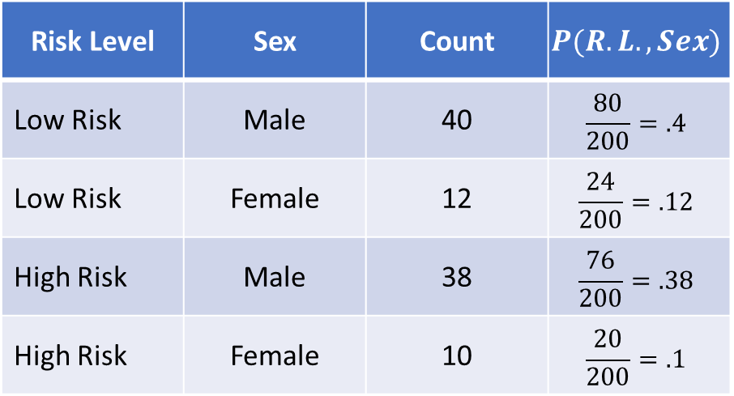
$$P(Risk Level, Sex)$$
What is the joint distribution: $P\left(Risk Level, Sex\right)?$
Number of people is:
  $80+24+76+20=200$
Risk Level | Sex | Count | $$P(R.L.,Sex)$$
Low Risk | Male | 40 | $$\frac{80}{200}=.4$$
Low Risk | Female | 12 | $$\frac{24}{200}=.12$$
High Risk | Male | 38 | $$\frac{76}{200}=.38$$
High Risk | Female | 10 | $$\frac{20}{200}=.1$$

Slide 9


$$P(Risk Level)$$
What is the marginal probability:
$$P\left(Risk Level=High Risk \right)$$
Risk Level | Sex | Count | $$P(R.L.,Sex)$$
Low Risk | Male | 40 | $$\frac{80}{200}=.4$$
Low Risk | Female | 12 | $$\frac{24}{200}=.12$$
High Risk | Male | 38 | $$\frac{76}{200}=.38$$
High Risk | Female | 10 | $$\frac{20}{200}=.1$$

Slide 10
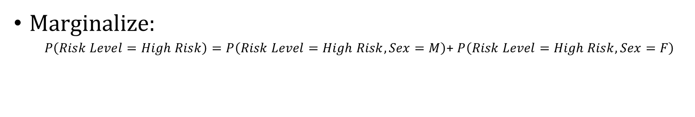
$$P(Risk Level)$$
What is the marginal probability:
$$P\left(Risk Level=High Risk \right)$$
Risk Level | Sex | Count | $$P(R.L.,Sex)$$
Low Risk | Male | 40 | $$\frac{80}{200}=.4$$
Low Risk | Female | 12 | $$\frac{24}{200}=.12$$
High Risk | Male | 38 | $$\frac{76}{200}=.38$$
High Risk | Female | 10 | $$\frac{20}{200}=.1$$
Marginalize:
  $P\left(Risk Level=High Risk\right)=P\left(Risk Level=High Risk,Sex=M\right)$+ $P\left(Risk Level=High Risk, Sex=F\right)$

Slide 11
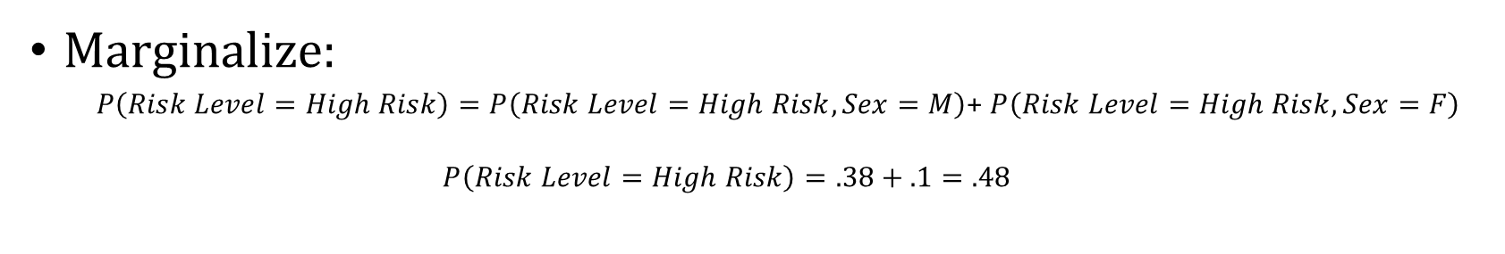
$$P(Risk Level)$$
What is the marginal probability:
$$P\left(Risk Level=High Risk \right)$$
Risk Level | Sex | Count | $$P(R.L.,Sex)$$
Low Risk | Male | 40 | $$\frac{80}{200}=.4$$
Low Risk | Female | 12 | $$\frac{24}{200}=.12$$
High Risk | Male | 38 | $$\frac{76}{200}=.38$$
High Risk | Female | 10 | $$\frac{20}{200}=.1$$
Marginalize:
  $P\left(Risk Level=High Risk\right)=P\left(Risk Level=High Risk,Sex=M\right)$+ $P\left(Risk Level=High Risk, Sex=F\right)$
  $$P\left(Risk Level=High Risk\right)=.38+.1=.48$$

