Slide 1
INST 414: Data Science Techniques Lecture 3 Conditional Probability

Slide 2
Today
Recap last week
Conditional Probabilities
Probability Practice

Slide 3
Re-capping Last Week

Slide 4

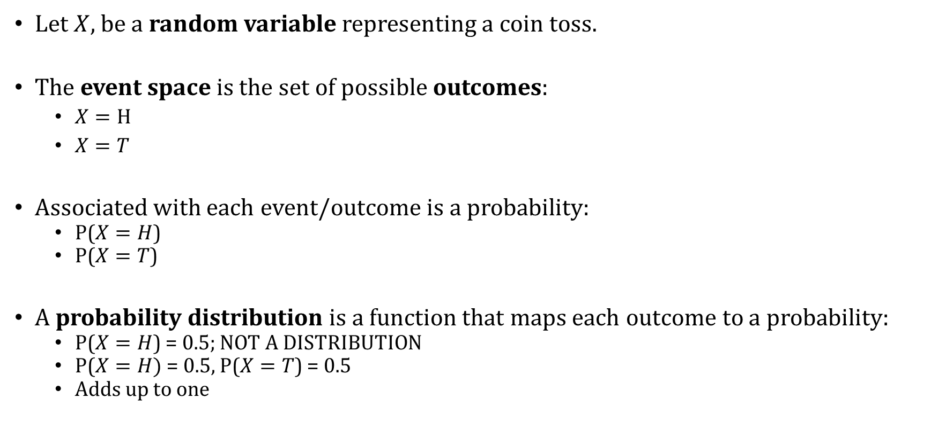
Probability
Let $X,$ be a random variable representing a coin toss.
The event space is the set of possible outcomes:
$X=H$
$X=T$
Associated with each event/outcome is a probability:
P($X=H$)
P($X=T$)
A probability distribution is a function that maps each outcome to a probability:
P($X=H$) = 0.5; NOT A DISTRIBUTION
P($X=H)$ = 0.5, P($X=T$) = 0.5
Adds up to one

Slide 5
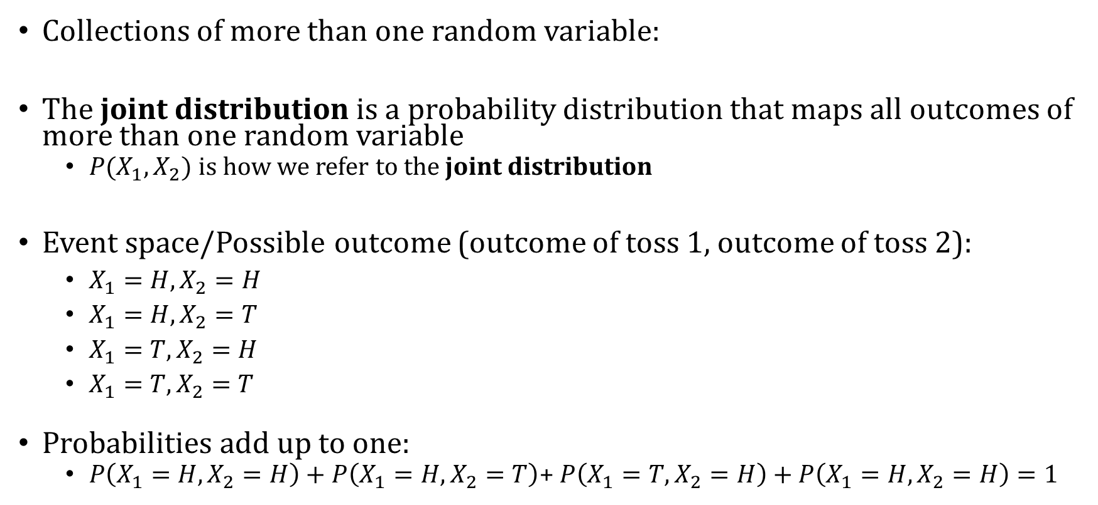
Joint and Marginal Distributions
Collections of more than one random variable:
The joint distribution is a probability distribution that maps all outcomes of more than one random variable
$P(X_{1},X_{2})$ is how we refer to the joint distribution
Event space/Possible outcome (outcome of toss 1, outcome of toss 2):
$X_{1}=H, X_{2}=H$
$X_{1}=H, X_{2}=T$
$X_{1}=T, X_{2}=H$
$X_{1}=T, X_{2}=T$
Probabilities add up to one:
$P\left(X_{1}=H,X_{2}=H\right)+P\left(X_{1}=H,X_{2}=T\right)$+ $P\left(X_{1}=T,X_{2}=H\right)+P\left(X_{1}=H,X_{2}=H\right)=1$

Slide 6

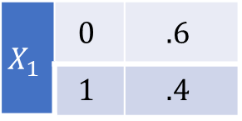
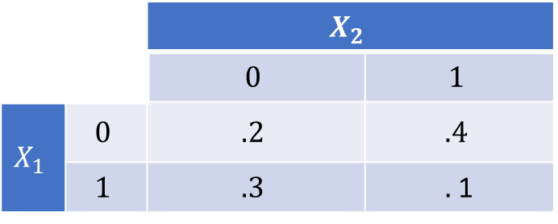
“Marginalizing” – Going from a Joint Distribution to a Marginal Distribution
 |  | $$X_{2}$$
 |  | $$0$$ | $$1$$
$$X_{1}$$ | $$0$$ | $$.2$$ | $$.4$$
 | $$1$$ | $$.3$$ | $.$1
Table describes $P\left(X_{1}=x,X_{2}=y\right)$
What is $P\left(X_{1}\right)?$
To get it, marginalize, or “sum over” $X_{2}$
$P\left(X_{1}=0\right)=P\left(X_{1}=0, X_{2}=0\right)+P\left(X_{1}=0, X_{2}=1\right)=.6$
$P\left(X_{1}=1\right)=P\left(X_{1}=1, X_{2}=0\right)+P\left(X_{1}=1, X_{2}=1\right)=.4$
$$X_{1}$$ | $$0$$ | $$.6$$
 | $$1$$ | $$.4$$

Slide 7
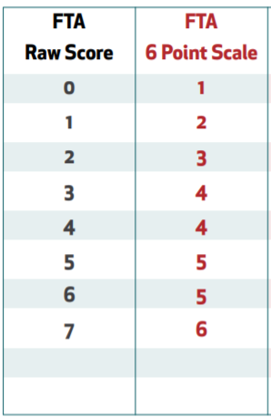
Risk Categorization from an Algorithm
Table shows the possible risk scores for future risk of failing to appear. Scores above 4 are considered high risk
Table shows the number of people in each risk level and sex category.
Risk Level | Sex | Count
Low Risk | Male | 80
Low Risk | Female | 24
High Risk | Male | 76
High Risk | Female | 20
Low Risk
High
Risk

Slide 8


$$P(Risk Level, Sex)$$
What is the joint distribution: $P\left(Risk Level, Sex\right)?$
Risk Level | Sex | Count
Low Risk | Male | 80
Low Risk | Female | 24
High Risk | Male | 76
High Risk | Female | 20

Slide 9

$$P(Risk Level, Sex)$$
What is the joint distribution: $P\left(Risk Level, Sex\right)?$
Number of people is:
$80+24+76+20=200$
Risk Level | Sex | Count
Low Risk | Male | 80
Low Risk | Female | 24
High Risk | Male | 76
High Risk | Female | 200

Slide 10
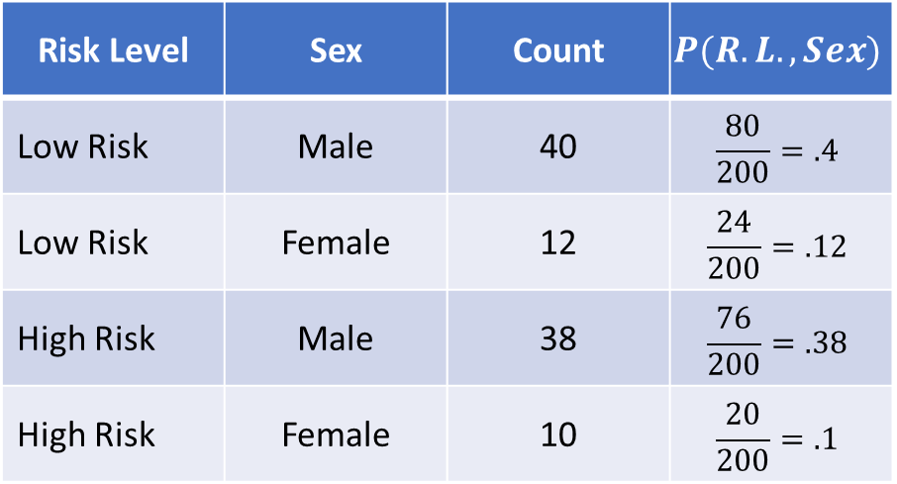
$$P(Risk Level, Sex)$$
What is the joint distribution: $P\left(Risk Level, Sex\right)?$
Number of people is:
$80+24+76+20=200$
Risk Level | Sex | Count | $$P(R.L.,Sex)$$
Low Risk | Male | 40 | $$\frac{80}{200}=.4$$
Low Risk | Female | 12 | $$\frac{24}{200}=.12$$
High Risk | Male | 38 | $$\frac{76}{200}=.38$$
High Risk | Female | 10 | $$\frac{20}{200}=.1$$

Slide 11


$$P(Risk Level)$$
What is the marginal probability:
$$P\left(Risk Level=High Risk \right)$$
Risk Level | Sex | Count | $$P(R.L.,Sex)$$
Low Risk | Male | 40 | $$\frac{80}{200}=.4$$
Low Risk | Female | 12 | $$\frac{24}{200}=.12$$
High Risk | Male | 38 | $$\frac{76}{200}=.38$$
High Risk | Female | 10 | $$\frac{20}{200}=.1$$

Slide 12
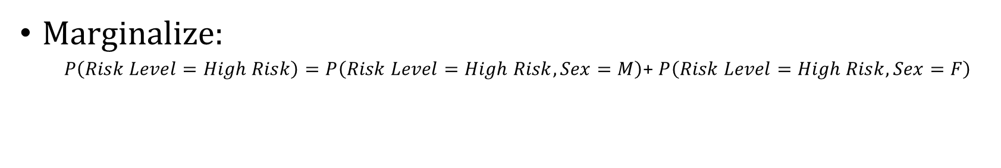
$$P(Risk Level)$$
What is the marginal probability:
$$P\left(Risk Level=High Risk \right)$$
Risk Level | Sex | Count | $$P(R.L.,Sex)$$
Low Risk | Male | 40 | $$\frac{80}{200}=.4$$
Low Risk | Female | 12 | $$\frac{24}{200}=.12$$
High Risk | Male | 38 | $$\frac{76}{200}=.38$$
High Risk | Female | 10 | $$\frac{20}{200}=.1$$
Marginalize:
$P\left(Risk Level=High Risk\right)=P\left(Risk Level=High Risk,Sex=M\right)$+ $P\left(Risk Level=High Risk, Sex=F\right)$

Slide 13
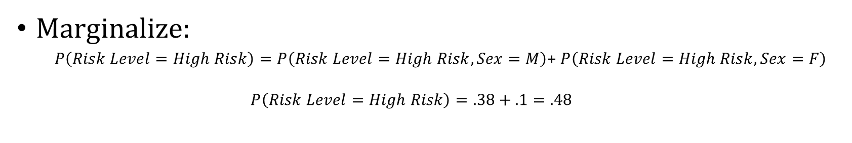
$$P(Risk Level)$$
What is the marginal probability:
$$P\left(Risk Level=High Risk \right)$$
Risk Level | Sex | Count | $$P(R.L.,Sex)$$
Low Risk | Male | 40 | $$\frac{80}{200}=.4$$
Low Risk | Female | 12 | $$\frac{24}{200}=.12$$
High Risk | Male | 38 | $$\frac{76}{200}=.38$$
High Risk | Female | 10 | $$\frac{20}{200}=.1$$
Marginalize:
$P\left(Risk Level=High Risk\right)=P\left(Risk Level=High Risk,Sex=M\right)$+ $P\left(Risk Level=High Risk, Sex=F\right)$
$$P\left(Risk Level=High Risk\right)=.38+.1=.48$$

Slide 14
Conditional Probabilities

Slide 15
Cond. Prob. Is Why Data Science Is Useful
Many prediction problems are binary:
Will this borrower default on their loan?
Will this student dropout of high school?
Will this defendant be re-arrested?
Does this MRI show cancer?
Will this user click on this ad?
Will this team win the Super Bowl?
Make traction by “conditioning” on what you observe

Slide 16
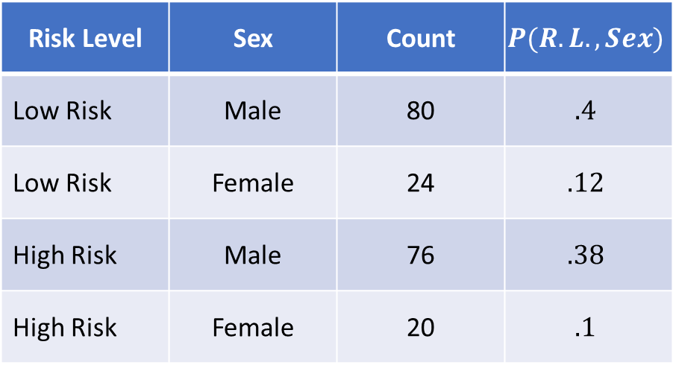
Joint Distribution
Risk Level | Sex | Count | $$P(R.L.,Sex)$$
Low Risk | Male | 80 | $$.4$$
Low Risk | Female | 24 | $$.12$$
High Risk | Male | 76 | $$.38$$
High Risk | Female | 20 | $$.1$$
We can ask:
What is the P(RL=H, Sex=M)?
Also write as P(RL=H and Sex=M)
What is the P(Sex=F)?
What is the P(RL=H or Sex=Male)?

Slide 17
Conditional Probability
Risk Level | Sex | Count | $$P(R.L.,Sex)$$
Low Risk | Male | 80 | $$.4$$
Low Risk | Female | 24 | $$.12$$
High Risk | Male | 76 | $$.38$$
High Risk | Female | 20 | $$.1$$
This week:
What is the probability that a Male is
high risk?

Slide 18
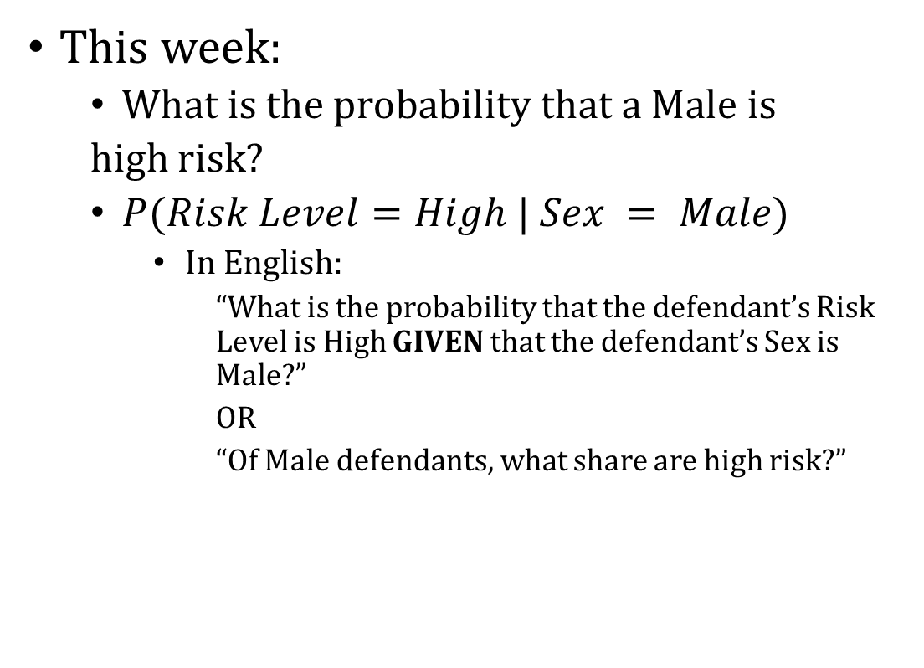
Conditional Probability
Risk Level | Sex | Count | $$P(R.L.,Sex)$$
Low Risk | Male | 80 | $$.4$$
Low Risk | Female | 24 | $$.12$$
High Risk | Male | 76 | $$.38$$
High Risk | Female | 20 | $$.1$$
This week:
What is the probability that a Male is
high risk?
$P(Risk Level=High | Sex = Male)$
In English:
“What is the probability that the defendant’s Risk Level is High GIVEN that the defendant’s Sex is Male?”
OR
“Of Male defendants, what share are high risk?”

Slide 19
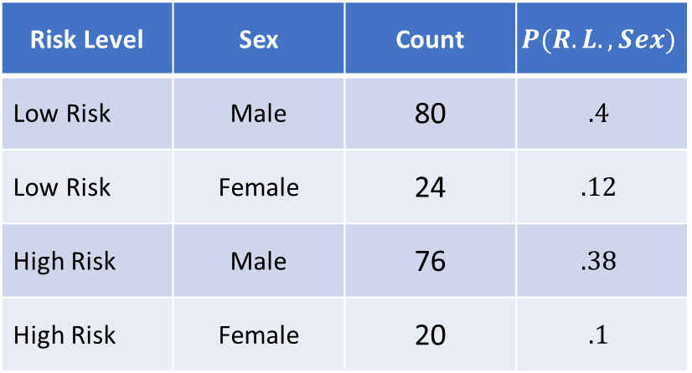

Conditional Probability
$$P(Risk Level=High | Sex = Male)=\frac{Numerator}{Denominator}$$
“Of Male defendants”
Which rows don’t satisfy this condition?
Risk Level | Sex | Count | $$P(R.L.,Sex)$$
Low Risk | Male | 80 | $$.4$$
Low Risk | Female | 24 | $$.12$$
High Risk | Male | 76 | $$.38$$
High Risk | Female | 20 | $$.1$$

Slide 20
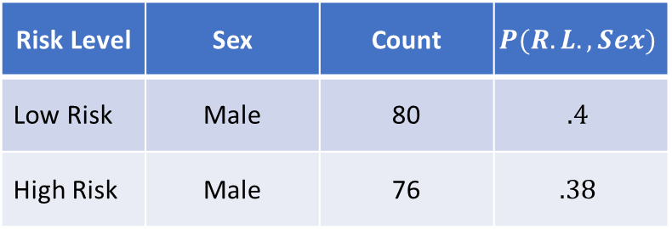
Conditional Probability
$$P(Risk Level=High | Sex = Male)=\frac{Numerator}{Denominator}$$
“Of Male defendants”
Which rows don’t satisfy this condition?
Risk Level | Sex | Count | $$P(R.L.,Sex)$$
Low Risk | Male | 80 | $$.4$$
High Risk | Male | 76 | $$.38$$

Slide 21
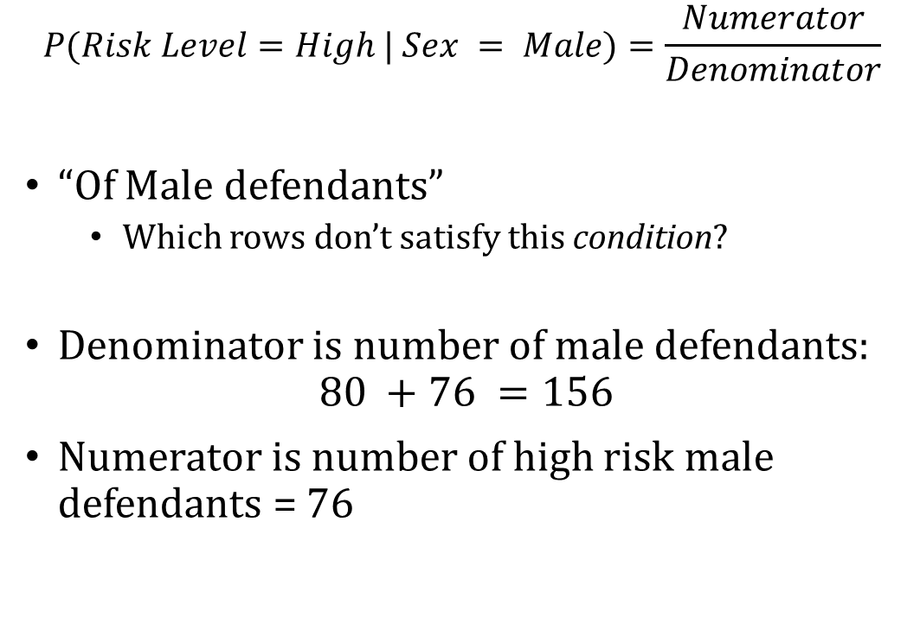
Conditional Probability
$$P(Risk Level=High | Sex = Male)=\frac{Numerator}{Denominator}$$
“Of Male defendants”
Which rows don’t satisfy this condition?
Denominator is number of male defendants:
$$80 +76 =156$$
Numerator is number of high risk male defendants = 76
Risk Level | Sex | Count | $$P(R.L.,Sex)$$
Low Risk | Male | 80 | $$.4$$
High Risk | Male | 76 | $$.38$$

Slide 22
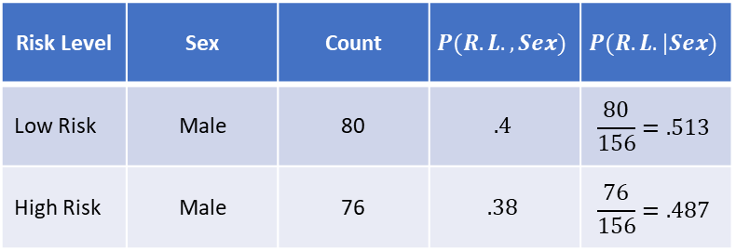
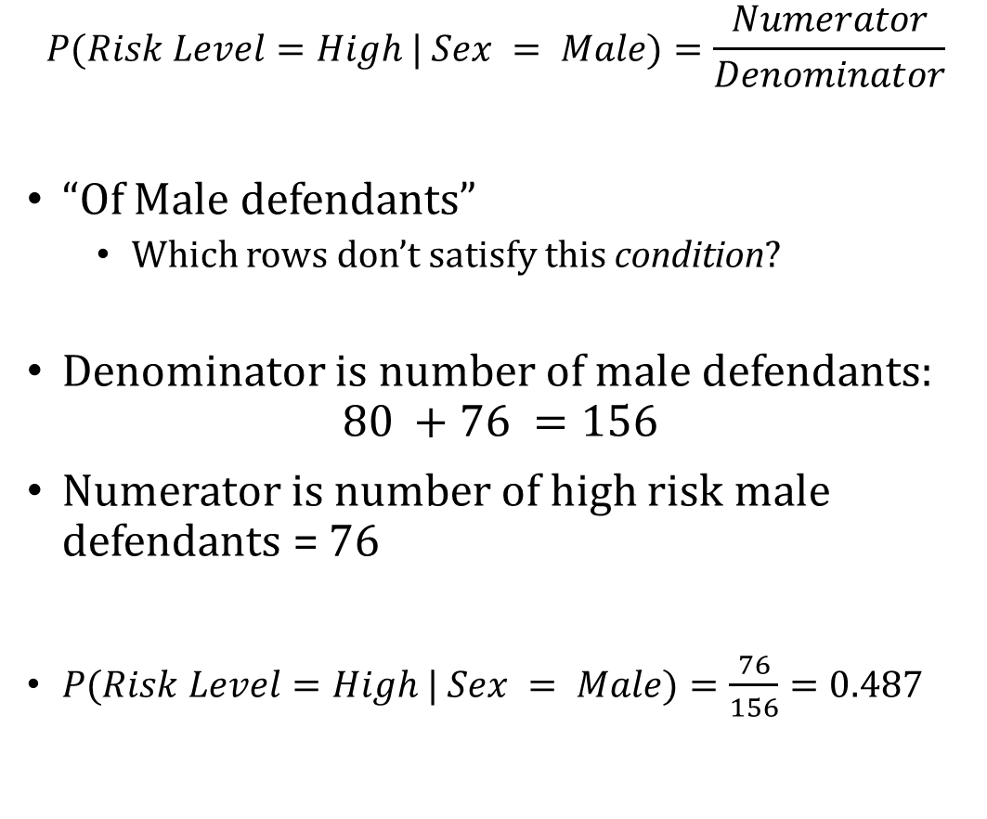
Conditional Probability
$$P(Risk Level=High | Sex = Male)=\frac{Numerator}{Denominator}$$
“Of Male defendants”
Which rows don’t satisfy this condition?
Denominator is number of male defendants:
$$80 +76 =156$$
Numerator is number of high risk male defendants = 76
$P(Risk Level=High | Sex = Male)=\frac{76}{156}=0.487$
Risk Level | Sex | Count | $$P(R.L.,Sex)$$ | $$P(R.L.|Sex)$$
Low Risk | Male | 80 | $$.4$$ | $$\frac{80}{156}=.513$$
High Risk | Male | 76 | $$.38$$ | $$\frac{76}{156}=.487$$

Slide 23
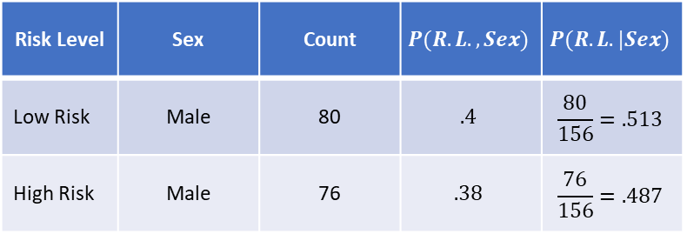

Conditional Probability
$$P(Risk Level=High | Sex = Male)=\frac{P(Risk Level=High, Sex=Male)}{P(Sex=Male)}=0.487$$
Risk Level | Sex | Count | $$P(R.L.,Sex)$$ | $$P(R.L.|Sex)$$
Low Risk | Male | 80 | $$.4$$ | $$\frac{80}{156}=.513$$
High Risk | Male | 76 | $$.38$$ | $$\frac{76}{156}=.487$$

Slide 24
Relationship between Conditional / Joint / Marginal Distributions

Slide 25
Visualizing Probabilities
This diagram represents the joint distribution of A and B
A=0 B=0
A=1
B=0
A=1
B=1
A=0
B=1

Slide 26

What Does Marginalizing Look Like?
Marginalization formula:
$P\left(A=1\right)=P\left(A=1,B=0\right)+P(A=1,B=1)$
A=0 B=0
A=1
B=0
A=1
B=1
A=0
B=1

Slide 27

What Does Marginalizing Look Like?
Marginalization formula:
$P\left(A=0\right)=P\left(A=0,B=0\right)+P\left(A=0,B=1\right)=1−P(A=1)$
A=0 B=0
A=1
B=0
A=1
B=1
A=0
B=1

Slide 28

What Does Conditioning Look Like?
$$P\left(A=0|B=1\right)= ?$$
A=0 B=0
A=1
B=0
A=1
B=1
A=0
B=1

Slide 29
What Does Conditioning Look Like?
$$P\left(A=0|B=1\right)= ?$$
A=0 B=0
A=1
B=0
A=1
B=1
A=0
B=1

Slide 30

What Does Conditioning Look Like?
$$P\left(A=0|B=1\right)=\frac{P\left(A=0, B=1\right)}{P\left(A=0, B=1\right)+P(A=1,B=1)}$$
A=0 B=0
A=1
B=0
A=1
B=1
A=0
B=1

Slide 31

What Does Conditioning Look Like?
$$P\left(A=0|B=1\right)=\frac{P\left(A=0, B=1\right)}{P\left(B=1\right)}$$
A=0 B=0
A=1
B=0
A=1
B=1
A=0
B=1

Slide 32
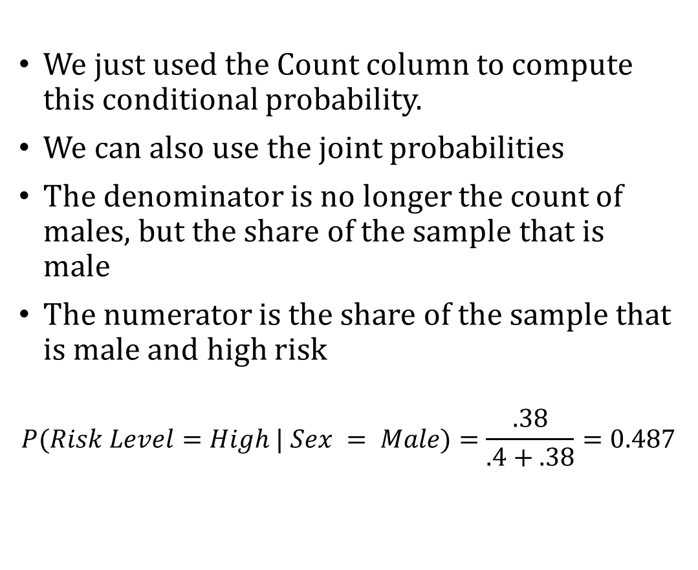
Conditional Probability
We just used the Count column to compute this conditional probability.
We can also use the joint probabilities
The denominator is no longer the count of males, but the share of the sample that is male
The numerator is the share of the sample that is male and high risk
$$P(Risk Level=High | Sex = Male)=\frac{.38}{.4+.38}=0.487$$
Risk Level | Sex | Count | $$P(R.L.,Sex)$$ | $$P(R.L.|Sex)$$
Low Risk | Male | 80 | $$.4$$ | $$\frac{80}{156}=.513$$
High Risk | Male | 76 | $$.38$$ | $$\frac{76}{156}=.487$$

Slide 33
Recapping

Slide 34
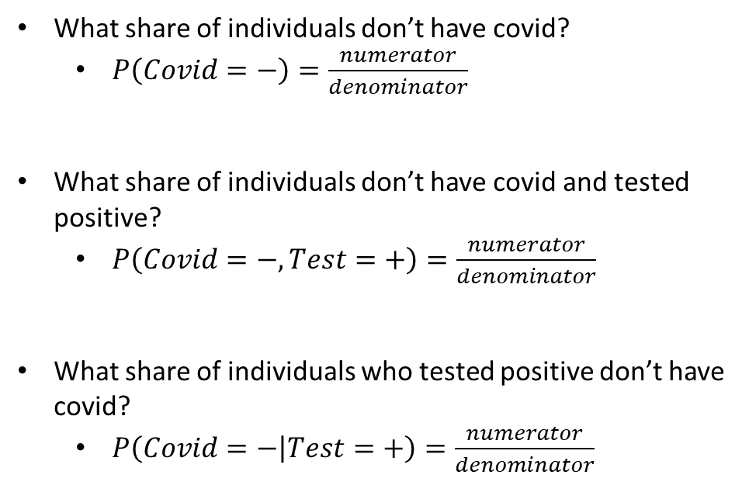
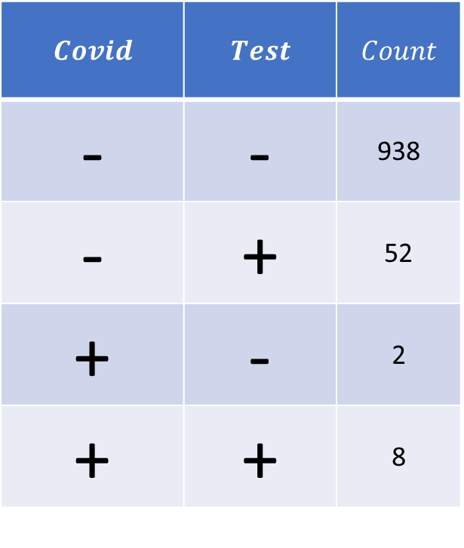
Difference between Marginal, Joint, and Conditional Probabilities
$$Covid$$ | $$Test$$ | $$Count$$
- | - | 938
- | + | 52
+ | - | 2
+ | + | 8
What share of individuals don’t have covid?
$P\left(Covid=−\right)=\frac{numerator}{denominator}$
What share of individuals don’t have covid and tested positive?
$P\left(Covid=−, Test=+\right)=\frac{numerator}{denominator}$
What share of individuals who tested positive don’t have covid?
$P\left(Covid=− | Test=+\right)=\frac{numerator}{denominator}$

Slide 35
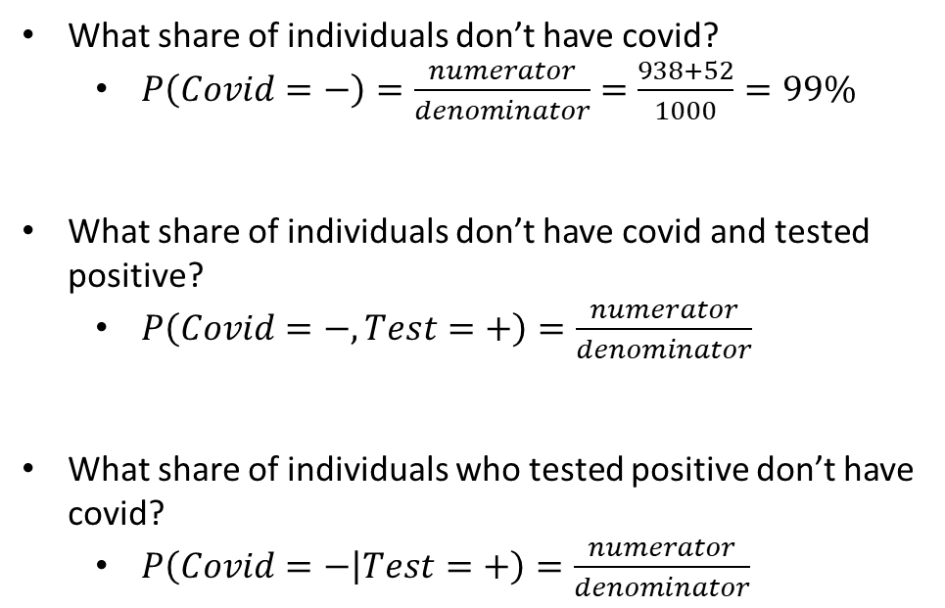
Difference between Marginal, Joint, and Conditional Probabilities
$$Covid$$ | $$Test$$ | $$Count$$
- | - | 938
- | + | 52
+ | - | 2
+ | + | 8
What share of individuals don’t have covid?
$P\left(Covid=−\right)=\frac{numerator}{denominator}=\frac{938+52}{1000}=99\%$
What share of individuals don’t have covid and tested positive?
$P\left(Covid=−, Test=+\right)=\frac{numerator}{denominator}$
What share of individuals who tested positive don’t have covid?
$P\left(Covid=− | Test=+\right)=\frac{numerator}{denominator}$

Slide 36
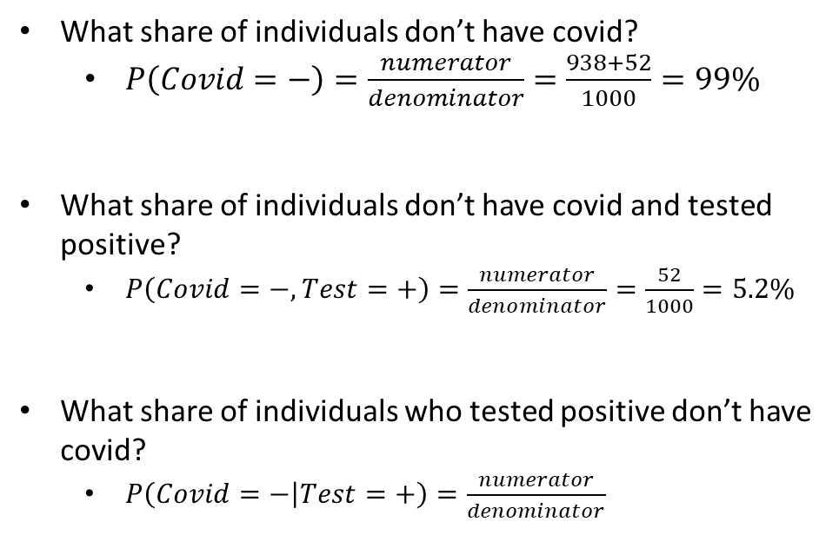
Difference between Marginal, Joint, and Conditional Probabilities
$$Covid$$ | $$Test$$ | $$Count$$
- | - | 938
- | + | 52
+ | - | 2
+ | + | 8
What share of individuals don’t have covid?
$P\left(Covid=−\right)=\frac{numerator}{denominator}=\frac{938+52}{1000}=99\%$
What share of individuals don’t have covid and tested positive?
$P\left(Covid=−, Test=+\right)=\frac{numerator}{denominator}=\frac{52}{1000}=5.2\%$
What share of individuals who tested positive don’t have covid?
$P\left(Covid=− | Test=+\right)=\frac{numerator}{denominator}$

Slide 37
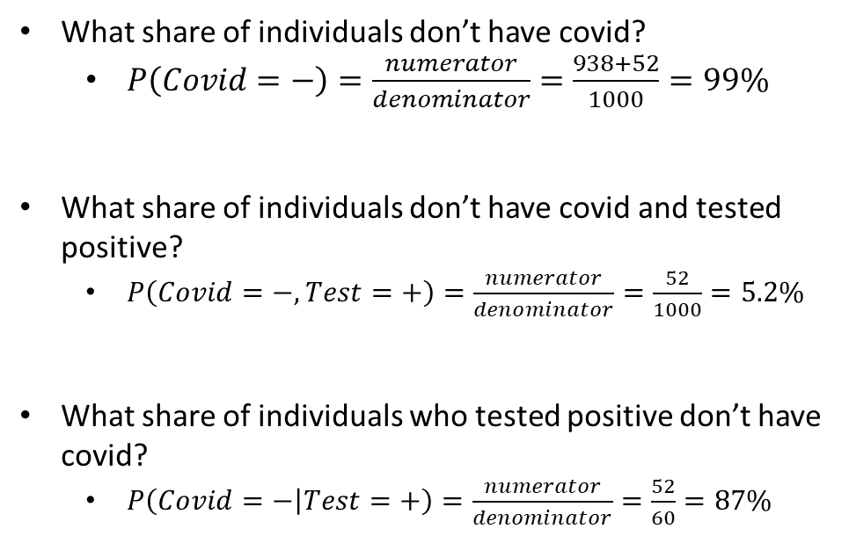
Difference between Marginal, Joint, and Conditional Probabilities
$$Covid$$ | $$Test$$ | $$Count$$
- | - | 938
- | + | 52
+ | - | 2
+ | + | 8
What share of individuals don’t have covid?
$P\left(Covid=−\right)=\frac{numerator}{denominator}=\frac{938+52}{1000}=99\%$
What share of individuals don’t have covid and tested positive?
$P\left(Covid=−, Test=+\right)=\frac{numerator}{denominator}=\frac{52}{1000}=5.2\%$
What share of individuals who tested positive don’t have covid?
$P\left(Covid=− | Test=+\right)=\frac{numerator}{denominator}=\frac{52}{60}=87\%$

Slide 38
Probability Practice

Slide 39
Dice roll
Let’s say we roll two dice one right after another. What is the probability that the sum of the two dice will be greater than 8 if the first roll was 5?

Slide 40

Dice roll – Direct Calculation
Let’s say we roll two dice one right after another. What is the probability that the sum of the two dice will be greater than 8 if the first roll was 5?
Let $X_{1}$ represent outcome of first roll
Let $X_{2}$ represent outcome of second roll

Slide 41
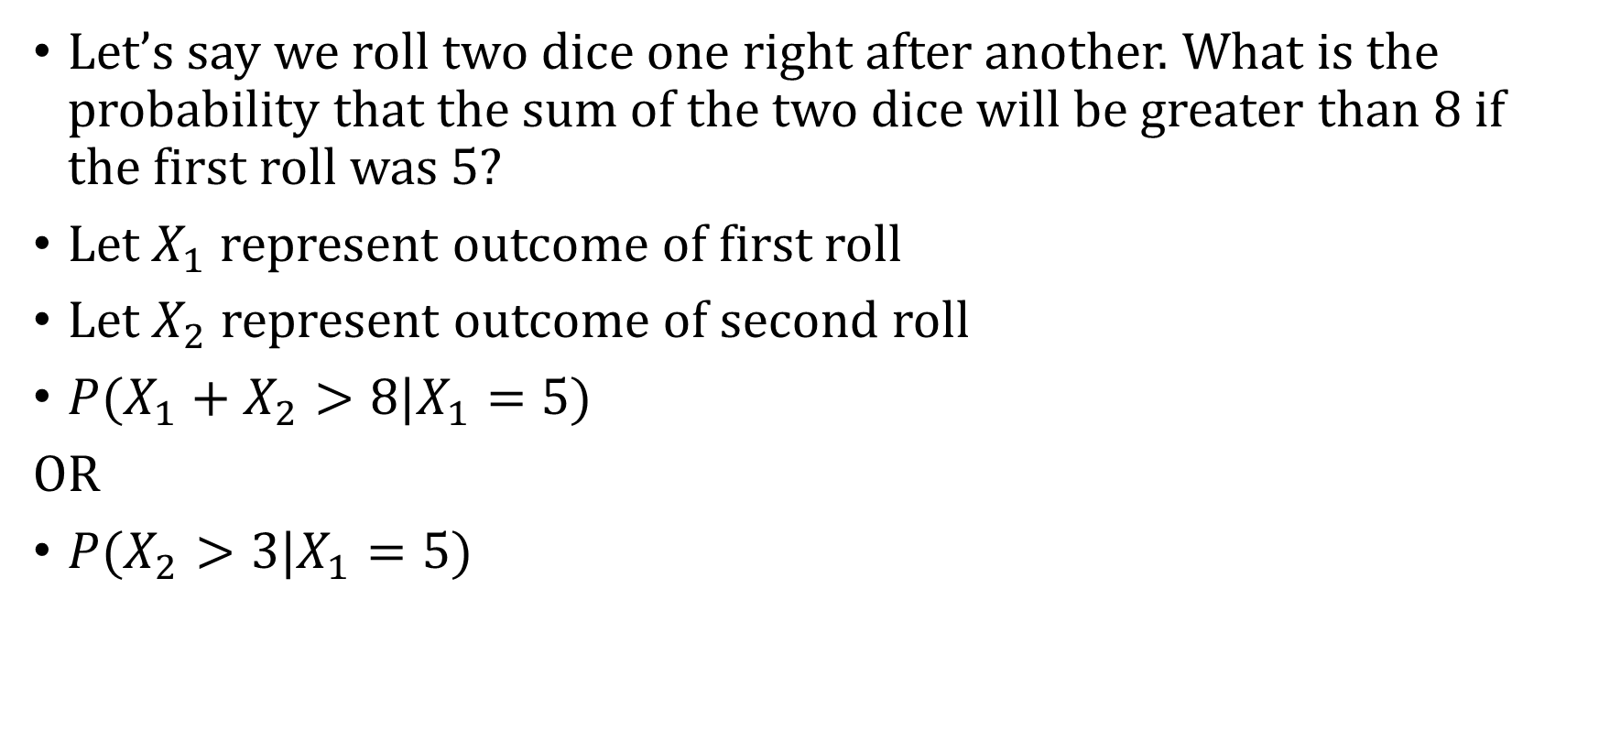
Dice roll – Direct Calculation
Let’s say we roll two dice one right after another. What is the probability that the sum of the two dice will be greater than 8 if the first roll was 5?
Let $X_{1}$ represent outcome of first roll
Let $X_{2}$ represent outcome of second roll
$P(X_{1}+X_{2}>8|X_{1}=5)$
OR
$P(X_{2}>3|X_{1}=5)$

Slide 42


Joint Distribution
$$X_{2}$$
 | 1 | 2 | 3 | 4 | 5 | 6
1 | 1/36 | 1/36 | 1/36 | 1/36 | 1/36 | 1/36
2 | 1/36 | 1/36 | 1/36 | 1/36 | 1/36 | 1/36
3 | 1/36 | 1/36 | 1/36 | 1/36 | 1/36 | 1/36
4 | 1/36 | 1/36 | 1/36 | 1/36 | 1/36 | 1/36
5 | 1/36 | 1/36 | 1/36 | 1/36 | 1/36 | 1/36
6 | 1/36 | 1/36 | 1/36 | 1/36 | 1/36 | 1/36
$$X_{1}$$

Slide 43
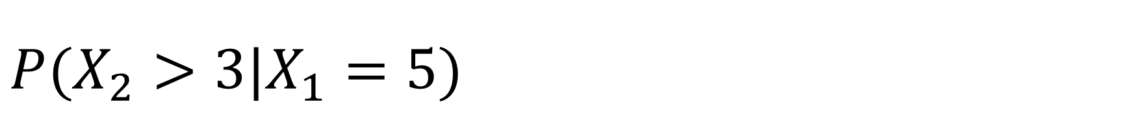
$P(X_{2}>3|X_{1}=5)$
$$X_{2}$$
 | 1 | 2 | 3 | 4 | 5 | 6
1 | 1/36 | 1/36 | 1/36 | 1/36 | 1/36 | 1/36
2 | 1/36 | 1/36 | 1/36 | 1/36 | 1/36 | 1/36
3 | 1/36 | 1/36 | 1/36 | 1/36 | 1/36 | 1/36
4 | 1/36 | 1/36 | 1/36 | 1/36 | 1/36 | 1/36
5 | 1/36 | 1/36 | 1/36 | 1/36 | 1/36 | 1/36
6 | 1/36 | 1/36 | 1/36 | 1/36 | 1/36 | 1/36
$$X_{1}$$

Slide 44

$P(X_{2}>3|X_{1}=5)$
$$X_{2}$$
 | 1 | 2 | 3 | 4 | 5 | 6
1 | 1/36 | 1/36 | 1/36 | 1/36 | 1/36 | 1/36
2 | 1/36 | 1/36 | 1/36 | 1/36 | 1/36 | 1/36
3 | 1/36 | 1/36 | 1/36 | 1/36 | 1/36 | 1/36
4 | 1/36 | 1/36 | 1/36 | 1/36 | 1/36 | 1/36
5 | 1/36 | 1/36 | 1/36 | 1/36 | 1/36 | 1/36
6 | 1/36 | 1/36 | 1/36 | 1/36 | 1/36 | 1/36
$$X_{1}$$
What share of the time is $X_{2}>3?$
$$\frac{\frac{3}{36}}{\frac{6}{36}}=\frac{1}{2}$$

Slide 45
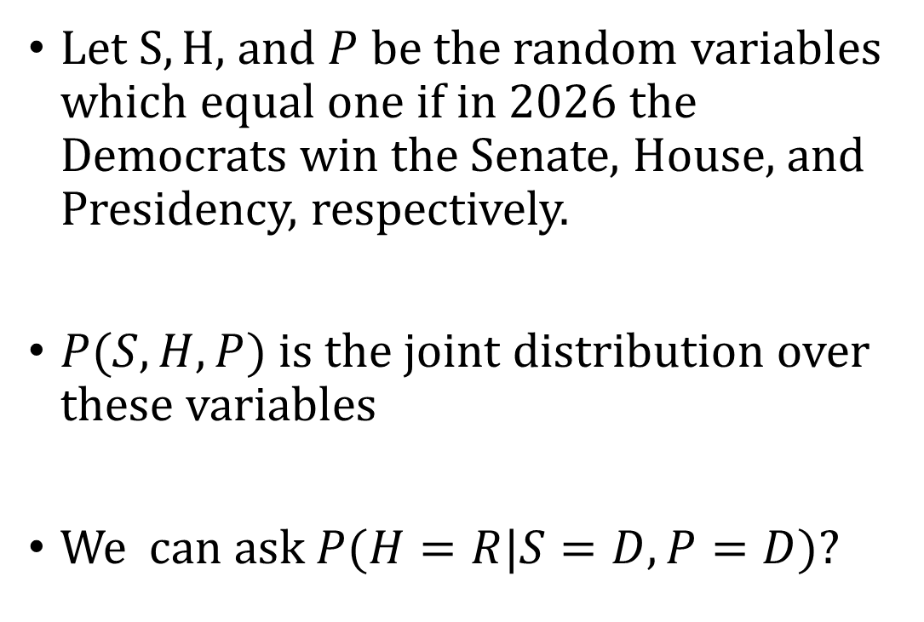
More than two random variables
House | President | Senate | Prob
D | D | D | .4
D | D | R | .05
D | R | D | .1
D | R | R | .05
R | D | D | .05
R | D | R | .1
R | R | D | .05
R | R | R | .2
Let $S, H,$ and $P$ be the random variables which equal one if in 2026 the Democrats win the Senate, House, and Presidency, respectively.
$P(S, H, P)$ is the joint distribution over these variables
We can ask $P(H=R|S=D, P=D)$?

Slide 46

More than two random variables
House | President | Senate | Prob
D | D | D | .4
D | D | R | .05
D | R | D | .1
D | R | R | .05
R | D | D | .05
R | D | R | .1
R | R | D | .05
R | R | R | .2
We can ask $P(H=R|S=D, P=D)$?
$P\left(H=R | S=D, P=D\right)=\frac{P\left(H=R, S=D, P=D\right)}{P(S=D, P=D)}$

Slide 47

More than two random variables
House | President | Senate | Prob
D | D | D | .4
D | D | R | .05
D | R | D | .1
D | R | R | .05
R | D | D | .05
R | D | R | .1
R | R | D | .05
R | R | R | .2
$P\left(H=R | S=D, P=D\right)=\frac{P\left(H=R, S=D, P=D\right)}{P(S=D, P=D)}$
$P\left(H=R, S=D, P=D\right)=.05$
$P\left(S=D,P=D\right)?$

Slide 48
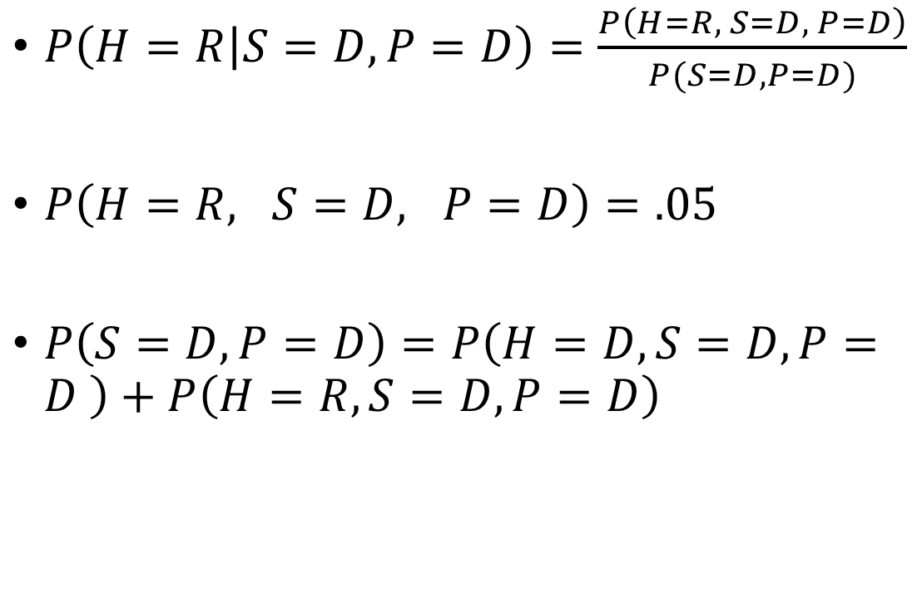
More than two random variables
House | President | Senate | Prob
D | D | D | .4
D | D | R | .05
D | R | D | .1
D | R | R | .05
R | D | D | .05
R | D | R | .1
R | R | D | .05
R | R | R | .2
$P\left(H=R | S=D, P=D\right)=\frac{P\left(H=R, S=D, P=D\right)}{P(S=D, P=D)}$
$P\left(H=R, S=D, P=D\right)=.05$
$P\left(S=D,P=D\right)=P\left(H=D, S=D,P=D \right)+P\left(H=R,S=D,P=D\right)$

Slide 49
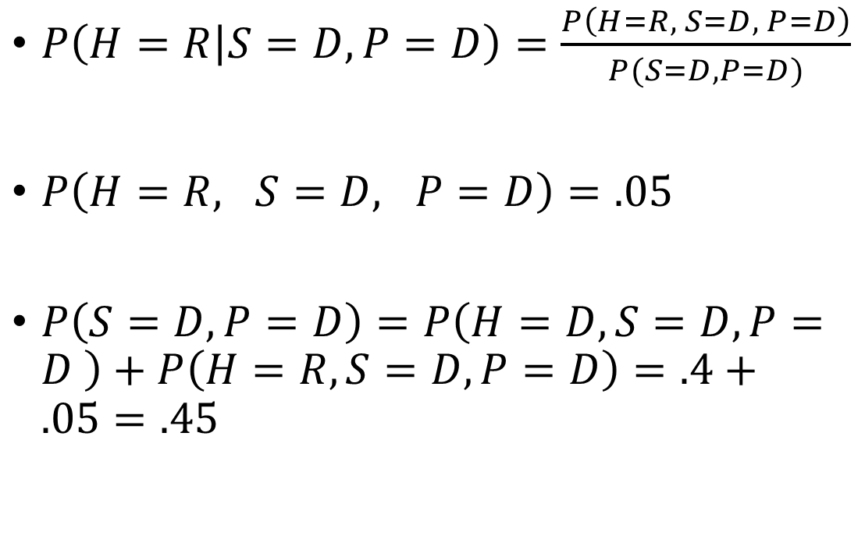
More than two random variables
House | President | Senate | Prob
D | D | D | .4
D | D | R | .05
D | R | D | .1
D | R | R | .05
R | D | D | .05
R | D | R | .1
R | R | D | .05
R | R | R | .2
$P\left(H=R | S=D, P=D\right)=\frac{P\left(H=R, S=D, P=D\right)}{P(S=D, P=D)}$
$P\left(H=R, S=D, P=D\right)=.05$
$P\left(S=D,P=D\right)=P\left(H=D, S=D,P=D \right)+P\left(H=R,S=D,P=D\right)=.4+.05=.45$

Slide 50
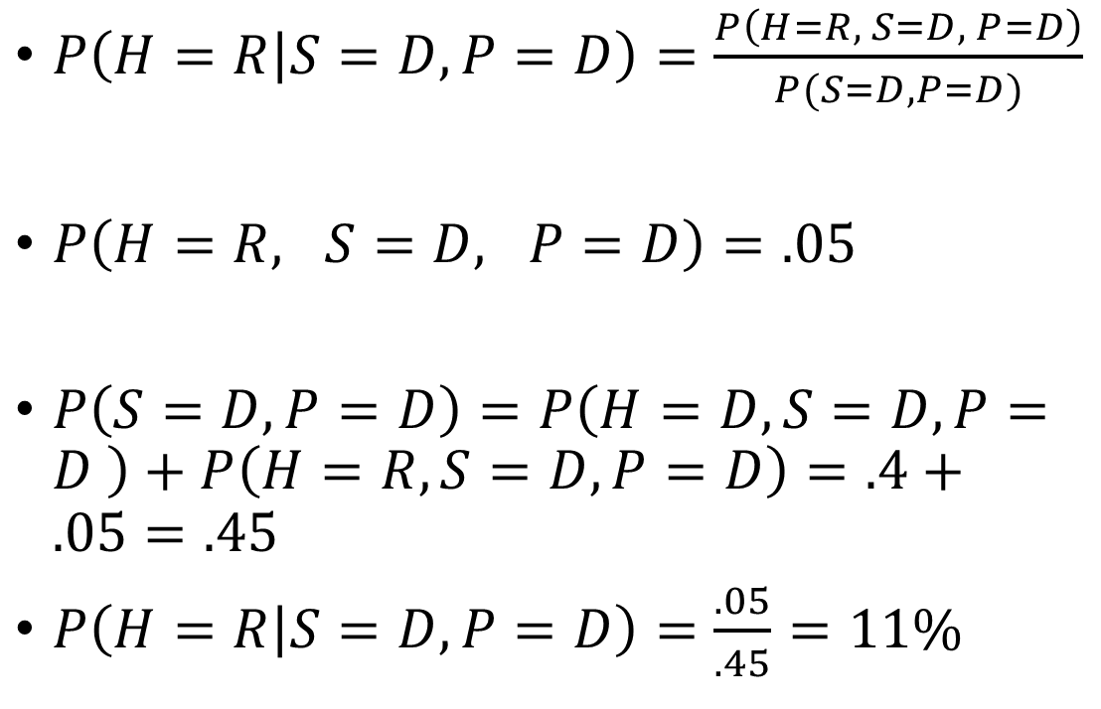
More than two random variables
House | President | Senate | Prob
D | D | D | .4
D | D | R | .05
D | R | D | .1
D | R | R | .05
R | D | D | .05
R | D | R | .1
R | R | D | .05
R | R | R | .2
$P\left(H=R | S=D, P=D\right)=\frac{P\left(H=R, S=D, P=D\right)}{P(S=D, P=D)}$
$P\left(H=R, S=D, P=D\right)=.05$
$P\left(S=D,P=D\right)=P\left(H=D, S=D,P=D \right)+P\left(H=R,S=D,P=D\right)=.4+.05=.45$
$P\left(H=R | S=D, P=D\right)=\frac{.05}{.45}=11\%$

Slide 51
Relationship Between Our Three Distributions

Slide 52
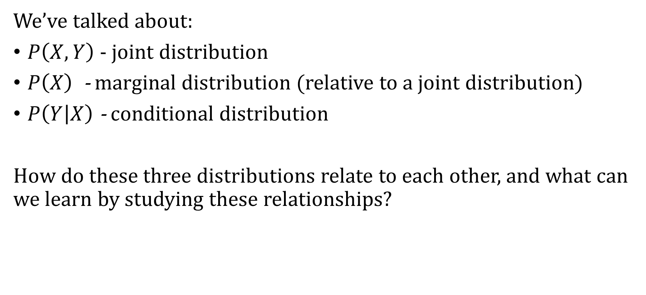
Relationship between Marginal, Joint, and Conditional
We’ve talked about:
$P\left(X, Y\right)$ - joint distribution
$P\left(X\right)$- marginal distribution (relative to a joint distribution)
$P\left(Y | X\right)$ - conditional distribution
How do these three distributions relate to each other, and what can we learn by studying these relationships?

Slide 53

Relationship between Marginal, Joint, and Conditional
Conditional Probability Formula:
$$P\left(B | A\right)=\frac{P\left(A, B\right)}{P(A)}$$

Slide 54

Relationship between Marginal, Joint, and Conditional
Conditional Probability Formula:
$$P\left(A\right) P\left(B | A\right)=\frac{P\left(A, B\right)}{P(A)}P\left(A\right)$$

Slide 55
Relationship between Marginal, Joint, and Conditional
Conditional Probability Formula:
$$P\left(A\right) P\left(B | A\right)=\frac{P\left(A, B\right)}{P(A)}P\left(A\right)$$

Slide 56

Relationship between Marginal, Joint, and Conditional
Conditional Probability Formula:
$$P\left(A\right) P\left(B | A\right)=\frac{P\left(A, B\right)}{P(A)}P\left(A\right)$$
That gives us the chain rule:
$$P\left(A, B\right)=P\left(B | A\right) P(A)$$

Slide 57
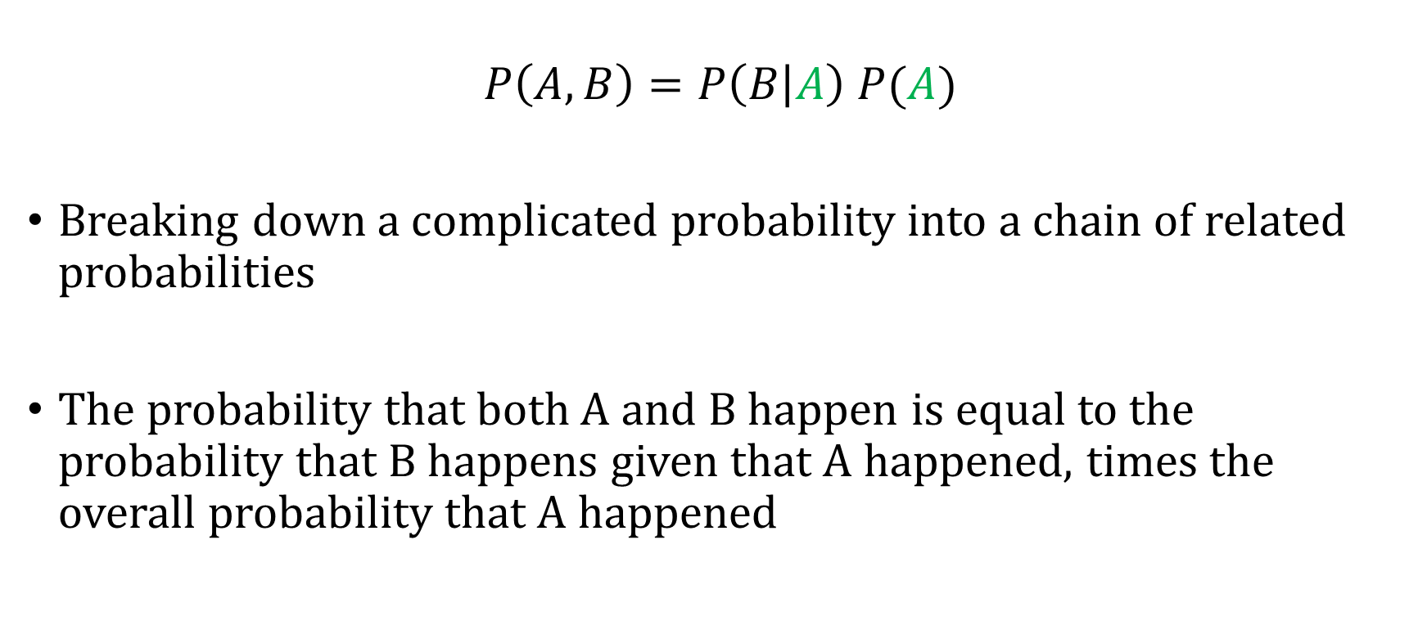
The Chain Rule
$$P\left(A, B\right)=P\left(B | A\right) P(A)$$
Breaking down a complicated probability into a chain of related probabilities
The probability that both A and B happen is equal to the probability that B happens given that A happened, times the overall probability that A happened

Slide 58

An Algebraic Fact
Let
$P\left(X\right) P\left(Y | X\right)=P\left(X, Y\right)$
$P\left(Y\right)P\left(X | Y\right)= ?$

Slide 59
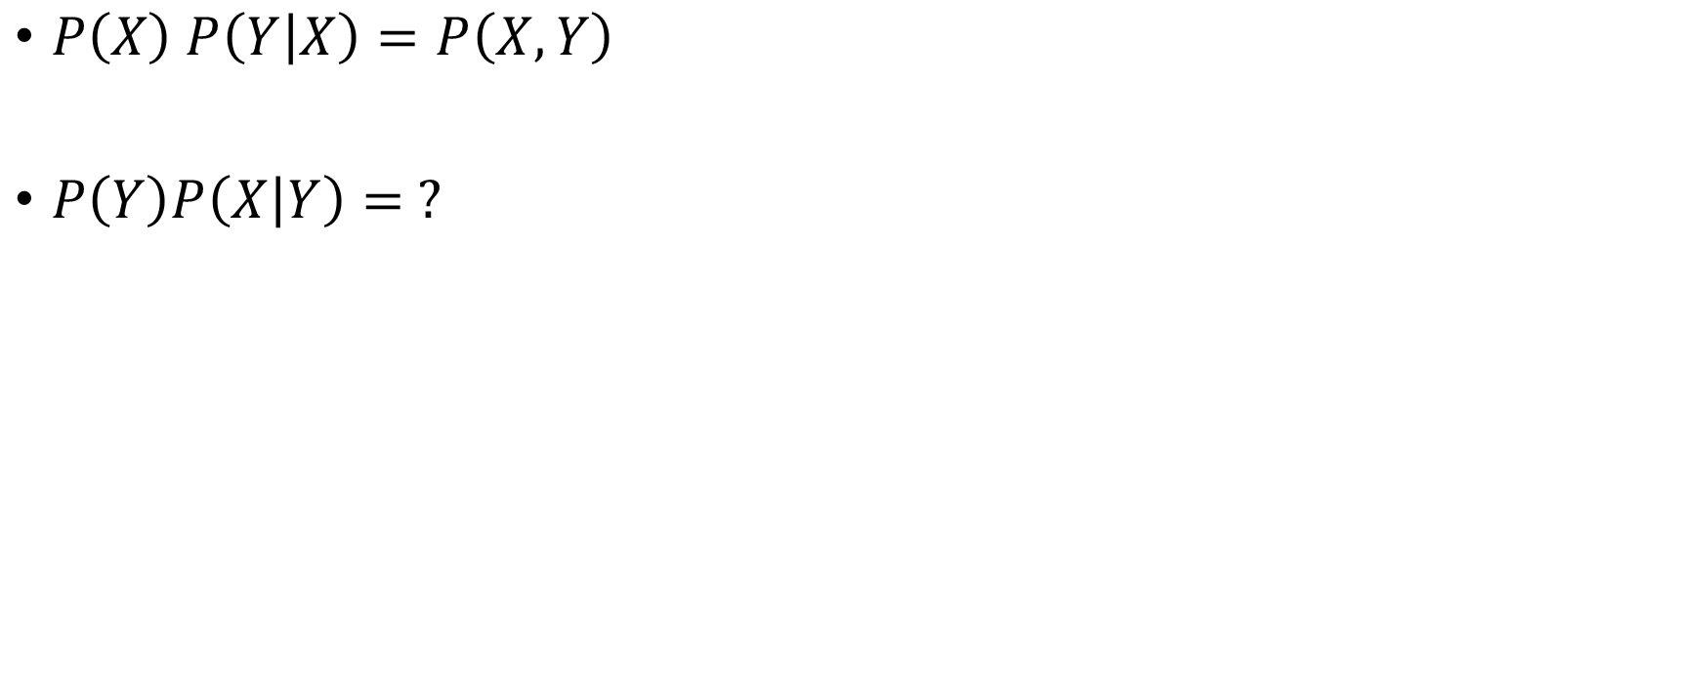
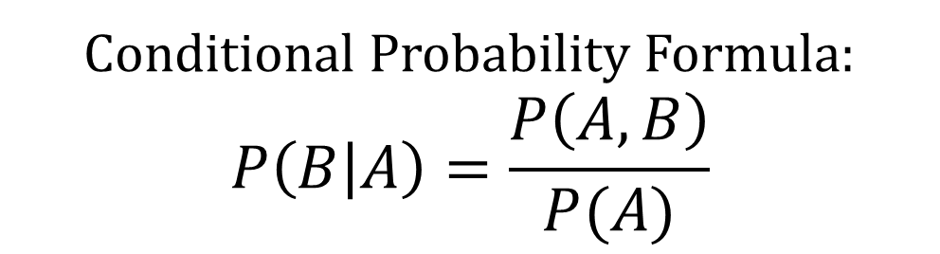
Relationship between Marginal, Joint, and Conditional
$P\left(X\right) P\left(Y | X\right)=P\left(X, Y\right)$
$P\left(Y\right)P\left(X | Y\right)= ?$
Conditional Probability Formula:
$$P\left(B | A\right)=\frac{P\left(A, B\right)}{P(A)}$$

Slide 60

Relationship between Marginal, Joint, and Conditional
$P\left(X\right) P\left(Y | X\right)=P\left(X, Y\right)$
$P\left(Y\right)P\left(X | Y\right)= ?$
Plug in:
$P\left(X | Y\right)=\frac{P(X, Y)}{P(Y)}$
Rearrange:
$P\left(Y\right)P\left(X | Y\right)=P(X,Y)$
Conditional Probability Formula:
$$P\left(B | A\right)=\frac{P\left(A, B\right)}{P(A)}$$

Slide 61
Marginalizing with Conditional Probabilities

Slide 62

We Learned How to Marginalize with Joint Probabilities
Recall that:
$$P\left(X=0\right)=P\left(X=0,Y=0\right)+P(X=0,Y=1)$$

Slide 63

Marginalizing with Conditional Probabilities
Recall that:
$$P\left(X=0\right)=P\left(X=0,Y=0\right)+P(X=0,Y=1)$$
We now know that : $P\left(A,B\right)=P\left(B | A\right) P(A)$

Slide 64

Marginalizing with Conditional Probabilities
Recall that:
$$P\left(X=0\right)=P\left(X=0,Y=0\right)+P(X=0,Y=1)$$
We now know that : $P\left(A,B\right)=P\left(B | A\right) P(A)$
So use the fact that: $P\left(X,Y\right)=P\left(X | Y\right)P(Y)$

Slide 65

Marginalizing with Conditional Probabilities
Recall that:
$$P\left(X=0\right)=P\left(X=0,Y=0\right)+P(X=0,Y=1)$$
We now know that : $P\left(A,B\right)=P\left(B | A\right) P(A)$
So use the fact that: $P\left(X,Y\right)=P\left(X | Y\right)P(Y)$
We can substitute:
$$P\left(X=0\right)=P\left(X=0|Y=0\right)P(Y=0)+P\left(X=0 | Y=1\right)P(Y=1)$$

Slide 66

Marginalizing with Conditional Probabilities
Recall that:
$$P\left(X=0\right)=P\left(X=0,Y=0\right)+P(X=0,Y=1)$$
We now know that : $P\left(A,B\right)=P\left(B | A\right) P(A)$
We can substitute:
$$P\left(X=0\right)=P\left(X=0|Y=0\right)P(Y=0)+P\left(X=0 | Y=1\right)P(Y=1)$$
You can compute marginal distribution from either the joint or conditional

Slide 67

Example
Risk Level | Sex | Count
Low Risk | Male | 80
Low Risk | Female | 24
High Risk | Male | 76
High Risk | Female | 20
$P\left(Sex=Male\right)=P\left(Sex=Male, RL=High\right)+P\left(Sex=Male, RL=Low\right)$

Slide 68

Example
Risk Level | Sex | Count
Low Risk | Male | 80
Low Risk | Female | 24
High Risk | Male | 76
High Risk | Female | 20
$P\left(Sex=Male\right)=P\left(Sex=Male, RL=High\right)+P\left(Sex=Male, RL=Low\right)$
$P\left(Sex=Male\right)= \frac{76}{76+80+24+20}+\frac{80}{76+80+24+20}=\frac{76}{200}+\frac{80}{200}=\frac{156}{200}=0.78$

Slide 69

Example
Risk Level | Sex | Count
Low Risk | Male | 80
Low Risk | Female | 24
High Risk | Male | 76
High Risk | Female | 20
Use chain rule formula:
$$P\left(Sex, RL\right)=P\left(Sex | RL\right)P(RL)$$
$P\left(Sex=Male\right)=P\left(Sex=M, RL=H\right)+P\left(Sex=M, RL=L\right)$
Plug in
$P\left(Sex=M\right)=P\left(Sex=M|RL=H\right) P\left(RL=H\right)+P\left(Sex=M|RL=L\right)P\left(RL=L\right)$

Slide 70

Example
Risk Level | Sex | Count
Low Risk | Male | 80
Low Risk | Female | 24
High Risk | Male | 76
High Risk | Female | 20
$P\left(Sex=M\right)=P\left(Sex=M|RL=H\right) P\left(RL=H\right)+P\left(Sex=M|RL=L\right)P\left(RL=L\right)$
$P\left(Sex=M\right)=\frac{76}{76+20} ∗\frac{76+20}{200}+\frac{80}{80+24} ∗\frac{80+24}{200}$

