Slide 1
INST 414: Data Science Techniques Lecture 14 The Predictive Utility of Arrest Records

Slide 2
Selective Labels Problem

Slide 3
Selective Labels Problem
Jail
Arraignment
FTA
Released
No FTA

Slide 4
The Issue
Judges detain people based on risk
Released
Jailed

Slide 5
Selective Labels Problem
Jail
Arraignment
FTA
Released
No FTA

Slide 6
The Issue
Judges detain people based on risk
Data available to the algorithm to build prediction model
Released
Jailed
Available data

Slide 7
The Research Question
Can a risk predictor help judges make better decisions?
More aligned with risk of committing a crime
What are we going to compare to make this assessment?
Are the individuals identified by the algorithm higher risk than the individuals identified and detained by the judges

Slide 8


Rankings of Judge and Algorithm
They don’t rank defendants in the same order
A
B
C
D
E
F
G
H
I
J
K
L
M
N
O
P
B
A
C
G
H
I
J
E
F
K
L
D
M
N
O
P

Slide 9
Rankings of Judge and Algorithm
They don’t rank defendants in the same order
Algorithm and judge detain the same number of people
A
B
C
D
E
F
G
H
I
J
K
L
M
N
O
P
B
A
C
G
H
I
J
E
F
K
L
D
M
N
O
P

Slide 10
Rankings of Judge and Algorithm
They don’t rank defendants in the same order
Algorithm and judge detain the same number of people
A
B
C
D
E
F
G
H
I
J
K
L
M
N
O
P
B
A
C
G
H
I
J
E
F
K
L
D
M
N
O
P

Slide 11
Rankings of Judge and Algorithm
They don’t rank defendants in the same order
Algorithm and judge detain the same number of people
Assess risk level of these two groups
A
B
C
D
E
F
G
H
I
J
K
L
M
N
O
P
B
A
C
G
H
I
J
E
F
K
L
D
M
N
O
P

Slide 12
Rankings of Judge and Algorithm
They don’t rank defendants in the same order
Algorithm and judge detain the same number of people
Assess risk level of these two groups
We don’t see outcomes for everybody
A
B
C
D
E
F
G
H
I
J
K
L
M
N
O
P
Jailed
Jailed
B
A
C
G
H
I
J
E
F
K
L
D
M
N
O
P

Slide 13
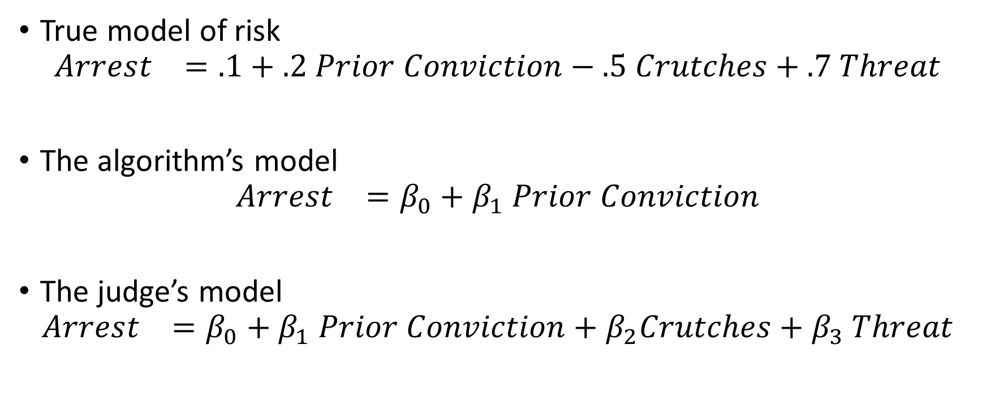
The Issue
True model of risk
$$Arrest_{}=.1+.2 Prior Conviction−.5 Crutches+.7 Threat$$
The algorithm’s model
$$Arrest_{}=β_{0}+β_{1} Prior Conviction$$
The judge’s model
$$Arrest_{}=β_{0}+β_{1} Prior Conviction+β_{2}Crutches+β_{3} Threat$$

Slide 14
The Issue
Judges detain people based on risk
Data available to the algorithm to build prediction model
Algorithm can predict for both jailed and not jailed
Released
Jailed
Available data
Observed Outcome
Imputed Outcome

Slide 15
The Issue
If the judge’s model of risk is accurate, it could be more accurate than the algorithm, but we won’t be able to tell.
If the unobserved information is important, then algorithm’s model imputations of risk for detained will be biased
If you’re interested in the solution to this problem, see:
Human Decisions and Machine Predictions

Slide 16
Recap: The Selective Labels Problem
Want to compare an algorithm to decisions made by a judge
The outcomes are not available for people selected by the judge
The judge has access to information not available to the algorithm
This information is predictive of risk
The judge is using the information accurately

Slide 17
Lessons and Limits of Predicting Shooting Victimization

Slide 18
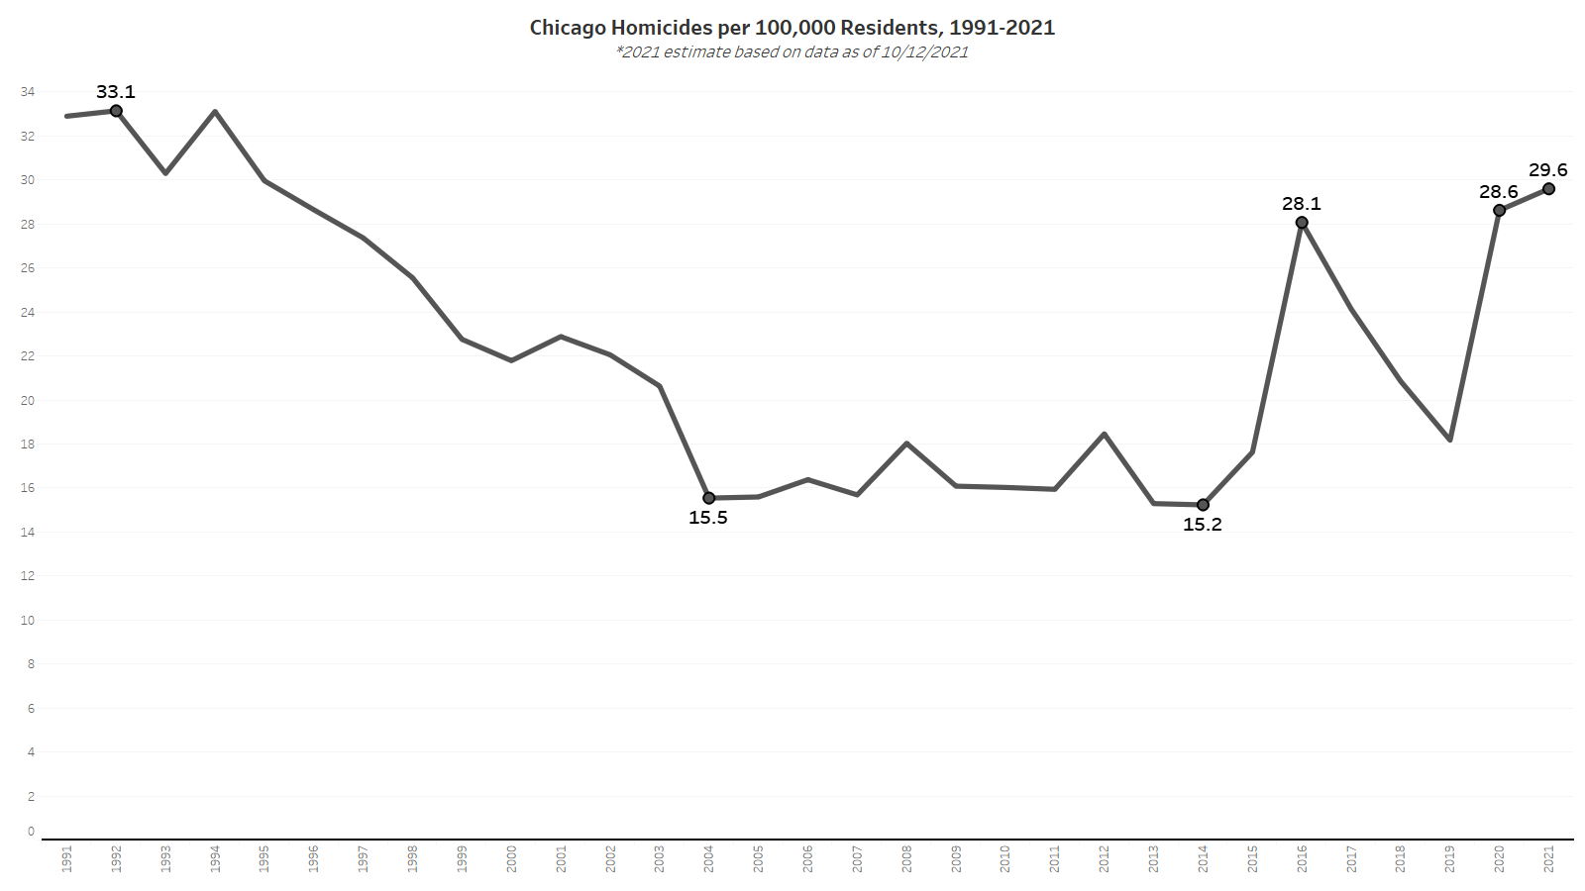
Notes:
15% lower than the peak in the 90s

Slide 19
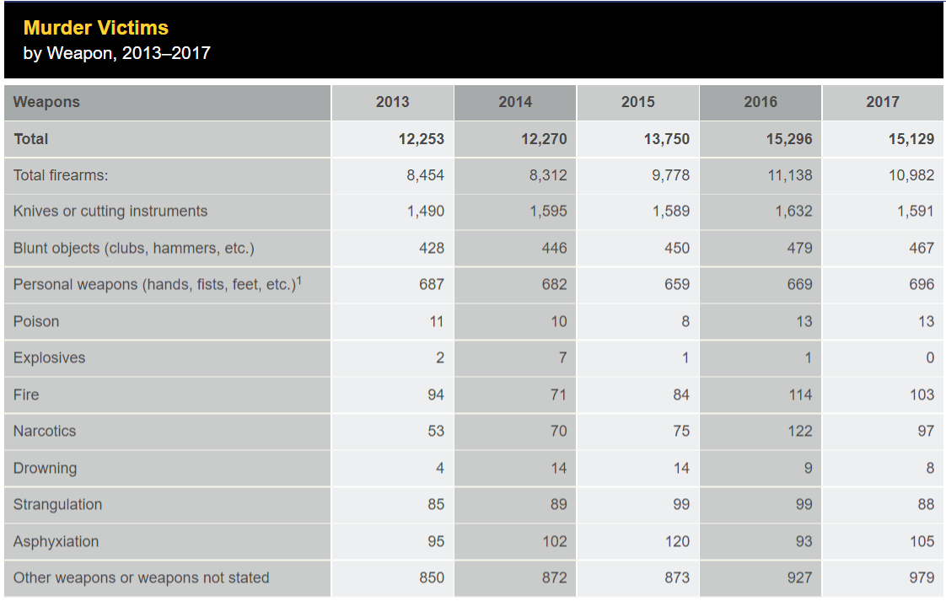
Causes of Homicide
In 2016, firearms accounted for 10,982 out of 15,129 homicides, 72.5%
Source: FBI UCR

Slide 20
Gun Violence Is Highly Concentrated
Geographically, within disadvantaged neighborhoods (Cook & Ludwig 2000; Sampson, Raudenbush & Earls 1997; Sampson 2012; Sharkey 2013)
Demographically, with young black men dying from gun homicide at 20 times rate of white counterparts (CDC 2019)
Socially, among young men with criminal justice contact, within networks (Braga 2003; Green et al. 2017; Papachristos et al. 2015)

Slide 21
Gives Hope
Promising interventions have been shown to be effective in reducing arrests (CBT + Summer Jobs)
People at high risk of being a shooting victim receive no programming
Shootings are very costly (to the victim and the community)
Most investments would pay for themselves if they are effective

Slide 22
Which Shooting Type to Predict?
Most proximate cause of shootings are shooting OFFENDERS
In order to measure offending, we have to use arrests
The share of shootings that lead to an arrest is very small < 20%

Slide 23
Is the outcome measured cleanly?
I.e. w/ little error?
Some shooting offenders are “selectively labeled” when they are arrested
Some have no opportunity of being arrested (police never get any leads)
Upshot: Shooting offending will have measurement error
All arrest outcomes will suffer from this

Slide 24
What about shooting victimization?
If gun shot results in hospitalization, must be reported to police
Severe shootings are well-measured
What’s missed?
“Grazings” that can be treated outside of hospital
Intention to shoot a person, but miss
Predict shooting victimization instead of shooting offending

Slide 25
Why Chicago?
- Higher violence rate than NYC, LA; less than Baltimore, St. Louis, Detroit; similar to Philly
Size + violence rate = sufficient data to train, test model
Training data likely to reflect disparities given history of problematic policing practices

Slide 26
Agenda
Data
Features
Prediction Model
Results overall
Results by subgroup
Potential Impact

Slide 27
Data
12 million records between 1999 to 2019
Arrest Records + Victimization Records
Define 1,400+ features
Demographics
Arrests and Victimizations
Networks

Slide 28
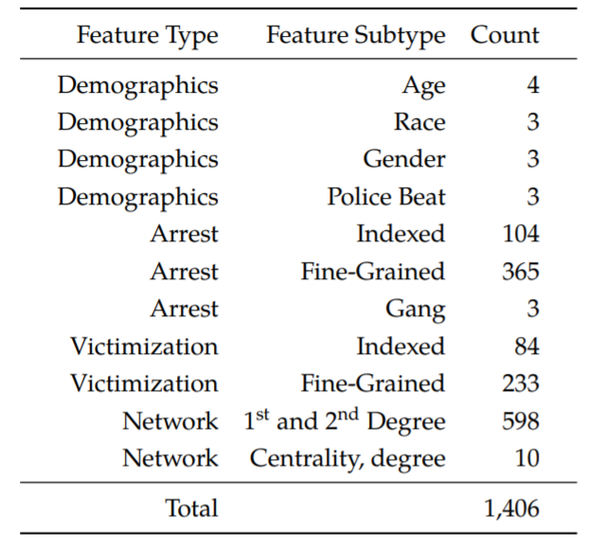
Feature Types
Demographic
Age, race, gender, geography
Arrests
Number of prior arrests in the last year, two years
Number of prior arrests of type X in the last year, two years, etc
Victimizations
Similar but on victimization side

Slide 29
Network Features
Person A and Person B get arrested together
Person A is young and has no arrest history
Person B is older and has many previous arrests was previously arrested with Person C
Person B was also previously arrested with Person C, who was previously a shooting victim
C
Arrest Event
A
B

Slide 30
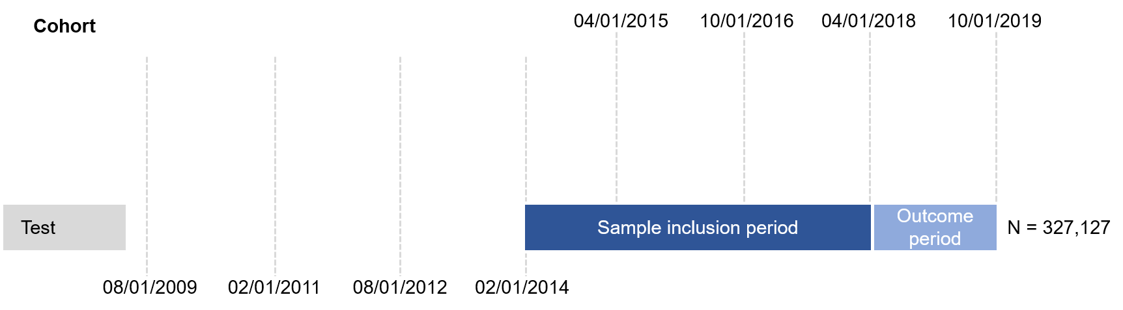
Prediction Setup

Slide 31
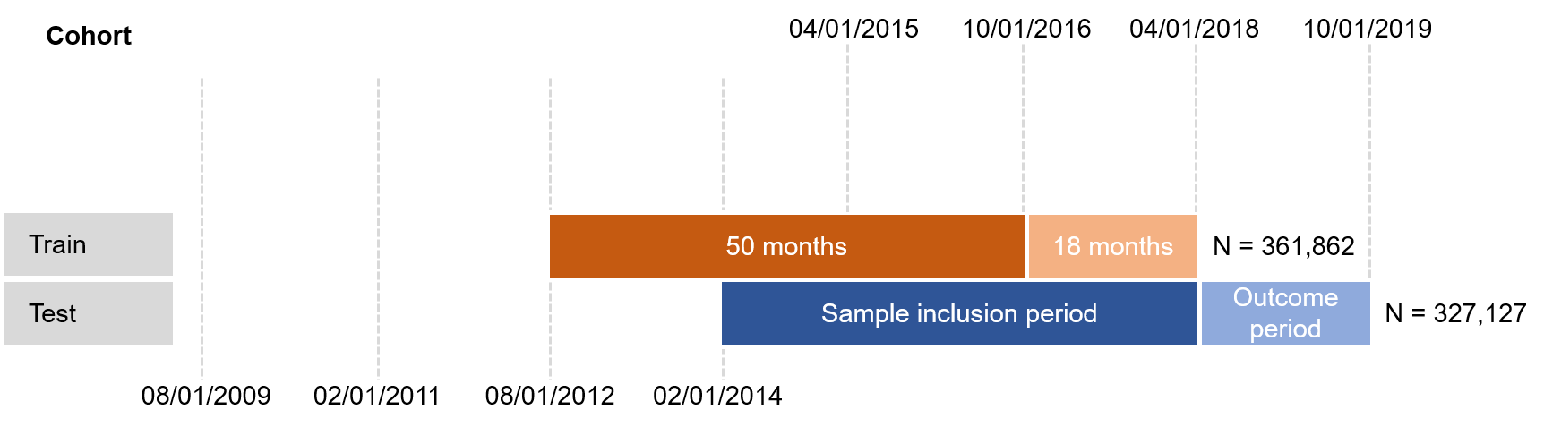
Prediction Setup

Slide 32
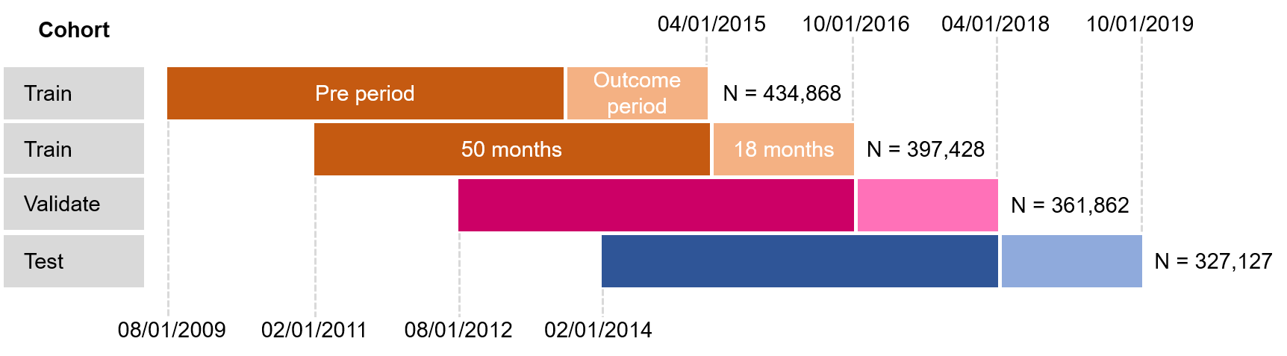
Prediction Setup

Slide 33
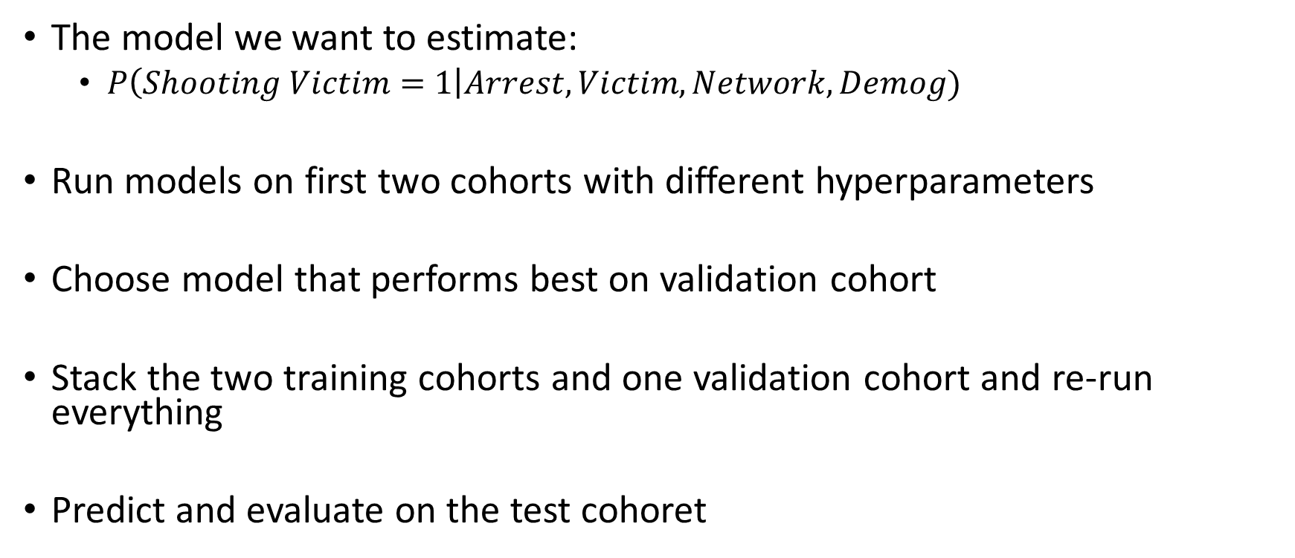
Prediction Setup: Recap
The model we want to estimate:
$P\left(Shooting Victim=1\right|Arrest,Victim,Network, Demog)$
Run models on first two cohorts with different hyperparameters
Choose model that performs best on validation cohort
Stack the two training cohorts and one validation cohort and re-run everything
Predict and evaluate on the test cohoret

Slide 34
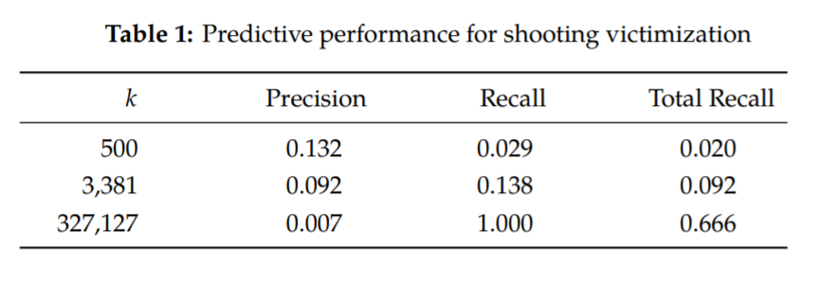
Results

Slide 35
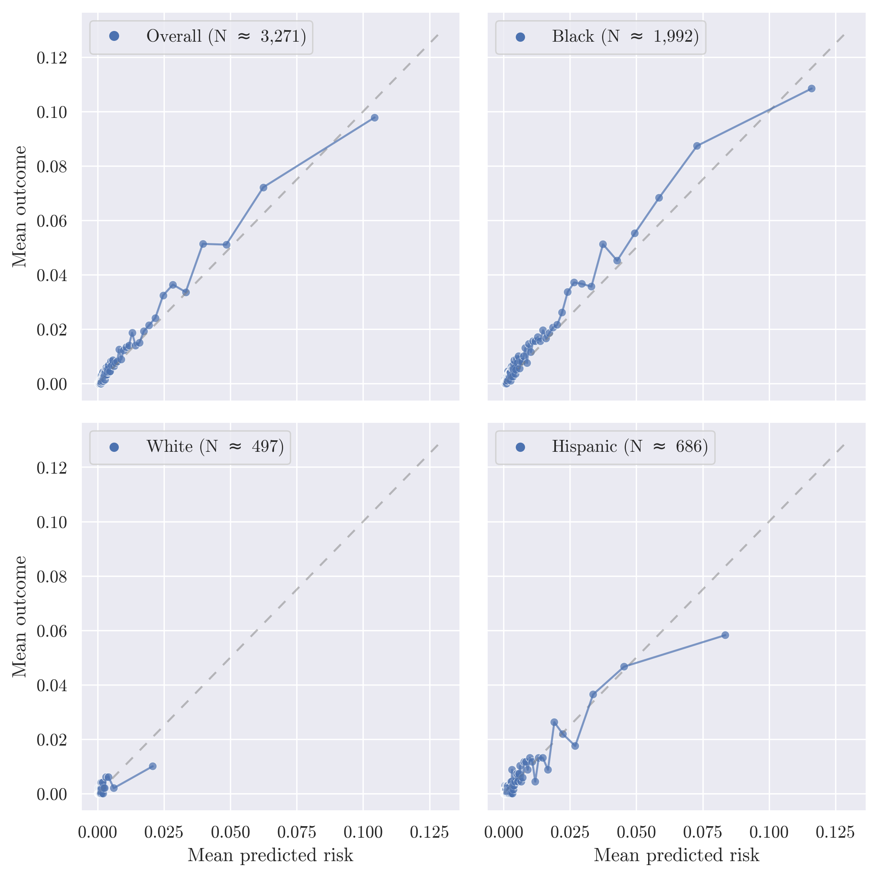
Calibration
Each dot is 1 percent of the prediction sample
Over 90% of the sample gets a predicted probability less that 5%
We appear to be calibrated overall (top left chart)
Some over-prediction for Hispanic and White subgroups relative to Black

Slide 36
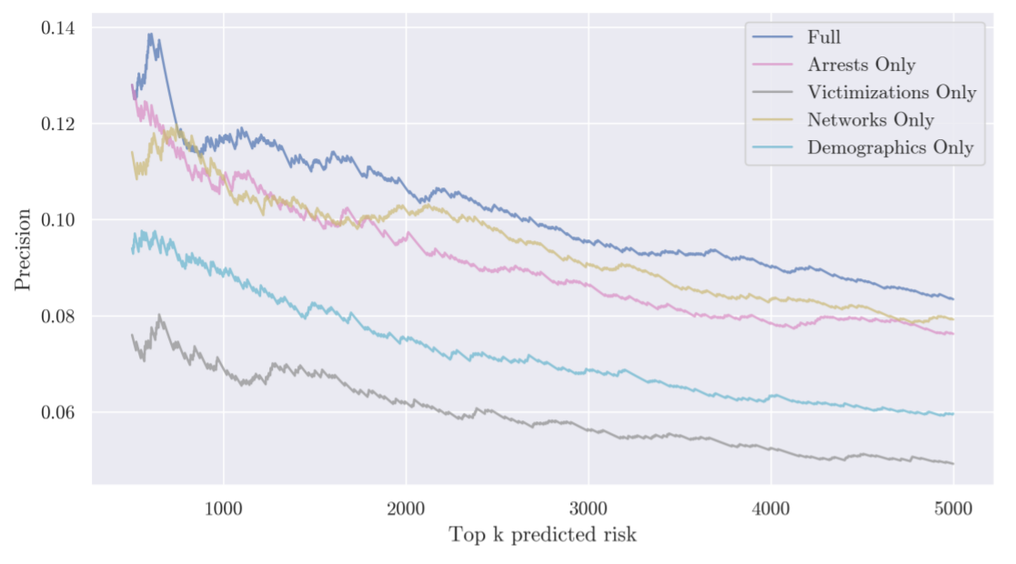
What Features Drive Performance?

Slide 37
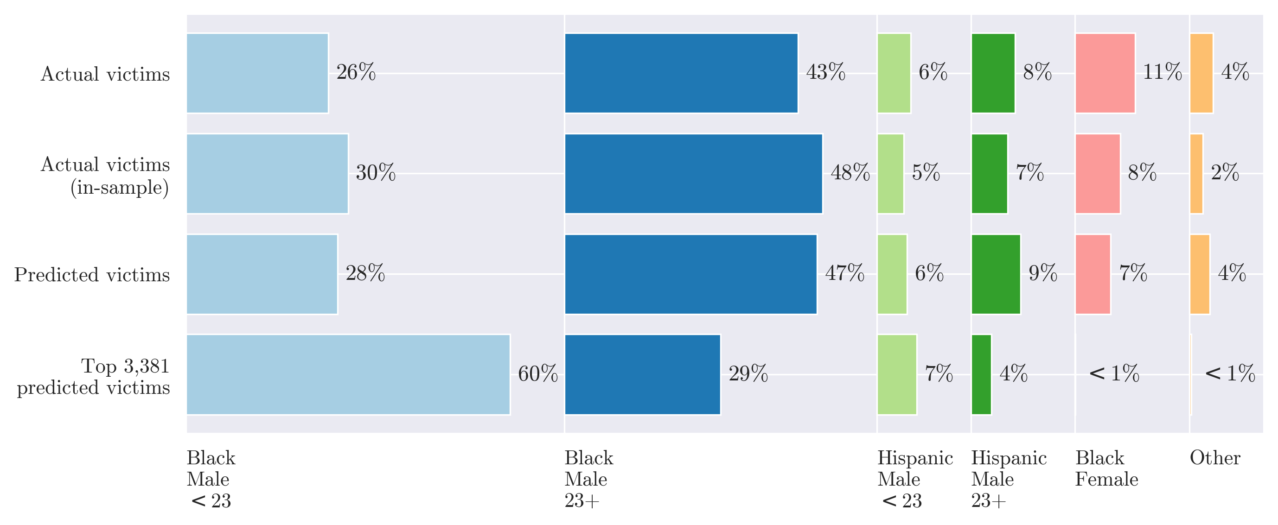
Who Gets Identified

Slide 38
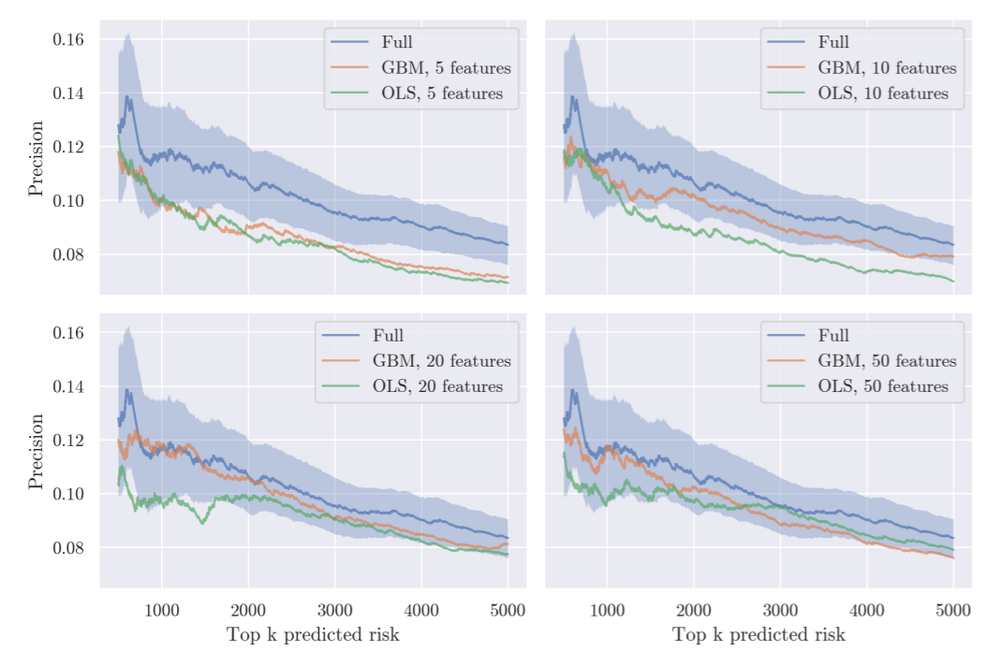
Machine Learning vs Data
Compare Full model
GBM
1,400+ features
GBM + OLS models with many fewer features

Slide 39
Potential Impact
Top 500 people account for 65 shooting victims (13%)
Treat all w/ CBT + Jobs. Cost $20k per person = $10 million
If CBT + Jobs reduced this risk by 50%: 65 victims to 33 victims
Very Crude: Value of a Quality-Adjusted Life Year (QALY). $50K to $150K. Choose $100K
33 * $100k * 1 year = 3.3 million
33 * $100k * 3 year = 9.0 million

Slide 40
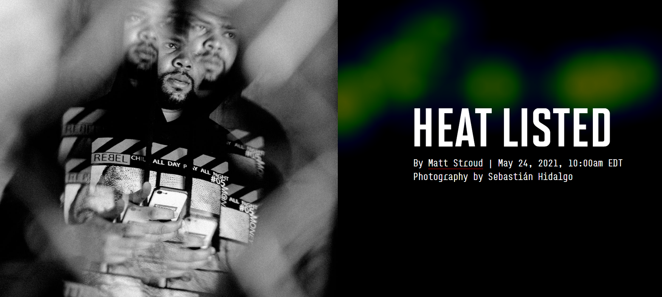
Strategic Subject List

