Slide 1
INST 414: Data Science Techniques Lecture 13 The Evaluation Challenge

Slide 2
Final Teams
Will be posted next Wed 12/7
Will be Due Thu at midnight (12/15)
Encourage you to work in teams of two
Only turn in one final
Make sure you indicate who is on the team
Email me by Tuesday 12/6 at midnight:
If you have a team: your team members
If you need help finding a partner

Slide 3
How Do Algorithms Become Biased/Unfair?

Slide 4
What is algorithmic unfairness?
When two otherwise similar groups are treated differently by the algorithm
What does “otherwise similar groups” mean?
All predictors are the same except whether the person belongs to group A versus B. (race, ethnicity, sex, gender, age, disability status, income, wealth, etc)

Slide 5
What does “treated differently” mean?
Balance in PPV/Calibration:
When an algorithm predicts a person to be at high risk of re-arrest, the actual re-arrest rate is the same regardless of what group the person belongs to
Balance in False Positive Rates:
The share of people who are incorrectly predicted to be high-risk (because they did not get re-arrested), is the same regardless of what group a person belongs to
Balance in False Negative Rates:
The share of people who are incorrectly predicted to be low-risk (because they did get re-arrested), is the same regardless of what group a person belongs to

Slide 6
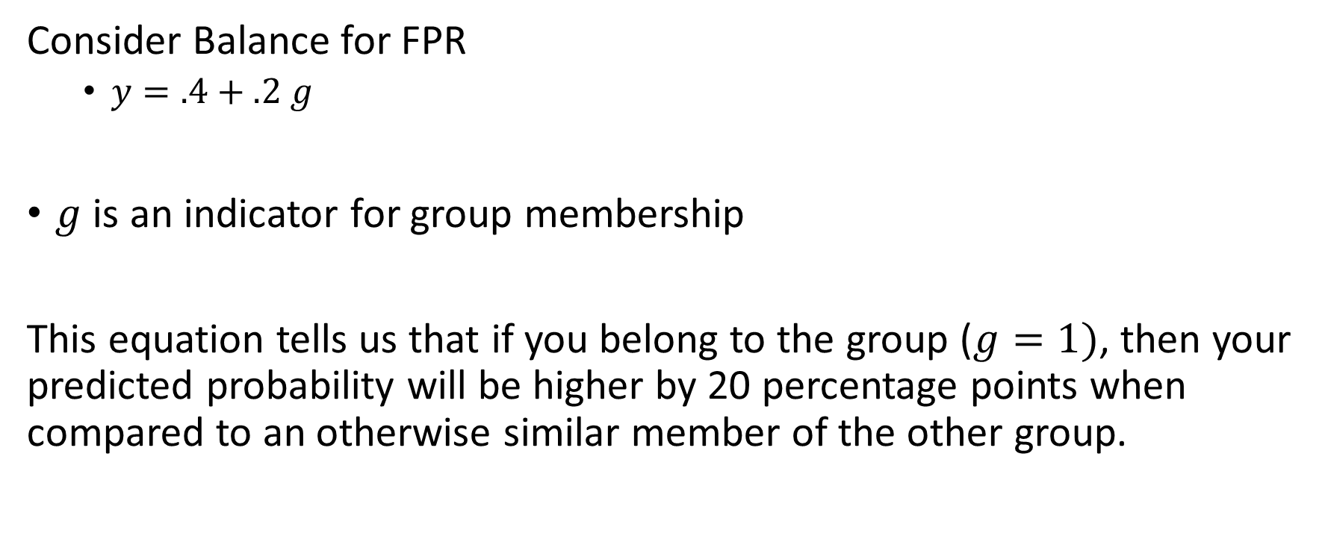
Why would “otherwise similar” groups be treated differently?
Consider Balance for FPR
$y=.4+.2 g$
$g$ is an indicator for group membership
This equation tells us that if you belong to the group ($g=1)$, then your predicted probability will be higher by 20 percentage points when compared to an otherwise similar member of the other group.

Slide 7
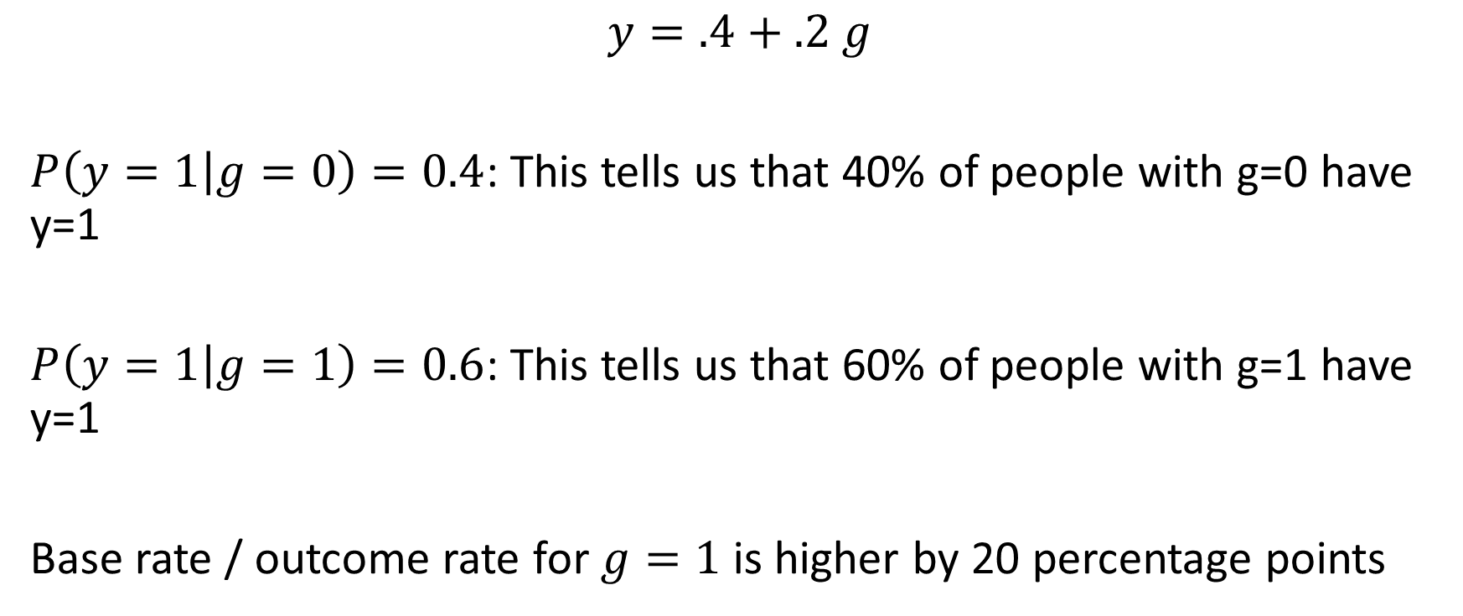
Example
$$y=.4+.2 g$$
$P\left(y=1 | g=0\right)=0.4$: This tells us that 40% of people with g=0 have y=1
$P\left(y=1 | g=1\right)=0.6$: This tells us that 60% of people with g=1 have y=1
Base rate / outcome rate for $g=1$ is higher by 20 percentage points

Slide 8
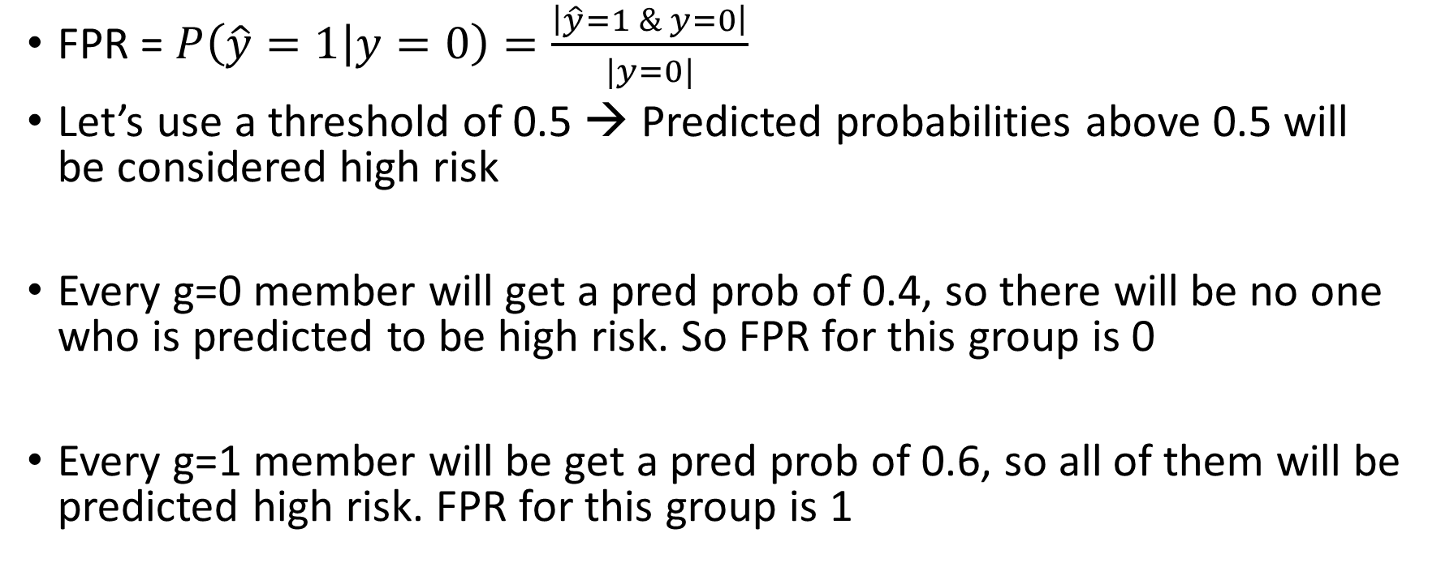
What about FPR?
FPR = $P\left(\hat{y}=1 | y=0\right)=\frac{\left|\hat{y}=1 \& y=0\right|}{|y=0|}$
Let’s use a threshold of 0.5 → Predicted probabilities above 0.5 will be considered high risk
Every g=0 member will get a pred prob of 0.4, so there will be no one who is predicted to be high risk. So FPR for this group is 0
Every g=1 member will be get a pred prob of 0.6, so all of them will be predicted high risk. FPR for this group is 1

Slide 9
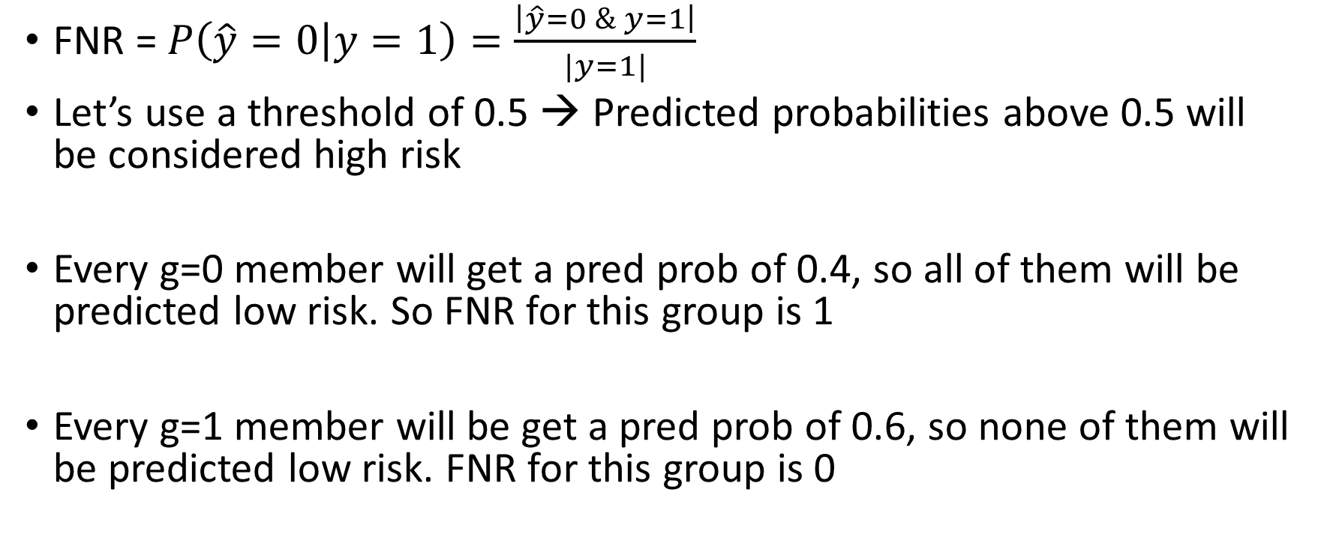
What about FNR?
FNR = $P\left(\hat{y}=0 | y=1\right)=\frac{\left|\hat{y}=0 \& y=1\right|}{|y=1|}$
Let’s use a threshold of 0.5 → Predicted probabilities above 0.5 will be considered high risk
Every g=0 member will get a pred prob of 0.4, so all of them will be predicted low risk. So FNR for this group is 1
Every g=1 member will be get a pred prob of 0.6, so none of them will be predicted low risk. FNR for this group is 0

Slide 10
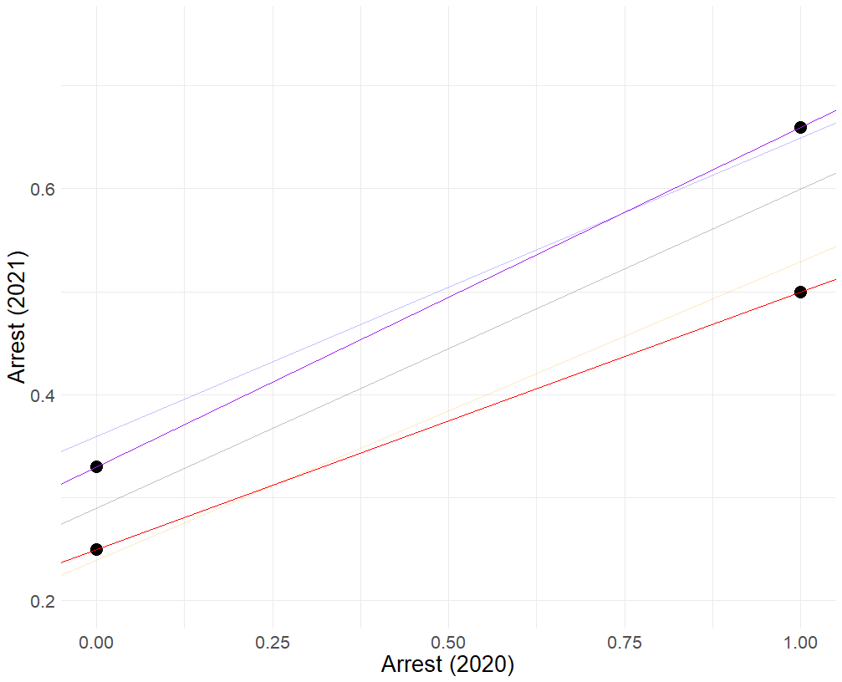
What about PPV/Calibration?
The relationship between differences in outcome rates and Balance in PPV/calibration is not straightforward
Algorithms like logistic regression are designed to achieve calibration even when outcome rates are different

Slide 11
How Do Sources of Bias Come Into Play?
There is no difference between groups in how data is collected (running example: police patrol different neighborhoods identically)
There are differences between groups in how predictor data (our X) is collected
There are differences between groups in how outcome data (our y) is collected

Slide 12
How Do Sources of Bias Come Into Play?
Lessons we learned:
If there is no error in the outcome measurement, it’s possible to achieve balance in PPV/calibration if model is complex enough (i.e. one that includes interactions)
If there is error in the outcome measurement that’s different between groups, then it’s not possible to achieve balance in PPV/calibration
Regardless of source of bias, can’t easily achieve balance in FPR or FNR

Slide 13
Evaluation Challenge

Slide 14
So far this semester
- We’ve talked about building and evaluating models in a vacuum
Typically, a model is aiding/replacing a process that already exists
A human decision (admit to school, approve loan, hire, arrest, imprison, etc)
An algorithm that already exists (updating a recommendation system)
How do we measure whether the new model is an improvement on the status quo?

Slide 15
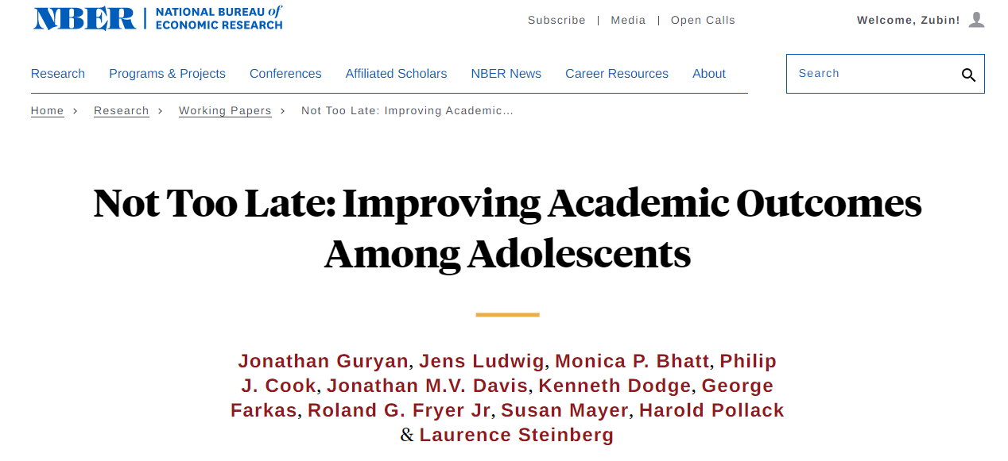
There is growing concern that it is too difficult or costly to substantially improve the academic skills of children who are behind in school once they reach adolescence. But perhaps what we have tried in the past relies on the wrong interventions, failing to account for challenges like the increased variability in academic needs during adolescence, or heightened difficulty of classroom management. This study tests the effects of one intervention that tries to solve both problems by simplifying the teaching task: individualized, intensive, in-school tutoring… Our first randomized controlled trial (RCT) of Saga’s tutoring model with 2,633 9th and 10th grade students in Chicago public schools found participation increased math test scores by 0.16 standard deviations (SDs) and increased grades in math and non-math courses. These effects persist into future years, although estimates for high school graduation are imprecise. …

Slide 16
Student Tutoring Intervention
Each year, teachers at a large school district identify 200 students who are at risk of dropping out.
They select 100 students to receive intensive tutoring.
Typically, 20% of the students who get the tutoring wind up dropping out.
50% of those who don’t get tutoring drop out

Slide 17
Student Tutoring Intervention
 | In Tutoring |  | No Tutoring |  | Total
 | Dropout | No Dropout | Dropout | No Dropout | Dropout | No Dropout | DropoutRate
Teacher Picks | 20 | 80 | 50 | 50 | 70 | 130 | 35%
Algorithm Picks |  |  | 50 | 50

Slide 18
Student Tutoring Intervention
The new principal wants to make a big splash and increase the graduation rate by better targeting this program. He suspects that an algorithm could do a better job selecting students for tutoring than these teachers.
He asks a local university researcher to design an algorithm to predict students at greatest likelihood of dropping out.

Slide 19
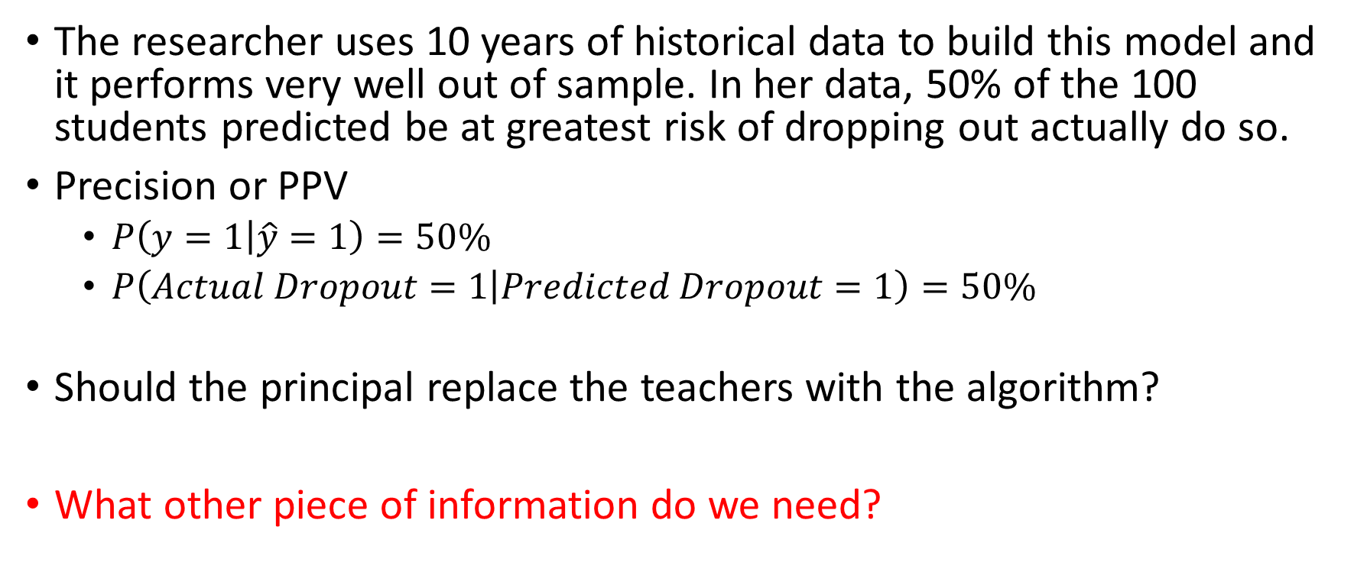
Student Tutoring Intervention
The researcher uses 10 years of historical data to build this model and it performs very well out of sample. In her data, 50% of the 100 students predicted be at greatest risk of dropping out actually do so.
Precision or PPV
$P\left(y=1 | \hat{y}=1\right)=50\%$
$P\left(Actual Dropout=1 | Predicted Dropout=1\right)=50\%$
Should the principal replace the teachers with the algorithm?
What other piece of information do we need?

Slide 20
Recap
When teachers decides, the share of students who dropout is 20%, after they get tutoring
When the algorithms decides, the share of students who dropout is 50%, before they get tutoring

Slide 21
Observed Graduation Rate
Observed Graduation Rate
Dropout Rate
Teachers
ML

Slide 22
If Tutoring Is Very Effective
Dropout Rate
Teachers
ML

Slide 23
If Tutoring Is Not Very Effective
Dropout Rate
Teachers
ML

Slide 24
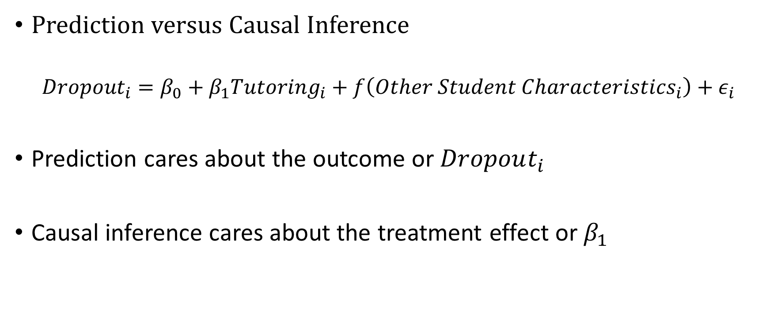
We Need to Know the Treatment Effect
Prediction versus Causal Inference
$${Dropout}_{i}=β_{0}+β_{1}{Tutoring}_{i}+f\left(Other Student Characteristics_{i}\right)+ε_{i}$$
Prediction cares about the outcome or $Dropout_{i}$
Causal inference cares about the treatment effect or $β_{1}$

Slide 25
Student Tutoring Intervention
The school performed an RCT on students and found that the tutoring program reduced chance of dropping out by 80 percent.
Should the principal replace the teachers with the algorithm?

Slide 26
Algorithm Picks
If intensive tutoring reduces the chance of dropping out by 80%
And if, without tutoring, the dropout rate is 50% for those selected by the algorithm
Then the new dropout rate AFTER tutoring for this group is:
100 students
Without tutoring, 50 would drop out
With tutoring, dropouts drop by 80%
So 40 of the 50 students no longer dropout
New dropout rate is 10%

Slide 27
Student Tutoring Intervention
Average dropout rate for students selected by teachers is 20%
Average dropout rate for students selected by ML is 50%
 | In Tutoring |  | No Tutoring |  | Total
 | Dropout | No Dropout | Dropout | No Dropout | Dropout | No Dropout
Teacher Picks | 20 | 80 | 50 | 50
Algorithm Picks | 10 | 90

Slide 28
Algorithm Picks
If intensive tutoring reduces the chance of dropping out by 80%
And if, with tutoring, the dropout rate is 20% for those selected by teachers
Then the new dropout rate without tutoring for this group is:
100 students
Without tutoring, 100 would drop out
New dropout rate is 100%

Slide 29
Student Tutoring Intervention
Average dropout rate for students selected by teachers is 20%
Average dropout rate for students selected by ML is 50%
 | In Tutoring |  | No Tutoring |  | Total
 | Dropout | No Dropout | Dropout | No Dropout | Dropout | No Dropout
Teacher Picks | 20 | 80 | 50 | 50
Algorithm Picks | 10 | 90 | 100 | 0

Slide 30
Student Tutoring Intervention
Average dropout rate for students selected by teachers is 20%
Average dropout rate for students selected by ML is 50%
 | In Tutoring |  | No Tutoring |  | Total
 | Dropout | No Dropout | Dropout | No Dropout | Dropout | No Dropout
Teacher Picks | 20 | 80 | 50 | 50 | 70 | 130
Algorithm Picks | 10 | 90 | 100 | 0 | 110 | 90

Slide 31
Cost Benefit Analysis

Slide 32
Scenario
The new governor of your state wants to reduce crime. To do so, they will target an intervention to those who are arrested each year (about 20,000 people)
Two possible interventions
“Precision” Enforcement
Everyone who is predicted to be high risk of a violent crime will be detained. The cost of detention is relatively high.

Slide 33
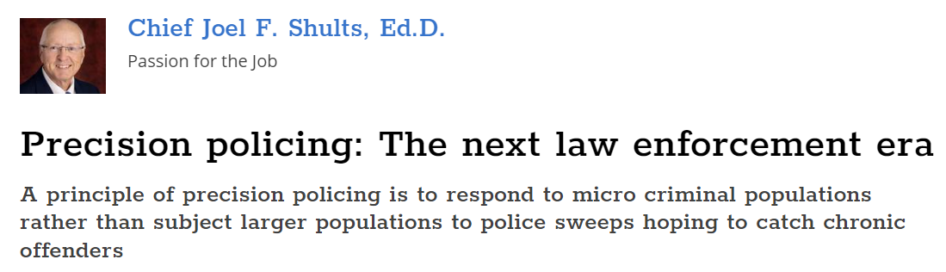
Precision Enforcement
Everyone who is predicted to be high risk of a violent crime will be detained. The cost of detention is relatively high.
Target a small number of people with a high-intensity intervention.

Slide 34
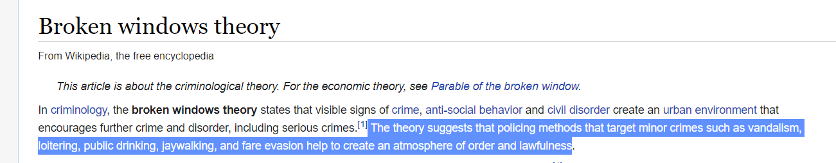
Broken Windows + Online Therapy
Everyone who is predicted to be high risk of any crime will be offered a low cost online behavioral health counseling
Target a large number of people with lower cost intervention

Slide 35
“Precision” Enforcement Approach
Identify those at greatest risk of violent rearrest
Detain them during their pretrial period
Capacity is 500
Impact:
Benefit: Everyone who is “correctly” detained will not reoffend
The treatment effect is 100%
Cost: Everyone who is “incorrectly” detained will suffer consequences

Slide 36
Broken Windows / Social Service Approach
Identify those at greatest risk of any rearrest
Offer them a spot in an online behavioral therapy program:
Capacity: 2,000
Impact:
Benefit: The treatment effect is 20%
Cost: Everyone who is “incorrectly” offered a spot detained will little-to-no ill effects

Slide 37
Some Assumptions
We will assume that the monetary cost of running the two interventions is the same
In other words: Total cost = Number of people * per-person-cost
And Total cost of the Precision Enforcement program is the same as the Total cost of the Broken Windows + Online Therapy program

Slide 38
Evaluating Impact
Precision Enforcement:
Calculating the benefit:
(Number of people detained) * (Share of detained who WOULD HAVE committed a violent crime without being detained)
500 * .2 = 100 violent crimes prevented
Calculating the cost:
(Number of people detained) * (Share of detained who WOULD NOT HAVE committed violent crime without being detained)
500 * .8 = 400 people incorrectly detained

Slide 39
Evaluating Impact
Broken Windows + Online Therapy
Calculating the benefit:
Number of people offered service * Share of those offered who WOULD HAVE committed a violent crime without being detained * Treatment effect
2000 * .4 * .2 = 160 crimes of any type (nonviolent + violent) prevented
Calculating the cost:
Assume that offering someone who is not high risk has minimal cost

Slide 40
Compare
Precision Enforcement
Prevent 100 violent crimes
Falsely detain 400 people
Broken Windows + Online Therapy
Prevent 160 crimes
Which crimes are prevented?
Scenario 1: 160 crimes = 100 violent + 60 nonviolent
Scenario 2: 160 crimes = 50 violent + 110 nonviolent

Slide 41
For the Final
Precision Enforcement
Prevent 100 violent crimes
Falsely detain 400 people
Fairness metrics
Broken Windows + Online Therapy
Prevent 160 crimes
Which crimes are prevented?
Scenario 1: 160 crimes = 100 violent + 60 nonviolent
Scenario 2: 160 crimes = 50 violent + 110 nonviolent
Fairness metrics

