Slide 1
INST 414: Data Science Techniques Lecture 12 Sources of Bias (Part II)

Slide 2
Last Week
We talked about two states of the world:
Every crime committed leads to an arrest
Still have disparities in Error rates (FPR / FNR / Positive Class / Negative Class)
Driven by differences in base rates
Only some crimes lead to an arrest

Slide 3
This Week
We talked about two states of the world:
Every crime committed leads to an arrest
Still have disparities in Error rates (FPR / FNR / Positive Class / Negative Class)
Driven by differences in base rates
Example
Only some crimes lead to an arrest
P(Arrest=1|Crime=1) is different across groups
What happens to our fairness metrics?

Slide 4
The Importance of Base Rates

Slide 5
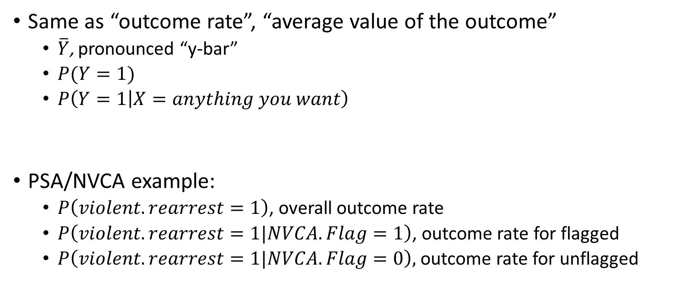
Base-rate
Same as “outcome rate”, “average value of the outcome”
$\overline{Y}$, pronounced “y-bar”
$P(Y=1)$
$P\left(Y=1 | X=anything you want\right)$
PSA/NVCA example:
$P\left(violent.rearrest=1\right)$, overall outcome rate
$P\left(violent.rearrest=1|NVCA.Flag=1\right)$, outcome rate for flagged
$P\left(violent.rearrest=1|NVCA.Flag=0\right),$ outcome rate for unflagged

Slide 6
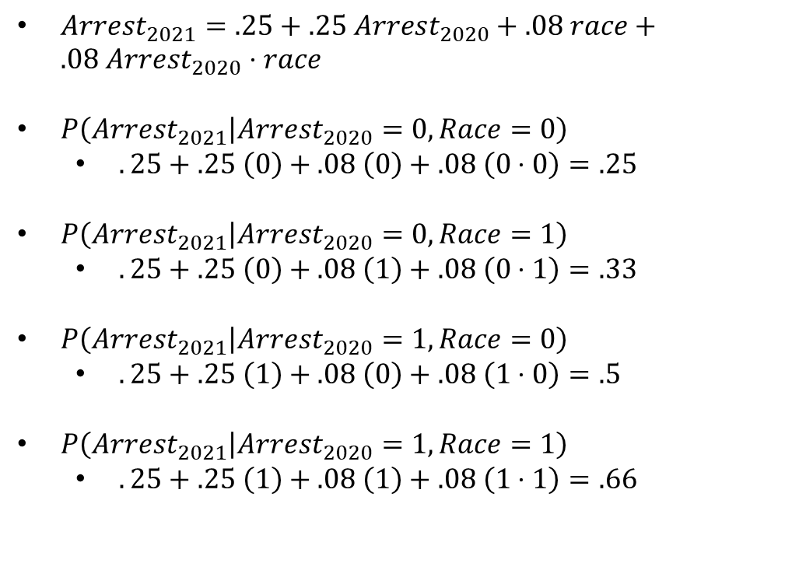
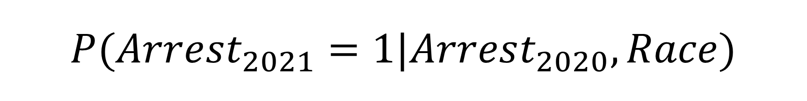
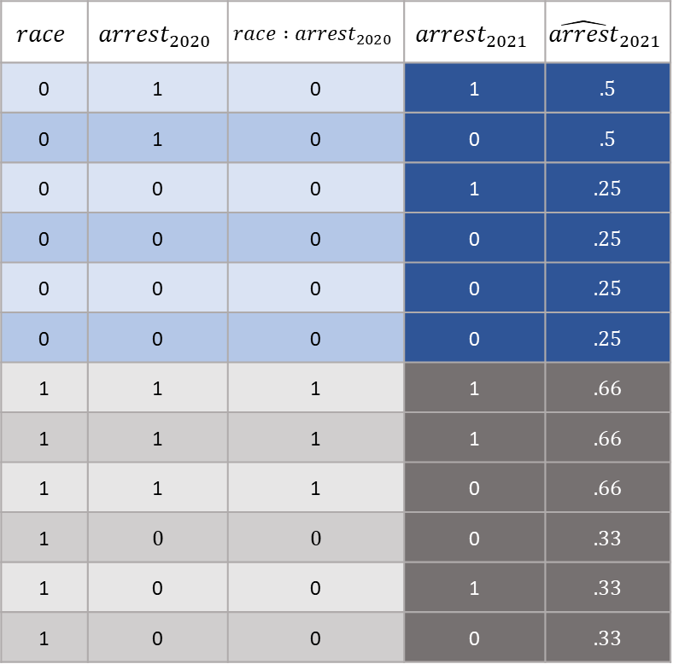
$$P(Arrest_{2021}=1|Arrest_{2020}, Race)$$
$Arrest_{2021}=.25+.25 Arrest_{2020}+.08 race+.08 Arrest_{2020}⋅race$
$P\left(Arrest_{2021} | Arrest_{2020}=0,Race=0\right)$
$.25+.25 \left(0\right)+.08 \left(0\right)+.08 \left(0⋅0\right)=.25$
$P\left(Arrest_{2021} | Arrest_{2020}=0,Race=1\right)$
$.25+.25 \left(0\right)+.08 \left(1\right)+.08 \left(0⋅1\right)=.33$
$P\left(Arrest_{2021} | Arrest_{2020}=1,Race=0\right)$
$.25+.25 \left(1\right)+.08 \left(0\right)+.08 \left(1⋅0\right)=.5$
$P\left(Arrest_{2021} | Arrest_{2020}=1,Race=1\right)$
$.25+.25 \left(1\right)+.08 \left(1\right)+.08 \left(1⋅1\right)=.66$
$$race$$ | $$arrest_{2020}$$ | $$race :arrest_{2020}$$ | $$arrest_{2021}$$ | $${\hat{arrest}}_{2021}$$
0 | 1 | 0 | 1 | .5
0 | 1 | 0 | 0 | .5
0 | 0 | 0 | 1 | .25
0 | 0 | 0 | 0 | .25
0 | 0 | 0 | 0 | .25
0 | 0 | 0 | 0 | .25
1 | 1 | 1 | 1 | .66
1 | 1 | 1 | 1 | .66
1 | 1 | 1 | 0 | .66
1 | 0 | 0 | 0 | .33
1 | 0 | 0 | 1 | .33
1 | 0 | 0 | 0 | .33

Slide 7
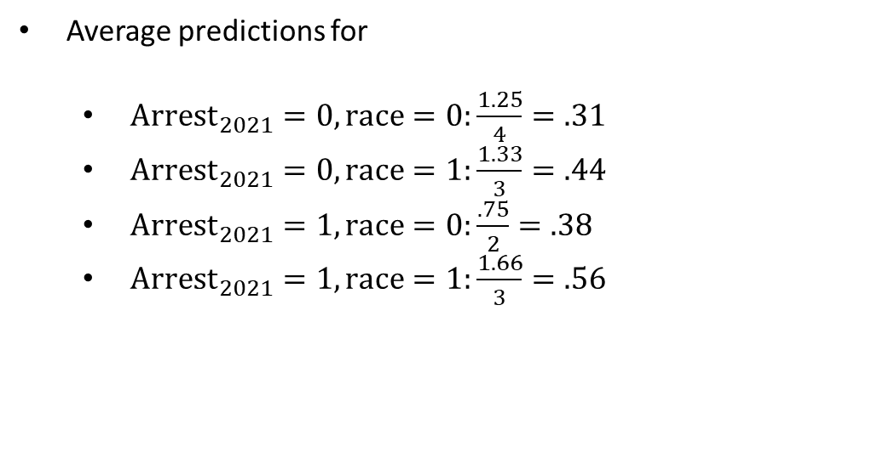
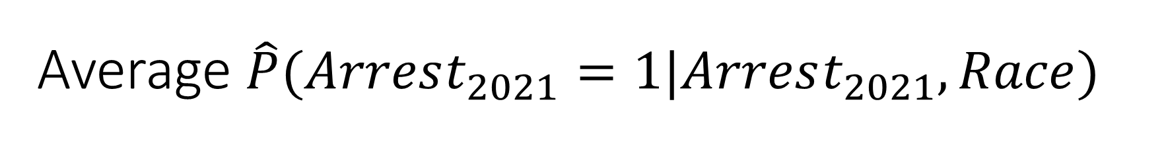
Average $\hat{P}(Arrest_{2021}=1|Arrest_{2021}, Race)$
Average predictions for
${Arrest}_{2021}=0, race=0:\frac{1.25}{4}=.31$
${Arrest}_{2021}=0, race=1:\frac{1.33}{3}=.44$
${Arrest}_{2021}=1, race=0:\frac{.75}{2}=.38$
${Arrest}_{2021}=1, race=1:\frac{1.66}{3}=.56$
$$race$$ | $$arrest_{2020}$$ | $$race :arrest_{2020}$$ | $$arrest_{2021}$$ | $${\hat{arrest}}_{2021}$$
0 | 1 | 0 | 1 | .5
0 | 1 | 0 | 0 | .5
0 | 0 | 0 | 1 | .25
0 | 0 | 0 | 0 | .25
0 | 0 | 0 | 0 | .25
0 | 0 | 0 | 0 | .25
1 | 1 | 1 | 1 | .66
1 | 1 | 1 | 1 | .66
1 | 1 | 1 | 0 | .66
1 | 0 | 0 | 0 | .33
1 | 0 | 0 | 1 | .33
1 | 0 | 0 | 0 | .33

Slide 8
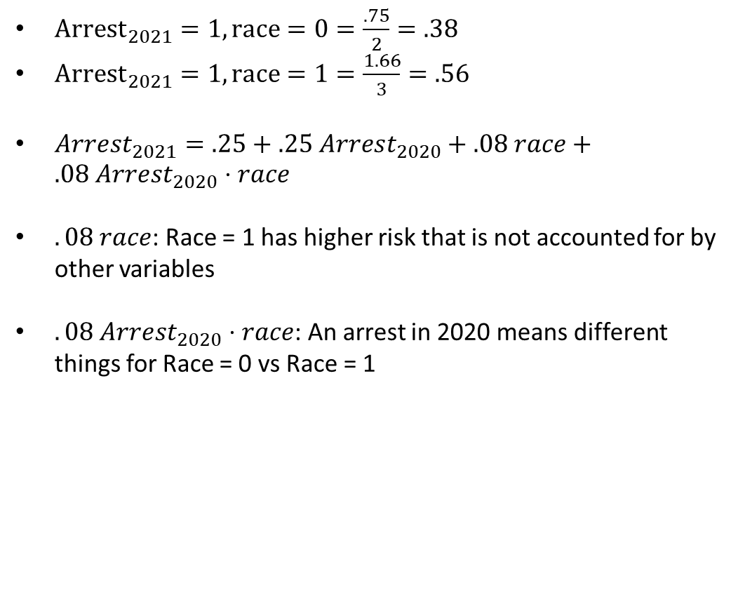
Why different predicted values?
${Arrest}_{2021}=1, race=0=\frac{.75}{2}=.38$
${Arrest}_{2021}=1, race=1=\frac{1.66}{3}=.56$
$Arrest_{2021}=.25+.25 Arrest_{2020}+.08 race+.08 Arrest_{2020}⋅race$
$.08 race$: Race = 1 has higher risk that is not accounted for by other variables
$.08 Arrest_{2020}⋅race$: An arrest in 2020 means different things for Race = 0 vs Race = 1
$$race$$ | $$arrest_{2020}$$ | $$race :arrest_{2020}$$ | $$arrest_{2021}$$ | $${\hat{arrest}}_{2021}$$
0 | 1 | 0 | 1 | .5
0 | 1 | 0 | 0 | .5
0 | 0 | 0 | 1 | .25
0 | 0 | 0 | 0 | .25
0 | 0 | 0 | 0 | .25
0 | 0 | 0 | 0 | .25
1 | 1 | 1 | 1 | .66
1 | 1 | 1 | 1 | .66
1 | 1 | 1 | 0 | .66
1 | 0 | 0 | 0 | .33
1 | 0 | 0 | 1 | .33
1 | 0 | 0 | 0 | .33

Slide 9
Why Is Race Predictive of the outcome?
Race is a stand-in for missing predictors
Differences in police behavior
Differences in treatment of different subgroups historically
Differences in environment, broadly speaking

Slide 10
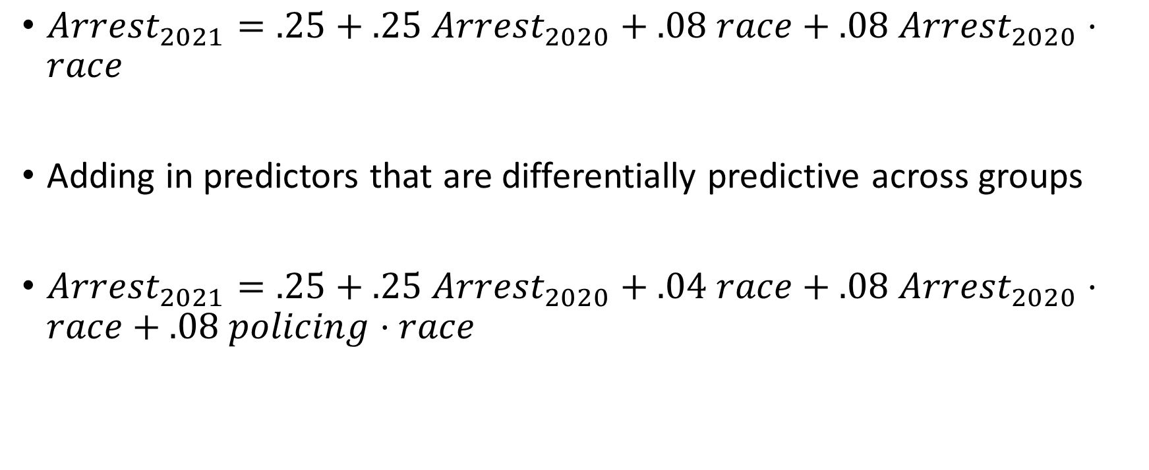
How Would We Equalize P-Hats?
$Arrest_{2021}=.25+.25 Arrest_{2020}+.08 race+.08 Arrest_{2020}⋅race$
Adding in predictors that are differentially predictive across groups
$Arrest_{2021}=.25+.25 Arrest_{2020}+.04 race+.08 Arrest_{2020}⋅race+.08 policing⋅race$

Slide 11
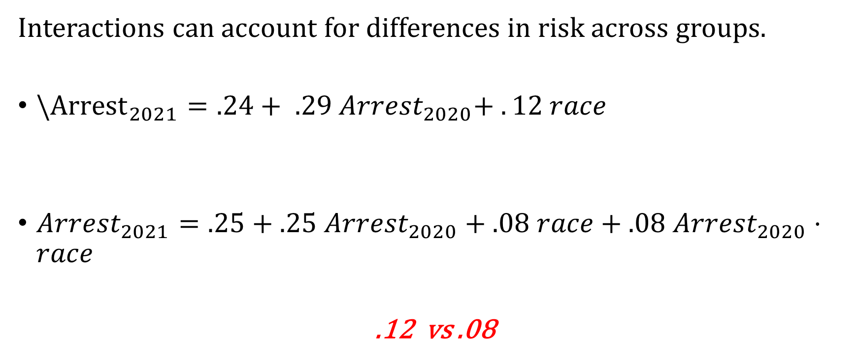
We See This Already
Interactions can account for differences in risk across groups.
$\backslash {Arrest}_{2021}=.24+ .29 Arrest_{2020}+ . 12 race$
$Arrest_{2021}=.25+.25 Arrest_{2020}+.08 race+.08 Arrest_{2020}⋅race$
.12 vs .08
Pure group differences matter less

Slide 12
Causes of Bias in Predictions (Part II)

Slide 13
Where Does Bias Come From? Scenario 1
Arrested
$P\left(Arrest=1 | Crime=1, Race=A\right)=50\%$
Crime
Not Arrested
$$P\left(Arrest=0 | Crime=1, Race=A\right)=50\%$$
In this scenario, one group is more likely to be re-arrested given that they committed a crime
Arrested
$$P\left(Arrest=1 | Crime=1, Race=B\right)=100\%$$
Crime
Not Arrested
$$P\left(Arrest=0 | Crime=1, Race=B\right)=0\%$$

Slide 14
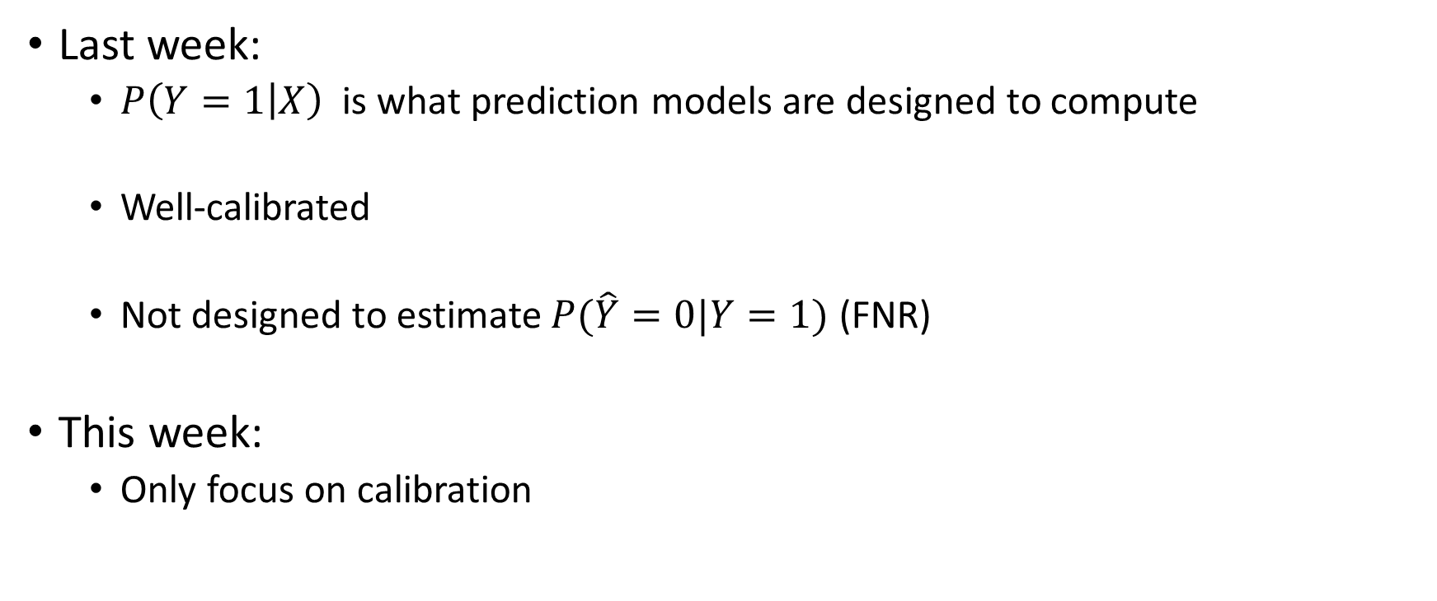
Focus on Calibration
Last week:
$P\left(Y=1 | X\right)$ is what prediction models are designed to compute
Well-calibrated
Not designed to estimate $P(\hat{Y}=0|Y=1)$ (FNR)
This week:
Only focus on calibration

Slide 15
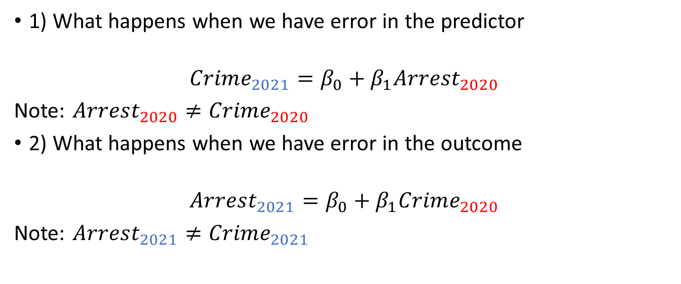
Agenda
1) What happens when we have error in the predictor
$$Crime_{2021}=β_{0}+β_{1}Arrest_{2020}$$
Note: $Arrest_{2020}≠Crime_{2020}$
2) What happens when we have error in the outcome
$$Arrest_{2021}=β_{0}+β_{1}Crime_{2020}$$
Note: $Arrest_{2021}≠Crime_{2021}$

Slide 16
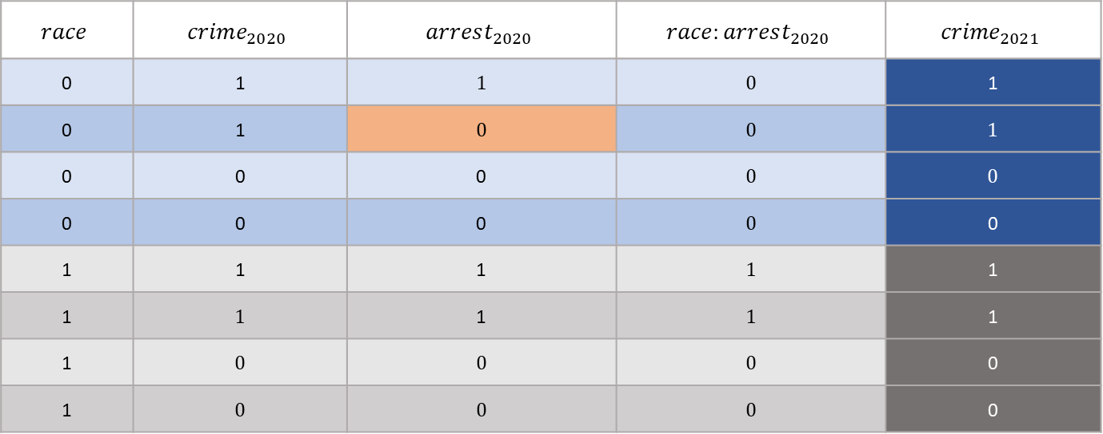
Data With Measurement Error
$$race$$ | $$crime_{2020}$$ | $$arrest_{2020}$$ | $$race:arrest_{2020}$$ | $${crime}_{2021}$$
0 | 1 | 1 | 0 | 1
0 | 1 | 0 | 0 | 1
0 | 0 | 0 | 0 | 0
0 | 0 | 0 | 0 | 0
1 | 1 | 1 | 1 | 1
1 | 1 | 1 | 1 | 1
1 | 0 | 0 | 0 | 0
1 | 0 | 0 | 0 | 0

Slide 17
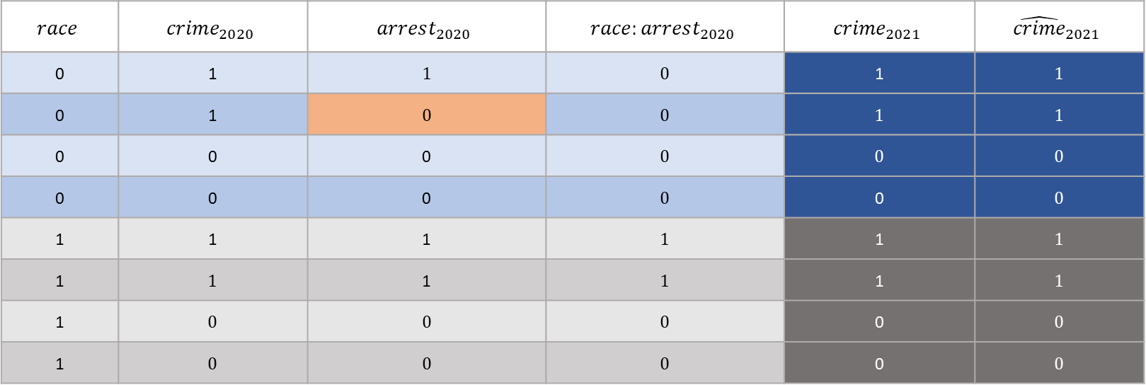
Perfectly Measured World
$$race$$ | $$crime_{2020}$$ | $$arrest_{2020}$$ | $$race:arrest_{2020}$$ | $${crime}_{2021}$$ | $${\hat{crime}}_{2021}$$
0 | 1 | 1 | 0 | 1 | 1
0 | 1 | 0 | 0 | 1 | 1
0 | 0 | 0 | 0 | 0 | 0
0 | 0 | 0 | 0 | 0 | 0
1 | 1 | 1 | 1 | 1 | 1
1 | 1 | 1 | 1 | 1 | 1
1 | 0 | 0 | 0 | 0 | 0
1 | 0 | 0 | 0 | 0 | 0
$$crime_{2021}=0+1⋅crime_{2020}$$

Slide 18

Model With Arrests Instead of Crimes
$$race$$ | $$crime_{2020}$$ | $$arrest_{2020}$$ | $$race:arrest_{2020}$$ | $${crime}_{2021}$$ | $${\hat{crime}}_{2021}$$
0 | 1 | 1 | 0 | 1 | 1
0 | 1 | 0 | 0 | 1 | .2
0 | 0 | 0 | 0 | 0 | .2
0 | 0 | 0 | 0 | 0 | .2
1 | 1 | 1 | 1 | 1 | 1
1 | 1 | 1 | 1 | 1 | 1
1 | 0 | 0 | 0 | 0 | .2
1 | 0 | 0 | 0 | 0 | .2
$${crime}_{2021}=0.2+0.8⋅arrest_{2020}$$

Slide 19
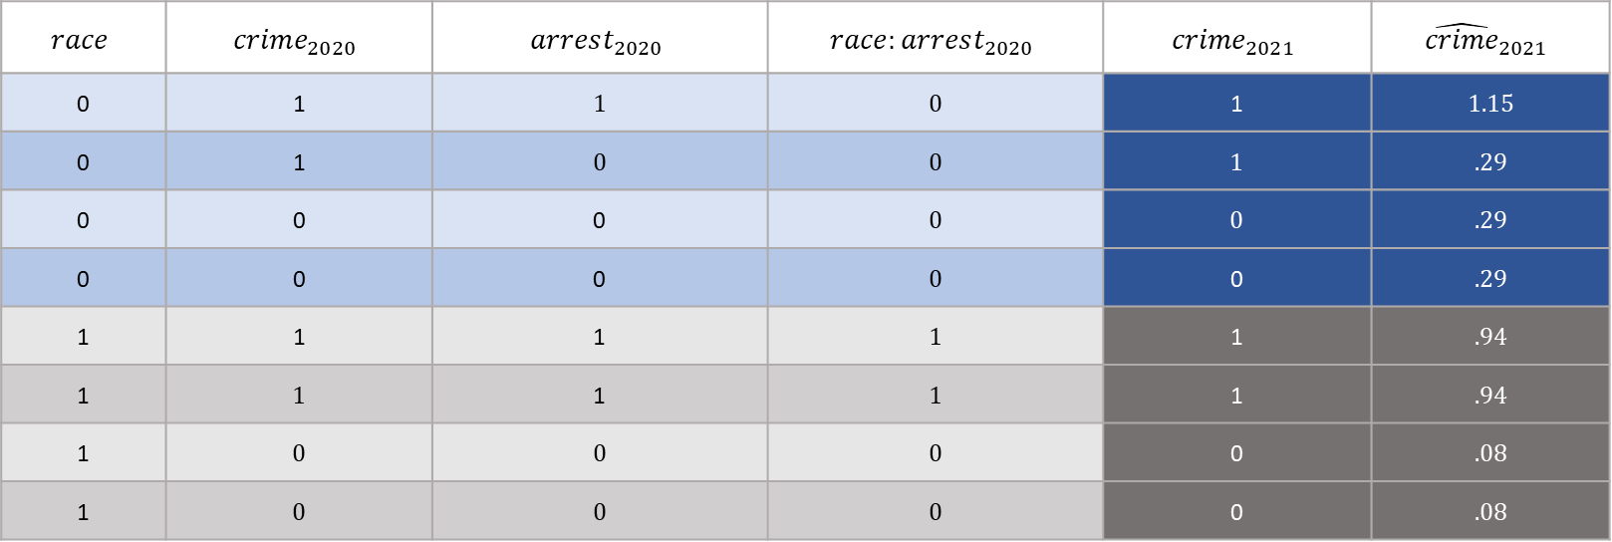
Account for Race
$$race$$ | $$crime_{2020}$$ | $$arrest_{2020}$$ | $$race:arrest_{2020}$$ | $${crime}_{2021}$$ | $${\hat{crime}}_{2021}$$
0 | 1 | 1 | 0 | 1 | 1.15
0 | 1 | 0 | 0 | 1 | .29
0 | 0 | 0 | 0 | 0 | .29
0 | 0 | 0 | 0 | 0 | .29
1 | 1 | 1 | 1 | 1 | .94
1 | 1 | 1 | 1 | 1 | .94
1 | 0 | 0 | 0 | 0 | .08
1 | 0 | 0 | 0 | 0 | .08
$${crime}_{2021}=0.29+0.86⋅arrest_{2020}−.21 race$$

Slide 20
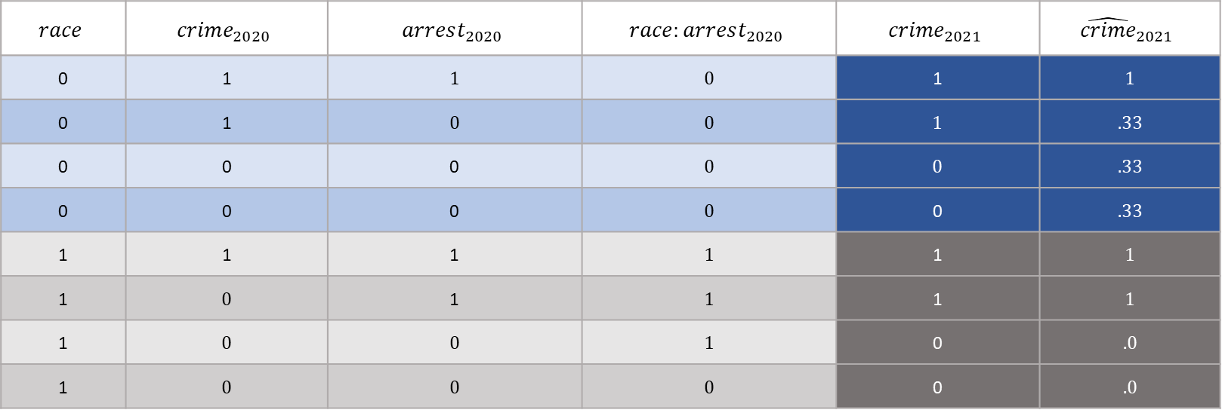
Account for Interaction
$$race$$ | $$crime_{2020}$$ | $$arrest_{2020}$$ | $$race:arrest_{2020}$$ | $${crime}_{2021}$$ | $${\hat{crime}}_{2021}$$
0 | 1 | 1 | 0 | 1 | 1
0 | 1 | 0 | 0 | 1 | .33
0 | 0 | 0 | 0 | 0 | .33
0 | 0 | 0 | 0 | 0 | .33
1 | 1 | 1 | 1 | 1 | 1
1 | 0 | 1 | 1 | 1 | 1
1 | 0 | 0 | 1 | 0 | .0
1 | 0 | 0 | 0 | 0 | .0
$${crime}_{2021}=0.33+0.667⋅arrest_{2020}−.33 race+.33arrest_{2020}:race$$

Slide 21
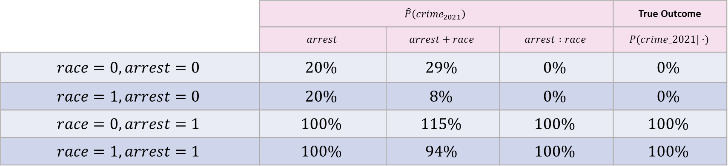
Calibration
 | $$\hat{P}\left({crime}_{2021}\right)$$ |  |  | True Outcome
 | $$arrest$$ | $$arrest+race$$ | $$arrest :race$$ | $$P(crime_2021|⋅)$$
$$race=0, arrest=0$$ | $$20\%$$ | $$29\%$$ | $$0\%$$ | $$0\%$$
$$race=1, arrest=0$$ | $$20\%$$ | $$8\%$$ | $$0\%$$ | $$0\%$$
$$race=0, arrest=1$$ | $$100\%$$ | $$115\%$$ | $$100\%$$ | $$100\%$$
$$race=1, arrest=1$$ | $$100\%$$ | $$94\%$$ | $$100\%$$ | $$100\%$$

Slide 22
What Did We Learn?
When the predictors are measured with bias, it’s still possible to have a calibrated model by taking race into account
It’s possible to use sensitive information such as someone’s race to generate a different prediction for them and make the algorithm fairer (affirmative action)
As opposed to a color-blind policy

Slide 23
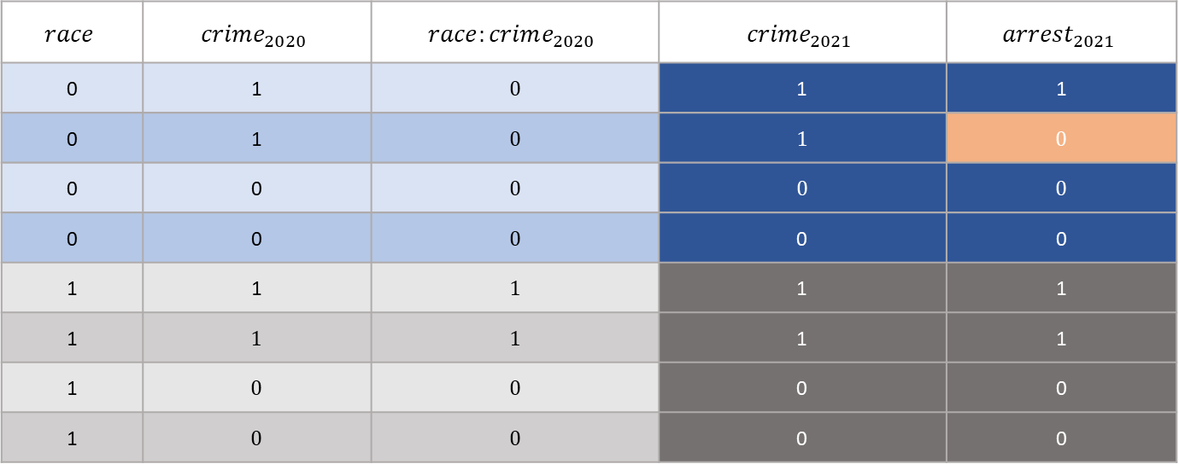
Data With Measurement Error
$$race$$ | $$crime_{2020}$$ | $$race:crime_{2020}$$ | $$crime_{2021}$$ | $$arrest_{2021}$$
0 | 1 | 0 | 1 | 1
0 | 1 | 0 | 1 | 0
0 | 0 | 0 | 0 | 0
0 | 0 | 0 | 0 | 0
1 | 1 | 1 | 1 | 1
1 | 1 | 1 | 1 | 1
1 | 0 | 0 | 0 | 0
1 | 0 | 0 | 0 | 0

Slide 24
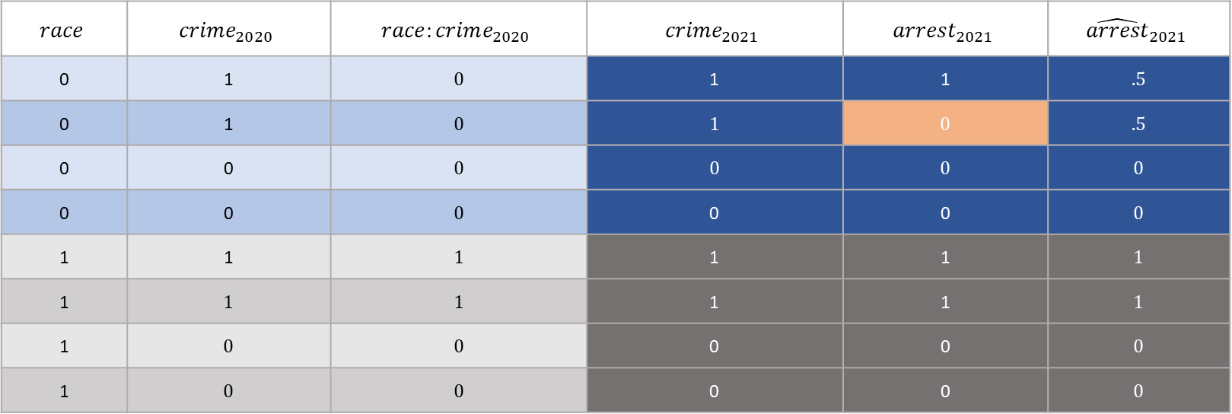
Accounting for Interaction
$$race$$ | $$crime_{2020}$$ | $$race:crime_{2020}$$ | $$crime_{2021}$$ | $$arrest_{2021}$$ | $${\hat{arrest}}_{2021}$$
0 | 1 | 0 | 1 | 1 | .5
0 | 1 | 0 | 1 | 0 | .5
0 | 0 | 0 | 0 | 0 | 0
0 | 0 | 0 | 0 | 0 | 0
1 | 1 | 1 | 1 | 1 | 1
1 | 1 | 1 | 1 | 1 | 1
1 | 0 | 0 | 0 | 0 | 0
1 | 0 | 0 | 0 | 0 | 0
$$arrest_{2021}=0.0+0.5⋅crime_{2020}+0.0 race+.5 crime_2020:race$$

Slide 25
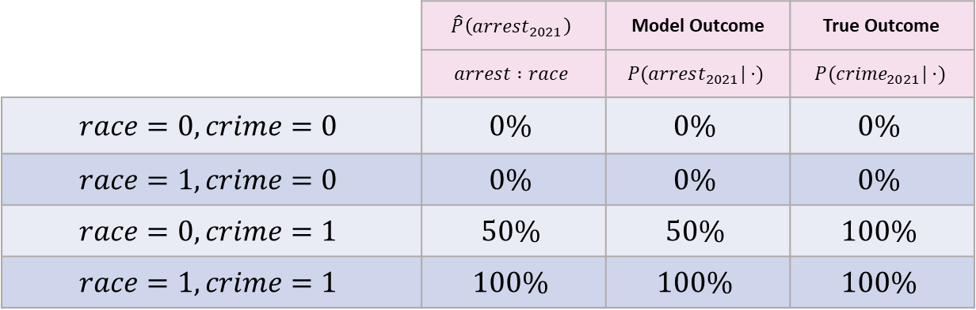
Calibration
 | $$\hat{P}\left(arrest_{2021}\right)$$ | Model Outcome | True Outcome
 | $$arrest :race$$ | $$P(arrest_{2021}|⋅)$$ | $$P(crime_{2021}|⋅)$$
$$race=0, crime=0$$ | $$0\%$$ | $$0\%$$ | $$0\%$$
$$race=1, crime=0$$ | $$0\%$$ | $$0\%$$ | $$0\%$$
$$race=0, crime=1$$ | $$50\%$$ | $$50\%$$ | $$100\%$$
$$race=1, crime=1$$ | $$100\%$$ | $$100\%$$ | $$100\%$$

Slide 26
What Did We Learn?
When the outcome is measured with bias, it’s NOT possible to have a calibrated model by taking race into account
But the model is run on the biased outcome, so it’ll be calibrated for the biased outcome
What do nearly all risk assessments in criminal justice predict? Arrests not crimes
Next week: A prediction on a “well-measured” outcome

