Slide 1
Recap: Performance Metrics

Slide 2

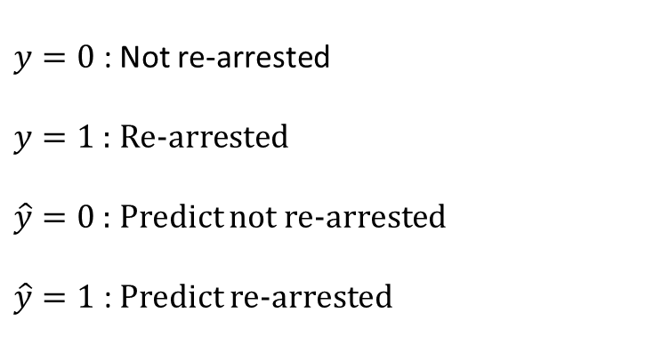




Convert $\hat{p}$ (p-hats) to $\hat{y}$ (y-hats)
$$\hat{y}$$
$$y$$
Risk Score
Outcome
High risk
$y=0$ : Not re-arrested
$y=1$ : Re-arrested
$\hat{y}=0$ : Predict not re-arrested
$\hat{y}=1$ : Predict re-arrested
1
1
1
0
1
1
0
0
1
0
0
1
0
0
0
0
$\hat{y}$=1
Threshold
$\hat{y}$=0
Low risk

Slide 3




Confusion Matrix
$$\hat{y}$$
$$y$$
Risk Score
Outcome
High risk
$$y=0$$
$$y=1$$
1
1
1
0
1
1
0
0
1
0
0
1
0
0
0
0
$\hat{y}$=1
True Negative (TN)
False Negative (FN)
$$\hat{y}=0$$
Threshold
False Positive (FP)
True Positive (TP)
$$\hat{y}=1$$
$\hat{y}$=0
Low risk

Slide 4


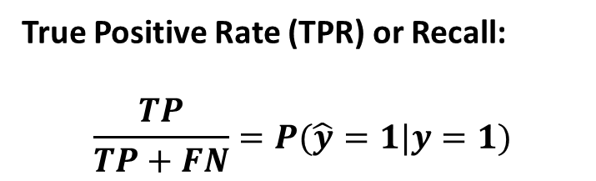


Performance Metrics
True Positive Rate (TPR) or Recall:
$$\frac{TP}{TP+FN}=P(\hat{y}=1|y=1)$$
$$y=0$$
$$y=1$$
True Negative (TN)
False Negative (FN)
$$\hat{y}=0$$
False Positive (FP)
True Positive (TP)
$$\hat{y}=1$$

Slide 5
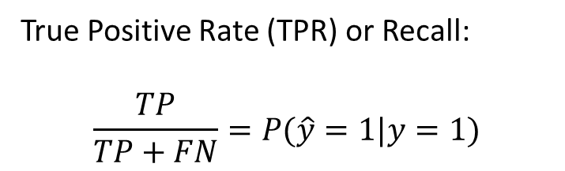
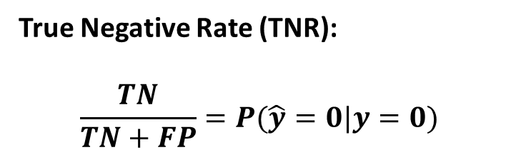
Performance Metrics
True Positive Rate (TPR) or Recall:
$$\frac{TP}{TP+FN}=P(\hat{y}=1|y=1)$$
$$y=0$$
$$y=1$$
True Negative (TN)
False Negative (FN)
$$\hat{y}=0$$
True Negative Rate (TNR):
$$\frac{TN}{TN+FP}=P(\hat{y}=0|y=0)$$
False Positive (FP)
True Positive (TP)
$$\hat{y}=1$$

Slide 6
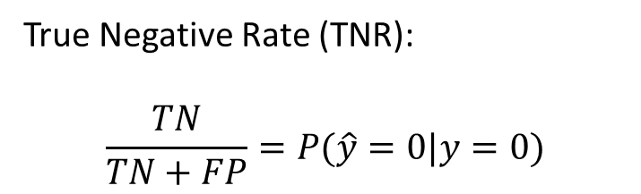

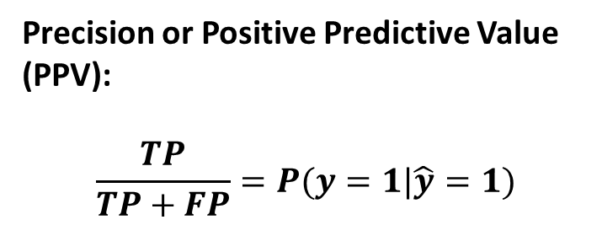

Performance Metrics
True Positive Rate (TPR) or Recall:
$$\frac{TP}{TP+FN}=P(\hat{y}=1|y=1)$$
$$y=0$$
$$y=1$$
True Negative (TN)
False Negative (FN)
$$\hat{y}=0$$
True Negative Rate (TNR):
$$\frac{TN}{TN+FP}=P(\hat{y}=0|y=0)$$
False Positive (FP)
True Positive (TP)
$$\hat{y}=1$$
Precision or Positive Predictive Value (PPV):
$$\frac{TP}{TP+FP}=P(y=1|\hat{y}=1)$$

Slide 7
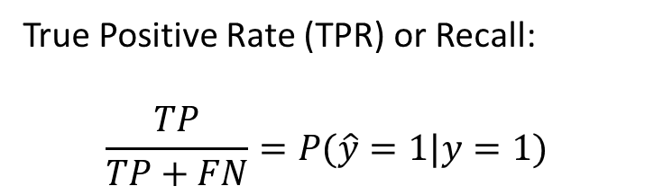
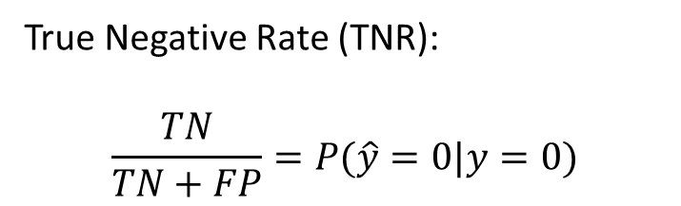
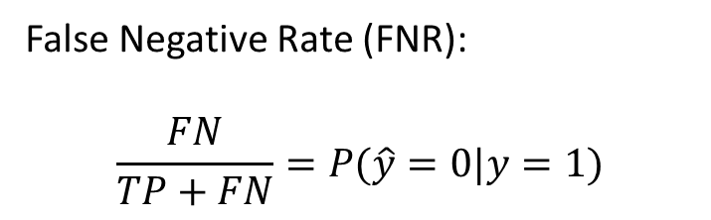
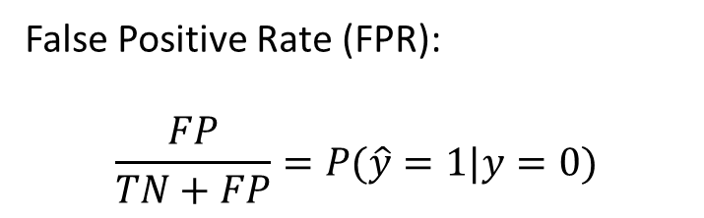
Error Metrics
True Positive Rate (TPR) or Recall:
$$\frac{TP}{TP+FN}=P(\hat{y}=1|y=1)$$
False Negative Rate (FNR):
$$\frac{FN}{TP+FN}=P(\hat{y}=0|y=1)$$
1 - TPR
True Negative Rate (TNR):
$$\frac{TN}{TN+FP}=P(\hat{y}=0|y=0)$$
False Positive Rate (FPR):
$$\frac{FP}{TN+FP}=P(\hat{y}=1|y=0)$$
1 - TNR

Slide 8
Causes of Bias in Predictions (Part I)

Slide 9
What Do We Mean by Bias?
Define a “fairness criterion”
For example, that False Positive Rates should be balanced between groups (race, gender, age, etc)
Could be more than one
If the criteria are not balanced, we’ll call this biased or unfair for today’s discussion.
There are infinite definitions of bias, so no claim that this is the only way to measure it

Slide 10
Our Data
Will be coming from police arrests
So we will either want to predict arrest in the future (next year)
Or use arrest data to predict another outcome (likelihood of dropping out of high school)
Or you could use arrest data as a predictor (X) or outcome to predict (Y)

Slide 11
Where Does Bias Come From?
Arrested
$$P\left(Arrest=1 | Crime=1, Report=1\right)$$
Crime Reported
$$P\left(Report=1 | Crime=1 \right)$$
Not Arrested
$$P\left(Arrest=0 | Crime=1, Report=1\right)$$
Crime Committed
Arrested
$$P\left(Arrest=1 | Crime=1, Report=0\right)$$
$$P\left(Report=0 | Crime=1 \right)$$
Crime Not Reported
Not Arrested
$$P\left(Arrest=0 | Crime=1, Report=0\right)$$

Slide 12
Where Does Bias Come From?
$$P\left(Arrest=1 | Crime=1, Race=A\right)$$
Arrested
Crime
Not Arrested
$$P\left(Arrest=0 | Crime=1, Race=A\right)$$
$$P\left(Arrest=1 | Crime=1, Race=B\right)$$
Arrested
Crime
Not Arrested
$$P\left(Arrest=0 | Crime=1, Race=B\right)$$

Slide 13
Where Does Bias Come From? Scenario 1
Arrested
$P\left(Arrest=1 | Crime=1, Race=A\right)=50\%$
Crime
Not Arrested
$$P\left(Arrest=0 | Crime=1, Race=A\right)=50\%$$
Arrested
$$P\left(Arrest=1 | Crime=1, Race=B\right)=100\%$$
Crime
Not Arrested
$$P\left(Arrest=0 | Crime=1, Race=B\right)=0\%$$

Slide 14
Where Does Bias Come From? Scenario 1
Arrested
$P\left(Arrest=1 | Crime=1, Race=A\right)=50\%$
Crime
Not Arrested
$$P\left(Arrest=0 | Crime=1, Race=A\right)=50\%$$
In this scenario, one group is more likely to be re-arrested given that they committed a crime
Arrested
$$P\left(Arrest=1 | Crime=1, Race=B\right)=100\%$$
Crime
Not Arrested
$$P\left(Arrest=0 | Crime=1, Race=B\right)=0\%$$

Slide 15
Where Does Bias Come From? Scenario 2
Arrested
$P\left(Arrest=1 | Crime=1, Race=A\right)=100\%$
Crime
Not Arrested
$$P\left(Arrest=0 | Crime=1, Race=A\right)=0\%$$
Arrested
$$P\left(Arrest=1 | Crime=1, Race=B\right)=100\%$$
Crime
Not Arrested
$$P\left(Arrest=0 | Crime=1, Race=B\right)=0\%$$

Slide 16
No Differences in Measurement
Arrested
$P\left(Arrest=1 | Crime=1, Race=A\right)=100\%$
Crime
Not Arrested
$$P\left(Arrest=0 | Crime=1, Race=A\right)=0\%$$
In this scenario, both groups are always arrested if they have committed a crime.
Arrested
$$P\left(Arrest=1 | Crime=1, Race=B\right)=100\%$$
Crime
Not Arrested
$$P\left(Arrest=0 | Crime=1, Race=B\right)=0\%$$

Slide 17
What Leads to Bias
We are going to imagine a world where everything is measured perfectly
We are going to compare two subgroups: race=0 and race=1
One subgroup will have a higher arrest rate than the other one
Why is there a difference in re-arrest rate?
Important for real-world discussions
Today we primarily care about the math

Slide 18
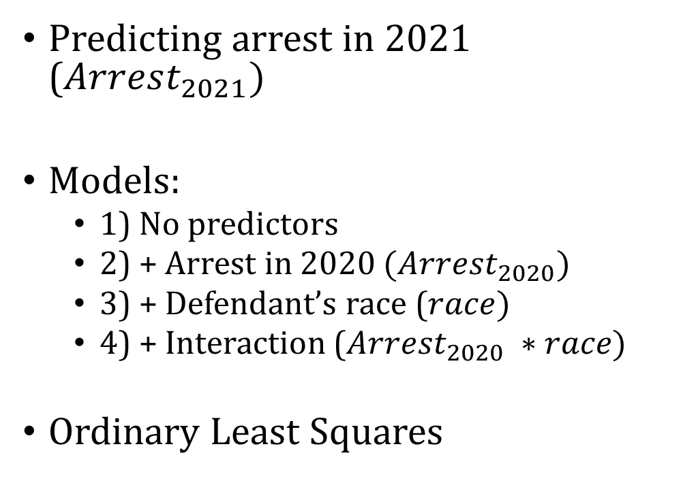
Example
Predicting arrest in 2021 ($Arrest_{2021})$
Models:
1) No predictors
2) + Arrest in 2020 $(Arrest_{2020})$
3) + Defendant’s race ($race)$
4) + Interaction ($Arrest_{2020} ∗race)$
Ordinary Least Squares

Slide 19
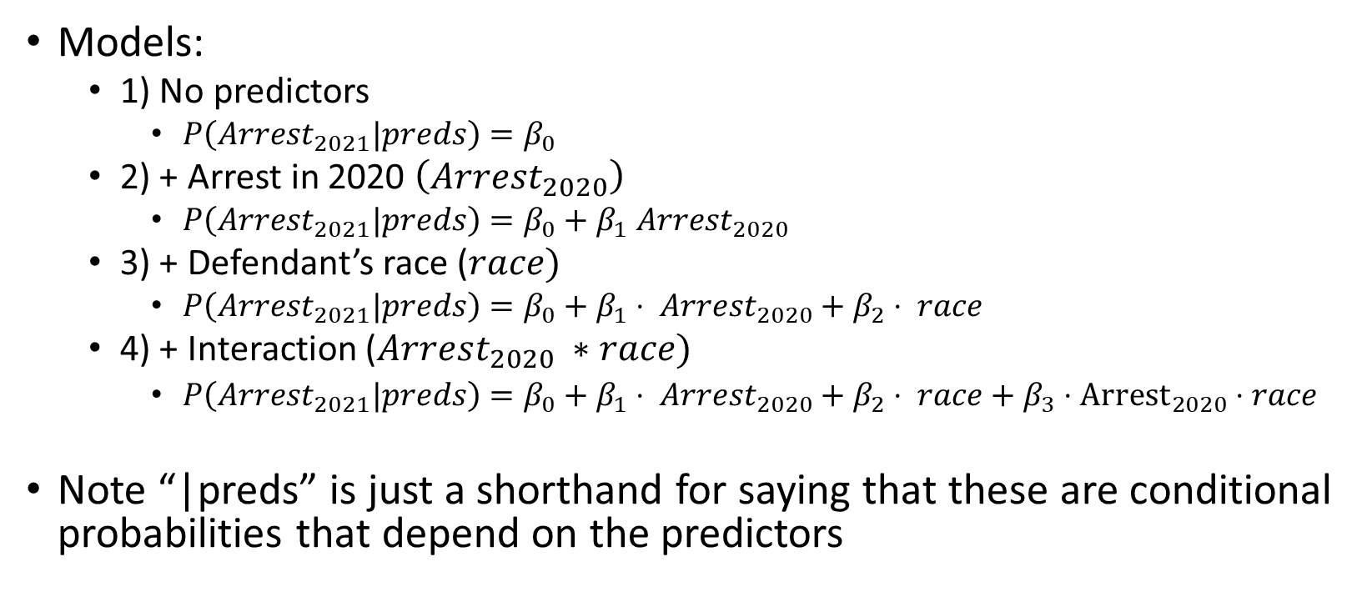
Example
Models:
1) No predictors
$P\left(Arrest_{2021}|preds\right)=β_{0}$
2) + Arrest in 2020 $\left(Arrest_{2020}\right)$
$P\left(Arrest_{2021}|preds\right)=β_{0}+β_{1} Arrest_{2020}$
3) + Defendant’s race ($race)$
$P\left(Arrest_{2021}|preds\right)=β_{0}+β_{1}⋅ Arrest_{2020}+β_{2}⋅ race$
4) + Interaction ($Arrest_{2020} ∗race)$
$P\left(Arrest_{2021}|preds\right)=β_{0}+β_{1}⋅ Arrest_{2020}+β_{2}⋅ race+β_{3}⋅{Arrest}_{2020}⋅race$
Note “|preds” is just a shorthand for saying that these are conditional probabilities that depend on the predictors

Slide 20
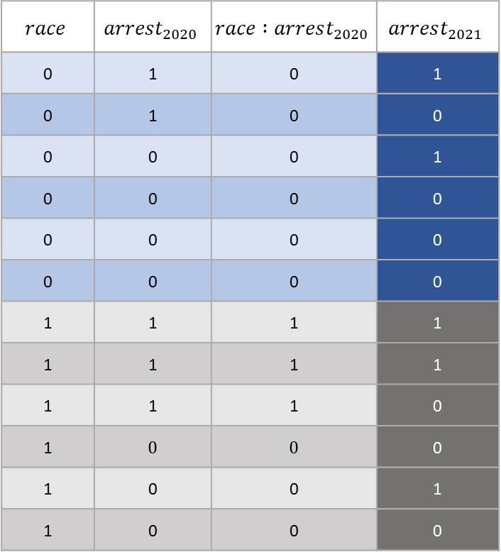

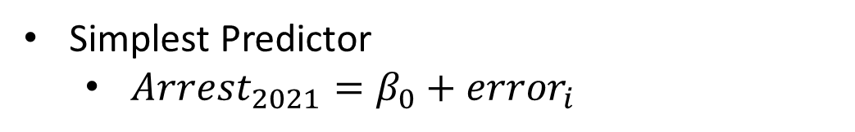
$$P(Arrest_{2021})$$
Simplest Predictor
$Arrest_{2021}=β_{0}+error_{i}$
$$race$$ | $$arrest_{2020}$$ | $$race :arrest_{2020}$$ | $$arrest_{2021}$$
0 | 1 | 0 | 1
0 | 1 | 0 | 0
0 | 0 | 0 | 1
0 | 0 | 0 | 0
0 | 0 | 0 | 0
0 | 0 | 0 | 0
1 | 1 | 1 | 1
1 | 1 | 1 | 1
1 | 1 | 1 | 0
1 | 0 | 0 | 0
1 | 0 | 0 | 1
1 | 0 | 0 | 0

Slide 21
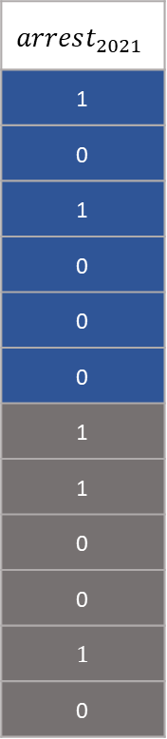
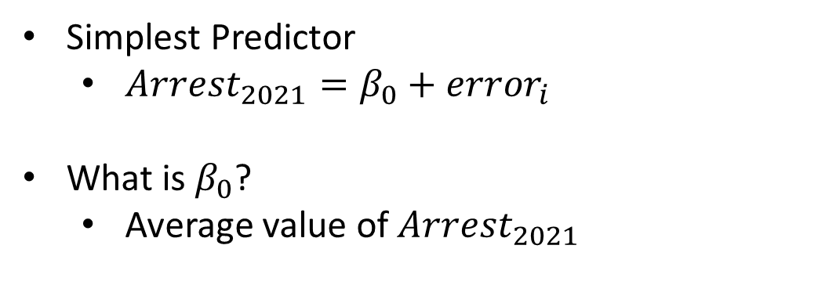
$$P(Arrest_{2021})$$
Simplest Predictor
$Arrest_{2021}=β_{0}+error_{i}$
What is $β_{0}$?
Average value of $Arrest_{2021}$
$$arrest_{2021}$$
1
0
1
0
0
0
1
1
0
0
1
0

Slide 22
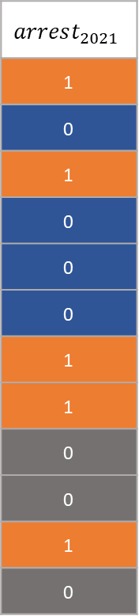
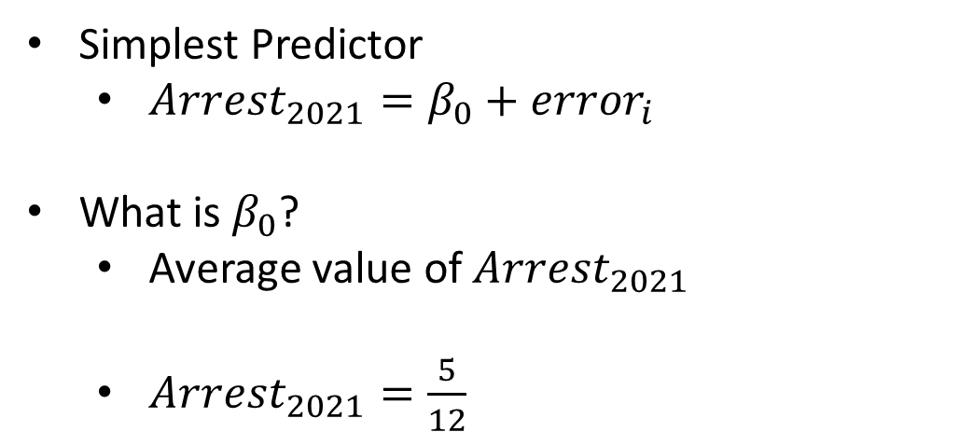
$$P(Arrest_{2021})$$
Simplest Predictor
$Arrest_{2021}=β_{0}+error_{i}$
What is $β_{0}$?
Average value of $Arrest_{2021}$
$Arrest_{2021}=\frac{5}{12}$
$$arrest_{2021}$$
1
0
1
0
0
0
1
1
0
0
1
0

Slide 23
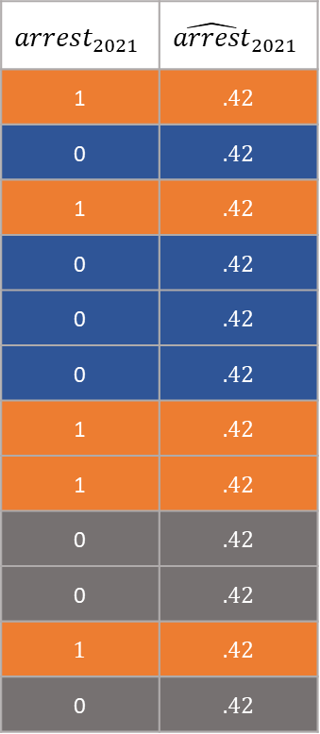
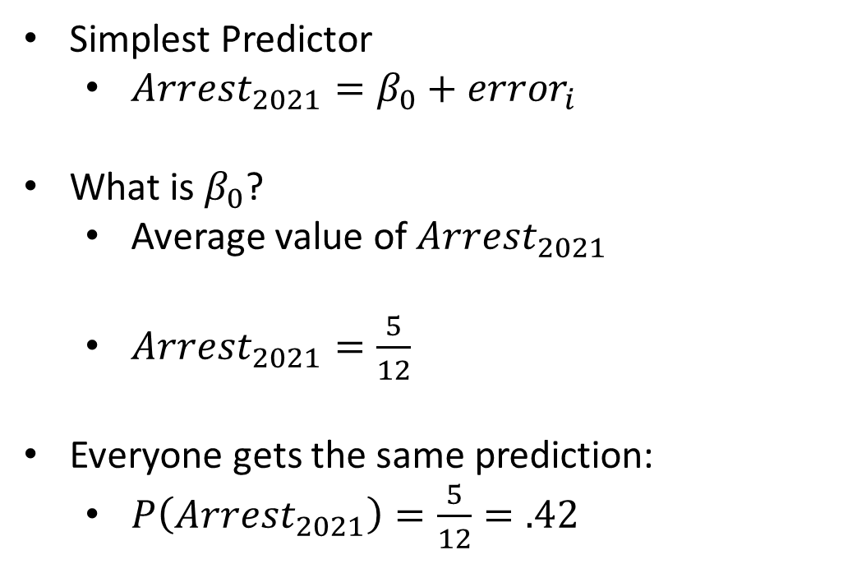
$$P(Arrest_{2021})$$
Simplest Predictor
$Arrest_{2021}=β_{0}+error_{i}$
What is $β_{0}$?
Average value of $Arrest_{2021}$
$Arrest_{2021}=\frac{5}{12}$
Everyone gets the same prediction:
$P\left(Arrest_{2021}\right)=\frac{5}{12}=.42$
$$arrest_{2021}$$ | $${\hat{arrest}}_{2021}$$
1 | .42
0 | .42
1 | .42
0 | .42
0 | .42
0 | .42
1 | .42
1 | .42
0 | .42
0 | .42
1 | .42
0 | .42

Slide 24
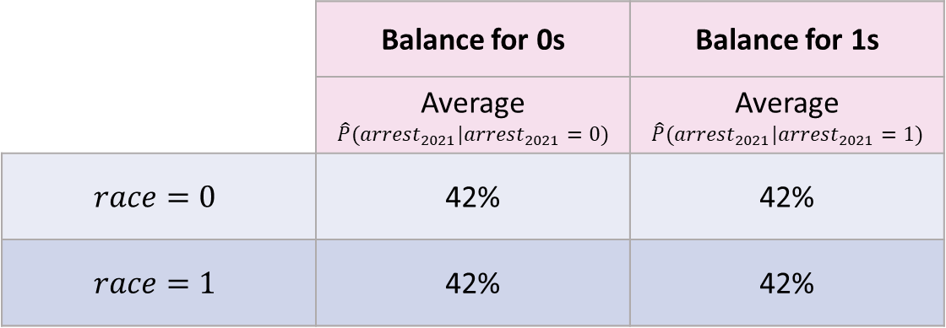
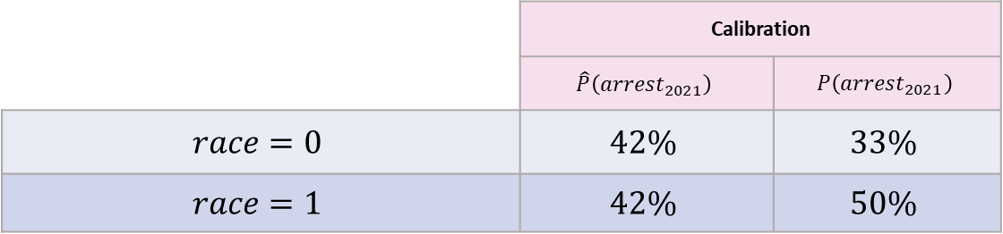
Compute Fairness Metrics
 | Calibration
 | $$\hat{P}\left(arrest_{2021}\right)$$ | $$P\left(arrest_{2021}\right)$$
$$race=0$$ | $$42\%$$ | $$33\%$$
$$race=1$$ | $$42\%$$ | $$50\%$$
 | Balance for 0s | Balance for 1s
 | Average $$\hat{P}(arrest_{2021}|arrest_{2021}=0)$$ | Average $$\hat{P}(arrest_{2021}|arrest_{2021}=1)$$
$$race=0$$ | 42% | 42%
$$race=1$$ | 42% | 42%

Slide 25

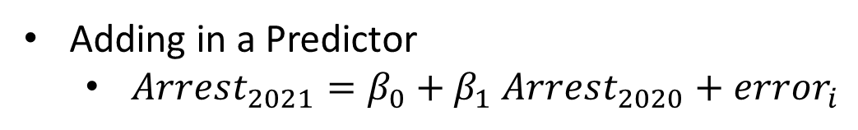
$$P(Arrest_{2021}|Arrest_{2020})$$
Adding in a Predictor
$Arrest_{2021}=β_{0}+β_{1} Arrest_{2020}+error_{i}$
$$race$$ | $$arrest_{2020}$$ | $$race :arrest_{2020}$$ | $$arrest_{2021}$$
0 | 1 | 0 | 1
0 | 1 | 0 | 0
0 | 0 | 0 | 1
0 | 0 | 0 | 0
0 | 0 | 0 | 0
0 | 0 | 0 | 0
1 | 1 | 1 | 1
1 | 1 | 1 | 1
1 | 1 | 1 | 0
1 | 0 | 0 | 0
1 | 0 | 0 | 1
1 | 0 | 0 | 0

Slide 26
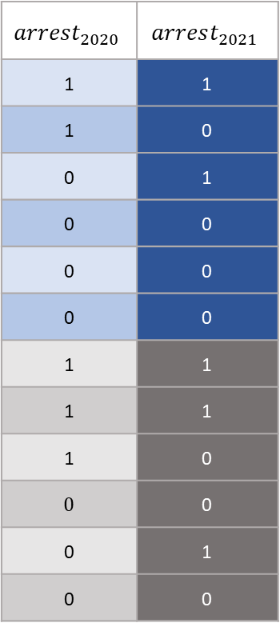
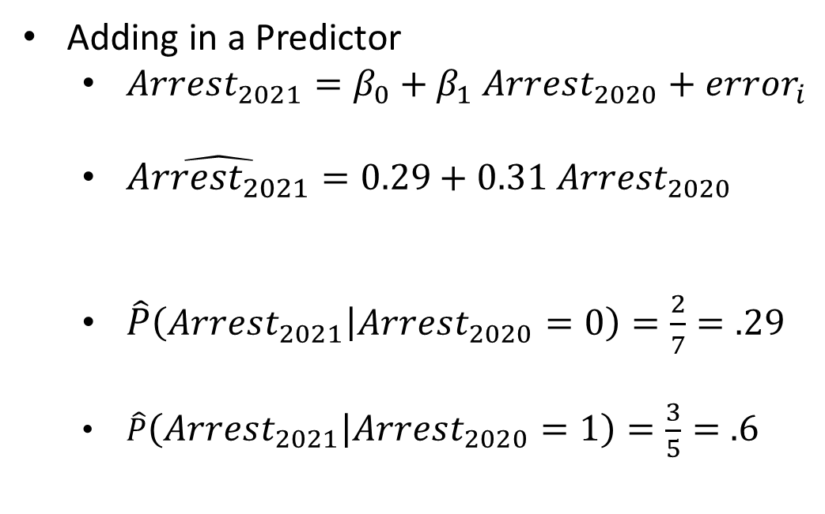
$$P(Arrest_{2021}|Arrest_{2020})$$
Adding in a Predictor
$Arrest_{2021}=β_{0}+β_{1} Arrest_{2020}+error_{i}$
$\hat{Arrest_{2021}}=0.29+0.31 Arrest_{2020}$
$\hat{P}\left(Arrest_{2021} | Arrest_{2020}=0\right)=\frac{2}{7}=.29$
$\hat{P}\left(Arrest_{2021} | Arrest_{2020}=1\right)=\frac{3}{5}=.6$
$$arrest_{2020}$$ | $$arrest_{2021}$$
1 | 1
1 | 0
0 | 1
0 | 0
0 | 0
0 | 0
1 | 1
1 | 1
1 | 0
0 | 0
0 | 1
0 | 0

Slide 27
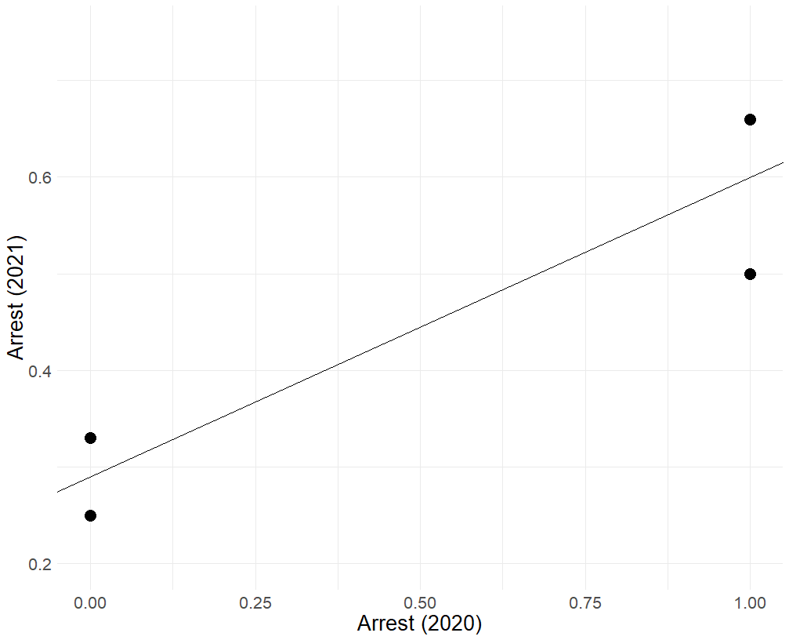
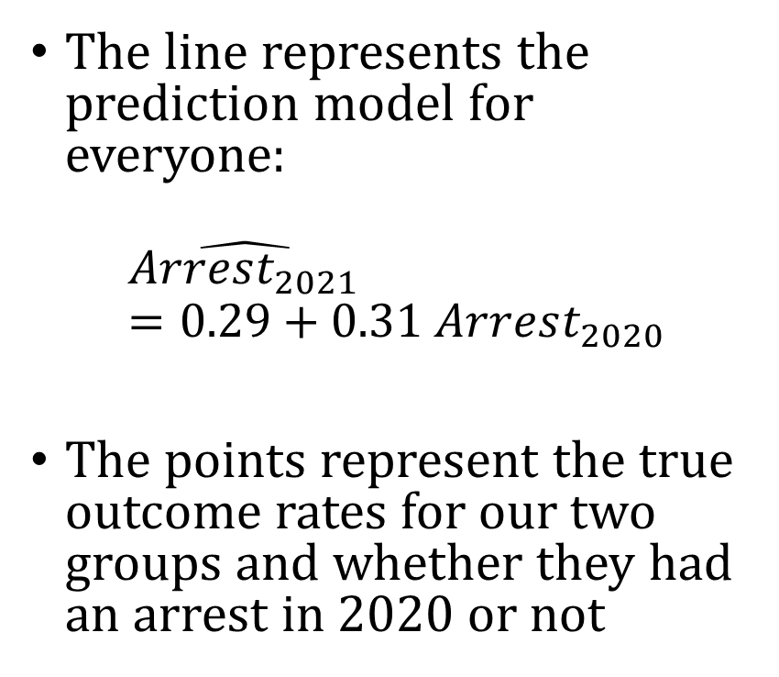




Visualizing the model
Base rate for Race = 1 and $Arrest_{2020}=1$
The line represents the prediction model for everyone:
$$\hat{Arrest_{2021}}=0.29+0.31 Arrest_{2020}$$
The points represent the true outcome rates for our two groups and whether they had an arrest in 2020 or not
Base rate for Race = 1 and $Arrest_{2020}=0$
Base rate for Race = 0 and $Arrest_{2020}=1$
Base rate for Race = 0 and $Arrest_{2020}=0$

Slide 28
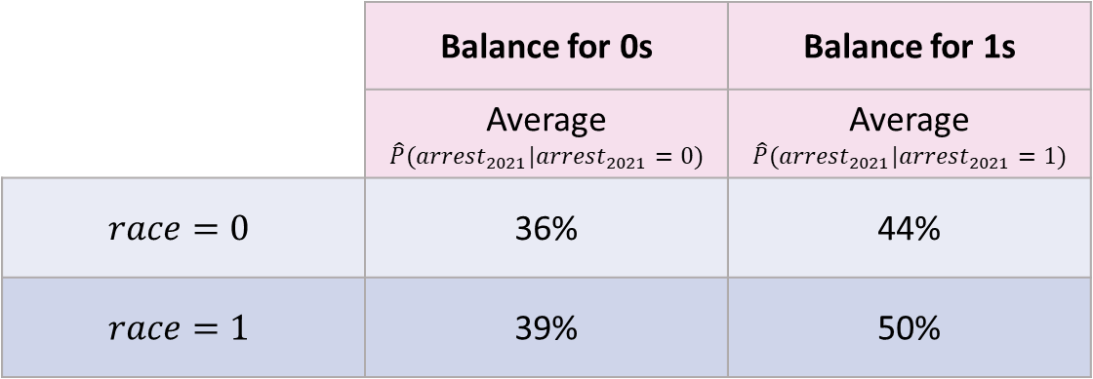
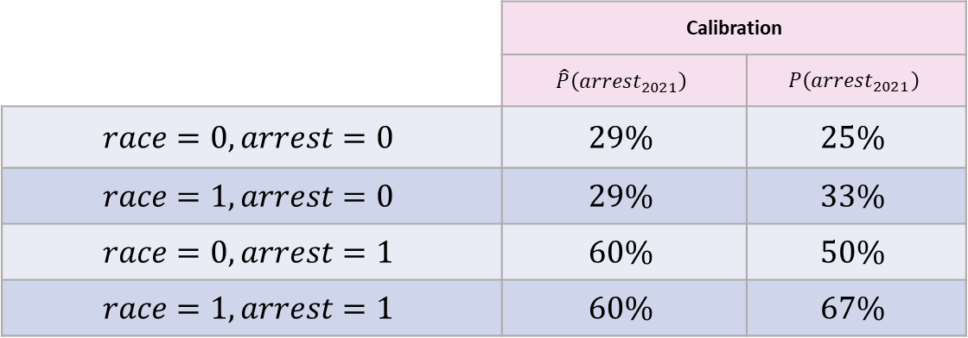
Compute Fairness Metrics
 | Calibration
 | $$\hat{P}\left(arrest_{2021}\right)$$ | $$P\left(arrest_{2021}\right)$$
$$race=0, arrest=0$$ | $$29\%$$ | $$25\%$$
$$race=1, arrest=0$$ | $$29\%$$ | $$33\%$$
$$race=0, arrest=1$$ | $$60\%$$ | $$50\%$$
$$race=1, arrest=1$$ | $$60\%$$ | $$67\%$$
 | Balance for 0s | Balance for 1s
 | Average $$\hat{P}(arrest_{2021}|arrest_{2021}=0)$$ | Average $$\hat{P}(arrest_{2021}|arrest_{2021}=1)$$
$$race=0$$ | 36% | 44%
$$race=1$$ | 39% | 50%

Slide 29

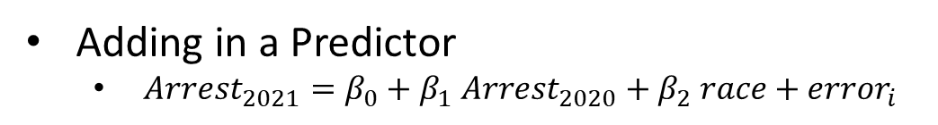
$$P(Arrest_{2021}|Arrest_{2020}, Race)$$
Adding in a Predictor
$Arrest_{2021}=β_{0}+β_{1} Arrest_{2020}+β_{2} race+error_{i}$
$$race$$ | $$arrest_{2020}$$ | $$race :arrest_{2020}$$ | $$arrest_{2021}$$
0 | 1 | 0 | 1
0 | 1 | 0 | 0
0 | 0 | 0 | 1
0 | 0 | 0 | 0
0 | 0 | 0 | 0
0 | 0 | 0 | 0
1 | 1 | 1 | 1
1 | 1 | 1 | 1
1 | 1 | 1 | 0
1 | 0 | 0 | 0
1 | 0 | 0 | 1
1 | 0 | 0 | 0

Slide 30
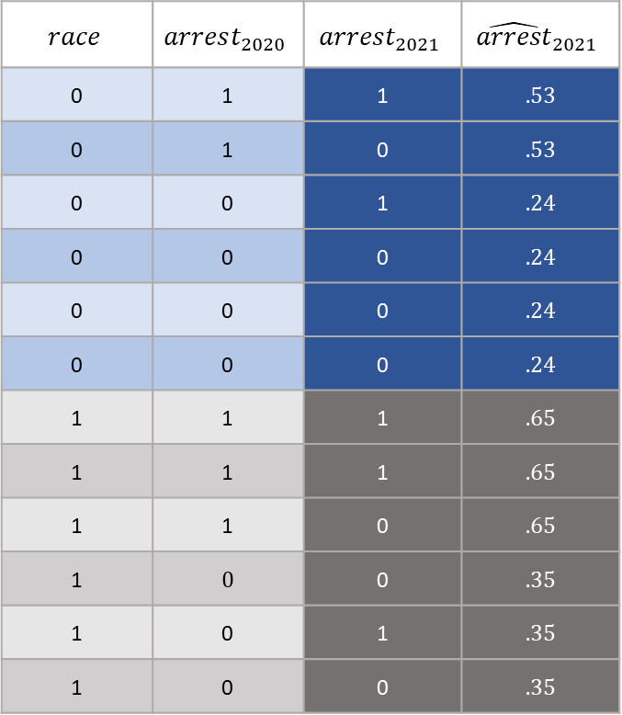
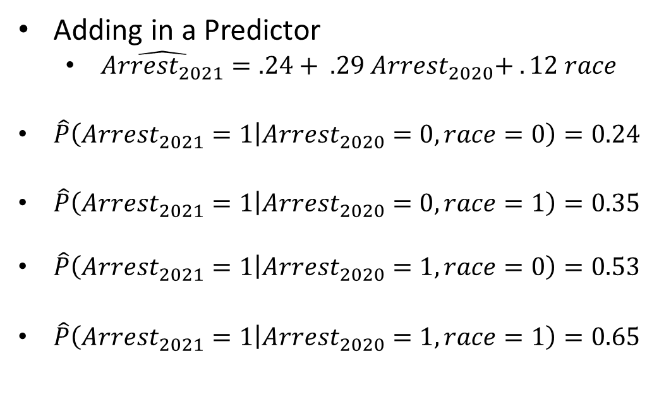
$$P(Arrest_{2021}|Arrest_{2020}, Race)$$
Adding in a Predictor
$\hat{Arrest_{2021}}=.24+ .29 Arrest_{2020}+ . 12 race$
$\hat{P}\left(Arrest_{2021}=1 | Arrest_{2020}=0, race=0\right)=0.24$
$\hat{P}\left(Arrest_{2021}=1 | Arrest_{2020}=0, race=1\right)=0.35$
$\hat{P}\left(Arrest_{2021}=1 | Arrest_{2020}=1, race=0\right)=0.53$
$\hat{P}\left(Arrest_{2021}=1 | Arrest_{2020}=1, race=1\right)=0.65$
$$race$$ | $$arrest_{2020}$$ | $$arrest_{2021}$$ | $${\hat{arrest}}_{2021}$$
0 | 1 | 1 | .53
0 | 1 | 0 | .53
0 | 0 | 1 | .24
0 | 0 | 0 | .24
0 | 0 | 0 | .24
0 | 0 | 0 | .24
1 | 1 | 1 | .65
1 | 1 | 1 | .65
1 | 1 | 0 | .65
1 | 0 | 0 | .35
1 | 0 | 1 | .35
1 | 0 | 0 | .35

Slide 31
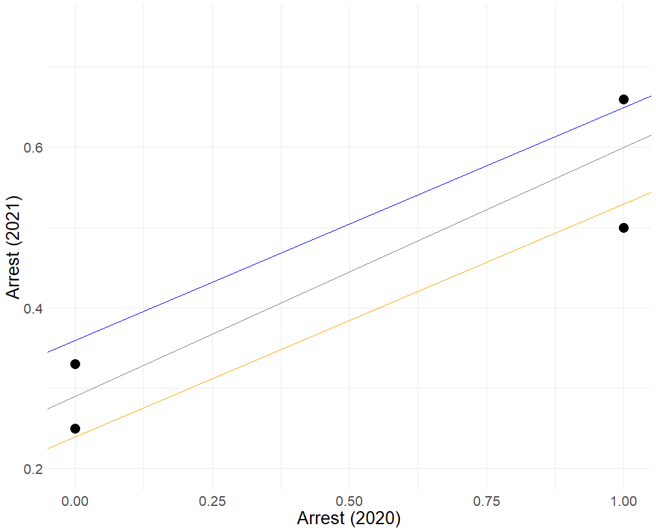
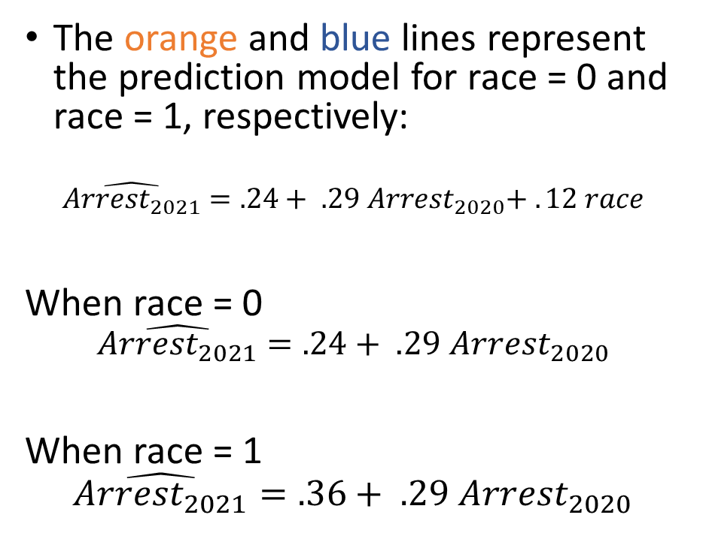


Visualizing the model
Base rate for Race = 1 and $Arrest_{2020}=1$
The orange and blue lines represent the prediction model for race = 0 and race = 1, respectively:
$$\hat{Arrest_{2021}}=.24+ .29 Arrest_{2020}+ . 12 race$$
When race = 0
$$\hat{Arrest_{2021}}=.24+ .29 Arrest_{2020}$$
When race = 1
$$\hat{Arrest_{2021}}=.36+ .29 Arrest_{2020}$$
Base rate for Race = 1 and $Arrest_{2020}=0$
Base rate for Race = 0 and $Arrest_{2020}=1$
Base rate for Race = 0 and $Arrest_{2020}=0$

Slide 32
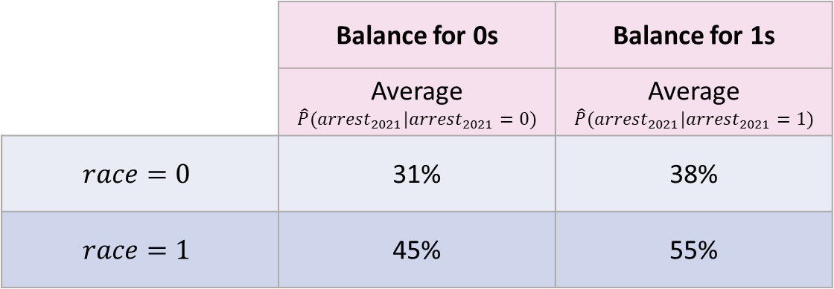
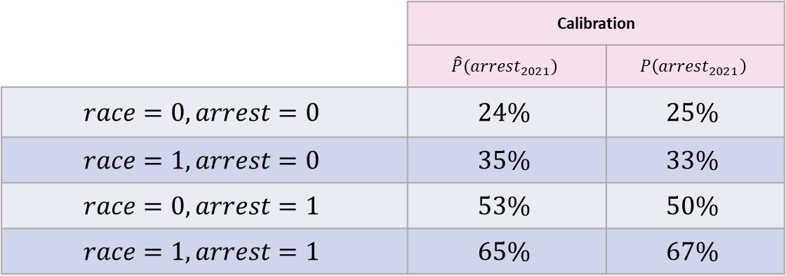
Compute Fairness Metrics
 | Calibration
 | $$\hat{P}\left(arrest_{2021}\right)$$ | $$P\left(arrest_{2021}\right)$$
$$race=0, arrest=0$$ | $$24\%$$ | $$25\%$$
$$race=1, arrest=0$$ | $$35\%$$ | $$33\%$$
$$race=0, arrest=1$$ | $$53\%$$ | $$50\%$$
$$race=1, arrest=1$$ | $$65\%$$ | $$67\%$$
 | Balance for 0s | Balance for 1s
 | Average $$\hat{P}(arrest_{2021}|arrest_{2021}=0)$$ | Average $$\hat{P}(arrest_{2021}|arrest_{2021}=1)$$
$$race=0$$ | 31% | 38%
$$race=1$$ | 45% | 55%

Slide 33
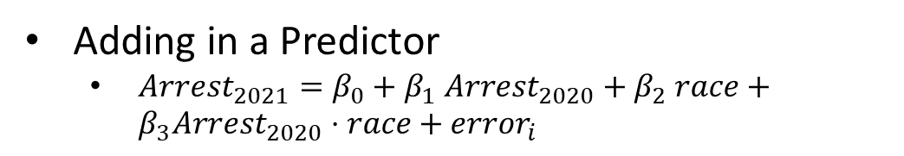
Add interaction
Adding in a Predictor
$Arrest_{2021}=β_{0}+β_{1} Arrest_{2020}+β_{2} race+β_{3}Arrest_{2020}⋅race+error_{i}$
$$race$$ | $$arrest_{2020}$$ | $$race :arrest_{2020}$$ | $$arrest_{2021}$$
0 | 1 | 0 | 1
0 | 1 | 0 | 0
0 | 0 | 0 | 1
0 | 0 | 0 | 0
0 | 0 | 0 | 0
0 | 0 | 0 | 0
1 | 1 | 1 | 1
1 | 1 | 1 | 1
1 | 1 | 1 | 0
1 | 0 | 0 | 0
1 | 0 | 0 | 1
1 | 0 | 0 | 0

Slide 34
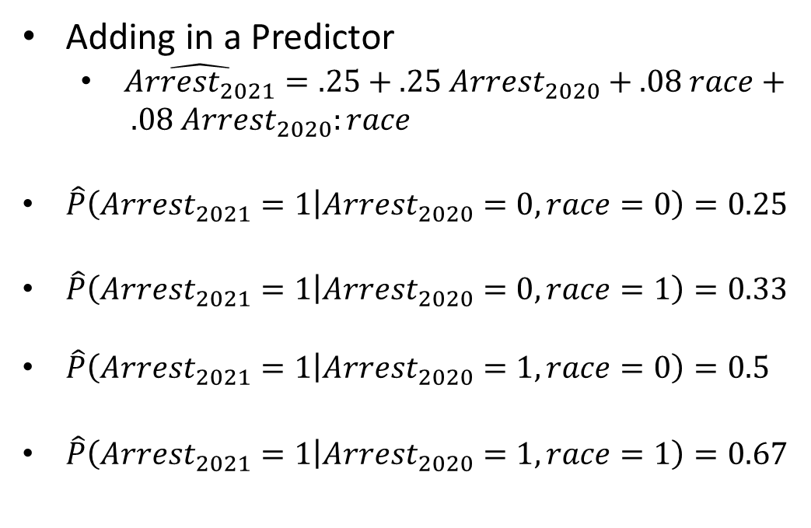
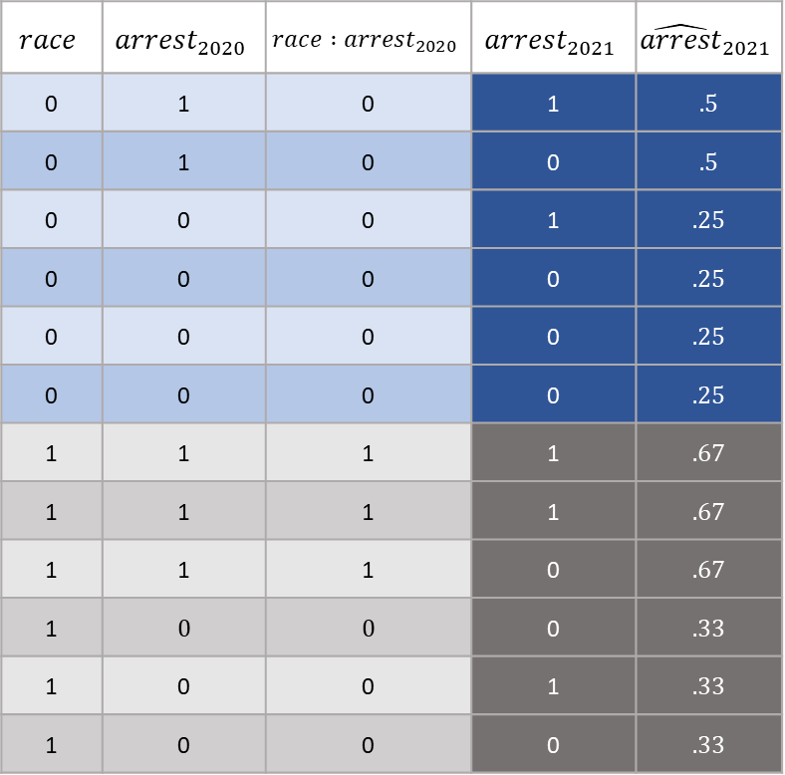
$$P(Arrest_{2021}|Arrest_{2020})$$
Adding in a Predictor
$\hat{Arrest_{2021}}=.25+.25 Arrest_{2020}+.08 race+ .08 Arrest_{2020}:race$
$\hat{P}\left(Arrest_{2021}=1 | Arrest_{2020}=0, race=0\right)=0.25$
$\hat{P}\left(Arrest_{2021}=1 | Arrest_{2020}=0, race=1\right)=0.33$
$\hat{P}\left(Arrest_{2021}=1 | Arrest_{2020}=1, race=0\right)=0.5$
$\hat{P}\left(Arrest_{2021}=1 | Arrest_{2020}=1, race=1\right)=0.67$
$$race$$ | $$arrest_{2020}$$ | $$race :arrest_{2020}$$ | $$arrest_{2021}$$ | $${\hat{arrest}}_{2021}$$
0 | 1 | 0 | 1 | .5
0 | 1 | 0 | 0 | .5
0 | 0 | 0 | 1 | .25
0 | 0 | 0 | 0 | .25
0 | 0 | 0 | 0 | .25
0 | 0 | 0 | 0 | .25
1 | 1 | 1 | 1 | .67
1 | 1 | 1 | 1 | .67
1 | 1 | 1 | 0 | .67
1 | 0 | 0 | 0 | .33
1 | 0 | 0 | 1 | .33
1 | 0 | 0 | 0 | .33

Slide 35
Visualizing the model
Base rate for Race = 1 and $Arrest_{2020}=1$
The line represents the prediction model for everyone:
$$\hat{Arrest_{2021}}=0.29+0.31 Arrest_{2020}$$
The points represent the true outcome rates for our two groups and whether they had an arrest in 2020 or not
Base rate for Race = 1 and $Arrest_{2020}=0$
Base rate for Race = 0 and $Arrest_{2020}=1$
Base rate for Race = 0 and $Arrest_{2020}=0$

Slide 36
Visualizing the model
Base rate for Race = 1 and $Arrest_{2020}=1$
The orange and blue lines represent the prediction model for race = 0 and race = 1, respectively:
$$\hat{Arrest_{2021}}=.24+ .29 Arrest_{2020}+ . 12 race$$
When race = 0
$$\hat{Arrest_{2021}}=.24+ .29 Arrest_{2020}$$
When race = 1
$$\hat{Arrest_{2021}}=.36+ .29 Arrest_{2020}$$
Base rate for Race = 1 and $Arrest_{2020}=0$
Base rate for Race = 0 and $Arrest_{2020}=1$
Base rate for Race = 0 and $Arrest_{2020}=0$

Slide 37
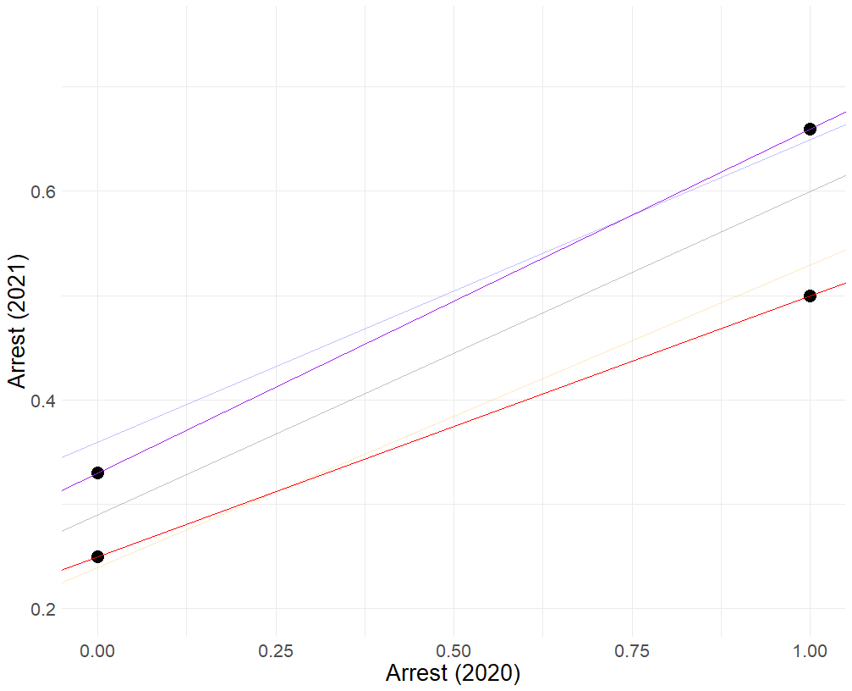
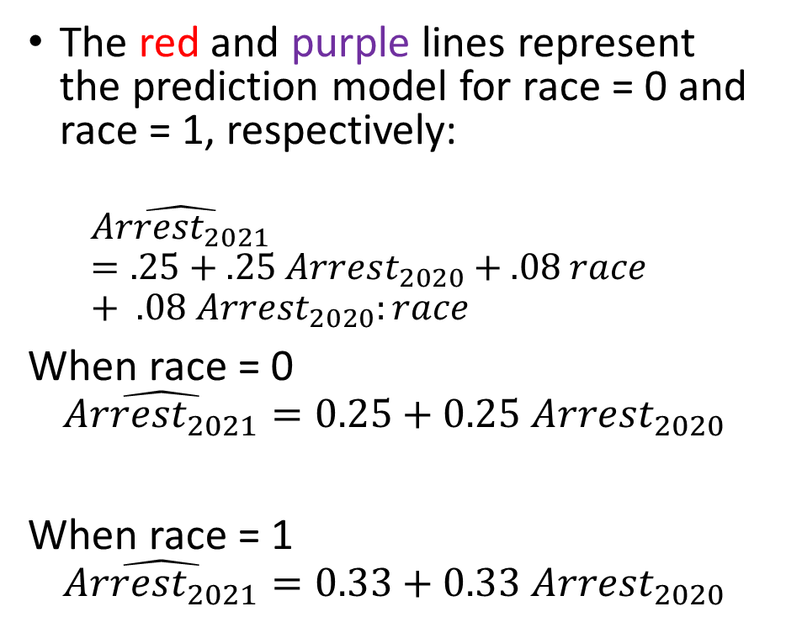
Visualizing the model
Base rate for Race = 1 and $Arrest_{2020}=1$
The red and purple lines represent the prediction model for race = 0 and race = 1, respectively:
$$\hat{Arrest_{2021}}=.25+.25 Arrest_{2020}+.08 race+ .08 Arrest_{2020}:race$$
When race = 0
$$\hat{Arrest_{2021}}=0.25+0.25 Arrest_{2020}$$
When race = 1
$$\hat{Arrest_{2021}}=0.33+0.33 Arrest_{2020}$$
Base rate for Race = 1 and $Arrest_{2020}=0$
Base rate for Race = 0 and $Arrest_{2020}=1$
Base rate for Race = 0 and $Arrest_{2020}=0$

Slide 38


Compute Fairness Metrics
 | Calibration
 | $$\hat{P}\left(arrest_{2021}\right)$$ | $$P\left(arrest_{2021}\right)$$
$$race=0, arrest=0$$ | $$25\%$$ | $$25\%$$
$$race=1, arrest=0$$ | $$33\%$$ | $$33\%$$
$$race=0, arrest=1$$ | $$50\%$$ | $$50\%$$
$$race=1, arrest=1$$ | $$67\%$$ | $$67\%$$
 | Balance for 0s | Balance for 1s
 | Average $$\hat{P}(arrest_{2021}|arrest_{2021}=0)$$ | Average $$\hat{P}(arrest_{2021}|arrest_{2021}=1)$$
$$race=0$$ | 31% | 38%
$$race=1$$ | 44% | 56%

Slide 39
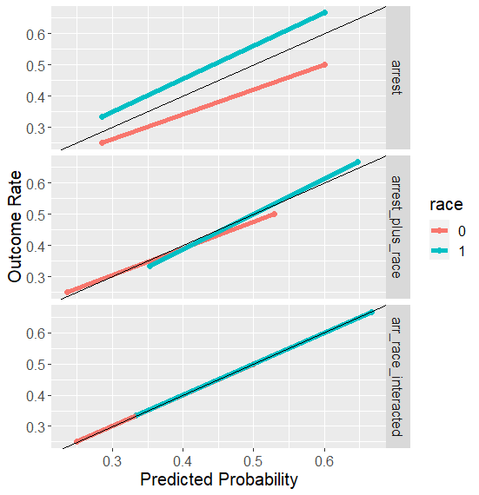
Calibration/PPV Balance
Improves with more features.

Slide 40
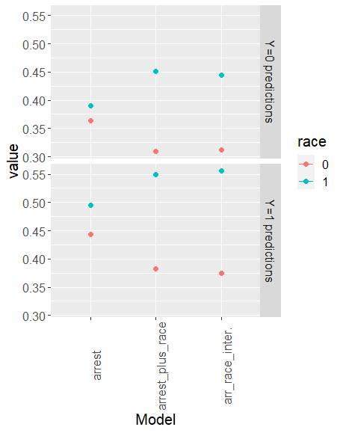
Error Rates
Degrade with more features

Slide 41
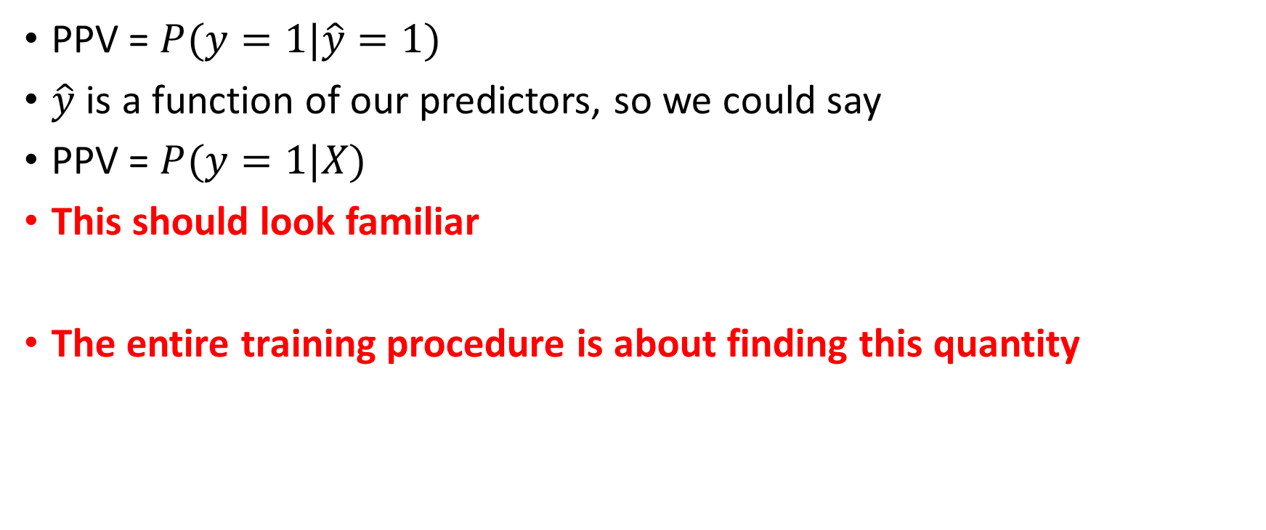
What Explains This Pattern?
PPV = $P(y=1|\hat{y}=1)$
$\hat{y}$ is a function of our predictors, so we could say
PPV = $P(y=1|X)$
This should look familiar
The entire training procedure is about finding this quantity

Slide 42

What Explains This Pattern?
But not the case for balance for positive and negative classes (FPR or FNR):
FNR: $P\left(\hat{y}=0 | y=1\right)$
How can we get our algorithms to optimize for this?

Slide 43

Constraints
Recall the objective function for ridge
$$\sum{{\left(y_{i}−{\hat{y}}_{i}\right)}^{2}+λ\sum_{j}{β_{j}^{2}}}$$

Slide 44

Constraints
Recall the objective function for ridge
$$\sum{{\left(y_{i}−{\hat{y}}_{i}\right)}^{2}+λ\sum_{j}{β_{j}^{2}}}$$
Penalty term: $\sum_{j}{β_{j}^{2}}$

Slide 45

Constraints
Other ways you could constrain
$$\sum{{\left(y_{i}−{\hat{y}}_{i}\right)}^{2}+λ Φ(y_{i}, {\hat{y}}_{i})}$$
$Φ\left(y_{i}, {\hat{y}}_{i}\right):$ a constraint to take into account FPR and/or FNR

Slide 46

What Would a “Constraint” Look Like
Differences in False Positive Rates should be zero, or close to zero
$P\left(\hat{y}=1 | y=0,race=0\right)=P\left(\hat{y}=1 | y=0,race=1\right)$
$\frac{1}{N_{0}}\sum_{i=1}^{N_{0}}{{\hat{y}}_{i}\left(1−y_{i}\right)}−\frac{1}{N_{1}}\sum_{j=1}^{N_{1}}{{\hat{y}}_{j}\left(1−y_{j}\right)}$

Slide 47
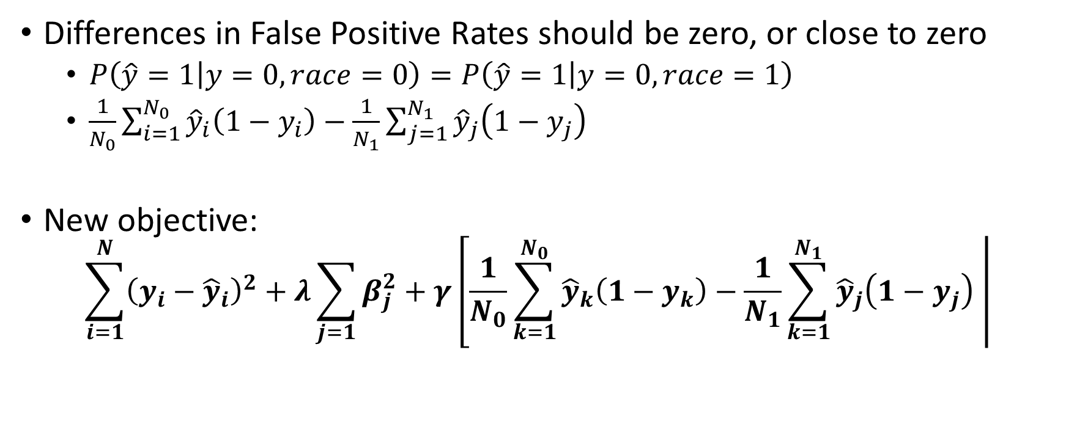
What Would a “Constraint” Look Like
Differences in False Positive Rates should be zero, or close to zero
$P\left(\hat{y}=1 | y=0,race=0\right)=P\left(\hat{y}=1 | y=0,race=1\right)$
$\frac{1}{N_{0}}\sum_{i=1}^{N_{0}}{{\hat{y}}_{i}\left(1−y_{i}\right)}−\frac{1}{N_{1}}\sum_{j=1}^{N_{1}}{{\hat{y}}_{j}\left(1−y_{j}\right)}$
New objective:
$$\sum_{i=1}^{N}{{\left(y_{i}−{\hat{y}}_{i}\right)}^{2}+λ\sum_{j=1}{β_{j}^{2}+γ\left[\frac{1}{N_{0}}\sum_{k=1}^{N_{0}}{{\hat{y}}_{k}\left(1−y_{k}\right)}−\frac{1}{N_{1}}\sum_{k=1}^{N_{1}}{{\hat{y}}_{j}\left(1−y_{j}\right) }\right|}}$$

Slide 48

What Would a “Constraint” Look Like
Differences in False Positive Rates should be zero, or close to zero
$P\left(\hat{y}=1 | y=0,race=0\right)=P\left(\hat{y}=1 | y=0,race=1\right)$
$\frac{1}{N_{0}}\sum_{i=1}^{N_{0}}{{\hat{y}}_{i}\left(1−y_{i}\right)}−\frac{1}{N_{1}}\sum_{j=1}^{N_{1}}{{\hat{y}}_{j}\left(1−y_{j}\right)}$
New objective:
$$\sum_{i=1}^{N}{{\left(y_{i}−{\hat{y}}_{i}\right)}^{2}+λ\sum_{j=1}{β_{j}^{2}+γ\left[\frac{1}{N_{0}}\sum_{k=1}^{N_{0}}{{\hat{y}}_{k}\left(1−y_{k}\right)}−\frac{1}{N_{1}}\sum_{k=1}^{N_{1}}{{\hat{y}}_{j}\left(1−y_{j}\right) }\right|}}$$

Slide 49







“Control Dials” for Algorithms
$$\sum_{i=1}^{N}{{\left(y_{i}−{\hat{y}}_{i}\right)}^{2}+λ\sum_{j=1}{β_{j}^{2}+γ\left[\frac{1}{N_{0}}\sum_{k=1}^{N_{0}}{{\hat{y}}_{k}\left(1−y_{k}\right)}−\frac{1}{N_{1}}\sum_{k=1}^{N_{1}}{{\hat{y}}_{j}\left(1−y_{j}\right) }\right|}}$$
${\left(y_{i}−{\hat{y}}_{i}\right)}^{2}$
How much do want to reduce error in the training data?
$λ\sum_{j=1}{β_{j}^{2}}$
How much do we want to prevent overfitting?
$γ\left[\frac{1}{N_{0}}\sum_{k=1}^{N_{0}}{{\hat{y}}_{k}\left(1−y_{k}\right)}−\frac{1}{N_{1}}\sum_{k=1}^{N_{1}}{{\hat{y}}_{j}\left(1−y_{j}\right) }\right|$
How much do we want to reduce disparities in False Positive Rates?

Slide 50
The Importance of Base Rates

Slide 51



$$P(Arrest_{2021}=1|Arrest_{2020}, Race)$$
$Arrest_{2021}=.25+.25 Arrest_{2020}+.08 race+.08 Arrest_{2020}⋅race$
$P\left(Arrest_{2021} | Arrest_{2020}=0,Race=0\right)$
$.25+.25 \left(0\right)+.08 \left(0\right)+.08 \left(0⋅0\right)=.25$
$P\left(Arrest_{2021} | Arrest_{2020}=0,Race=1\right)$
$.25+.25 \left(0\right)+.08 \left(1\right)+.08 \left(0⋅1\right)=.33$
$P\left(Arrest_{2021} | Arrest_{2020}=1,Race=0\right)$
$.25+.25 \left(1\right)+.08 \left(0\right)+.08 \left(1⋅0\right)=.5$
$P\left(Arrest_{2021} | Arrest_{2020}=1,Race=1\right)$
$.25+.25 \left(1\right)+.08 \left(1\right)+.08 \left(1⋅1\right)=.66$
$$race$$ | $$arrest_{2020}$$ | $$race :arrest_{2020}$$ | $$arrest_{2021}$$ | $${\hat{arrest}}_{2021}$$
0 | 1 | 0 | 1 | .5
0 | 1 | 0 | 0 | .5
0 | 0 | 0 | 1 | .25
0 | 0 | 0 | 0 | .25
0 | 0 | 0 | 0 | .25
0 | 0 | 0 | 0 | .25
1 | 1 | 1 | 1 | .66
1 | 1 | 1 | 1 | .66
1 | 1 | 1 | 0 | .66
1 | 0 | 0 | 0 | .33
1 | 0 | 0 | 1 | .33
1 | 0 | 0 | 0 | .33

Slide 52
Why Is Race Predictive of the outcome?
Race is a stand-in for missing predictors
Differences in police behavior
Differences in treatment of different subgroups historically
Differences in environment, broadly speaking

Slide 53

How Would We Equalize P-Hats?
$Arrest_{2021}=.25+.25 Arrest_{2020}+.08 race+.08 Arrest_{2020}⋅race$
Adding in predictors that are differentially predictive across groups
$Arrest_{2021}=.25+.25 Arrest_{2020}+.04 race+.08 Arrest_{2020}⋅race+.08 policing⋅race$

Slide 54

We See This Already
Interactions can account for differences in risk across groups.
${Arrest}_{2021}=.24+ .29 Arrest_{2020}+ . 12 race$
$Arrest_{2021}=.25+.25 Arrest_{2020}+.08 race+.08 Arrest_{2020}⋅race$
.12 vs .08
Pure group differences matter less

Slide 55
Causes of Bias in Predictions (Part II)

Slide 56
Where Does Bias Come From? Scenario 1
Arrested
$P\left(Arrest=1 | Crime=1, Race=A\right)=50\%$
Crime
Not Arrested
$$P\left(Arrest=0 | Crime=1, Race=A\right)=50\%$$
In this scenario, one group is more likely to be re-arrested given that they committed a crime
Arrested
$$P\left(Arrest=1 | Crime=1, Race=B\right)=100\%$$
Crime
Not Arrested
$$P\left(Arrest=0 | Crime=1, Race=B\right)=0\%$$

Slide 57

Agenda (focus on Calibration)
1) What happens when we have error in the predictor
$$Crime_{2021}=β_{0}+β_{1}Arrest_{2020}$$
Note: $Arrest_{2020}≠Crime_{2020}$
2) What happens when we have error in the outcome
$$Arrest_{2021}=β_{0}+β_{1}Crime_{2020}$$
Note: $Arrest_{2021}≠Crime_{2021}$

Slide 58

Data With Measurement Error
$$race$$ | $$crime_{2020}$$ | $$arrest_{2020}$$ | $$race:arrest_{2020}$$ | $${crime}_{2021}$$
0 | 1 | 1 | 0 | 1
0 | 1 | 0 | 0 | 1
0 | 0 | 0 | 0 | 0
0 | 0 | 0 | 0 | 0
1 | 1 | 1 | 1 | 1
1 | 1 | 1 | 1 | 1
1 | 0 | 0 | 0 | 0
1 | 0 | 0 | 0 | 0

Slide 59

Perfectly Measured World
$$race$$ | $$crime_{2020}$$ | $$arrest_{2020}$$ | $$race:arrest_{2020}$$ | $${crime}_{2021}$$ | $${\hat{crime}}_{2021}$$
0 | 1 | 1 | 0 | 1 | 1
0 | 1 | 0 | 0 | 1 | 1
0 | 0 | 0 | 0 | 0 | 0
0 | 0 | 0 | 0 | 0 | 0
1 | 1 | 1 | 1 | 1 | 1
1 | 1 | 1 | 1 | 1 | 1
1 | 0 | 0 | 0 | 0 | 0
1 | 0 | 0 | 0 | 0 | 0
$$crime_{2021}=0+1⋅crime_{2020}$$

Slide 60

Model With Arrests Instead of Crimes
$$race$$ | $$crime_{2020}$$ | $$arrest_{2020}$$ | $$race:arrest_{2020}$$ | $${crime}_{2021}$$ | $${\hat{crime}}_{2021}$$
0 | 1 | 1 | 0 | 1 | 1
0 | 1 | 0 | 0 | 1 | .2
0 | 0 | 0 | 0 | 0 | .2
0 | 0 | 0 | 0 | 0 | .2
1 | 1 | 1 | 1 | 1 | 1
1 | 1 | 1 | 1 | 1 | 1
1 | 0 | 0 | 0 | 0 | .2
1 | 0 | 0 | 0 | 0 | .2
$${crime}_{2021}=0.2+0.8⋅arrest_{2020}$$

Slide 61

Account for Race
$$race$$ | $$crime_{2020}$$ | $$arrest_{2020}$$ | $$race:arrest_{2020}$$ | $${crime}_{2021}$$ | $${\hat{crime}}_{2021}$$
0 | 1 | 1 | 0 | 1 | 1.15
0 | 1 | 0 | 0 | 1 | .29
0 | 0 | 0 | 0 | 0 | .29
0 | 0 | 0 | 0 | 0 | .29
1 | 1 | 1 | 1 | 1 | .94
1 | 1 | 1 | 1 | 1 | .94
1 | 0 | 0 | 0 | 0 | .08
1 | 0 | 0 | 0 | 0 | .08
$${crime}_{2021}=0.29+0.86⋅arrest_{2020}−.21 race$$

Slide 62

Account for Interaction
$$race$$ | $$crime_{2020}$$ | $$arrest_{2020}$$ | $$race:arrest_{2020}$$ | $${crime}_{2021}$$ | $${\hat{crime}}_{2021}$$
0 | 1 | 1 | 0 | 1 | 1
0 | 1 | 0 | 0 | 1 | .33
0 | 0 | 0 | 0 | 0 | .33
0 | 0 | 0 | 0 | 0 | .33
1 | 1 | 1 | 1 | 1 | 1
1 | 0 | 1 | 1 | 1 | 1
1 | 0 | 0 | 1 | 0 | .0
1 | 0 | 0 | 0 | 0 | .0
$${crime}_{2021}=0.33+0.667⋅arrest_{2020}−.33 race+.33arrest_{2020}:race$$

Slide 63

Calibration
 | $$\hat{P}\left({crime}_{2021}\right)$$ |  |  | True Outcome
 | $$arrest$$ | $$arrest+race$$ | $$arrest :race$$ | $$P(crime_2021|⋅)$$
$$race=0, arrest=0$$ | $$20\%$$ | $$29\%$$ | $$0\%$$ | $$0\%$$
$$race=1, arrest=0$$ | $$20\%$$ | $$8\%$$ | $$0\%$$ | $$0\%$$
$$race=0, arrest=1$$ | $$100\%$$ | $$115\%$$ | $$100\%$$ | $$100\%$$
$$race=1, arrest=1$$ | $$100\%$$ | $$94\%$$ | $$100\%$$ | $$100\%$$

Slide 64
What Did We Learn?
When the predictors are measured with bias, it’s still possible to have a calibrated model by taking race into account
It’s possible to use sensitive information such as someone’s race to generate a different prediction for them and make the algorithm fairer (affirmative action)
As opposed to a color-blind policy

Slide 65

Data With Measurement Error
$$race$$ | $$crime_{2020}$$ | $$race:crime_{2020}$$ | $$crime_{2021}$$ | $$arrest_{2021}$$
0 | 1 | 0 | 1 | 1
0 | 1 | 0 | 1 | 0
0 | 0 | 0 | 0 | 0
0 | 0 | 0 | 0 | 0
1 | 1 | 1 | 1 | 1
1 | 1 | 1 | 1 | 1
1 | 0 | 0 | 0 | 0
1 | 0 | 0 | 0 | 0

Slide 66

Accounting for Interaction
$$race$$ | $$crime_{2020}$$ | $$race:crime_{2020}$$ | $$crime_{2021}$$ | $$arrest_{2021}$$ | $${\hat{arrest}}_{2021}$$
0 | 1 | 0 | 1 | 1 | .5
0 | 1 | 0 | 1 | 0 | .5
0 | 0 | 0 | 0 | 0 | 0
0 | 0 | 0 | 0 | 0 | 0
1 | 1 | 1 | 1 | 1 | 1
1 | 1 | 1 | 1 | 1 | 1
1 | 0 | 0 | 0 | 0 | 0
1 | 0 | 0 | 0 | 0 | 0
$$arrest_{2021}=0.0+0.5⋅crime_{2020}+0.0 race+.5 crime_2020:race$$

Slide 67

Calibration
 | $$\hat{P}\left(arrest_{2021}\right)$$ | Model Outcome | True Outcome
 | $$arrest :race$$ | $$P(arrest_{2021}|⋅)$$ | $$P(crime_{2021}|⋅)$$
$$race=0, crime=0$$ | $$0\%$$ | $$0\%$$ | $$0\%$$
$$race=1, crime=0$$ | $$0\%$$ | $$0\%$$ | $$0\%$$
$$race=0, crime=1$$ | $$50\%$$ | $$50\%$$ | $$100\%$$
$$race=1, crime=1$$ | $$100\%$$ | $$100\%$$ | $$100\%$$

Slide 68
What Did We Learn?
When the outcome is measured with bias, it’s NOT possible to have a calibrated model by taking race into account
But the model is run on the biased outcome, so it’ll be calibrated for the biased outcome
What do nearly all risk assessments in criminal justice predict? Arrests not crimes

Slide 69
Potential Solutions + Best Practices
Use well-measured outcomes that directly capture the relevant construct
Account for group differences and consider using sensitive attributes to promote fairness
Regularly audit algorithms for fairness and transparency
Engage stakeholders and impacted communities in the development and evaluation of algorithms

Slide 70
Conclusion
Base rates play a crucial role in determining the fairness of algorithmic predictions
Measurement errors in predictors and outcomes can lead to biased and unfair predictions
Accounting for group differences and using well-measured outcomes can help mitigate bias
By being aware of the sources of bias, considering different fairness criteria, and implementing best practices, we can work towards more equitable and just algorithmic decision-making

