Slide 1
INST 414: Data Science Techniques
Sources of Bias

Slide 2
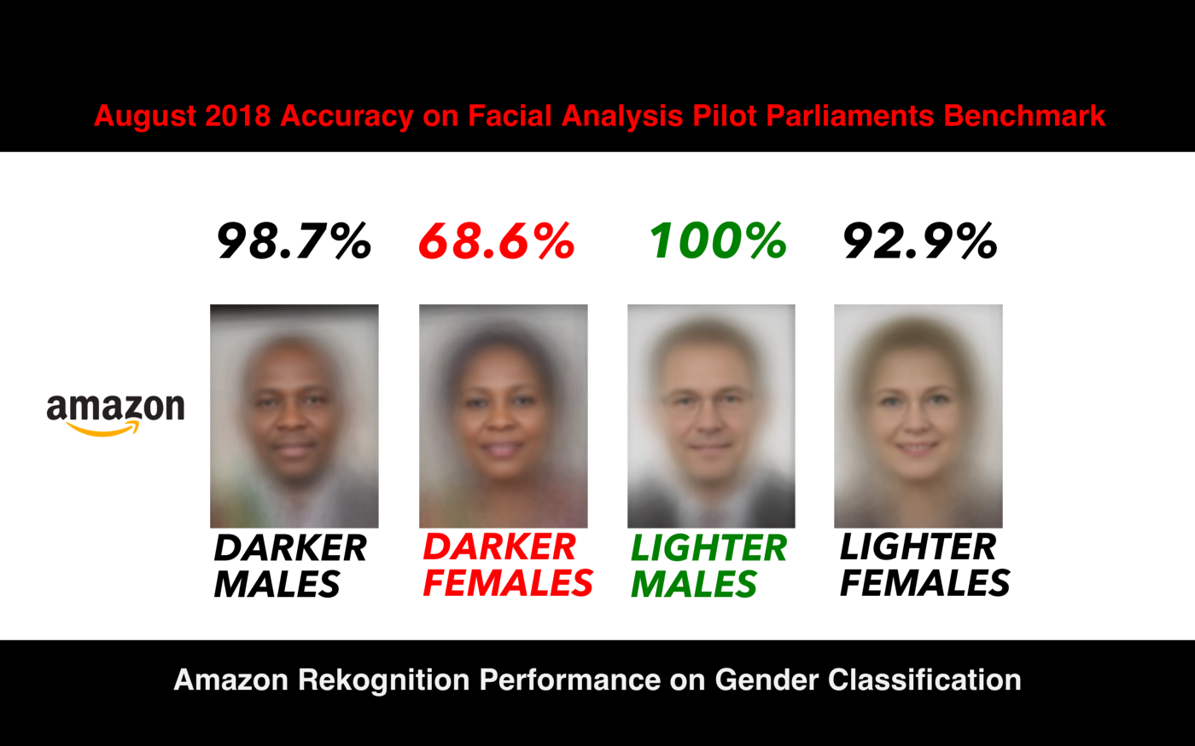
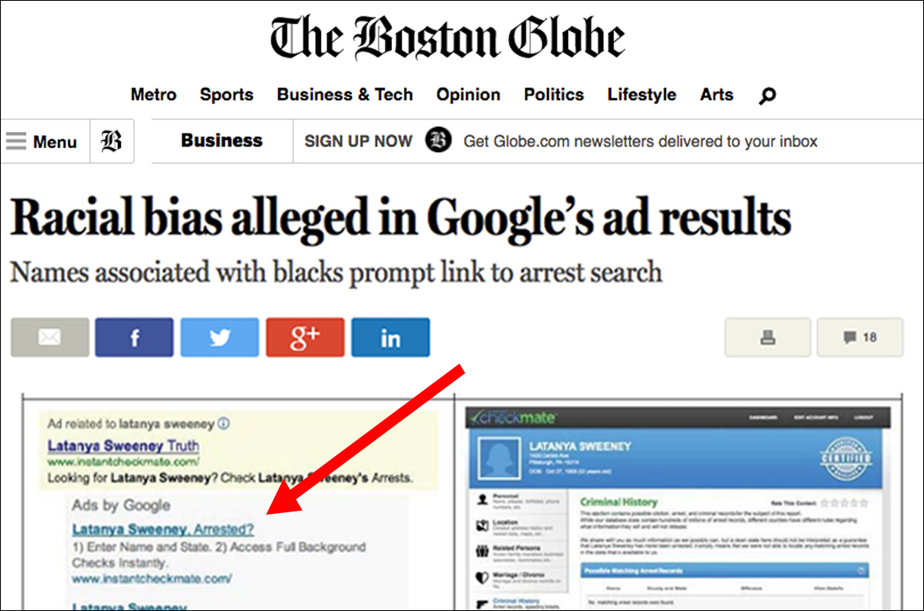
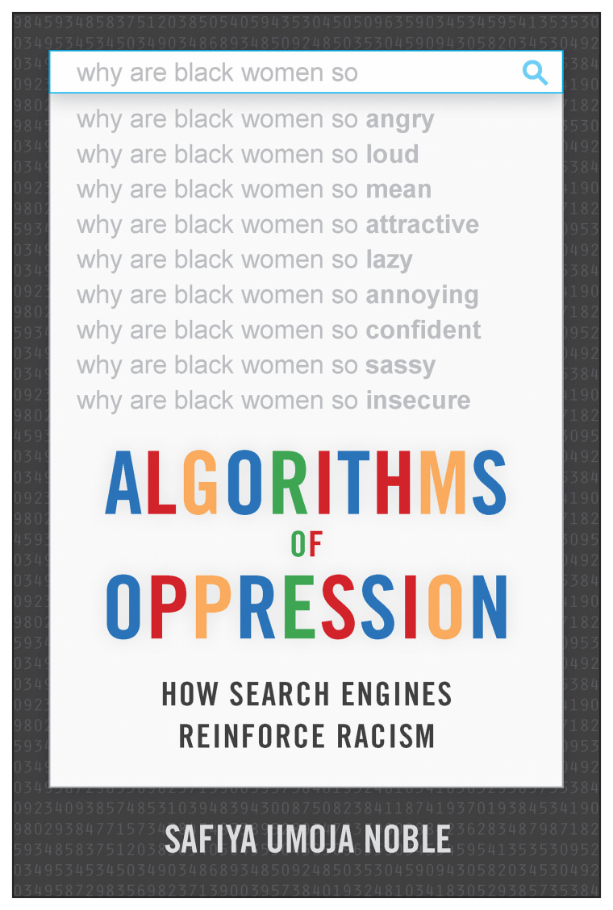
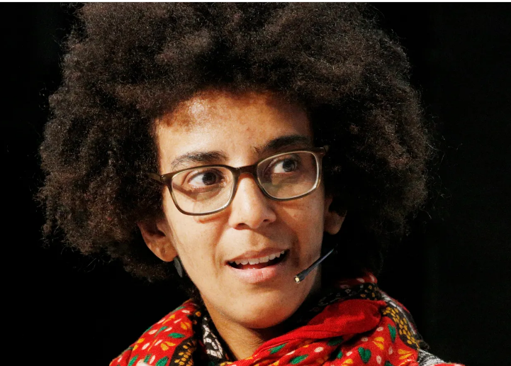

Slide 3
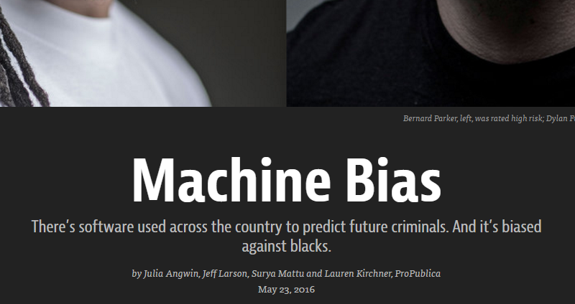
Fairness
Notes:
There are a lot of

Slide 4
What is Compas
“Correctional Offender Management Profiling for Alternative Sanction”
Risk assessment designed for use in
  Pretrial
  Prison
  Parole
Developed by NorthPointe/equivant
  Predict the likelihood of recidivism
Gives a score between 1 and 10

Slide 5
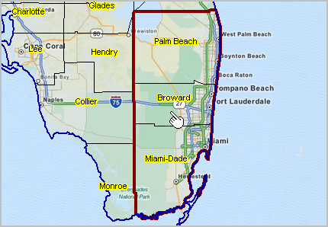
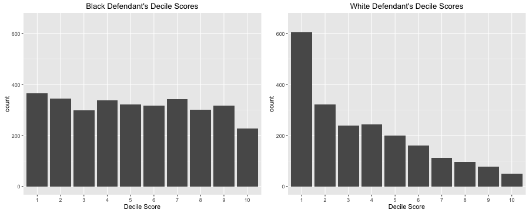
Compas Tool
Pro Publica examined defendants in Broward County, FL

Slide 6
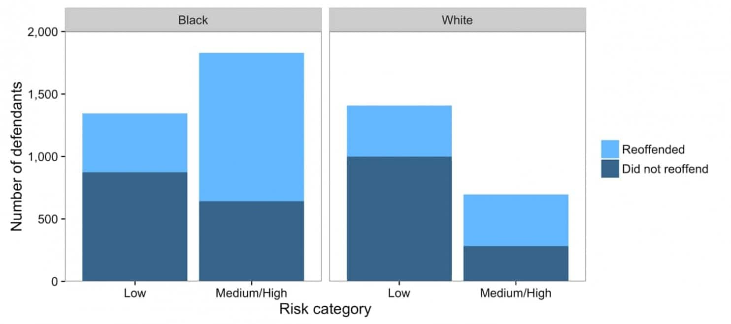

Slide 7

Pro Publica Definition 1
Equal False Positive Rates across groups
$P\left( \hat{y}=1 | y=0, race=Black\right)>P(\hat{y}=1|y=0, race=White)$

Slide 8


Slide 9
False Positive Rate

Slide 10

Pro Publica Fairness Definition 2
Equal False Negative Rates across groups
$P\left( \hat{y}=0 | y=1, race=Black\right)<P(\hat{y}=0|y=1, race=White)$

Slide 12
False Negative Rate

Slide 13

NorthPointe Fairness Definition
Equal Positive Predictive Values across groups (calibrated)
$P\left(y=1\right| \hat{y}=1, race=Black)=P\left(y=1\right| \hat{y}=1, race=White)$

Slide 14


Slide 15
Positive Predictive Value

Slide 16
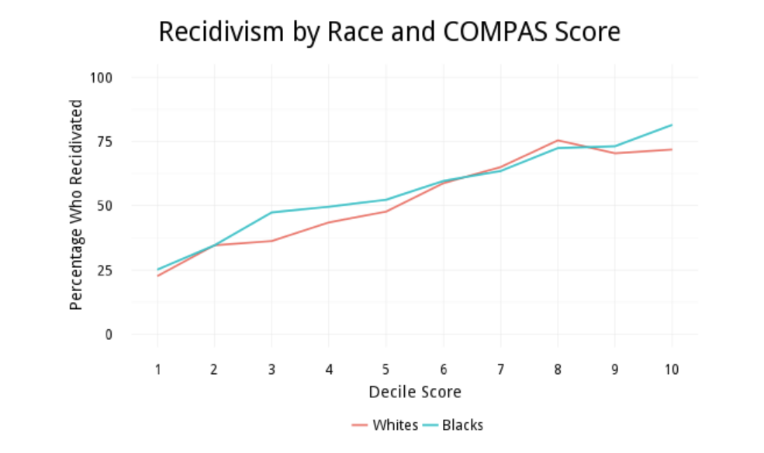

Slide 17
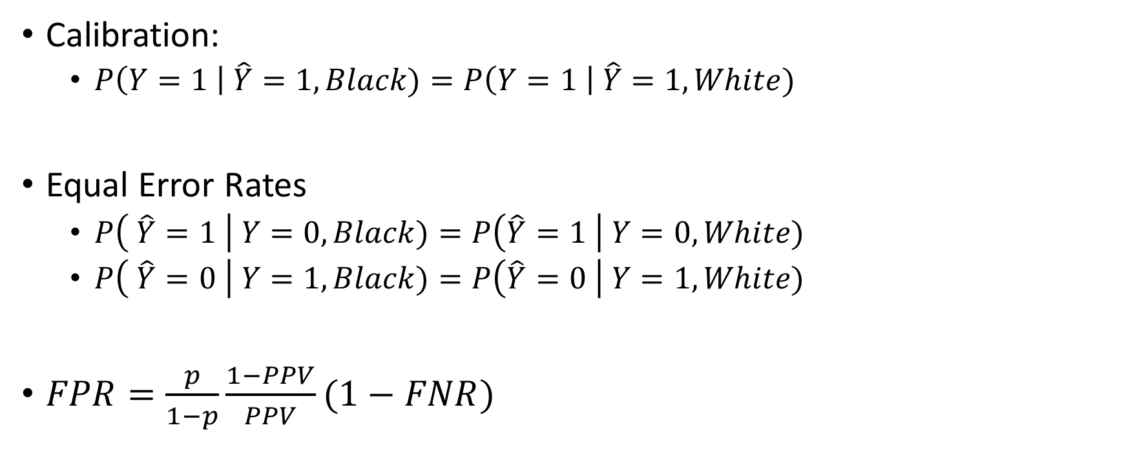
Reasonable Definitions for Fairness
Calibration:
  $P\left(Y=1 \right| \hat{Y}=1, Black)=P\left(Y=1 \right| \hat{Y}=1, White)$
Equal Error Rates
  $P\left( \hat{Y}=1 \right| Y=0, Black)=P\left(\hat{Y}=1 \right| Y=0, White)$
  $P\left( \hat{Y}=0 \right| Y=1, Black)=P\left(\hat{Y}=0 \right| Y=1, White)$
$FPR=\frac{p}{1−p}\frac{1−PPV}{PPV}(1−FNR)$

Slide 18
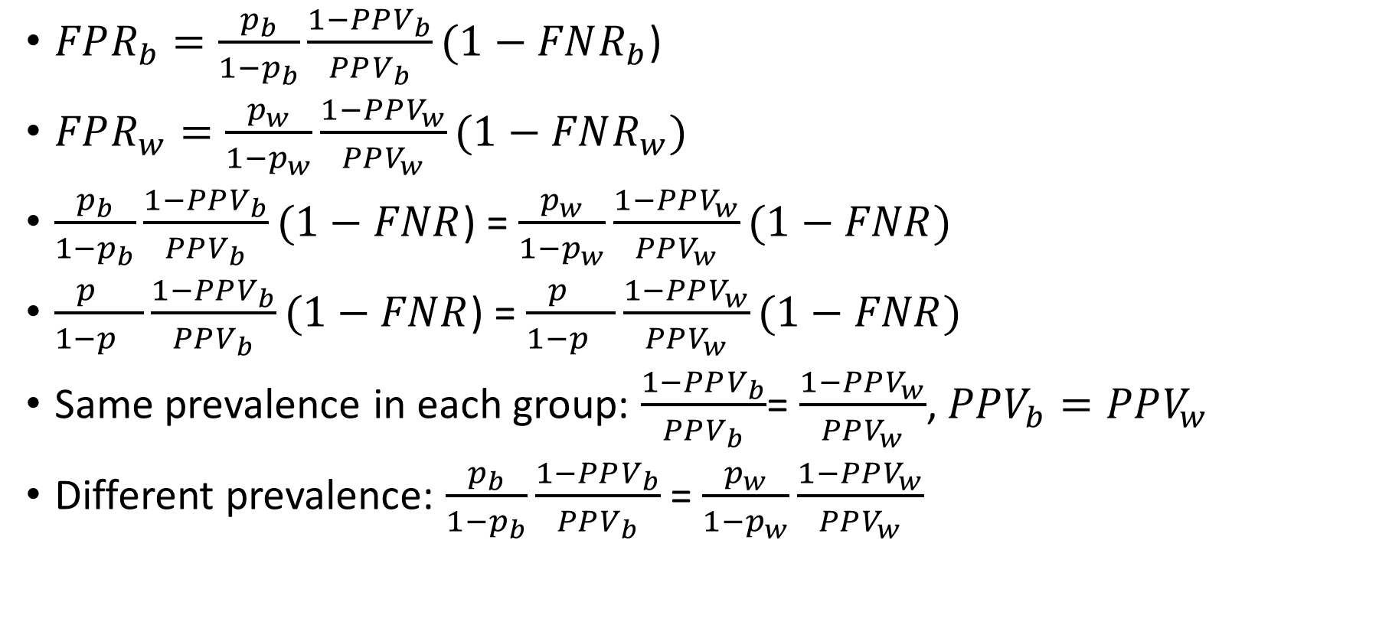
Impossibility
$FPR_{b}=\frac{p_{b}}{1−p_{b}}\frac{1−PPV_{b}}{PPV_{b}}(1−FNR_{b}$)
$FPR_{w}=\frac{p_{w}}{1−p_{w}}\frac{1−PPV_{w}}{PPV_{w}}(1−FNR_{w})$
$\frac{p_{b}}{1−p_{b}}\frac{1−PPV_{b}}{PPV_{b}}(1−FNR$) = $\frac{p_{w}}{1−p_{w}}\frac{1−PPV_{w}}{PPV_{w}}(1−FNR)$
$\frac{p_{}}{1−p_{}}\frac{1−PPV_{b}}{PPV_{b}}(1−FNR$) = $\frac{p_{}}{1−p_{}}\frac{1−PPV_{w}}{PPV_{w}}(1−FNR)$
Same prevalence in each group: $\frac{1−PPV_{b}}{PPV_{b}}$= $\frac{1−PPV_{w}}{PPV_{w}}$, $PPV_{b}=PPV_{w}$
Different prevalence: $\frac{p_{b}}{1−p_{b}}\frac{1−PPV_{b}}{PPV_{b}}$ = $\frac{p_{w}}{1−p_{w}}\frac{1−PPV_{w}}{PPV_{w}}$
Notes:
You can get two out of 3 but not all three.
Algorithms are not going to solve fairness.
Different definitions may be of interest to different stake holders.
For example, from the perspective of defendants, being treated the same if flagged as
Calibration: From a defendant’s point of view

