Slide 1
INST 414: Data Science Techniques Lecture 1 Introduction

Slide 2

About Me
Assistant Professor at the College of Information and Department of Criminology and Criminal Justice
Ph.D. in Computer Science from NYU in 2017
Before UMD:
Research areas:
ML in public policy, particularly criminal justice
Record linkage
Science of science
You can refer to me by:
Professor Jelveh, Dr. Jelveh, or Zubin

Slide 3
What is data science?

Slide 4
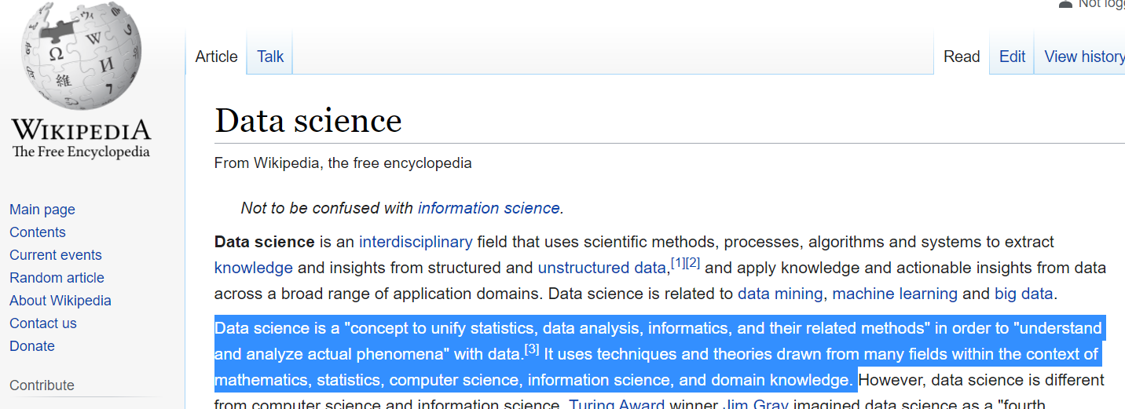
I love Wikipedia, but…

Slide 5
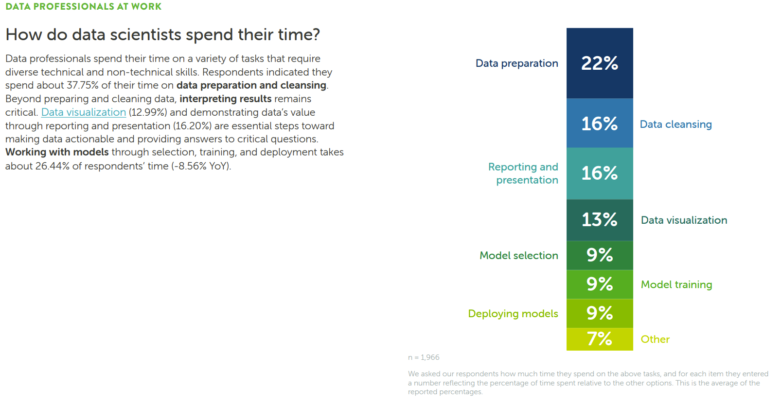
Source: Anaconda State of Data Science Survey (2022)

Slide 6
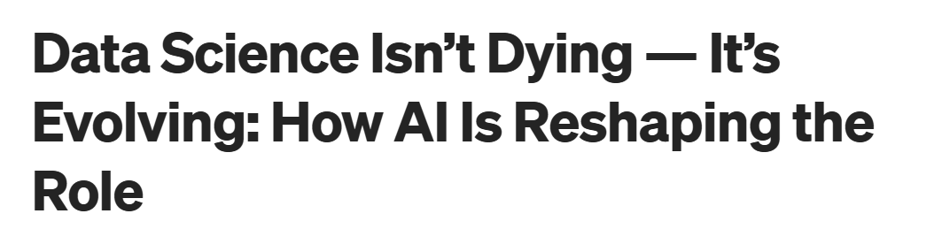

Source:
https://medium.com/data-science-collective/data-science-is-dead-again-why-the-role-keeps-evolving-not-disappearing-21ac8586a22a

Slide 7


Data Science = Prediction
Detect
Facial recognition
License plate readers
Voice recognition
Forecast
Pretrial
Credit Score
Calcium Score
Predictive policing

Slide 8
Detecting Is Much Easier Than Forecasting
Detect
Face Recognition Vendor Test:
False Non-Match Rates ~ $0\%$ error
License plate readers:
Wang et al. (2022) < 1% error
Forecast
Pretrial release:
Kleinberg et al. (2018) – 44% of top risk percentile do not FTA
Shooting victimization:
Heller et al. (2023) – 87% of top 500 are not victims

Slide 9
Logistics
Course content will be posted: https://zjelveh.github.io/teaching/inst414_spring2026

Slide 10
Course Roadmap

Slide 11
Course Roadmap
Predicting a 0-1 outcome
What is the chance that some outcome (rearrest) will happen?
Probability
Marginal, Joint, Conditional probabilities
Bayes Theorem
Weighted Averages / Expected Probabilities

Slide 12
Course Roadmap
Evaluating Algorithms I :
Predictive accuracy
Algorithms
Naïve Bayes
Linear and Logistic Regression
Cross-validation / Hyperparameter Tuning / Bias-variance Tradeoff
Decision Trees
Random Forest / Gradient Boosting
Evaluating Algorithms II
Fairness
Impact

Slide 13
Course Roadmap
Last part of the course:
Text-mining
Vector-space model
What are large language models doing?

Slide 14
What This Course Does Not Cover
Other machine learning approaches:
Social network analysis
Recommendation systems
LLMs

Slide 15
On the Coding Side
Learning Objectives:
Colab Notebooks
Pandas (data manipulation)
Scikit-Learn (ML models)
Seaborn (visualization)
Feature Engineering

Slide 16
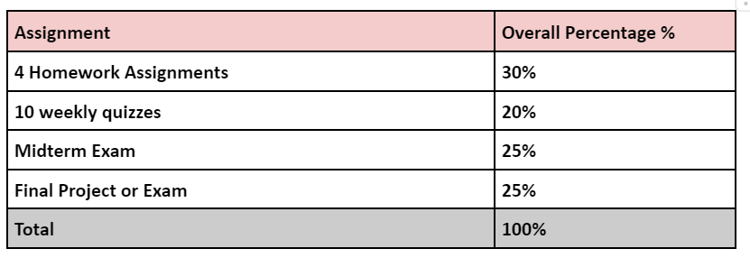
Content + Grading

