Slide 1
INST 414: Data Science Techniques Lab 8 Fairness and the Influence of Base Rates

Slide 2
Fairness + Base Rates
We talk about three measures of fairness:
When defendants from different groups (e.g. race, sex, etc)
Get flagged as high risk, the rate at which they are rearrested should be the same
Equality in Precision/Calibration by race
Are not rearrested, the rate at which they mistakenly get predicted to be high risk should be the same
Equality in False Positive Rates
Are rearrested, the rate at which they mistakenly get predicted to be low risk should be the same
Equality in False Negative Rates

Slide 3
Impossibility
While all three measures seem like reasonable requirements for an algorithm, it is mathematically impossible to have equality between groups for all three measures
Two special case exceptions:
When an algorithm is 100% accurate (which is very rare)
When the prevalence of the outcome (the base rate) is the same between groups
E.g. if the rearrest rate for White and Black was the same

Slide 4
The Influence of Base Rates on Predictions
This impossibility points to the importance of base rates in how algorithms are built

Slide 5
Today’s Lab
Our dataset is 15,000 arrest records.
We will predict two types of rearrest:
Felony (more serious)
Low level (less serious)

Slide 6
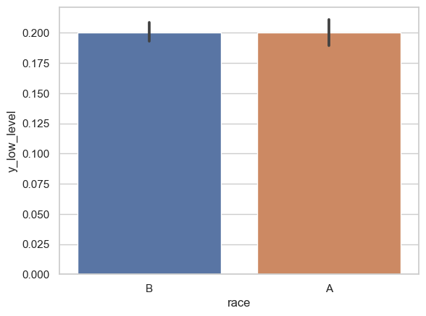
Prevalence by Group
The bar plot on the right shows the low level rearrest rate by group.
We see that group A and B have the same rearrest rates.

Slide 7
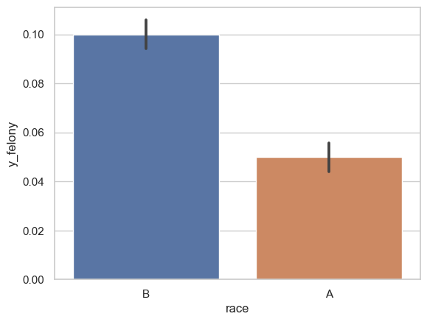
Prevalence by Group
The bar plot on the right shows the felony rearrest rate by group.
We see that the race A has a felony rearrest rate of 5% while race B has a felony rearrest rate of 10%

Slide 8
Predictive Features
In today’s lab, the predictive features have been provided for you an consist of:
Number of (any) arrests in the last 4 years
Number of (any) arrests in the last 1 year
Number of (violent) arrests in the last 4 years
Number of (violent) arrests in the last 1 year
Number of (felony) arrests in the last 4 years
Number of (felony) arrests in the last 1 year

Slide 9
Models to run
You will run four random forest models:
Outcome: Felony rearrest, Features: Prior arrests,
Outcome: Felony rearrest, Features: Prior arrests + Race
Outcome: Low level rearrest, Features: Prior arrests
Outcome: Low level rearrest, Features: Prior arrests + Race

Slide 10
Fairness Metrics
You will then compute these fairness metrics by race
Positive Predictive Value
False Negative Rate
False Positive Rate
(Plus a fourth one called Demographic (or Statistical) Parity)

Slide 11
Pay Attention To
What happens to predicted probabilities when the Race feature is included in the model? Do they go up or down? Is it different between the races? The outcomes being predicted?
What happens to the fairness metrics when the Race features is included in the model? Do the models become more or less fair? Is it different across the outcomes?
Is the fairness qualities of the models different across the outcomes?

