Slide 1
CCJS 699F: Data Science for Criminology
Lab 9
Cross-validation with Scikit-Learn

Slide 2
Running a Prediction Model

Slide 3
Cross-validation
We want our model to perform well out-of-sample
We mimic this by splitting up our data first into two parts:
  Training
  Holdout (ultimate out-of-sample performance measure)
All Data
Train
Holdout

Slide 4

K-fold Cross-validation
Training data:
  We split this up into $k$ folds
Train
Fold 1
Fold 2
Fold 3
Fold 4
Fold 5

Slide 5
K-fold Cross-validation
Training data:
  We iteratively holdout one fold (validation set) and train on the rest.
Validation
Train
Train
Validation
Train
Train
Validation

Slide 6




K-Fold Cross-Validation
For each fold we train the model with many different values of $λ$
Validation
Train
$$λ∈\{.01, .1, 1, …,10, …\}$$
Train
Validation
Train
$$λ∈\{.01, .1, 1, …,10, …\}$$
Train
Validation
$$λ∈\{.01, .1, 1, …,10, …\}$$

Slide 7
Functions for Performing K-Fold CV
We will use the GridSearchCV function
This takes the following parameters:
  estimator = which model to search over (e.g. logistic regression, decision trees, random forest, etc.)
  param_grid = The hyperparameters and associated values to search over
  cv = number of folds (this is the value of K)

Slide 8
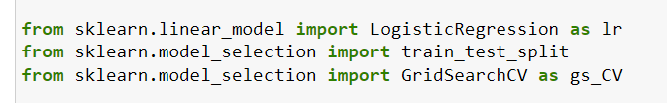
Example Logistic Regression with Ridge
First, load scikit learn functionality we will use

Slide 9
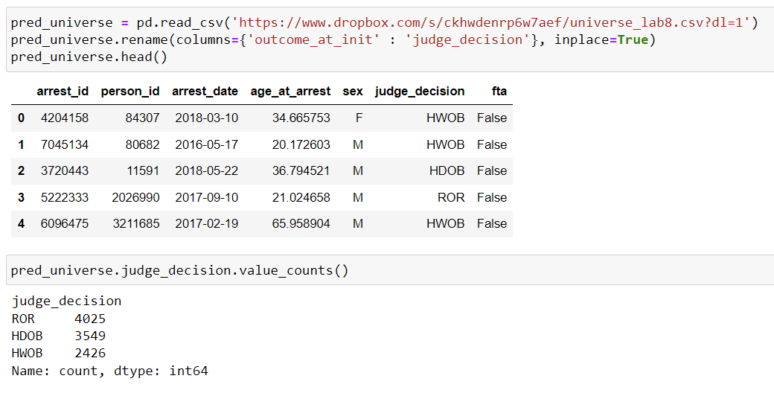
Load Data
This week we will predict whether a defendant will fail to appear at a future court appearance (fta)
We will use the predictors:
  age_at_arrest
  The judge decision at the initial hearing
    ROR – released
    HWOB (Held without bail/detention)
    HDOB (Held on bail)

Slide 10
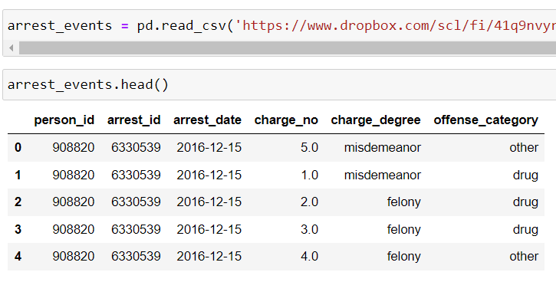
Load Data
We will also create features using the arrest_events table
This version of the table has multiple charges per arrest (indicated by charge_no column)

Slide 11
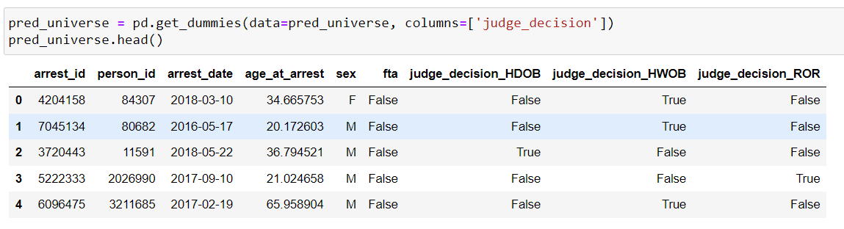
Feature 1 – One-Hot Encode Judge Decision
Use get_dummies

Slide 12
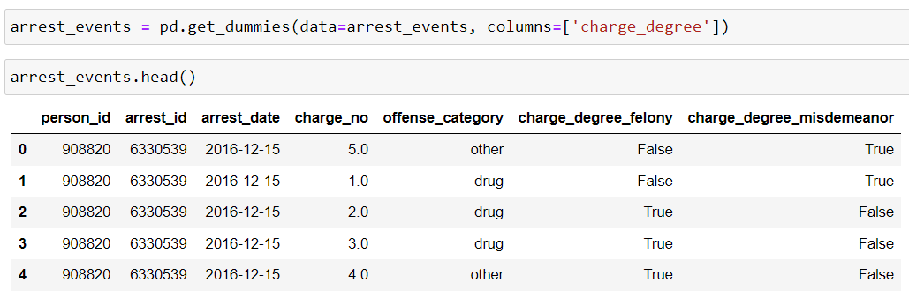
Feature 2 – One-Hot Encode Charge Degree
Step 1: Use get_dummies on charge_degree in arrest_events

Slide 13
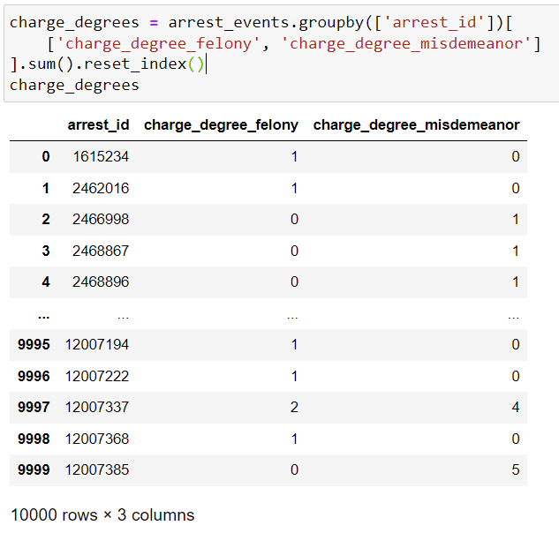
Feature 2 – One-Hot Encode Charge Degree
Step 2: Use groupby on the new columns to count number of felony and misdemeanor charges per arrest
We use reset_index to make the arrest_id a column (instead of an index, which is the default behavior for groupby)

Slide 14
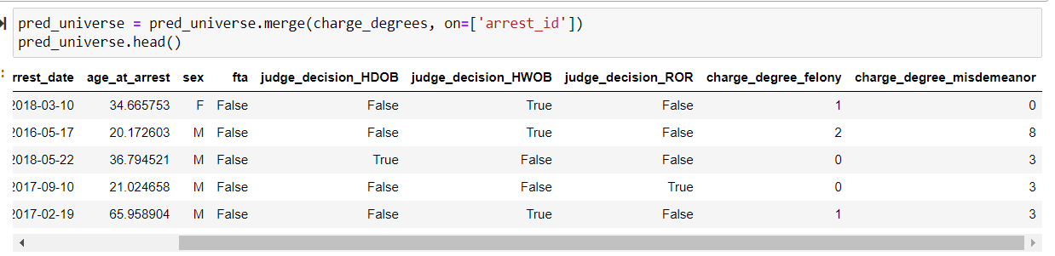
Feature 2 – One-Hot Encode Charge Degree
Step 3: Merge with pred_universe

Slide 15


Running GridSearchCV
Step 1: Create parameter_grid to search over
Step 2: Create train, test split
Step 3: Initialize Logistic Regression model

Slide 16
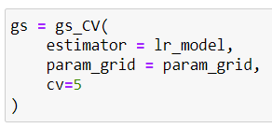
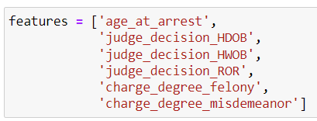
Running GridSearchCV
Step 4: Initialize GridSearchCV
Step 5: Create a list of column names which will be our predictive features

Slide 17

Running GridSearchCV
Step 6: Run the model
Underneath the hood, this is
  Splitting the train set into five folds
  Holding out one fold and running logistic regression on the other 4 folds with C set to 0.1, 1, and 10
  Finding the model with the best average performance across the 5 folds for each C
  Chooses the best model

Slide 18


Running GridSearchCV
Step 7: Find out what value was chosen
  In this case it was C = 0.1 (so the most regularization)
Step 8: Predict for test set

Slide 19
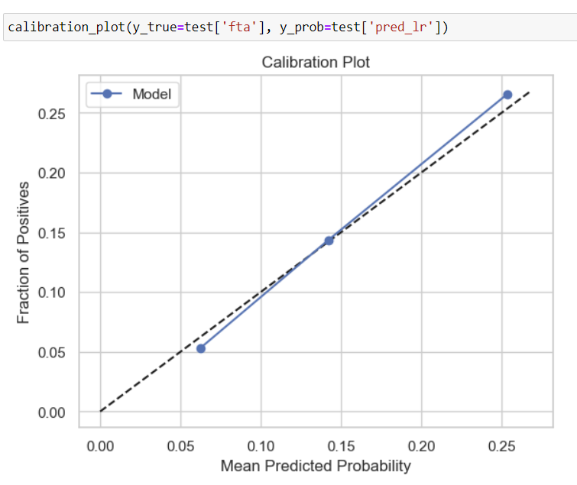
Plot Calibration Curve
There is a function at the top of your notebook which will run create this plot.
How calibrated is the model?

Slide 20
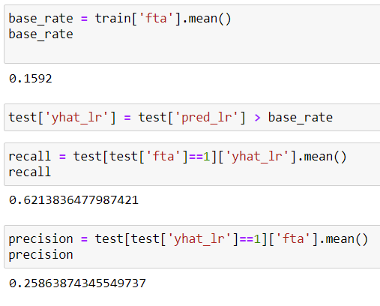
Evaluate Performance
Use the base rate in the training set as the threshold.
Compute recall and precision

Slide 21
Nested Cross-Validation
The process by which an optimal model is chosen using cross-validation is called model selection
After model selection, we do model evaluation on held out data:
With nested cross-validation, we can iteratively treat all of the data as holdout
Train
Holdout

Slide 22
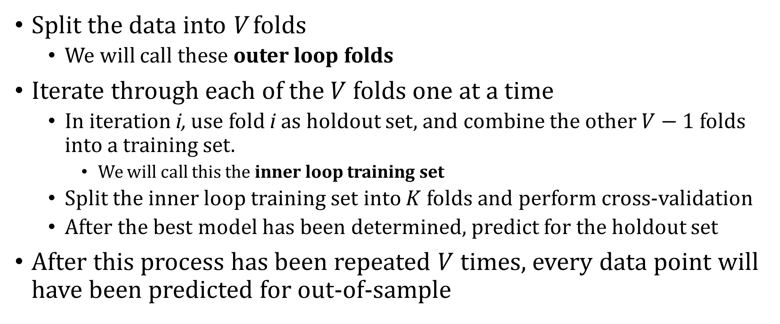
Nested Cross-Validation Procedure
Split the data into V folds
  We will call these outer loop folds
Iterate through each of the $V$ folds one at a time
  In iteration i, use fold i as holdout set, and combine the other $V−1$ folds into a training set.
    We will call this the inner loop training set
  Split the inner loop training set into $K$ folds and perform cross-validation
  After the best model has been determined, predict for the holdout set
After this process has been repeated $V$ times, every data point will have been predicted for out-of-sample

Slide 23
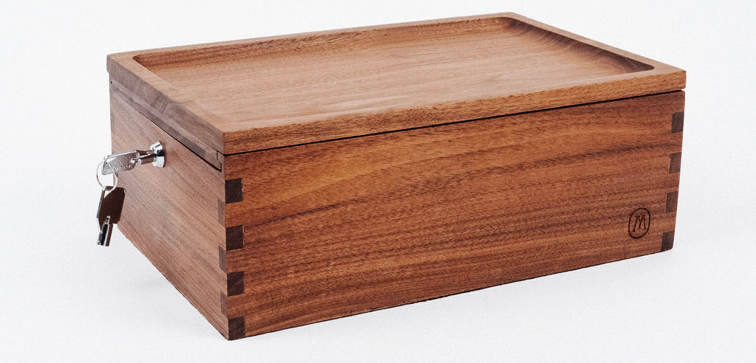
Why Do Nested Cross-Validation?
Benefit:
  Allows for more accurate performance estimates
    Let’s say you have 1,000 data points.
      No nested cv: if holdout set is 20% of full sample, evaluation based on 200 data points.
      With nested cv: evaluation based on all 1,000 data points.
Drawback:
  Risk of over-fitting to the holdout sets if procedure is used many times.
    Separate “Lock-Box” set you use only once after
    model selection

Slide 24
Running Nested CV
Step 1: Similar to GridSearchCV but also need to load cross_val_predict
This will allow us to automatically create out-of-sample predictions instead of doing it manually

Slide 25
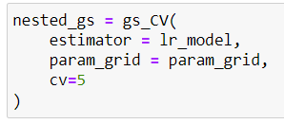
Running Nested CV
Step 2: Initialize GridSearchCV for our inner loop

Slide 26
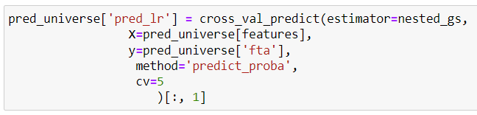
Running Nested CV
Step 3: Run nested CV and generate predictions for all data points
Note:
  We use pred_universe and not train/test (why?)
  The “method” parameter tells cross_val_predict which prediction function to use
  cv parameter defines how many holdout sets to create
  The output of this function is a prediction, so we assign it to pred_lr

Slide 27
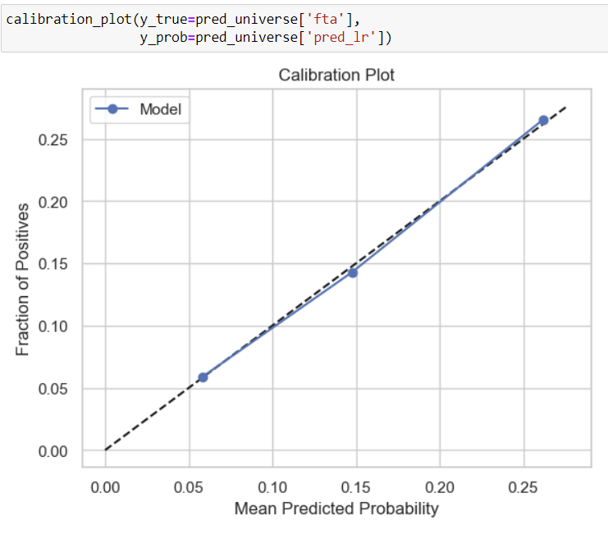
Calibration plot
Slightly more calibrated than previous version.
See notebook for recall and precision values

