Slide 1
INST 414: Data Science Techniques Lab 6 Scikit-Learn

Slide 2


What We Covered Last Time
Feature engineering:
Universe table keeps track of who we are training on/predicting for
Events tables:
We apply transformations to the events table to create features
Merge these features back onto the universe table
Event-level data
(e.g. each arrest).
Has N rows.
Apply a series of transformations/
functions
Person-level data
(e.g. each person).
Has M<N rows.

Slide 3
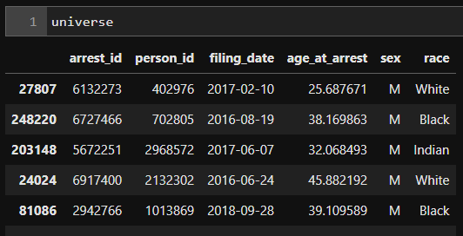
Universe Table
Last time, we worked with the following universe table:
arrest_id: unique identifier for the arrest
person_id: identity of the person who was arrested
filing_date: date of the arrest
sex: sex of the defendant as recorded by police
race: race of the defendant as recorded by police

Slide 4
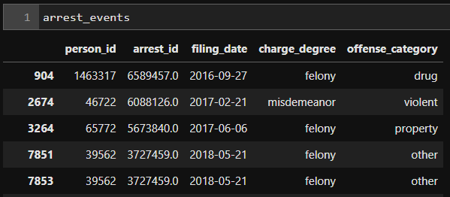
Arrest Events Table
On the right is the events table.
We used information from this table to create features to merge into our Universe table
There are 6,383 rows in this table

Slide 5
We Created Features
charge_degree_felony: Was the current charge a felony
num_arr_last_year: Number of arrests in the last year
num_prop_arr_last_2yrs: Number of property arrests in the last year
offense_category: (Was the current charge one of the type following types)
Drug
Property
Violent

Slide 6
Creating an Outcome
Today we are going train and evaluate our first prediction model.
To do so we need to create an outcome.
The first outcome we will create is whether someone was re-arrested within one year of their current arrest.
So, let’s say someone was arrested on July 5, 2016.
We need to figure out if this person was arrested at any point between July 6, 2016 and July 5, 2017.

Slide 7
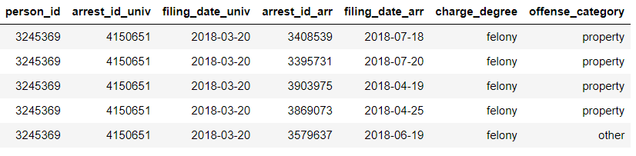
Creating an Outcome
Step 1: Merge the universe and arrest events tables
We only use the relevant columns from the Universe table. Here is the result of the merge:

Slide 8
Creating an Outcome
Step 2: Limit to dates that happened within one year of the current arrest date
We use the between function to look for the right dates
We also use the pd.DateOffSet function to set the beginning and end dates that define “within one year of current arrest”.

Slide 9
Creating an Outcome
Step 3: Use the isin function to create the outcome column in the Universe table
Question: Why does this work?
The baserate of the outcome (or P(outcome_any_arrest=1)) is 43.4%.

Slide 10
Running a Prediction Model

Slide 11

Scikit-Learn
Popular open source machine learning library for Python.
Provides a wide range of algorithms via a consistent interface. Easy to switch between different machine learning models.

Slide 12

Steps for running a model
We first import the model, in this case OLS
We then instantiate an instance of the ols class

Slide 13
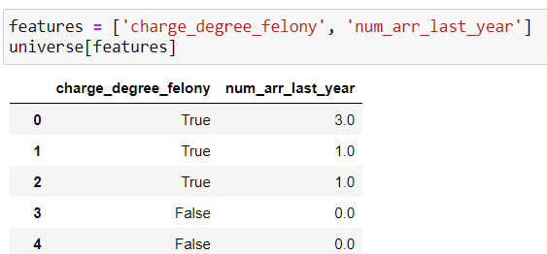
The fit function
In order to run the model, we use the fit function and provide the correct predictors and outcome.
We will use two predictors:
charge_degree_felony
num_arr_last_year

Slide 14
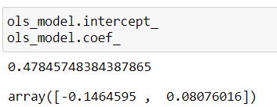
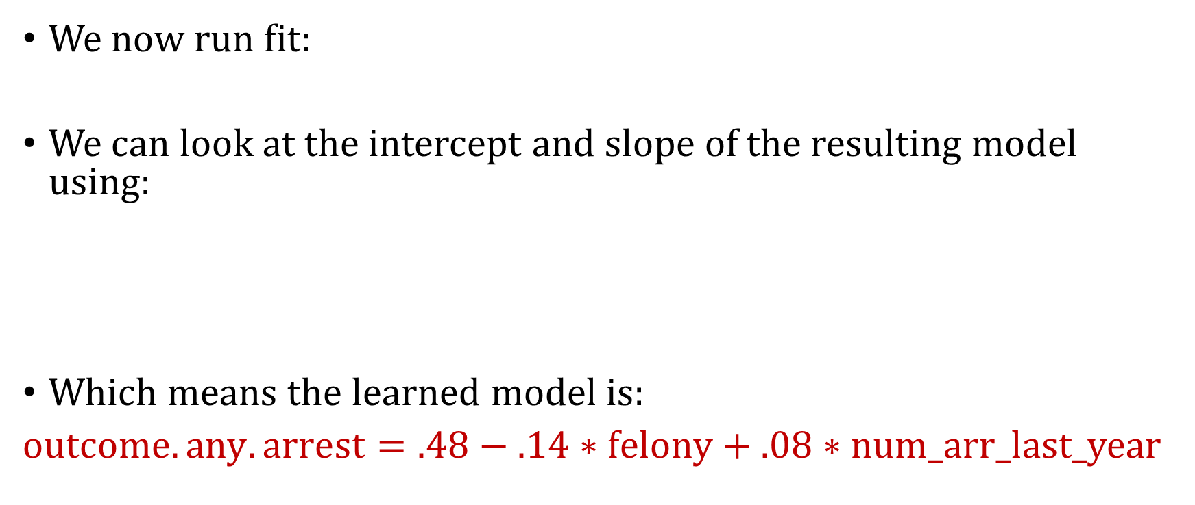
The fit function
We now run fit:
We can look at the intercept and slope of the resulting model using:
Which means the learned model is:
$outcome.any.arrest=.48−.14∗felony+.08∗num_arr$_last_year

Slide 15
The predict function
After fitting the model, we can then use the model to generate predictions.
To do so, we call the predict function and feed it the set of predictors. We assign the outcome to a new column called prediction

Slide 16


Computing performance metrics
First we choose a threshold and then create a yhat column. In this example, the threshold we will use is the baserate of the outcome.
Then we compute TPR:
And PPV:

Slide 17
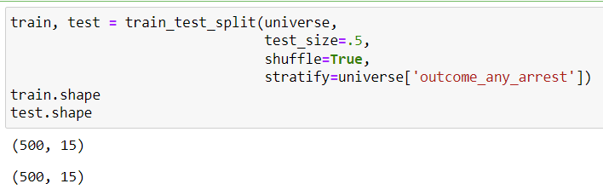
Using train_test_split function
Notice that in the previous example we trained and evaluated on the same data. We will now split into training and evaluation sets.

Slide 18
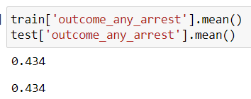
Using train_test_split function
The function takes a DataFrame (universe), the percentage to split by (test_size), whether to shuffle the rows, and whether to stratify.
We stratify on the outcome, which means both train and test will have the same base rates.

Slide 19
Running Logistic Regression
We will also use logistic regression today. The version we will use will do Ridge Regression. In scikit-learn, the Lambda parameter is referred to as C, and it’s 1/Lambda
Larger C means LESS regularization
Smaller C means MORE regularization

Slide 20

Running Ridge Logistic Regression
We first import the model:
When then instantiate the model:
We run it:

Slide 21
Predicting with Logistic Regression
We use the predict_proba function. (So different than OLS).
This function returns two columns, the first is P(outcome=0) and the second is P(outcome=1) (where outcome is outcome_any_arrest). We are interested in the latter.
So when we create the prediction column, we will only grab the second column from the output of predict_proba

Slide 22
Today’s Lab Task
Perform hyperparameter tuning by testing another value for C and decide which one gives better performance
Define a new outcome
Run OLS model with new outcome and more predictors

