Slide 1
INST 414: Data Science Techniques
Lab 5
Feature Engineering for
Event-Based Data

Slide 2
Today’s Lab
New functions
  get_dummies()
  merge()
  fillna()
  to_datetime()
  DateOffset()
  reset_index()
  drop()
First look at feature engineering

Slide 3
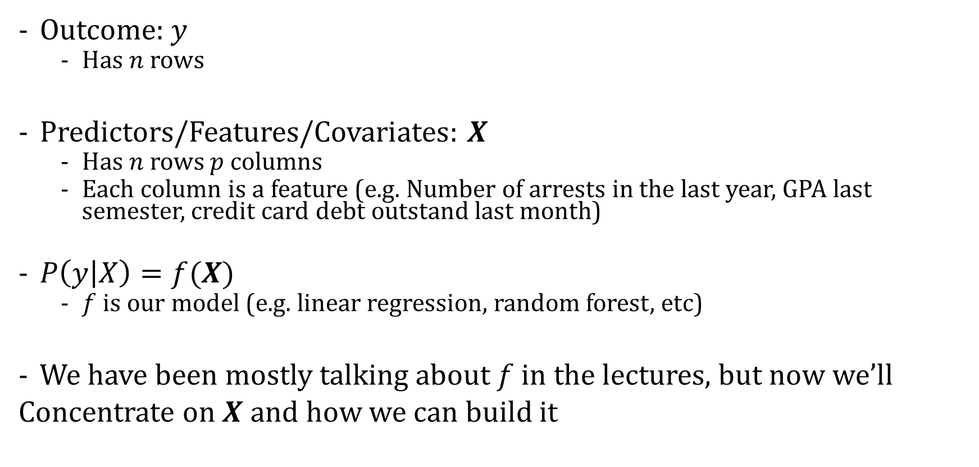
A Prediction Model
Outcome: $y$
  Has $n$ rows
Predictors/Features/Covariates: $X$
  Has $n$ rows $p$ columns
  Each column is a feature (e.g. Number of arrests in the last year, GPA last semester, credit card debt outstand last month)
$P\left(y | X\right)=f(X)$
  $f$ is our model (e.g. linear regression, random forest, etc)
We have been mostly talking about $f$ in the lectures, but now we’ll
Concentrate on $X$ and how we can build it

Slide 4


Typical Feature Engineering Process
Event-level data
(e.g. each arrest).
Has N rows.
Apply a series of transformations/
functions
Prediction-level data
(e.g. each person).
Has M<N rows.

Slide 5
Prediction Time
Scenario: Predicting rearrest during the pretrial hearing
Judge has information about the defendant as of the day of the hearing
Our prediction model will mimic this scenario

Slide 6
Dataset That Is Fed Into the Algorithm
Each row in training data is a defendant’s hearing and contains information as of the time of prediction.
The unit of analysis for our prediction is going to be person AND arrest (why?)
arrest_id | person_id | Current charge violent | Current charge felony | Number arrests last year | Number violent arrests last 2 years | Outcome
125 | AAA | 1 | 1 | 1 | 1 | 1
124 | BBB | 0 | 0 | 2 | 1 | 0
123 | AAA | 0 | 1 | 0 | 0 | 1
126 | CCC | 1 | 0 | 1 | 0 | 0

Slide 7
Three Components
Universe
Features
Outcome
arrest_id | person_id | Current charge violent | Current charge felony | Number arrests last year | Number violent arrests last 2 years | Outcome
123 | AAA | 1 | 1 | 1 | 1 | 1
124 | BBB | 0 | 0 | 2 | 1 | 0
125 | AAA | 0 | 1 | 0 | 0 | 1
126 | CCC | 1 | 0 | 1 | 0 | 0
Today’s lab we will focus on the Universe and Features

Slide 8
Universe
This is the set of entities that you want to predict for.
It is a DataFrame where each row is an entity that gets a prediction.
Examples, predicting:
Re-arrest at the pretrial hearing. Each row is a hearing
Highschool dropout for ninth graders. Each row is a ninth grader
Labor law violations. Each row is a company.

Slide 9
Features
We will talk about two types of predictors
  Information about the current incident. Examples:
    Arrestee’s age
    Charge classes (Felony, Misdemeanor)
    Charges types (Weapons, Property, etc)
    Arrestee’s sex
  Information about the defendant’s history. Examples:
    Total number of arrests
    Total number of violent arrests
    Number of arrests in the last six months
    Number of convictions in the last 4 years
    Number of violent arrests in the last 4 years

Slide 10
Features About Current Incident

Slide 11
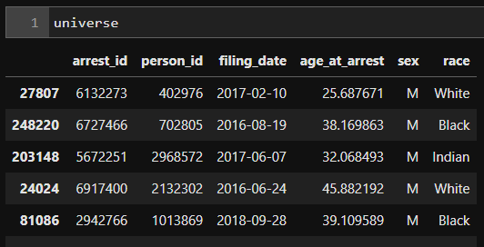
In Today’s Lab
On the right is the universe DataFrame we will be working with.
Each arrest_id represents an arrest for which a judge will decide whether to detain or release a defendant.
So we aim to generate a prediction for each arrest_id here
There are 1,000 rows in the Universe table

Slide 12
Universe Table
The Universe table has information on:
  arrest_id: unique identifier for the arrest
  person_id: identity of the person who was arrested
  filing_date: date of the arrest
  sex: sex of the defendant as recorded by police
  race: race of the defendant as recorded by police

Slide 13
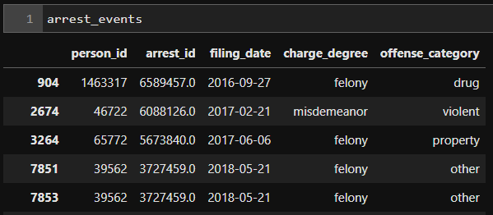
Arrest Events Table
On the right is the events table.
We will use information from this table to create features to merge into our Universe table
There are 6,383 rows in this table

Slide 14
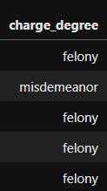
First feature: Charge Type
We will now create a feature that tells us whether the current arrest was a felony or misdemeanor.
We will use the `charge_degree` column
Notice that this is filled with strings:
  `felony` or `misdemeanor`
We are going to create a new column called `charge_degree_felony` which will equal 0 if the charge is a misdemeanor and 1 if the charge is a felony

Slide 15
get_dummies()
To do so, we will use the get_dummies function to perform “one-hot encoding”
One-hot encoding takes a column of categories
  It converts each category into a binary column
  It assigns a True/1 for the value in the corresponding column
This function takes as input
  The events DataFrame
  The column name that we want to encode

Slide 16
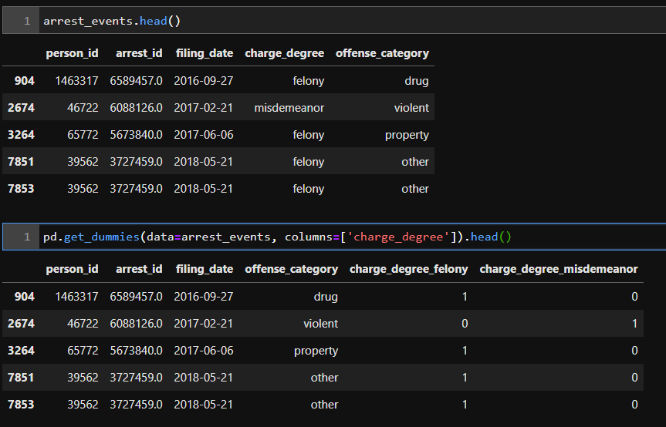
Example
Notice that when we run get_dummies, the ‘charge_degree` column is dropped
In its place are “one-hot” encoded columns

Slide 17
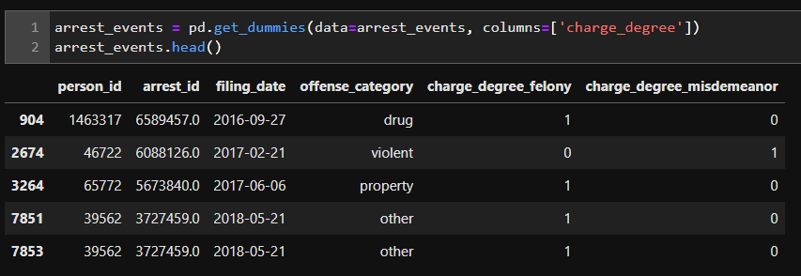
Example
This is the full set of steps.
We call get_dummies and then assign the output back to arrest_events

Slide 18
Merging in Result to Universe Table
Goal: Add the charge_degree_felony column to the Universe table
Note: the reason we don’t add the charge_degree_misdemeanor column is that it is redundant (charge_degree_felony=0 is the same as charge_degree_misdemeanor=1)

Slide 19
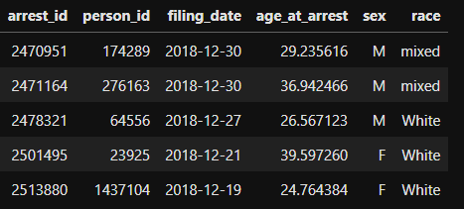
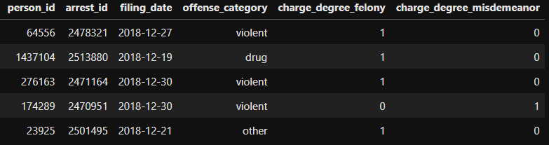
Visually What’s Happening
Universe
Arrest Events
We are going to add the charge_degree_felony column to the Universe table by merging the relevant information from the Arrest Events table
The arrow points from arrest_id = 2470951 in the Arrest Events table to the same arrest_id in the Universe table

Slide 20
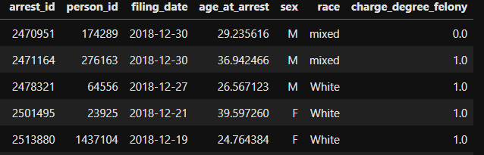
Visually What’s Happening
Universe
Arrest Events
This is what the Universe table will look like after the merge

Slide 21
merge()
The typical syntax for merging DataFrame is:
  merged_df = df_left.merge(right=df_right, on=[‘arrest_id’], how=‘left’)
What the parameters mean:
  right = Name of the DataFrame that will be merged with df_left
  on = The name of the column (or columns) that will uniquely identify the rows in each DataFrame. In this example, it will be ‘arrest_id’
  how = Dictates which rows to keep after the merge
    left – all rows in the left DataFrame, regardless of whether there is a match
    right – all rows in the right DataFrame, regardless of whether there is a match
    inner – only rows in the left DataFrame that match to rows in the right DataFrame
    outer – all rows in both DataFrames regardless of whether the match

Slide 22
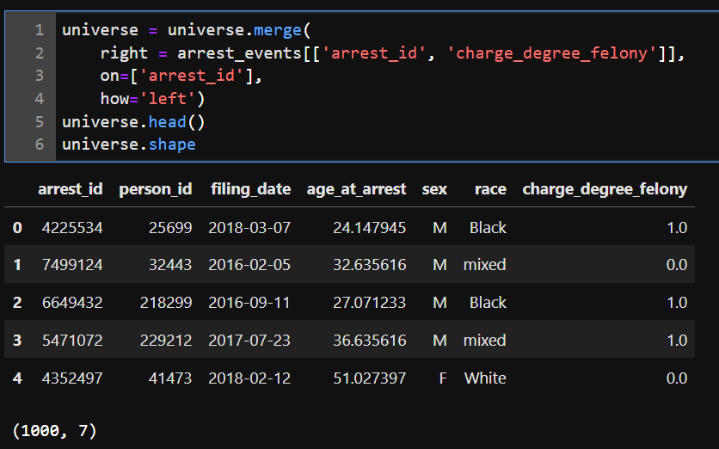
Code
Notice that we are only using the relevant columns from arrest_events
Also notice that the number of rows does not change after the merge (1,000)
This last point is critical.
  The number of rows in the Universe table should not change
  Why?

Slide 23
Prior-History Based Features

Slide 24
Features based on prior history
Now let’s add a feature that is the number of arrests for a defendant in the Universe table that happened in the last year.

Slide 25
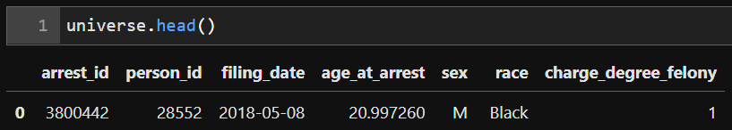
Our Goal
Identify the arrests that happened BEFORE the filing_date in the Universe table, and AFTER one year before the filing_date
So for the person_id above, we want to find arrests in the Arrest events table that happened between 2017-05-08 to 2018-05-07

Slide 26
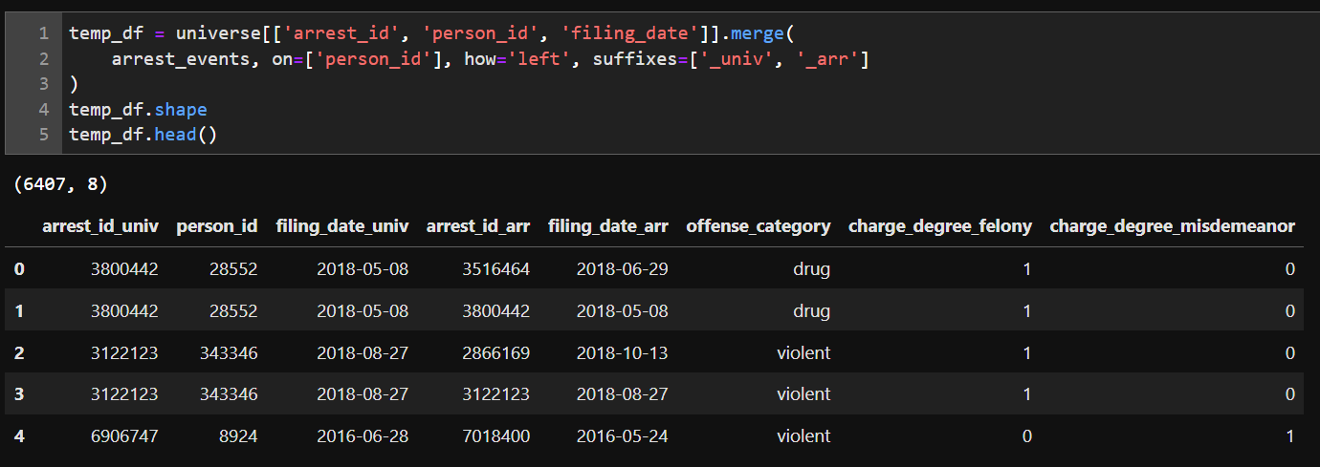
Step 1
This is a multi-step process, so we will create a temporary DataFrame as we construct the feature.
Merge arrest_events table into the Universe table

Slide 27
Step 1
Notice: We are using the suffixes parameter. If there are duplicated column names in both DataFrames, suffixes will add a user-defined suffix to the column names in the left and right DataFrames.

Slide 28
Step 1
The duplicated column names are arrest_id and filing_date
Here we are using [‘_univ’, ‘_arr’] which will add ‘_univ’ to the end of the duplicated names from the Universe table and ‘_arr’ for the Arrest events table

Slide 29
Step 2: Drop Invalid Rows
We want to keep rows where the `filing_date_arr’ is less than ‘filing_date_univ’. (Why?)
So we will drop these rows

Slide 30
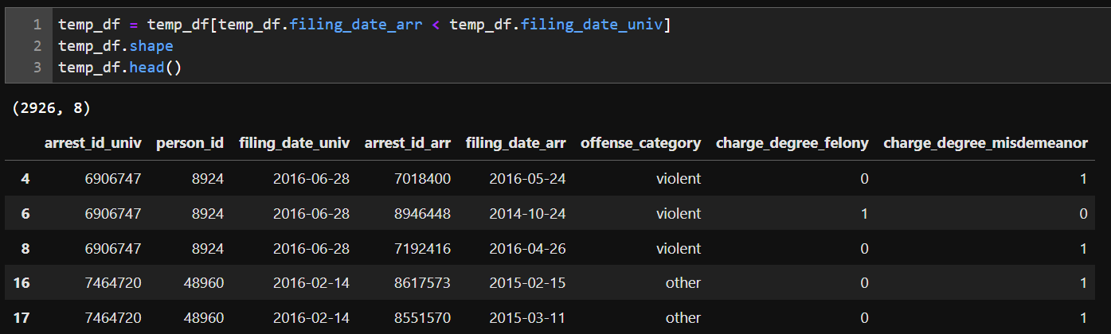
Step 2: Drop Invalid Rows
We have kept 2,926 rows

Slide 31
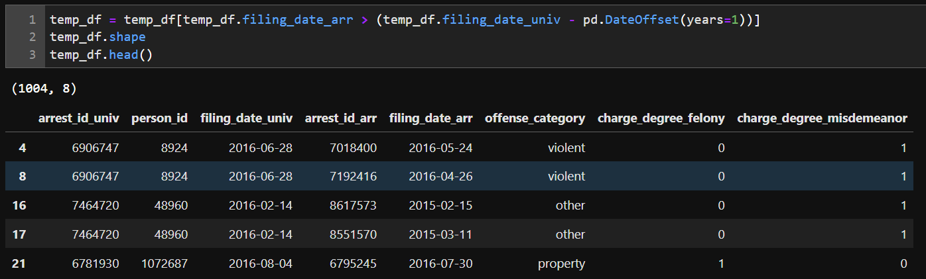
Step 2: Drop Invalid Rows
Now we will keep rows where the filing_date_arr is within one-year of filing_date_univ.
To do so, we use pd.DateOffset(years=1) to subtract one year from filing_date_univ

Slide 32
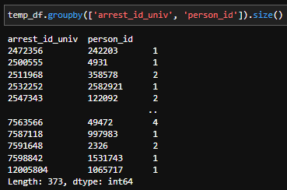
Step 3: Count Number of Arrests for each person-arrest
To do this, we groupby arrest_id_univ and person_id, which gives us a DataFrame for each person-arrest.
We then call size(), which tells us the number of rows in each DataFrame (this is the number of arrests for that person at focal arrest)
However, the result is a Series, and we need a DataFrame in order to merge it in with the Universe table

Slide 33
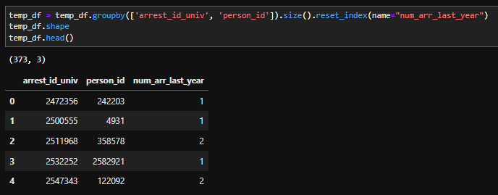
Step 3: Count Number of Arrests for each person
Therefore, we use the reset_index() function, which gives us a DataFrame.
The name parameter allows us to name the column name in the resulting DataFrame

Slide 34
Step 4: Merge back into the Universe
Now we have what we want:
  The number of arrests for each person in the Universe Table (well almost)
There are 1,000 rows in the Universe Table
There are 375 rows in the DataFrame on the previous slide
What does this mean?
  That the other people did not have an arrest in the year prior to their current arrest
  This will matter when we do the merge

Slide 35
Step 4: Merge back into the Universe
Additionally, we’ll have to consider the following when doing the merge:
We want to know the number of arrests in the last year for a particular person-arrest.
In the universe DataFrame, the arrest_id column is unique for each person-arrest
In the temp_df DataFrame, the arrest_id_univ column holds the same information.
So we are going to use the left_on and right_on parameter when we merge

Slide 36
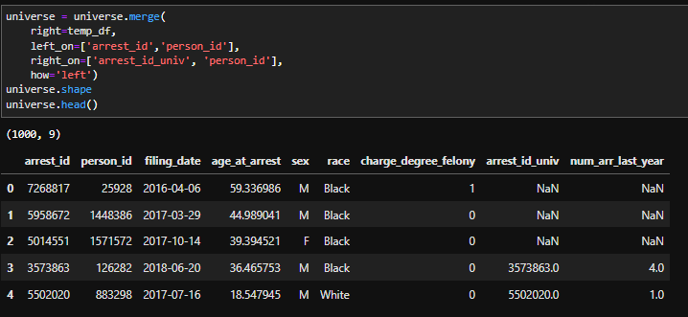
Step 4: Merge back into the Universe
left_on refers to the matching columns in the left DataFrame (universe)
right_on refers to the matching columns in the right DataFrame (temp_df)
We still use how=“left”, so that every person in the Universe table is still there after the merge. (even though there is not a corresponding arrest_id_univ in temp_df)
Note, strictly speaking, we don’t need to use person_id here (why?), but we use it here to reinforce that this is a prediction for a person at a particular arrest.

Slide 37
Step 4: Merge back into the Universe
The people who are in universe but are not in temp_df will get a null value (NaN) in the num_arr_last_year column.
Since this is a count, we can just replace it with a zero

Slide 38
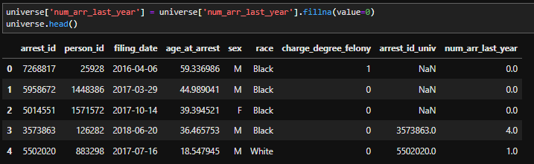
Step 5: Fill NAN with 0s
We use the fillna() function on num_arr_last_year and replace null values with zero.
Notice that we are assigning this back to num_arr_last_year

Slide 39
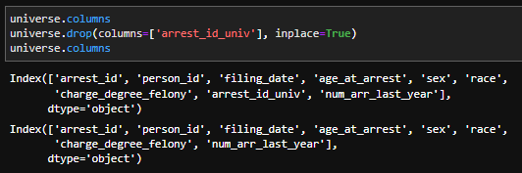
Step 6: Drop Column We Don’t Need
The merge resulted in the universe DataFrame having:
  arrest_id column (this was always there)
  arrest_id_univ column (from the temp_df DataFrame).
We no longer need arrest_id_univ so we are going to drop it (using the drop function)

