Slide 1
INST 414: Data Science Techniques
Lab 4
Performance Metrics, Naïve Bayes

Slide 2
Today’s Session
Computing Performance Metrics:
  Introduce:
    sort_values functionality of pandas
    map function
    between function
Using Naïve Bayes to Predict

Slide 3
Computing Performance Metrics

Slide 4
The Dataset
A sample of 10,000 records from a dataset covering arrests made in Maryland between 2013 and 2019.
This data contains predictions for 1-year violent rearrest using a machine learning model (random forest)
The data also contains information on a defendant’s age, and past conviction and arrest records.
  A conviction is an arrest that was found to be guilty

Slide 5
Performance Metrics
We will use the DataFrame methods that we have been practicing to compute performance metrics (i.e. conditional probabilities)
TPR
PPV

Slide 6
New Functions

Slide 7
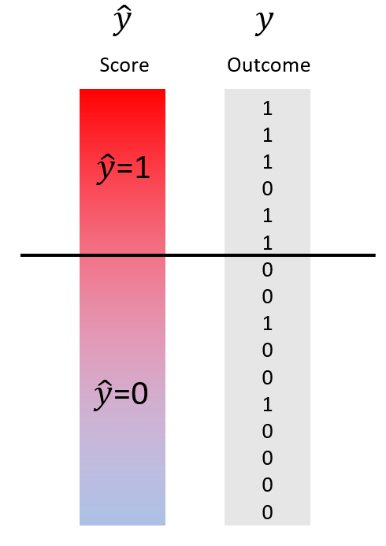
sort_values() function
Sometimes we want to sort a dataframe by the values of one (or more columns)
For example, left column in the image on right is sorted from highest predicted risk to lowest predicted risk

Slide 8
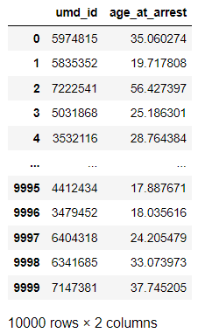
sort_values() function
To do so, we use the sort_values function on the DataFrame.
We have a DataFrame on the right with two columns:
  Umd_id : unique identifier
  Age_at_arrest
We will sort the DataFrame by age

Slide 9
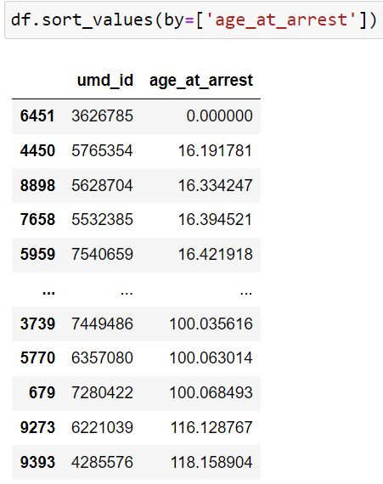
sort_values() function
Notice that by default, the DataFrame is sorted from lowest value to highest value
We can sort from highest to lowest by using the “ascending” parameter, which has a default value of True

Slide 10
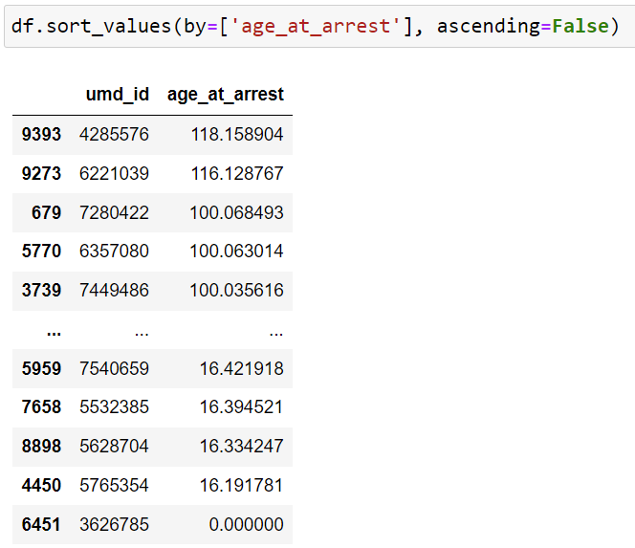
sort_values() function
We change it to ascending=False

Slide 11
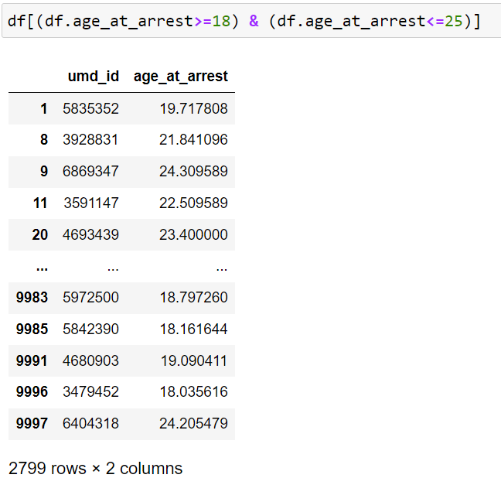
between() function
Sometimes we want to know what rows lie between two numbers.
We can use logical conditioning to do this.
Code to the right limits the DataFrame to rows where the age_at_arrest is between 18 and 25

Slide 12
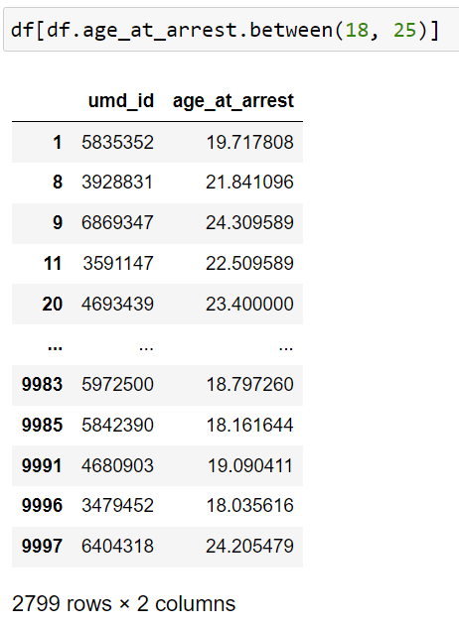
between() function
We can use the between function to accomplish the same thing

Slide 13
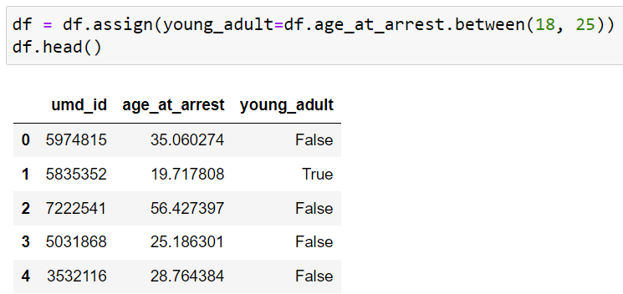
map() function
Sometimes we want to change the values in a column to new values.
Common use case is converting True/False to 1/0s
Or change categorical strings: E.g. “M” to “Male”, “F” to “Female”, etc
Code below first creates a new column

Slide 14
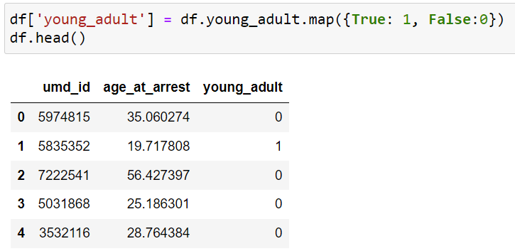
map() function
Now we will use the map function to convert True/False to 1/0.

