Slide 1
INST 414: Data Science Techniques
Lab 3
Groupby

Slide 2
Today’s Session
Introduce:
  groupby functionality of pandas
  apply function
  lambda keyword

Slide 3
Recap of Last Week

Slide 4


Computing Conditional Probabilities
We went through three different ways of computing:
$$P(survived=1|pclass=1)$$

Slide 5

Method 1: Using Probabilities
$$P\left(survived=1 | pclass=1\right)=\frac{P\left(survived=1, pclass=1\right)}{P(pclass=1)}$$

Slide 6
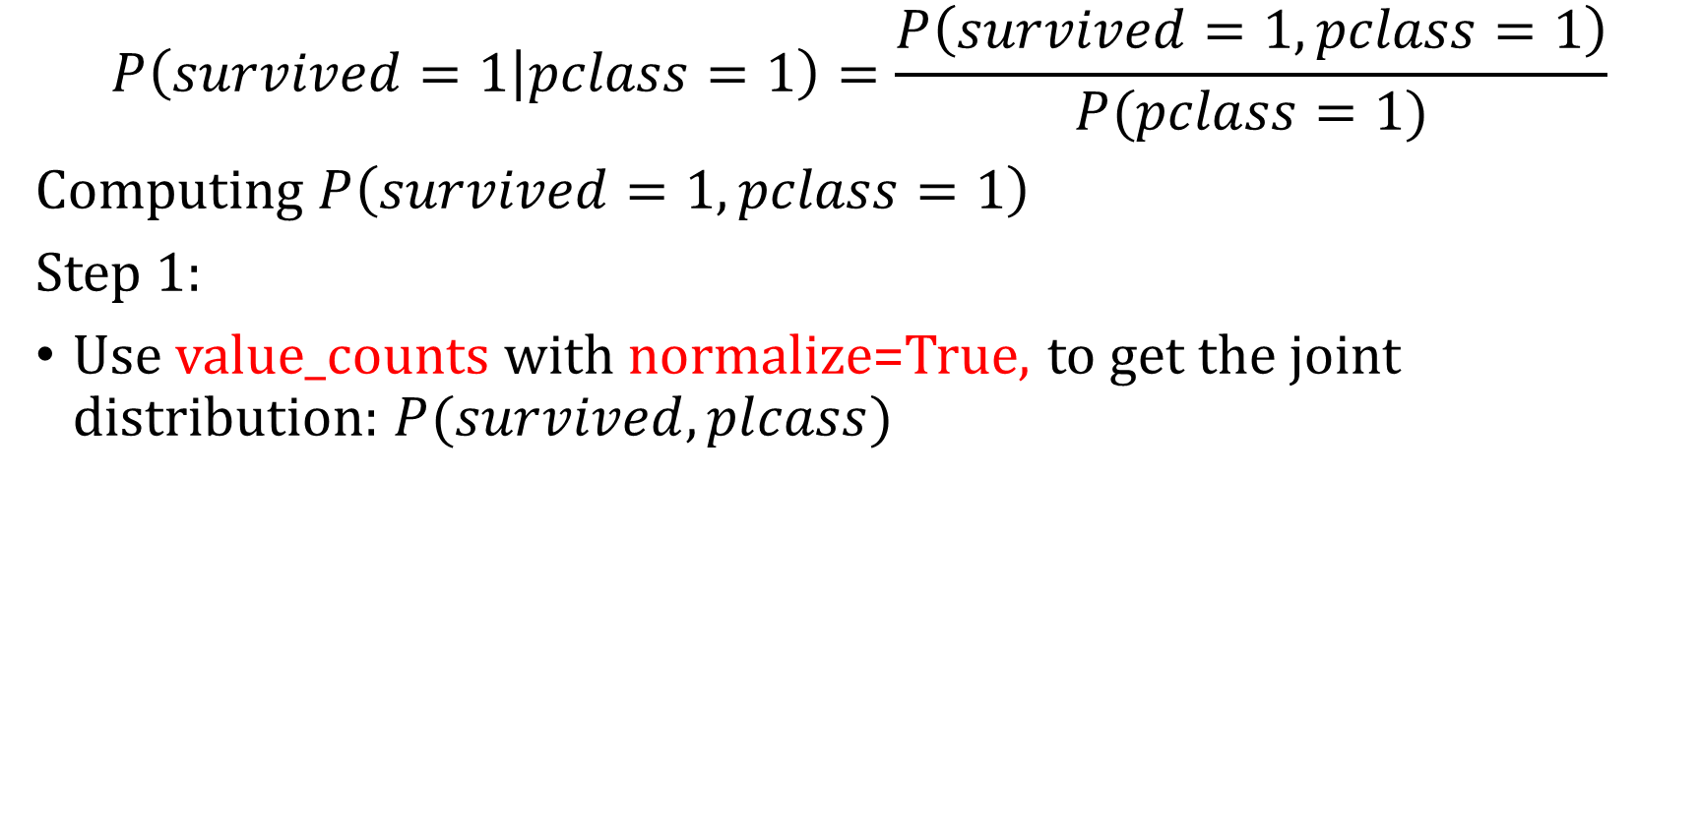
Method 1: Compute Numerator
$$P\left(survived=1 | pclass=1\right)=\frac{P\left(survived=1, pclass=1\right)}{P(pclass=1)}$$
Computing $P\left(survived=1, pclass=1\right)$
Step 1:
Use value_counts with normalize=True, to get the joint distribution: $P(survived, plcass)$

Slide 7
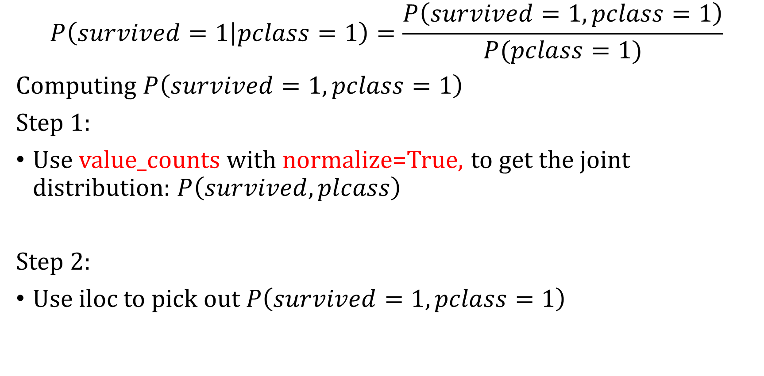
Method 1: Compute Numerator
$$P\left(survived=1 | pclass=1\right)=\frac{P\left(survived=1, pclass=1\right)}{P(pclass=1)}$$
Computing $P\left(survived=1, pclass=1\right)$
Step 1:
Use value_counts with normalize=True, to get the joint distribution: $P\left(survived, plcass\right)$
Step 2:
Use iloc to pick out $P\left(survived=1, pclass=1\right)$

Slide 8
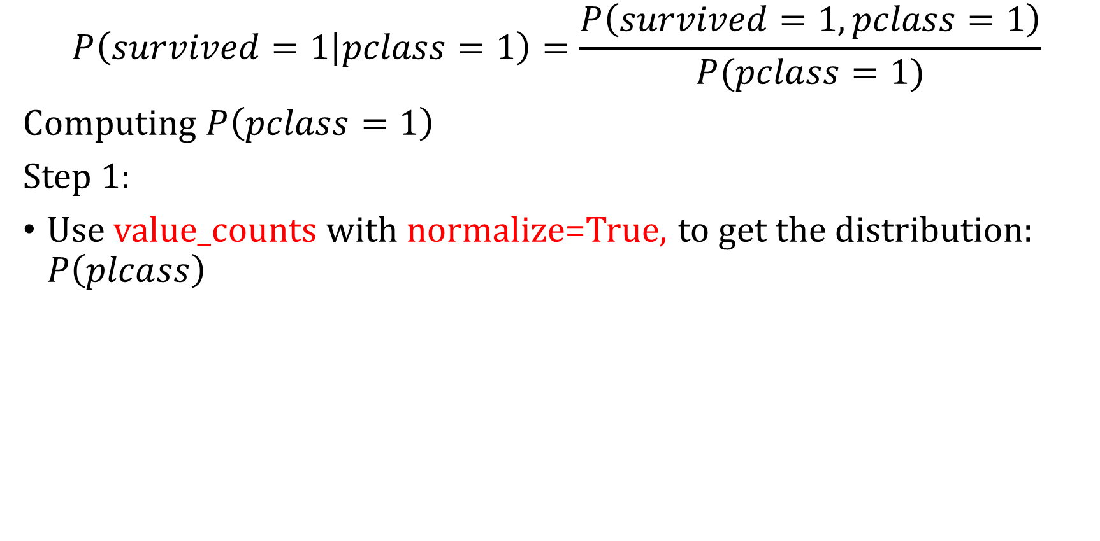
Method 1: Compute Denominator
$$P\left(survived=1 | pclass=1\right)=\frac{P\left(survived=1, pclass=1\right)}{P(pclass=1)}$$
Computing $P\left(pclass=1\right)$
Step 1:
Use value_counts with normalize=True, to get the distribution: $P\left(plcass\right)$

Slide 9
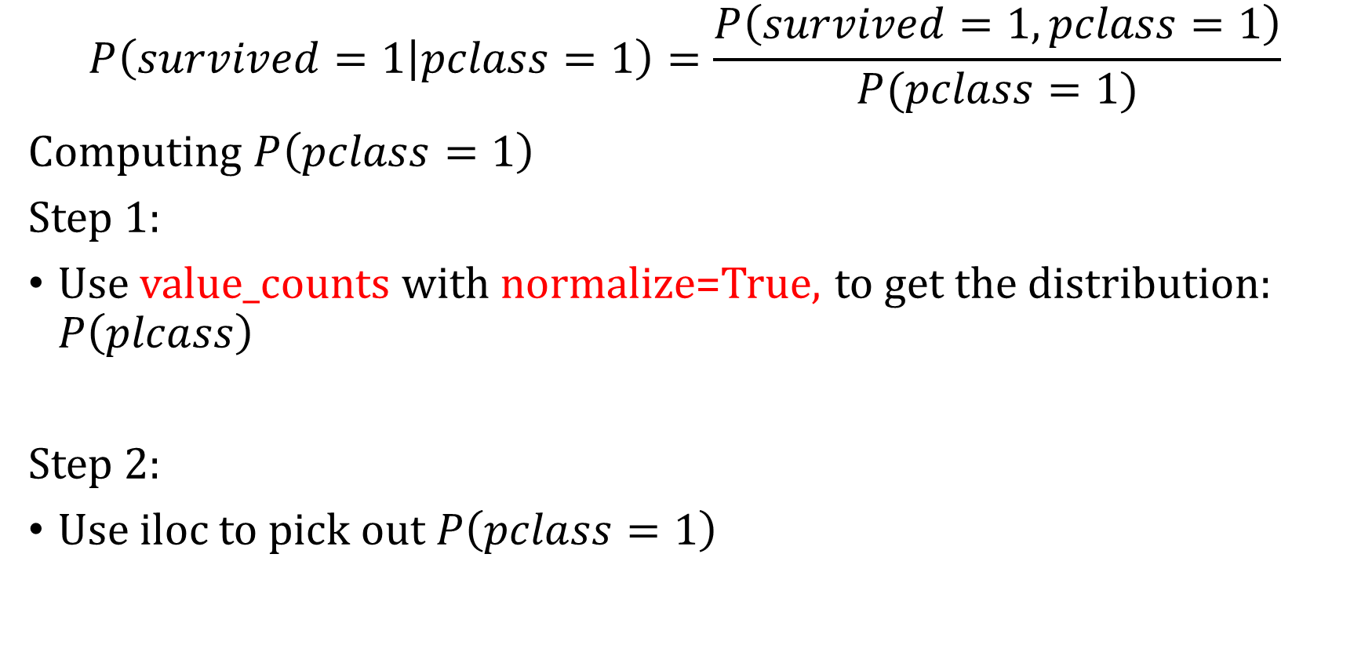
Method 1: Compute Denominator
$$P\left(survived=1 | pclass=1\right)=\frac{P\left(survived=1, pclass=1\right)}{P(pclass=1)}$$
Computing $P\left(pclass=1\right)$
Step 1:
Use value_counts with normalize=True, to get the distribution: $P\left(plcass\right)$
Step 2:
Use iloc to pick out $P\left(pclass=1\right)$

Slide 10

Method 1: Final Step
$$P\left(survived=1 | pclass=1\right)=\frac{P\left(survived=1, pclass=1\right)}{P(pclass=1)}$$
Divide $P(survived=1, pclass)$ by $P\left(pclass=1\right)$

Slide 11

Method 2: Use counts
$$P\left(survived=1 | pclass=1\right)=\frac{Num of passengers in pclass 1 who survived}{Num of passengers in pclass 1}$$
Step 1:
Numerator: Use logical filtering and shape to get the number of passengers in pclass 1 who survived

Slide 12
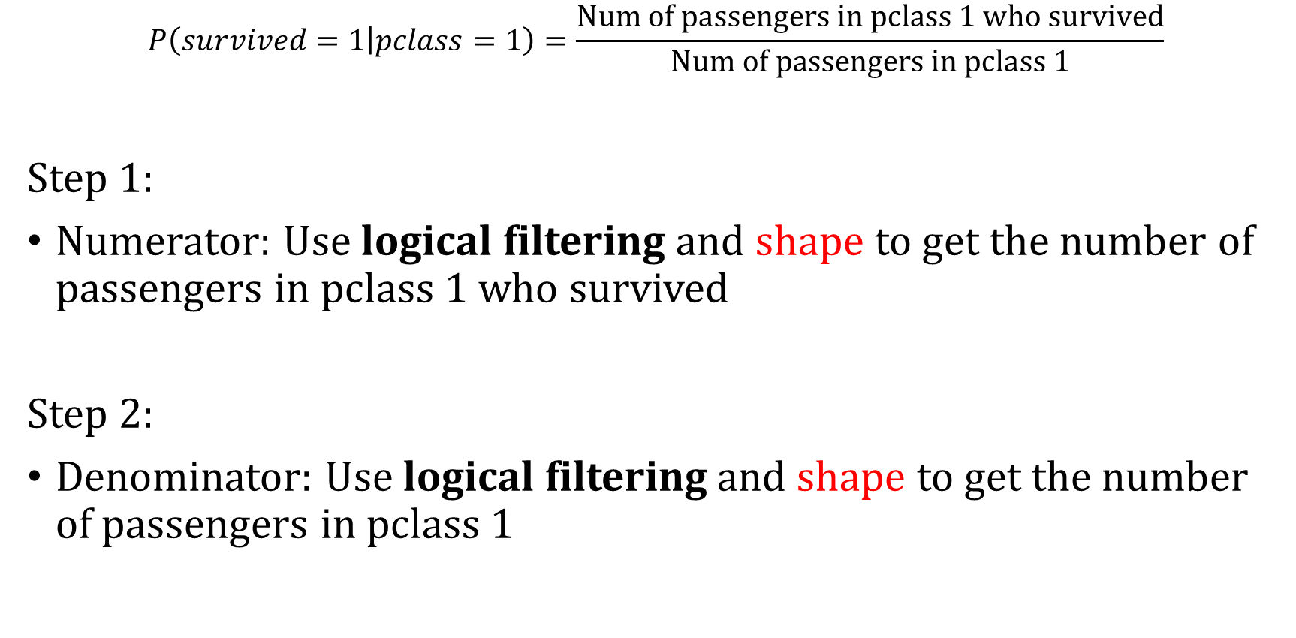
Method 2: Use counts
$$P\left(survived=1 | pclass=1\right)=\frac{Num of passengers in pclass 1 who survived}{Num of passengers in pclass 1}$$
Step 1:
Numerator: Use logical filtering and shape to get the number of passengers in pclass 1 who survived
Step 2:
Denominator: Use logical filtering and shape to get the number of passengers in pclass 1

Slide 13

Method 2: Final Step
$$P\left(survived=1 | pclass=1\right)=\frac{Num of passengers in pclass 1 who survived}{Num of passengers in pclass 1}$$
Divide numerator by denominator

Slide 14
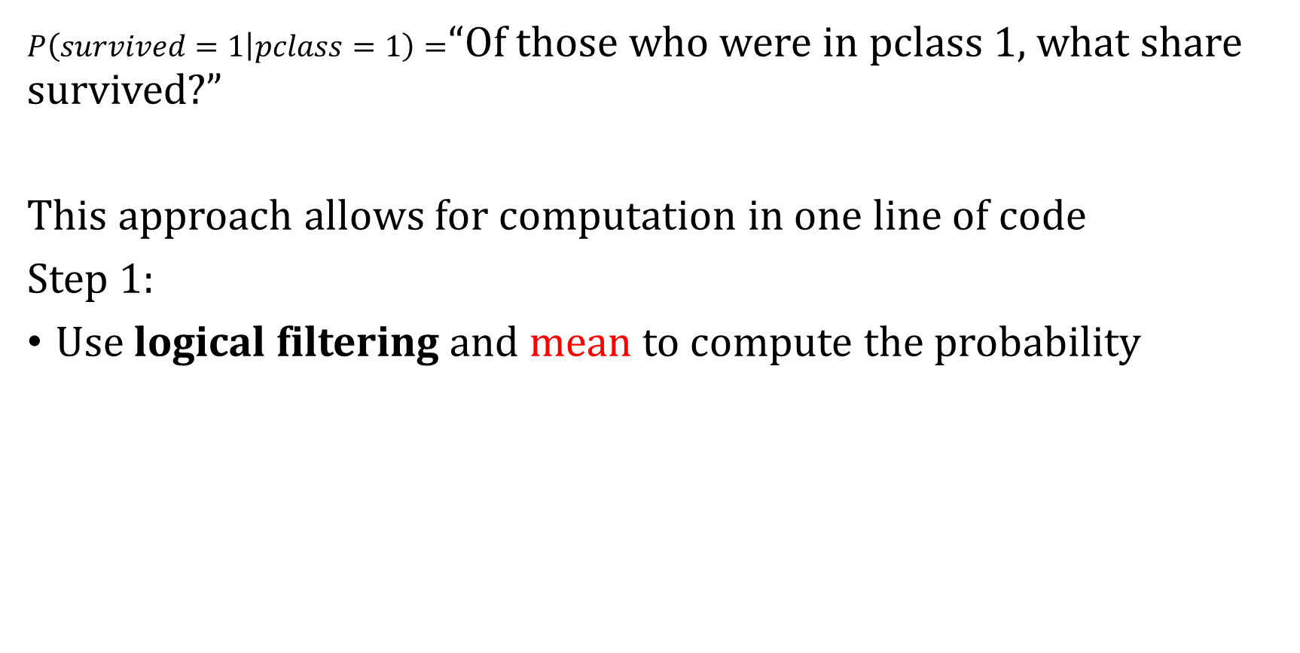
Method 3: Direct method
$P\left(survived=1 | pclass=1\right)=$“Of those who were in pclass 1, what share survived?”
This approach allows for computation in one line of code
Step 1:
Use logical filtering and mean to compute the probability

Slide 15
Method 3: Direct method
$P\left(survived=1 | pclass=1\right)=$“Of those who were in pclass 1, what share survived?”
This approach allows for computation in one line of code
Step 1:
Use logical filtering and mean to compute the probability

Slide 16
This Week: groupby/apply/lambda

Slide 17
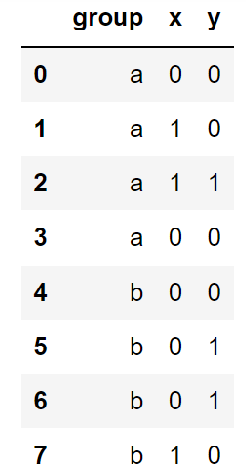
groupby in pandas
Dataframe called df
Useful for when we want to perform the same operation on subgroups.

Slide 18
groupby in pandas
Dataframe called df
What is the sum of x?

Slide 19
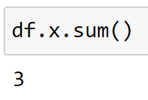
groupby in pandas
Dataframe called df
What is the sum of x?

Slide 20
groupby in pandas
Dataframe called df
What is the sum of x for Group a?

Slide 21
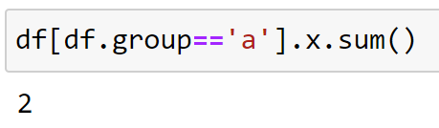
groupby in pandas
Dataframe called df
What is the sum of x for Group a?

Slide 22
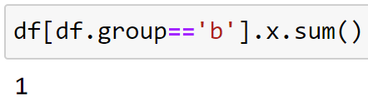
groupby in pandas
Dataframe called df
What is the sum of x for Group b?

Slide 23
groupby in pandas
Dataframe called df
What is the sum of x for Group a and b?

Slide 24
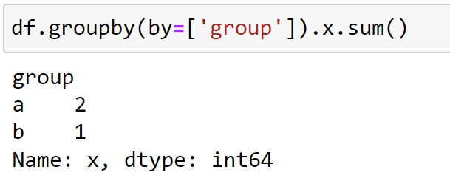
groupby in pandas
Dataframe called df
What is the sum of x for Group a and b?

Slide 25
apply in pandas
Dataframe called df
apply takes a function as the input and applies it to each column in the dataframe.

Slide 26
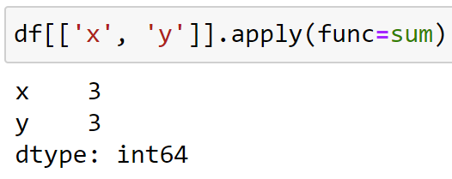
apply in pandas
Dataframe called df
apply takes a function as the input and applies it to each column in the dataframe. Here we are applying the sum function
(We didn’t include “group” in the call above because we don’t want to apply sum to a string column)

Slide 27
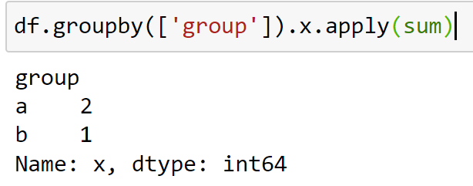
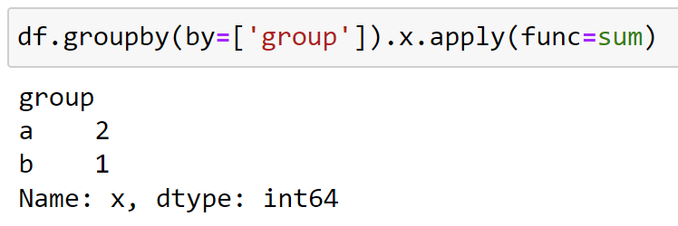
groupby and apply in pandas
A few slides back we ran:
Now let’s do the same using apply:

Slide 28
What Did We Learn?
The apply function takes a function as a parameter and applies it to each group separately
df.groupby(by=[‘group’]).x.apply(func=sum)
Terms in red are all functions
Reading from left to right:
  df is a dataframe that we call the groupby function on.
    We group by the “group” column.
  We then take the X column and apply the sum function by group.

Slide 29
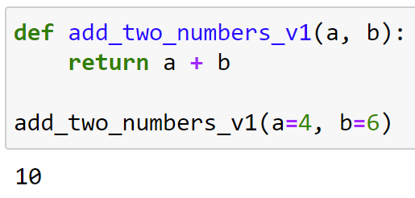
lambda keyword
How we typically write a function in python →

Slide 30
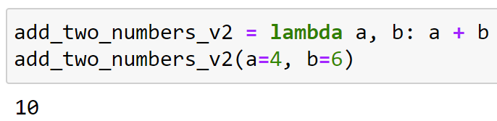
lambda keyword
How we typically write a function in python →
lambda is another way you can write a function
But typically you do not assign a lambda function to variable. It is for writing ANONYMOUS functions

Slide 31
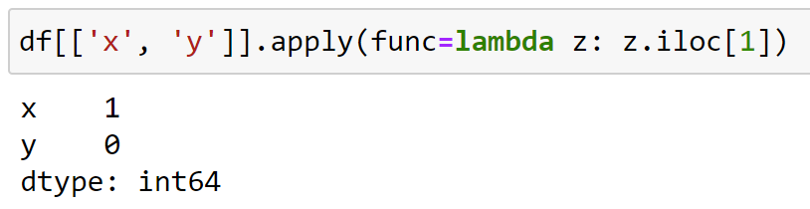
Why is lambda useful?
Let’s combine apply and lambda
What just happened?

Slide 32
Why is lambda useful?
Let’s combine apply and lambda
apply applied the anonymous function to columns x and y (separately)
The anonymous function took in each column (which is referred to as z here), and got the second element

Slide 33
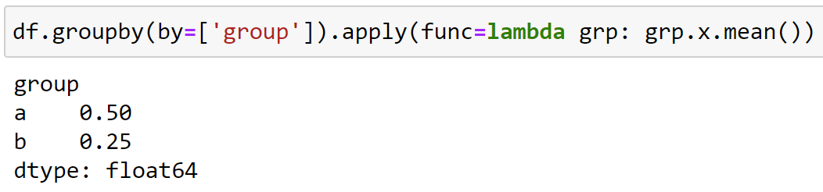

Combining groupby, apply, and lambda
Dataframe called df
Let’s compute
$$P(x=1|group)$$

Slide 34
What Just Happened?
df.groupby(by=[‘group’]).apply(func=lambda grp: grp.x.mean())
apply: we will apply the
function defined by lambda to each group
grp: Is the parameter the function takes, in our case it’s just the df filtered to each group
grp.X.sum(): Is the function itself.
It’s saying: take the grp dataframe,
look at the X column, and then add it up
lambda: Is the keyword that tells python we are defining a function

Slide 35
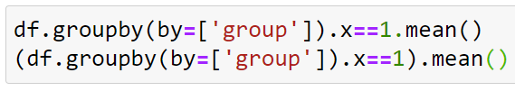
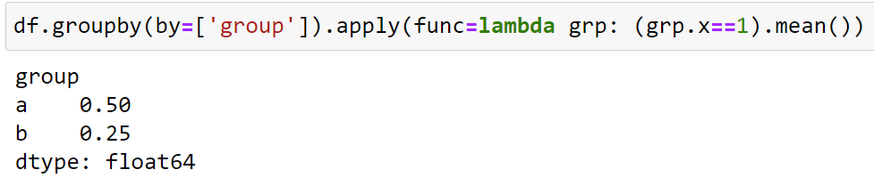
Using logical conditioning with groupby
Dataframe called df
The following two lines will fail:
To use logical conditioning, you need to use apply/lambda

