Slide 1
INST 414: Data Science Techniques Lab 2 Computing Probabilities With Pandas

Slide 2
Today’s Session
Introduce two features of Pandas:
The iloc property
For flexibly accessing rows and columns in a DataFrame
Two ways to create a column
Using value_counts to compute probabilities
Marginal
Joint
Conditional

Slide 3
Recap of Last Week

Slide 4
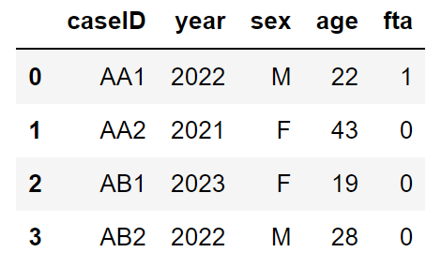
Number of rows and columns
The DataFrame is called df
df.shape
Number of rows and columns
(4, 5)
5 columns
4 rows

Slide 5
Column names
df.columns
Tell us the column names
[‘caseID’, ‘year’, ‘sex’, ‘age’, ‘fta’]

Slide 6
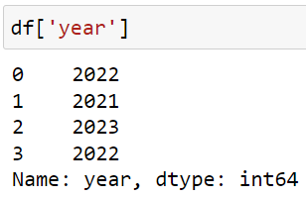
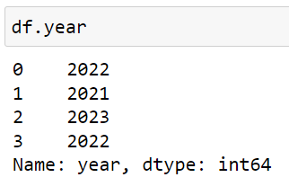
Accessing columns
Two ways to access a single column that returns a Series:

Slide 7
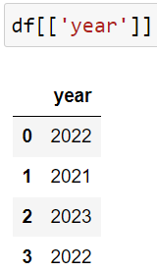
Accessing columns
Accessing a single column to get a DataFrame:

Slide 8
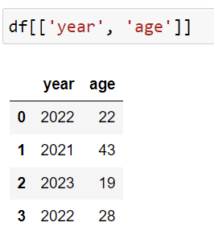
Accessing multiple columns
Accessing more than one column (returns a DataFrame):

Slide 9
Operations on columns
To add up the values in a column
sum
df.age.sum()
112
To get the average/mean
mean
df.fta.mean()
0.25

Slide 10
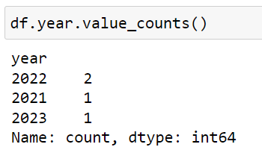
Count unique values
We use value_counts

Slide 11
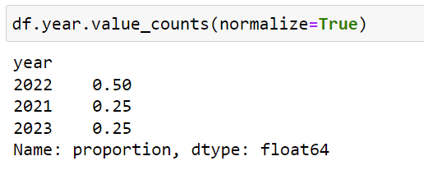
Count unique values
We use value_counts
Use normalize=True parameter to get probabilities

Slide 12
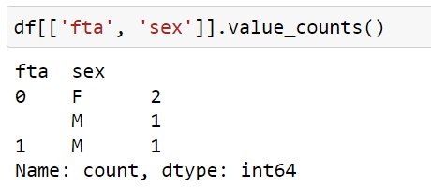
Count unique values
Works for more than one column
Check your understanding
What does the first row mean? (fta=0, sex=F, 2)

Slide 13
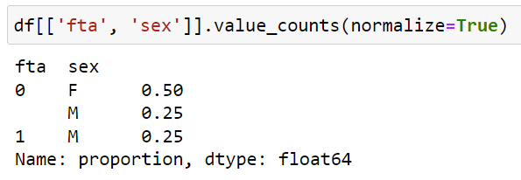
Count unique values
Works for more than one column
Computing a joint distribution

Slide 14
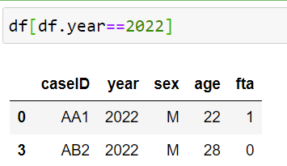
Using logic to filter
Get rows where year is 2022

Slide 15
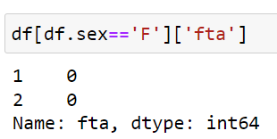
Using logic to filter
Return fta column where sex is F

Slide 16
This Week

Slide 17
Creating columns
Let’s say I wanted to add a new column that was True when year is 2022 and False otherwise

Slide 18
Creating columns
Let’s say I wanted to add a new column that was True when year is 2022 and False otherwise
I have to come up with a column name. Let’s say “year_is_2022”.

Slide 19
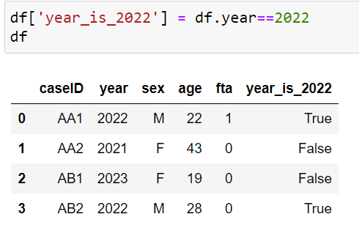
Creating columns
Let’s say I wanted to add a new column that was True when year is 2022 and False otherwise
I have to come up with a column name. Let’s say “year_is_2022”.
Method 1)

Slide 20
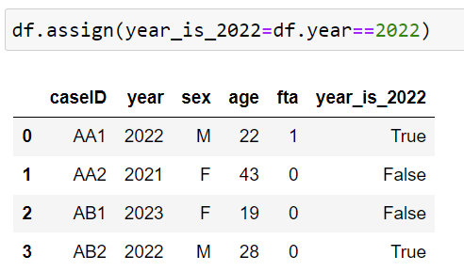
Creating columns
Method 2) uses the assign function:
The left side of the equal sign is the column name and the right side is the value we want to assign

Slide 21
Flexibly accessing rows and columns
We will use the iloc property
df.iloc[row_index, column_index]
The form of iloc is that we have a bracket
Inside the bracket, the first element accesses rows and the second element accesses columns
If row_index is :, that means get all rows
If column_index is :, that means get all columns

Slide 22
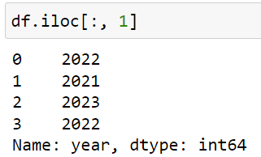
Flexibly accessing rows and columns
Examples
Second column

Slide 23
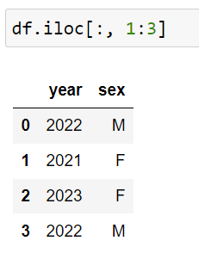
Flexibly accessing rows and columns
Examples
Second column
Second and third column

Slide 24

Flexibly accessing rows and columns
Examples
Second column
Second and third column
Second row, third column

