Slide 1
INST 414: Data Science Techniques
Lab 1
Tabular Data and Pandas

Slide 2
Today’s Session
Define “Tabular Data”
Introduce the concept of “Tidy Data”, or how to efficiently collect data in a table
We will introduce Pandas, a workhorse Python module for data science
Practice working with Pandas

Slide 3
What Is Data?
Still images
Videos
Audio files
Text
Sports statistics
Police records

Slide 4
For Our Class, Data Is Tabular
Variables
 | Column 1 | Column 2 | …
Row 1
Row 2
Row 3
Row 4
…
Observations

Slide 5
Tidy Data

Slide 6
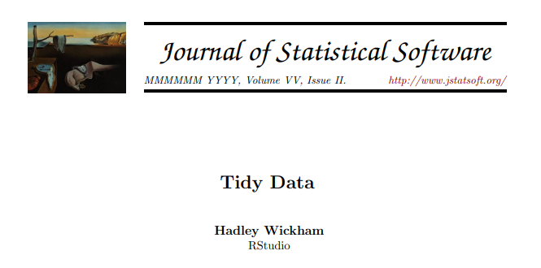

Slide 7
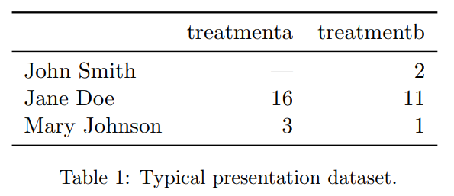

Slide 8
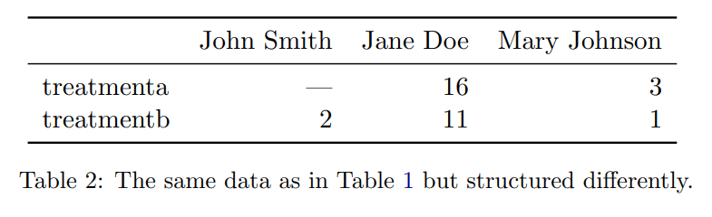

Slide 9
Values
Values – A dataset is a collection of values
  Quantitative (numbers)
  Qualitative (strings)
Values belong to variables and observations
  Variable - contains all values that measure same underlying values
  Observation - all values measured on the same unit (like a person, or a day, or a race) across attributes.
Main benefit of tidy data: Consistency

Slide 10
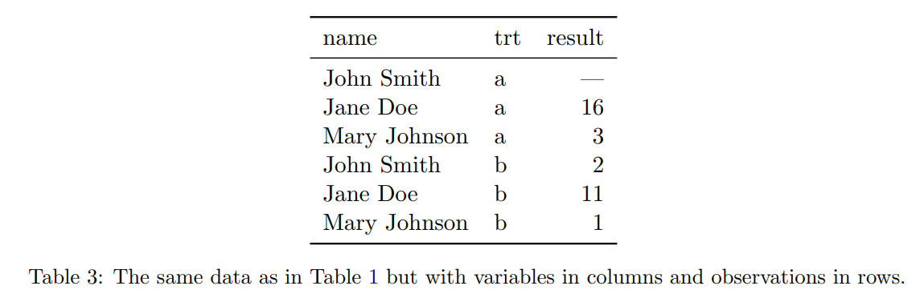

Slide 11
Variables

Slide 12
Each row is an observation

Slide 13
Missing
value

Slide 14
The table is unique at the level of (name, trt)

Slide 15
Pandas

Slide 16

Working with tabular data in python
Name comes from “PANel DAta”
  Panel data refers to tabular data where the same units (for example, people) are observed at multiple time points
  You have a “panel” of units that you follow over time.
  See this week’s module for links for getting started with pandas (optional but recommended).

Slide 17
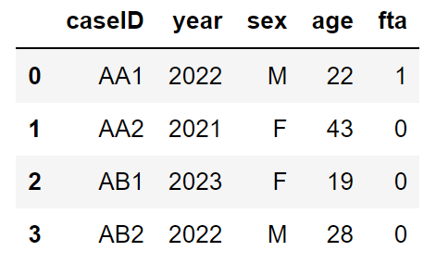


Pandas Data Frames
The main type (or class) that we will be working with is a Pandas DataFrame.
Pandas DataFrames make it easy to create and work with tidy datasets
Example DataFrame
columns
index
values

Slide 18
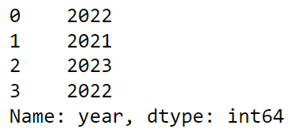
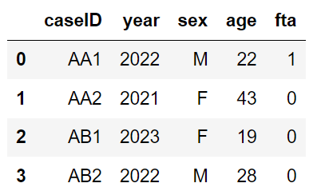
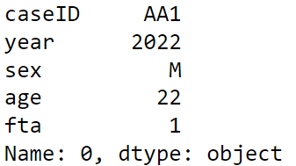


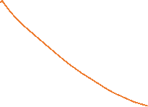

DataFrames vs Series
DataFrames are made up of Series
Series are another data types (or class) in Python.
Each row and column is a Series
We’ll cover the different ways that we can access individual rows and columns in Labs 2 and 3

Slide 19
Operations on Tables (i.e. DataFrames)

Slide 20
We analyze data collected in tables by performing operationson those tables. Here is an example:
Let’s call the table exp_data
Example: What is the number of unique names in the “name” columns?
  Unique names = 3
Example: What is the number of times each treatment appears in the “trt” column?
  trt==a appears 3 times
  trt==b appears 3 times

Slide 21
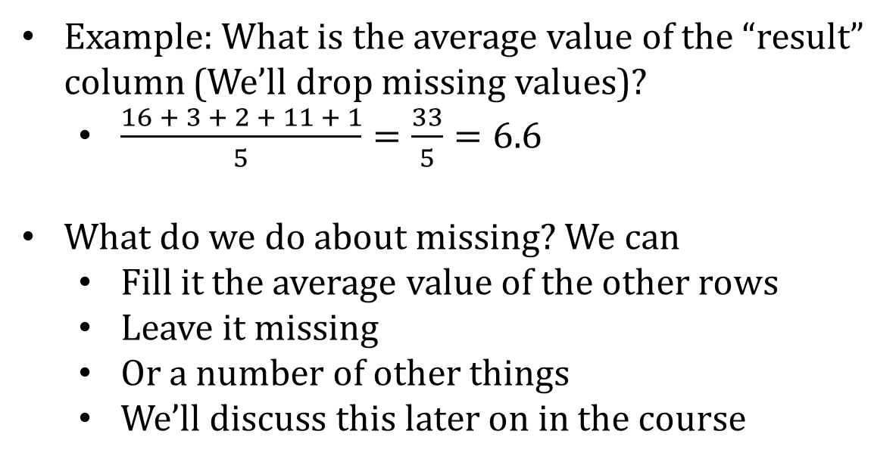
Example: What is the average value of the “result” column (We’ll drop missing values)?
  $\frac{16 + 3 + 2 + 11 + 1}{5}=\frac{33}{5}=6.6$
What do we do about missing? We can
  Fill it the average value of the other rows
  Leave it missing
  Or a number of other things
  We’ll discuss this later on in the course

Slide 22
Today’s Session
read_csv()
columns
shape
head()
Accessing columns
value_counts()
unique()
nunique()
Accessing rows using logic

Slide 23
read_csv
df is a variable that we are creating
We are setting it equal to the output of pd.read_csv()
read_csv is a function in Pandas
A function takes inputs and produces outputs
  The input here is the location of the csv file
  The output here is a DataFrame
    We assign this DataFrame to the variable df
‘filepath_or_buffer’ is called a “function parameter”

Slide 24
parameters
A function can have multiple parameters. Parameters are just inputs
For example, we might have a function called:
divide_two_numbers(numerator, denominator)
We could call the function in the two following ways:
divide_two_numbers(numerator=12, denominator=6)
divide_two_numbers(12, 6)
In the second version, uses ordering to figure out what you mean
  i.e. it assigns 12 to numerator and 6 to denominator

Slide 25
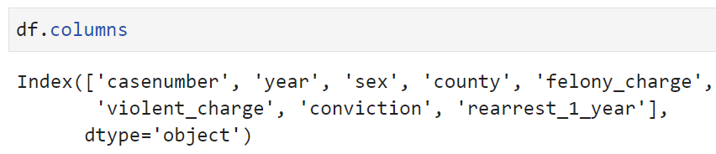
See column names
A DataFrame is a table with rows and columns.
  Rows are observations and associated values
  Columns are the what is being measured

Slide 26
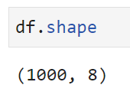
See number of rows and columns
The “shape” property gives us this
The first number is the number of rows
The second number is the number of columns

Slide 27
Brackets []
In python, brackets are used to access parts of an object.
For example, let’s say we have the following line of code:
my_list = [2, 5, 8]
my_list is a list with three elements
To access an element within my_list, we would use the brackets:
my_list[1]
Would access the second in the list, which is 5
So how would we find the number of rows for df?

Slide 28
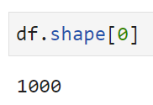
Brackets []
In python, brackets are used to access parts of an object.
For example, let’s say we have the following line of code:
my_list = [2, 5, 8]
my_list is a list with three elements
To access an element within my_list, we would use the brackets:
my_list[1]
Would access the second in the list, which is 5
So how would we find the number of rows for df?

Slide 29
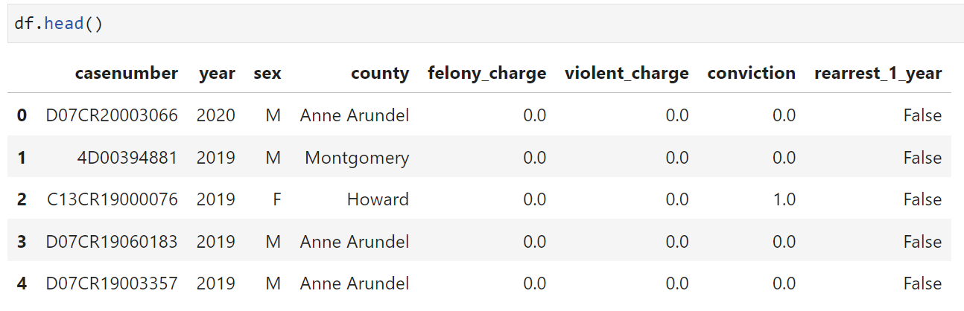
Seeing the first 5 rows in a DataFrame

Slide 30
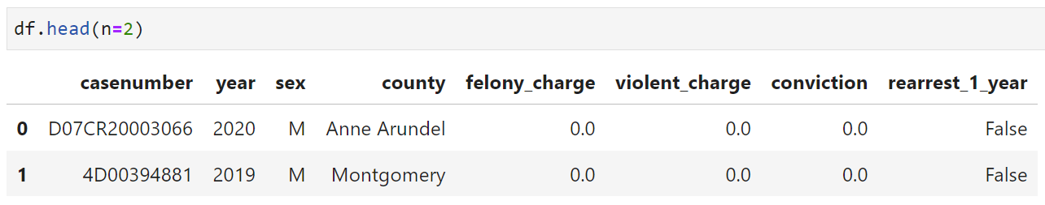
Seeing the first n rows in a DataFrame
The head function has a parameter called “n”.
By default n=5, so when you are running df.head(), you are actually running df.head(n=5)

Slide 31
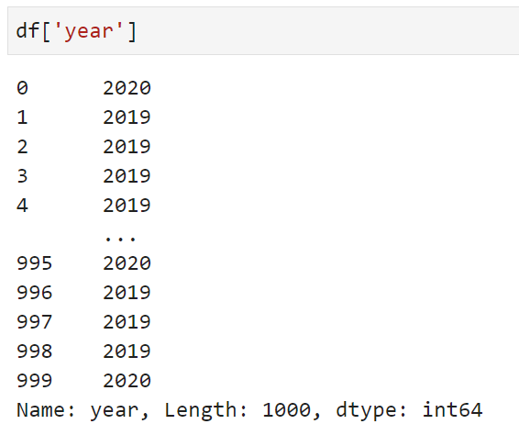
Access the data in a column
We want to access something, so we will use brackets.
In this case, we put the name of the column inside the brackets.

Slide 32
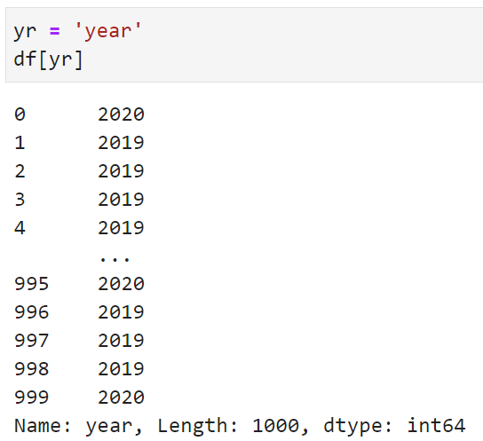
Example
Let’s combine assigning variables with accessing columns
Let’s create a variable called yr and set it equal to the text string “year”

Slide 33
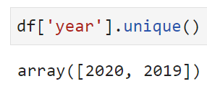
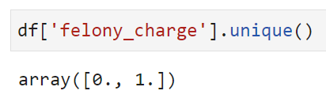
Performing operations on columns
“unique” gives us the unique values in a column

Slide 34
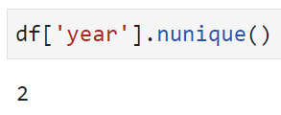
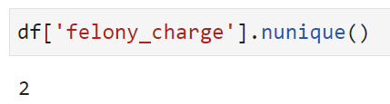
Performing operations on columns
“unique” gives us the unique values in a column
“nunique” gives the number of unique values in a column

Slide 35
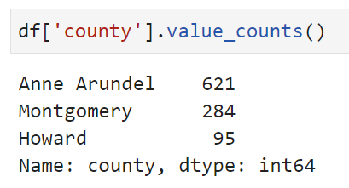
value_counts()
What if we want to know the number of times each unique value appears in a column?
We use the value_counts() function

Slide 36
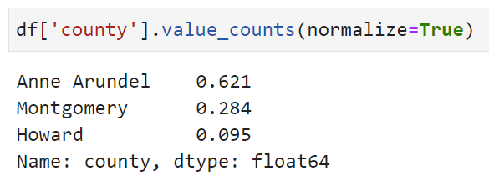
The “normalize” parameter
An important parameter for value_counts is normalize and the default value is False
Normalizing here means to divide the count of each unique value by the number of rows in the DataFrame

Slide 37
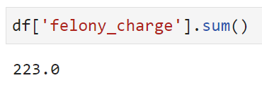
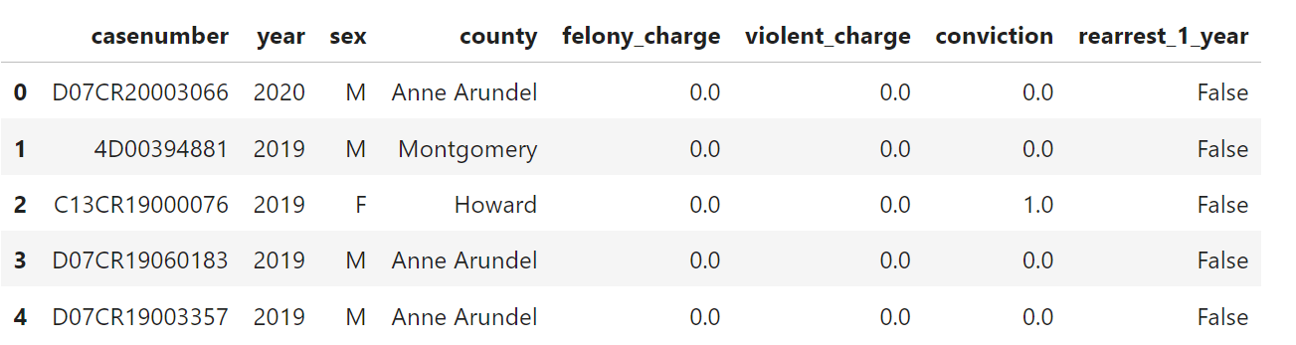
Other common functions on columns
We use sum to add up all of the values in a column

Slide 38
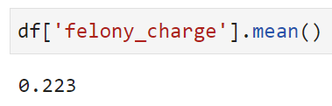
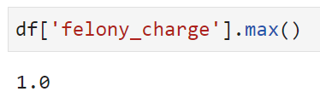
Other common functions on columns
We use mean to compute the average value of a column
We use max to get the maximum value of a column (and similar for min)

Slide 39
Using logic to access rows
We are talking about accessing parts of a DataFrame so we are going to be using brackets here
We are going to use logical conditions, so that means we’ll use
  == (is equal to)
  != (is NOT equal to)
  > (is greater than)
  < (is less than)
  >= (is greater than or equal to)
  <= (is less than or equal to_

Slide 40
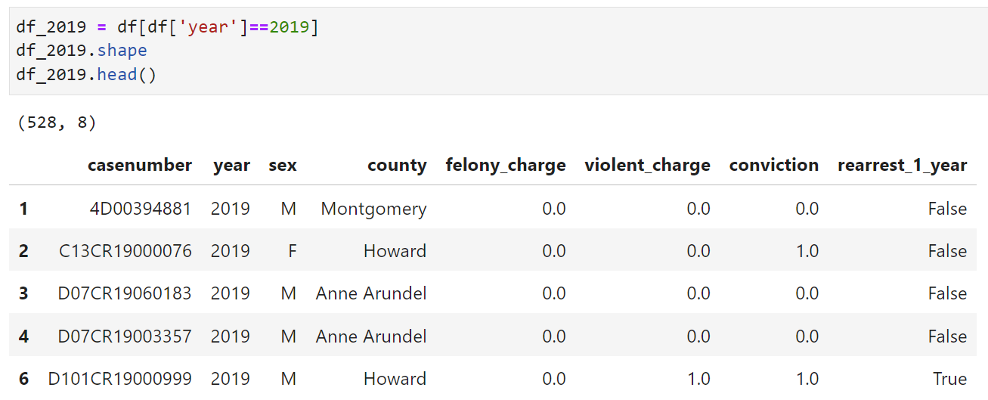
Limit to 2019 data

Slide 41
Example
Let’s now combine access rows, accessing columns, and performing an operation on a column

Slide 42
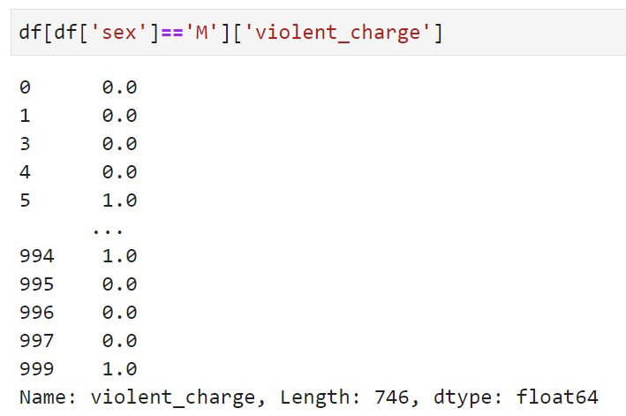
Example
Let’s now combine access rows and accessing columns

Slide 43
Example
Let’s now combine access rows and accessing columns
  We limit to rows where sex==‘M’ and look at the violent charge column

Slide 44
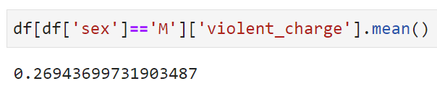
Example
Let’s now combine access rows, accessing columns, and performing an operation on a column

