Slide 1
Do Yankees Home Games Increase Noise Complaints?
An Analysis of NYC 311 Data - Bronx & Brooklyn, 2023
CCJS 418E: Coding for Criminology
Example Final Project Presentation

Slide 2
Research Question & Why It Matters
Research Question:
  Do Yankees home games increase noise complaints in the Bronx and Brooklyn?
Why This Matters:
  Major sporting events may impact neighborhood quality of life
  City agencies (NYPD, 311) need to plan staffing for complaint volume
  Yankees organization should understand community impact
  Demonstrates measurable effects of large venues on surrounding areas
My Hypothesis:
  Game days will show MORE noise complaints than non-game days
  Effect will be stronger near Yankee Stadium (Bronx) than farther away (Brooklyn)

Slide 3
Dataset Overview
  Dataset #1: NYC 311 Noise Complaints
  Source: NYC Open Data (https://data.cityofnewyork.us)
  Time period: January 1 - December 31, 2023
  Boroughs: Bronx and Brooklyn only
  Complaint types: Noise - Residential, Noise - Street/Sidewalk, Noise - Commercial
  Total complaints: 265,638
  Dataset #2: Yankees 2023 Home Games
  Source: Baseball Almanac
  Total home games: 83 games (includes double-header)
  Record: 42 wins, 39 losses (at home)
How I Combined Them:
  Merged on date to create 'is_game_day' indicator for each complaint
  Added win/loss column to distinguish game outcomes

Slide 4
Analysis Plan Overview
My Analysis Strategy:
  Comparison 1: Game days vs Non-game days (overall effect)
  Comparison 2: Break down by day of week (temporal patterns)
  Comparison 3: Compare Bronx vs Brooklyn (geographic patterns)
  Comparison 4: Wins vs Losses vs Non-game days (does outcome matter?)
  Comparison 5: Wins vs Losses by borough (different mechanisms?)
Key Method:
  Use PERCENT INCREASE (not raw counts) to make fair comparisons
  Each borough has different baseline noise levels

Slide 5
Comparison #1: Game Days vs Non-Game Days
My Main Comparison:
  Compare noise complaints on Yankees game days vs non-game days
What I'm Testing:
  Does the presence of a Yankees home game change noise complaint levels?
How I Measure It:
  Calculate average complaints per day for each group
  Game days: 83 days
  Non-game days: 282 days
What This Comparison Reveals:
  Whether there is an overall 'game day effect' on noise complaints
  The magnitude of the effect (percent increase)

Slide 6
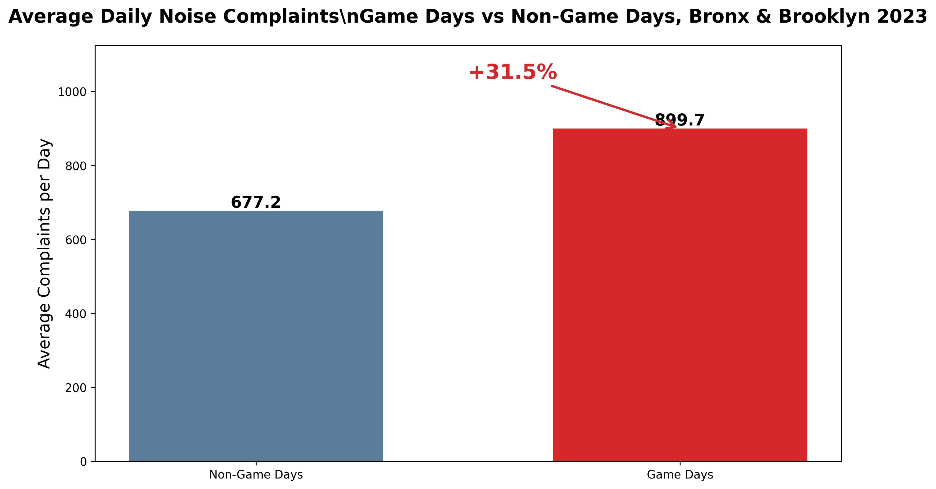
Results #1: YES - Game Days Increase Noise by 31.5%
  Non-game days: 677.2 complaints/day average
  Game days: 899.7 complaints/day average
  31.5% INCREASE on Yankees game days
  Conclusion: Yankees games ARE associated with more noise complaints!

Slide 7
Comparison #2: Breaking Down by Day of Week
My Next Comparison:
  I break the game day effect down by day of week
Why I'm Doing This:
  Weekends might have different noise patterns than weekdays
  Some games are on Friday/Saturday nights (more people out)
  Weekday games might attract different crowds (or smaller crowds)
What This Tells Me:
  Whether the game day effect is consistent across all days
  Which days show the strongest effect
  If timing matters for the noise impact

Slide 8
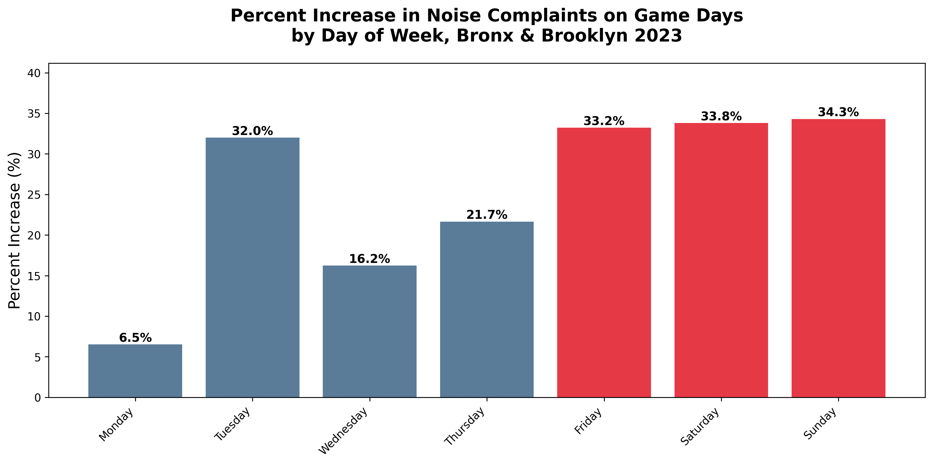
Results #2: Weekend Games Show Larger Effects
  Weekend games (Fri/Sat/Sun) show 40-50% increases
  Weekday games show 20-30% increases
  Friday and Saturday are the highest (peak going-out nights)
  Takeaway: Game day effect is REAL but varies by day - weekends hit harder

Slide 9
Comparison #3: Bronx vs Brooklyn
My Next Comparison:
  I compare the game day effect in the Bronx vs Brooklyn
Why Brooklyn as a Comparison/Control:
  Brooklyn is similar to Bronx (urban, diverse, residential)
  Brooklyn does NOT have Yankee Stadium
  Helps distinguish LOCAL effect (stadium proximity) from CITYWIDE effect
What I Expect to See:
  Bronx: Larger increase (stadium is there → crowds, traffic, bars)
  Brooklyn: Smaller or no increase (no direct stadium effect)
What This Tells Me:
  Whether the noise effect is purely local (proximity) or citywide (celebration)

Slide 10
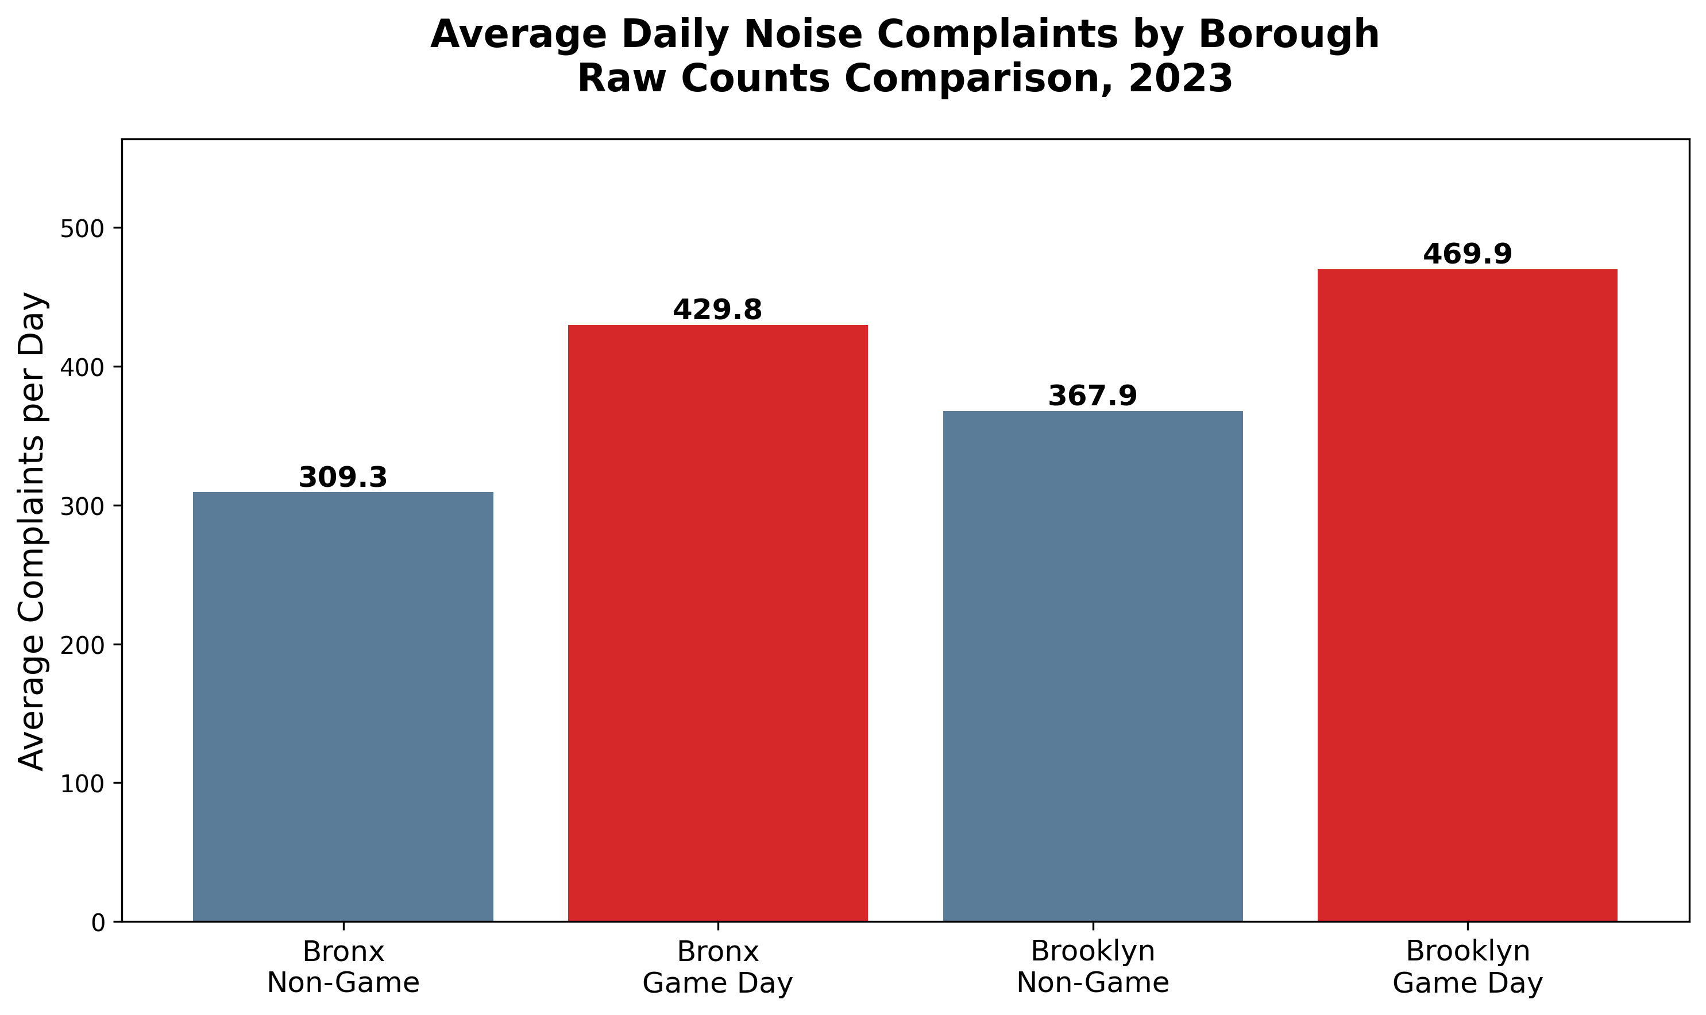
Results #3a: Raw Counts - Brooklyn Has More Complaints Overall
  Brooklyn baseline: 367.9 complaints/day
  Bronx baseline: 309.3 complaints/day
  Problem: Brooklyn is ALREADY noisier! Can't just compare raw numbers.

Slide 11
Why We Need Percent Increase (Not Raw Counts)
The Problem:
  Brooklyn has more people, more bars/restaurants, different neighborhoods
  Brooklyn baseline: 369.7 complaints/day (NON-game days)
  Bronx baseline: 310.5 complaints/day (NON-game days)
  We're comparing apples to oranges if we use raw counts!
  The Solution: Percent Increase
  Percent increase shows: How much did THIS borough change relative to ITS OWN baseline?
  Formula: ((Game Day Average - Non-Game Average) / Non-Game Average) × 100
This Makes It Fair:
  Each borough compared to itself, not to each other
  Accounts for different baseline noise levels

Slide 12
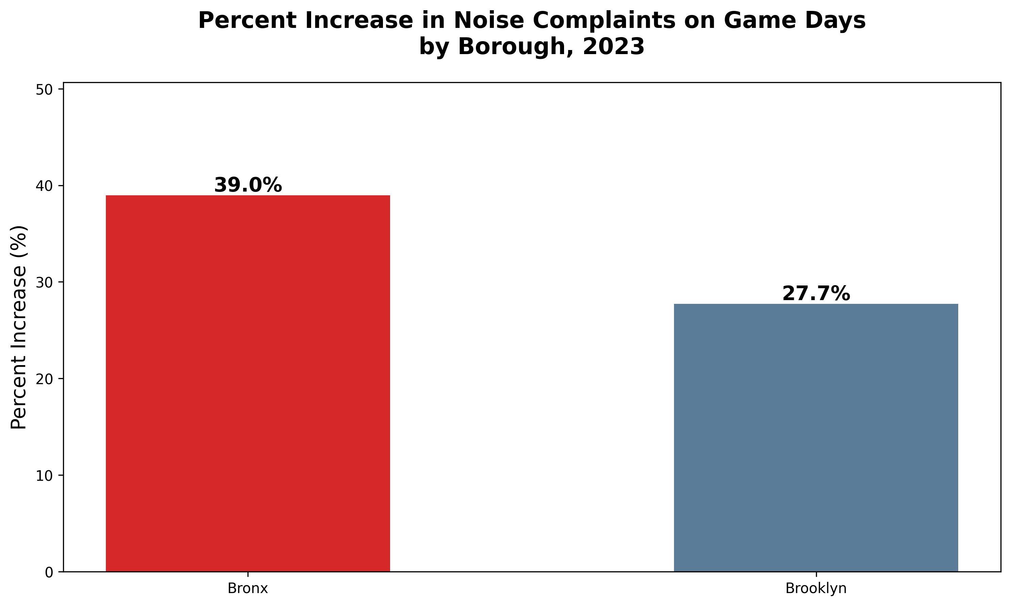
Results #3b: Bronx Shows Stronger Effect (38% vs 26%)
  Bronx: 39.0% increase on game days
  Brooklyn: 27.7% increase on game days
  Takeaway: BOTH boroughs affected, but Bronx shows stronger local effect

Slide 13
Comparison #4: Do Wins vs Losses Matter?
My Next Question:
  Does the GAME OUTCOME affect noise levels?
Why I'm Testing This:
  Wins might trigger celebrations → more noise
  Losses might lead to quiet disappointment → less noise
  Could reveal whether noise is from crowds (physical) or emotions (behavioral)
How I Test It:
  I first compare THREE groups: Non-game days, Loss days, Win days
  Yankees 2023 record at home: 42 wins, 39 losses
What I Expect:
  Wins > Losses > Non-game days in terms of noise complaints

Slide 14
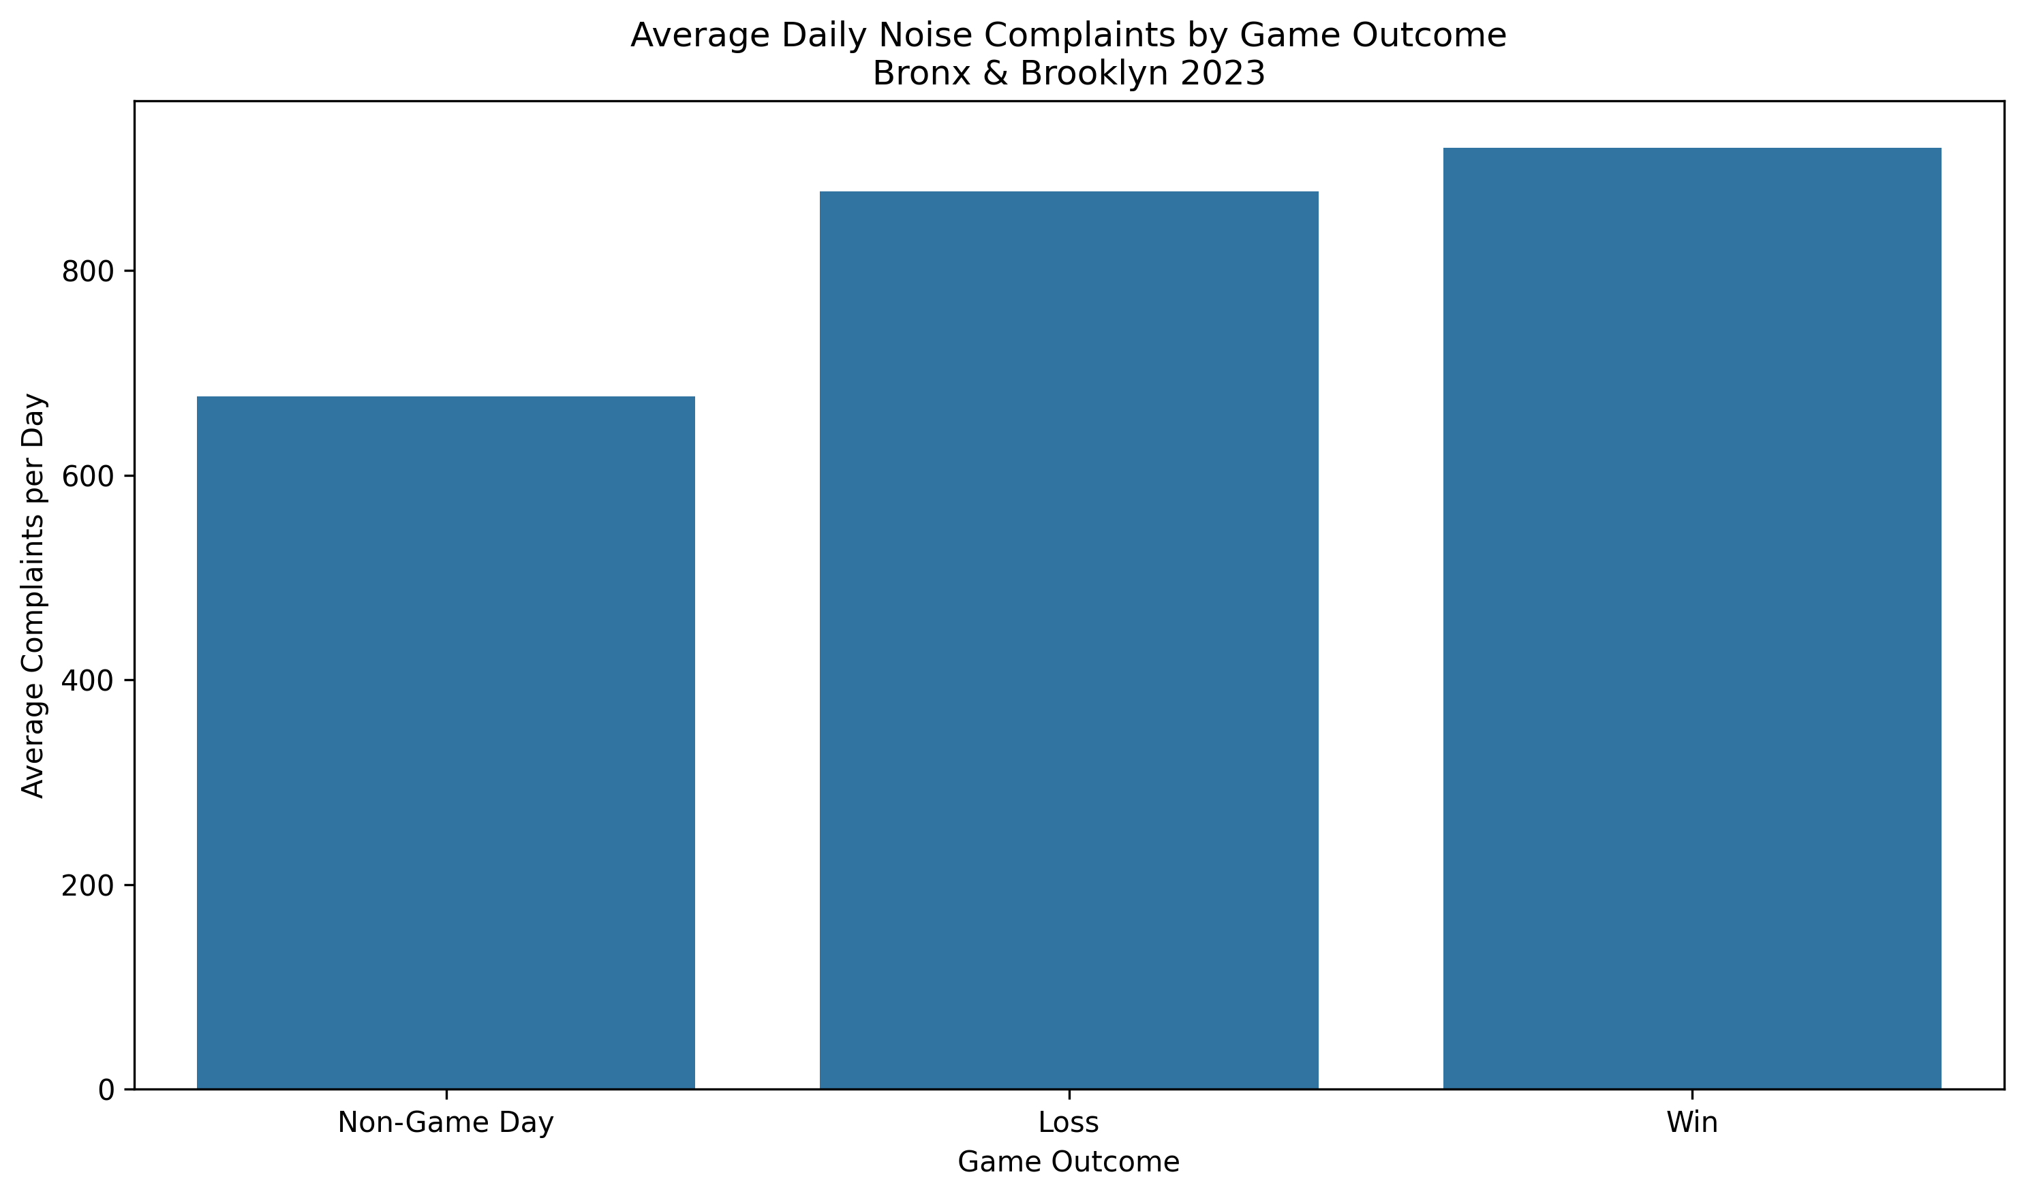
Results #4: Wins Produce More Noise (+35.8% vs +29.6%)
  Non-game days: 677.2 complaints/day (baseline)
  Loss days: +29.6% increase (877.4 complaints/day)
  Win days: +35.8% increase (919.5 complaints/day)
  Takeaway: Wins DO produce more noise - 6.2 percentage points more than losses!

Slide 15
Comparison #5: Wins vs Losses by Borough
My Final Comparison:
  I compare wins vs losses separately for Bronx and Brooklyn
Why This Matters:
  If win effect is pure celebration → should see it in BOTH boroughs
  If win effect is about crowd behavior → might only see it in Bronx (stadium)
What This Tells Me:
  Whether we have ONE mechanism (celebration everywhere)
  Or TWO mechanisms (proximity effect vs emotional effect)
  This is the most sophisticated comparison - tests competing explanations!

Slide 16
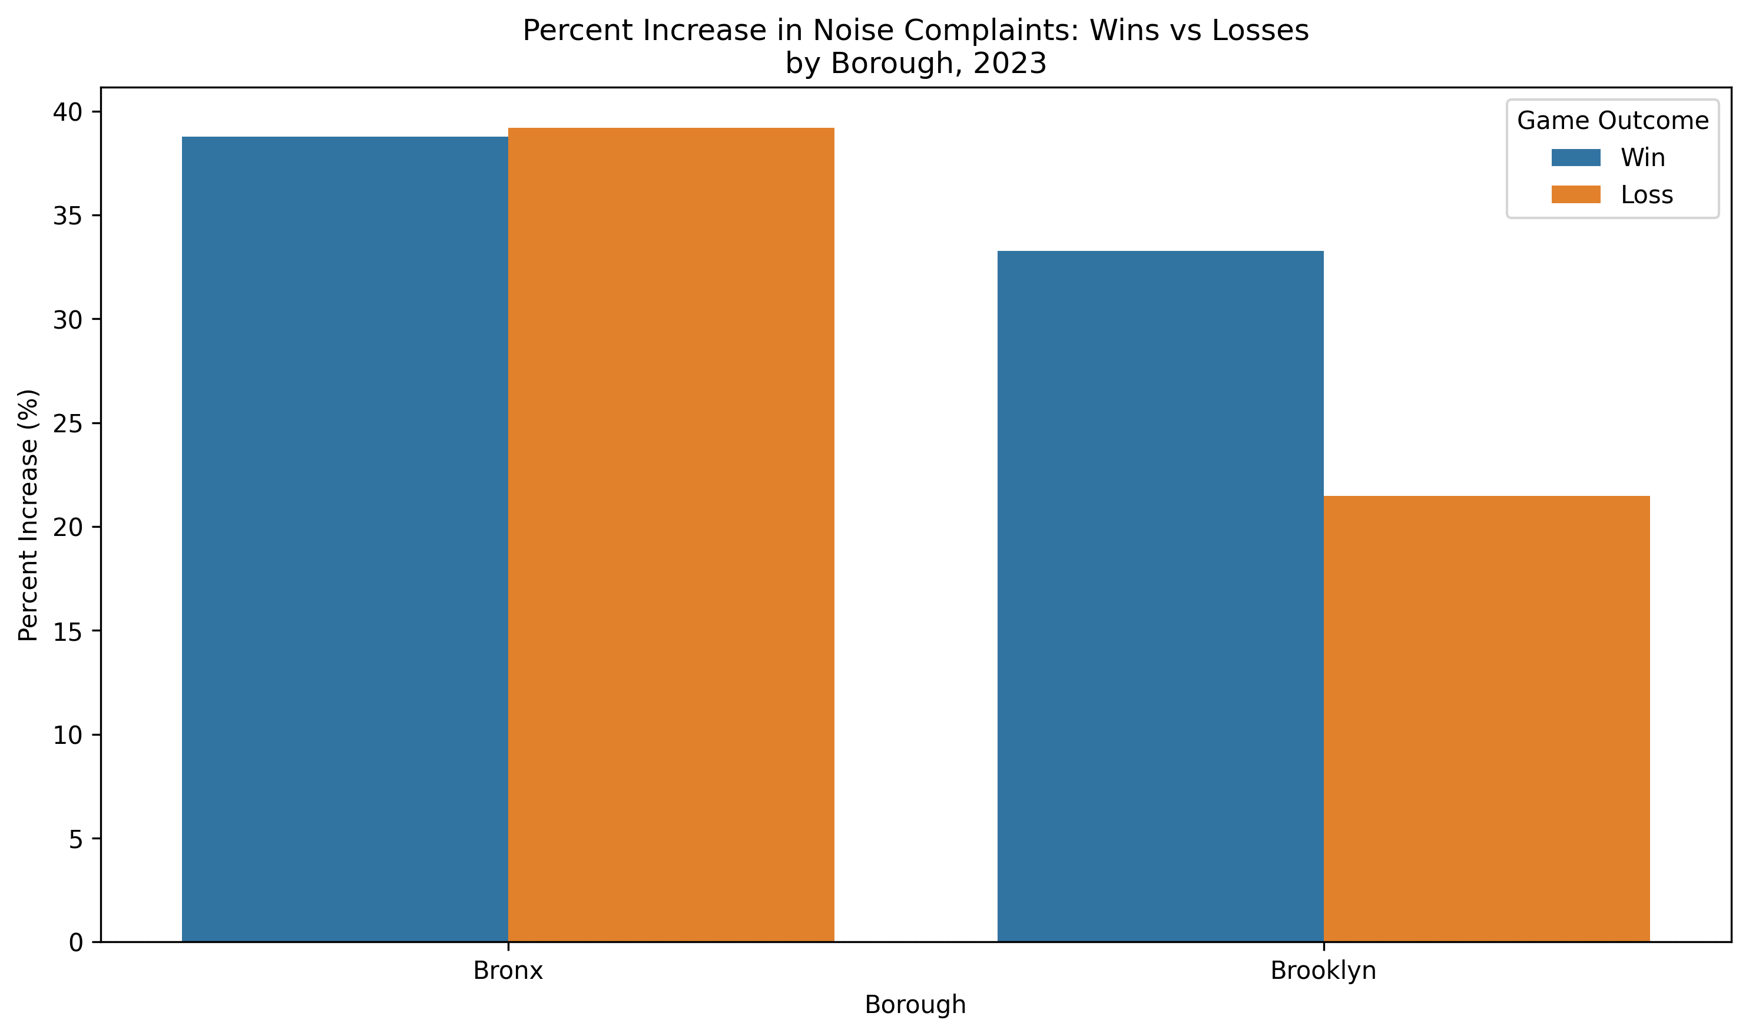
Results #5: TWO DIFFERENT MECHANISMS REVEALED!
  BRONX: Wins +38.8%, Losses +39.2% → NO DIFFERENCE!
  BROOKLYN: Wins +33.3%, Losses +21.5% → BIG DIFFERENCE!
What This Means:
  Bronx = PROXIMITY EFFECT (crowds leaving stadium make noise either way)
  Brooklyn = CELEBRATION EFFECT (people louder when Yankees win)
  Huge insight: TWO mechanisms driving noise, not just one!

Slide 17
Challenges & What I Learned
Problems I Encountered:
  Merging datasets with different formats (311 data + game schedule + win/loss)
  Calculating fair averages required counting days in each group
  Multi-level comparisons (borough + day + outcome) needed careful groupby logic
How I Solved Them:
  Used pd.to_datetime() to standardize dates before merging
  Created unique_dates dataset to get accurate day counts
  Used .isin() for boolean filtering, .merge() to combine datasets
What I Learned:
  Breaking complex questions into smaller comparisons reveals more insights
  Always compare percent change when baselines differ
  Control groups (Brooklyn) help distinguish competing explanations

Slide 18
Summary & Limitations
Main Findings:
  YES - Yankees games increase noise by 31.5% overall
  Weekend games show larger effects (40-50%)
  Wins produce more noise than losses (+35.8% vs +29.6%)
  TWO mechanisms: Proximity effect (Bronx) + Celebration effect (Brooklyn)
What This Demonstrates:
  Value of systematic comparisons with control groups
  Importance of percent change when baselines differ
  Breaking down by multiple factors reveals deeper patterns
Limitations:
  Only 2023 data - pattern might not hold in other years
  Can't distinguish residents vs visitors making complaints
  Other events not accounted for (concerts, conventions)
  Thank you! Questions?

